Slide 1

What do we know about low-value care and de-implementation?
Christian D. Helfrich MPH, PhD
Seattle-Denver Center of Innovation for Veteran-Centered & Value-Driven Care

Slide 2
Definitions
Low-value care (a.k.a., medical overuse): are diagnostic or therapeutic practices that provide no demonstrable benefit or where the benefits are outweighed by harms
De-implementation: systematic efforts to end the use of low-value care whether a specific alternative is available or not
Extinction: when a clinical practice is discontinued

Slide 3
Low-value care
How many of you are working on low-value care?

Slide 4
Extent of low-value care and trends
Estimates of range low of 10-16% to high of 30-46% (Morgan, Brownlee et al. 2015; Niven, Mrklas et al. 2015)
$210 billion in associated health care waste in 2009 (Berenson et Docteur 2013)
Medical overuse doesn’t seem to be improving (Kale et al 2013; Chamberlain et al 2013) even as some evidence that medical underuse is improving (i.e., that specific instances of medical underuse have decreased over time) (Kale et al 2013)

Slide 5
De-implementation research & strategies
Literature on medical overuse and strategies to address medical overuse is growing year-to-year, doubling from 2014 to 2015 (Morgan et al 2017; Morgan et al 2018)
Small (n=20) set of NIH/AHRQ grants on de-implementation but majority within past 2 years (Norton et al 2017)
Physician awareness of Choosing Wisely low (21% 2014; 25% 2017 (Colla et al 2017b))

Slide 6
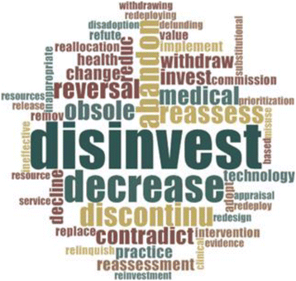
Fragmented literature
43 terms (Niven et al, 2015; Gnjidic & Elshaug 2015)

Slide 7
At least 7 lit reviews on factors associated with low-value care or interventions to reduce it*
Notes:
Demand side interventions are things to curb patient demand, e.g., cost-sharing & patient education. Supply-side are things like P4P & clinical decision support

Slide 8
At least 7 lit reviews on factors associated with low-value care or interventions to reduce it*
Systems of care, e.g., HMO vs. fee-based, and low-value care (Keyhani et al 2013)
Not associated
Notes:
Demand side interventions are things to curb patient demand, e.g., cost-sharing & patient education. Supply-side are things like P4P & clinical decision support

Slide 9
At least 7 lit reviews on factors associated with low-value care or interventions to reduce it*
Scoping review: 44 articles on facilitating; on 2 on sustaining (Niven et al 2015)
30% on Dx de-implement
13 frameworks
Notes:
Demand side interventions are things to curb patient demand, e.g., cost-sharing & patient education. Supply-side are things like P4P & clinical decision support

Slide 10
At least 7 lit reviews on factors associated with low-value care or interventions to reduce it*
Narrative review on cognitive bias & overuse (Scott et al, 2017)
Small number (n=5) on behavioral nudges
Notes:
Demand side interventions are things to curb patient demand, e.g., cost-sharing & patient education. Supply-side are things like P4P & clinical decision support

Slide 11
At least 7 lit reviews on factors associated with low-value care or interventions to reduce it*
Systematic review of supply vs. demand-side interventions (Colla et al 2017a)
84 studies tested intervention effectiveness
Most effective (by number):
Clinical decision support;
Multicomponent
Provider education & patient education;
56% targeted meds vs. 12% radiology & 10% labs/path
Notes:
Demand side interventions are things to curb patient demand, e.g., cost-sharing & patient education. Supply-side are things like P4P & clinical decision support

Slide 12
Morgan et al (2015) drivers of overuse - Providers
Intrinsic
Lack of knowledge of harm from overuse

Slide 13
Morgan et al (2015) drivers of overuse - Providers
Intrinsic
Regret for errors of omission > commission

Slide 14
Morgan et al (2015) drivers of overuse - Providers
Intrinsic
Belief action better than inaction

Slide 15
Morgan et al (2015) drivers of overuse - Providers
 | Extrinsic
 | Inadequate time

Slide 16
Morgan et al (2015) drivers of overuse - Providers
 | Extrinsic
 | Positive publication bias

Slide 17
Morgan et al (2015) drivers of overuse - Providers
 | Extrinsic
 | Guidelines promoting overuse

Slide 18
Morgan et al (2015) drivers of overuse - Providers
 | Extrinsic
 | Medical culture

Slide 19
Morgan et al (2015) drivers of overuse - Patients
Intrinsic
Belief more care is better

Slide 20
Morgan et al (2015) drivers of overuse - Patients
Intrinsic
Lack of knowledge of harm from overuse

Slide 21
Morgan et al (2015) drivers of overuse - Patients
Intrinsic
Discomfort with uncertainty

Slide 22
Morgan et al (2015) drivers of overuse - Patients
 | Extrinsic
 | Media misrepresentation of research

Slide 23
Morgan et al (2015) drivers of overuse - Patients
 | Extrinsic
 | Advocacy groups

Slide 24
Drivers of low-value care
No relation to geographic variation in utilization (Keyhani et al. 2012) & systems of care (e.g., fee for service vs. managed care) (Keyhani et al 2013)
While patients appear open to the idea that over-treatment can cause harm they’re more resistant to the idea that tests & diagnostics can cause harm
Fragmented care & reluctance to take patients off of inherited prescriptions (Bokhof et Junius-Walker 2016; Ailabouni et al 2016; Helfrich et Stryczek 2017)

Slide 25
Frameworks and models
Niven et al (2015) found 13 frameworks and adapted Knowledge-to-Action model (continuous improvement model)
Morgan and colleagues (2015) framework for understanding & reducing overuse taking into account culture & health care system
Parchman and colleagues (2017) planned action model based on engaging providers at a clinic level
Patel et al (2018) proposed framework for deploying nudges based on work of the Penn Medicine Nudge Unit
Our provider-level model: unlearning vs. substitution (Helfrich et al 2018)
Notes:
There are at least 18 “frameworks” that have been applied to de-implementation. Niven et al said they found 11 articles with 13 frameworks but they don’t identify the 11 articles; I’ve got an e-mail to Dan to ask for them.

Slide 26
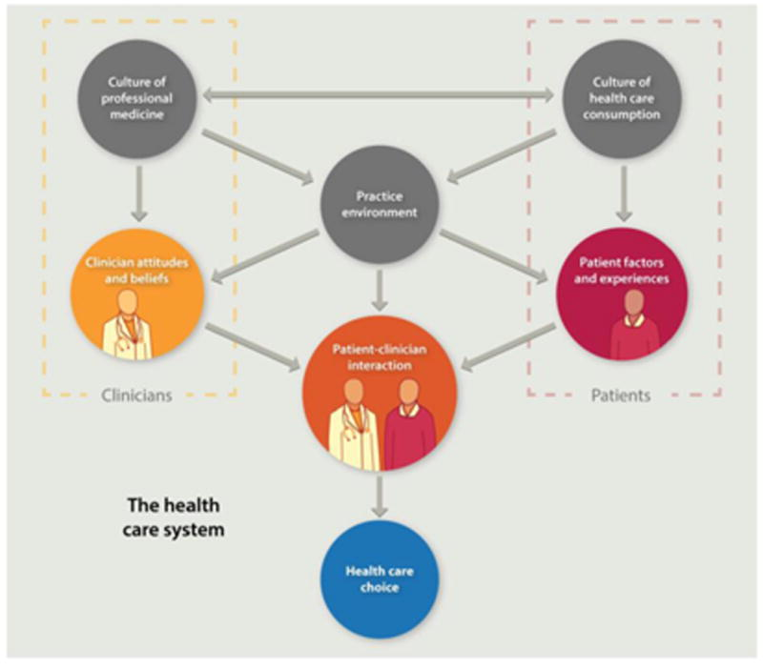

Slide 27
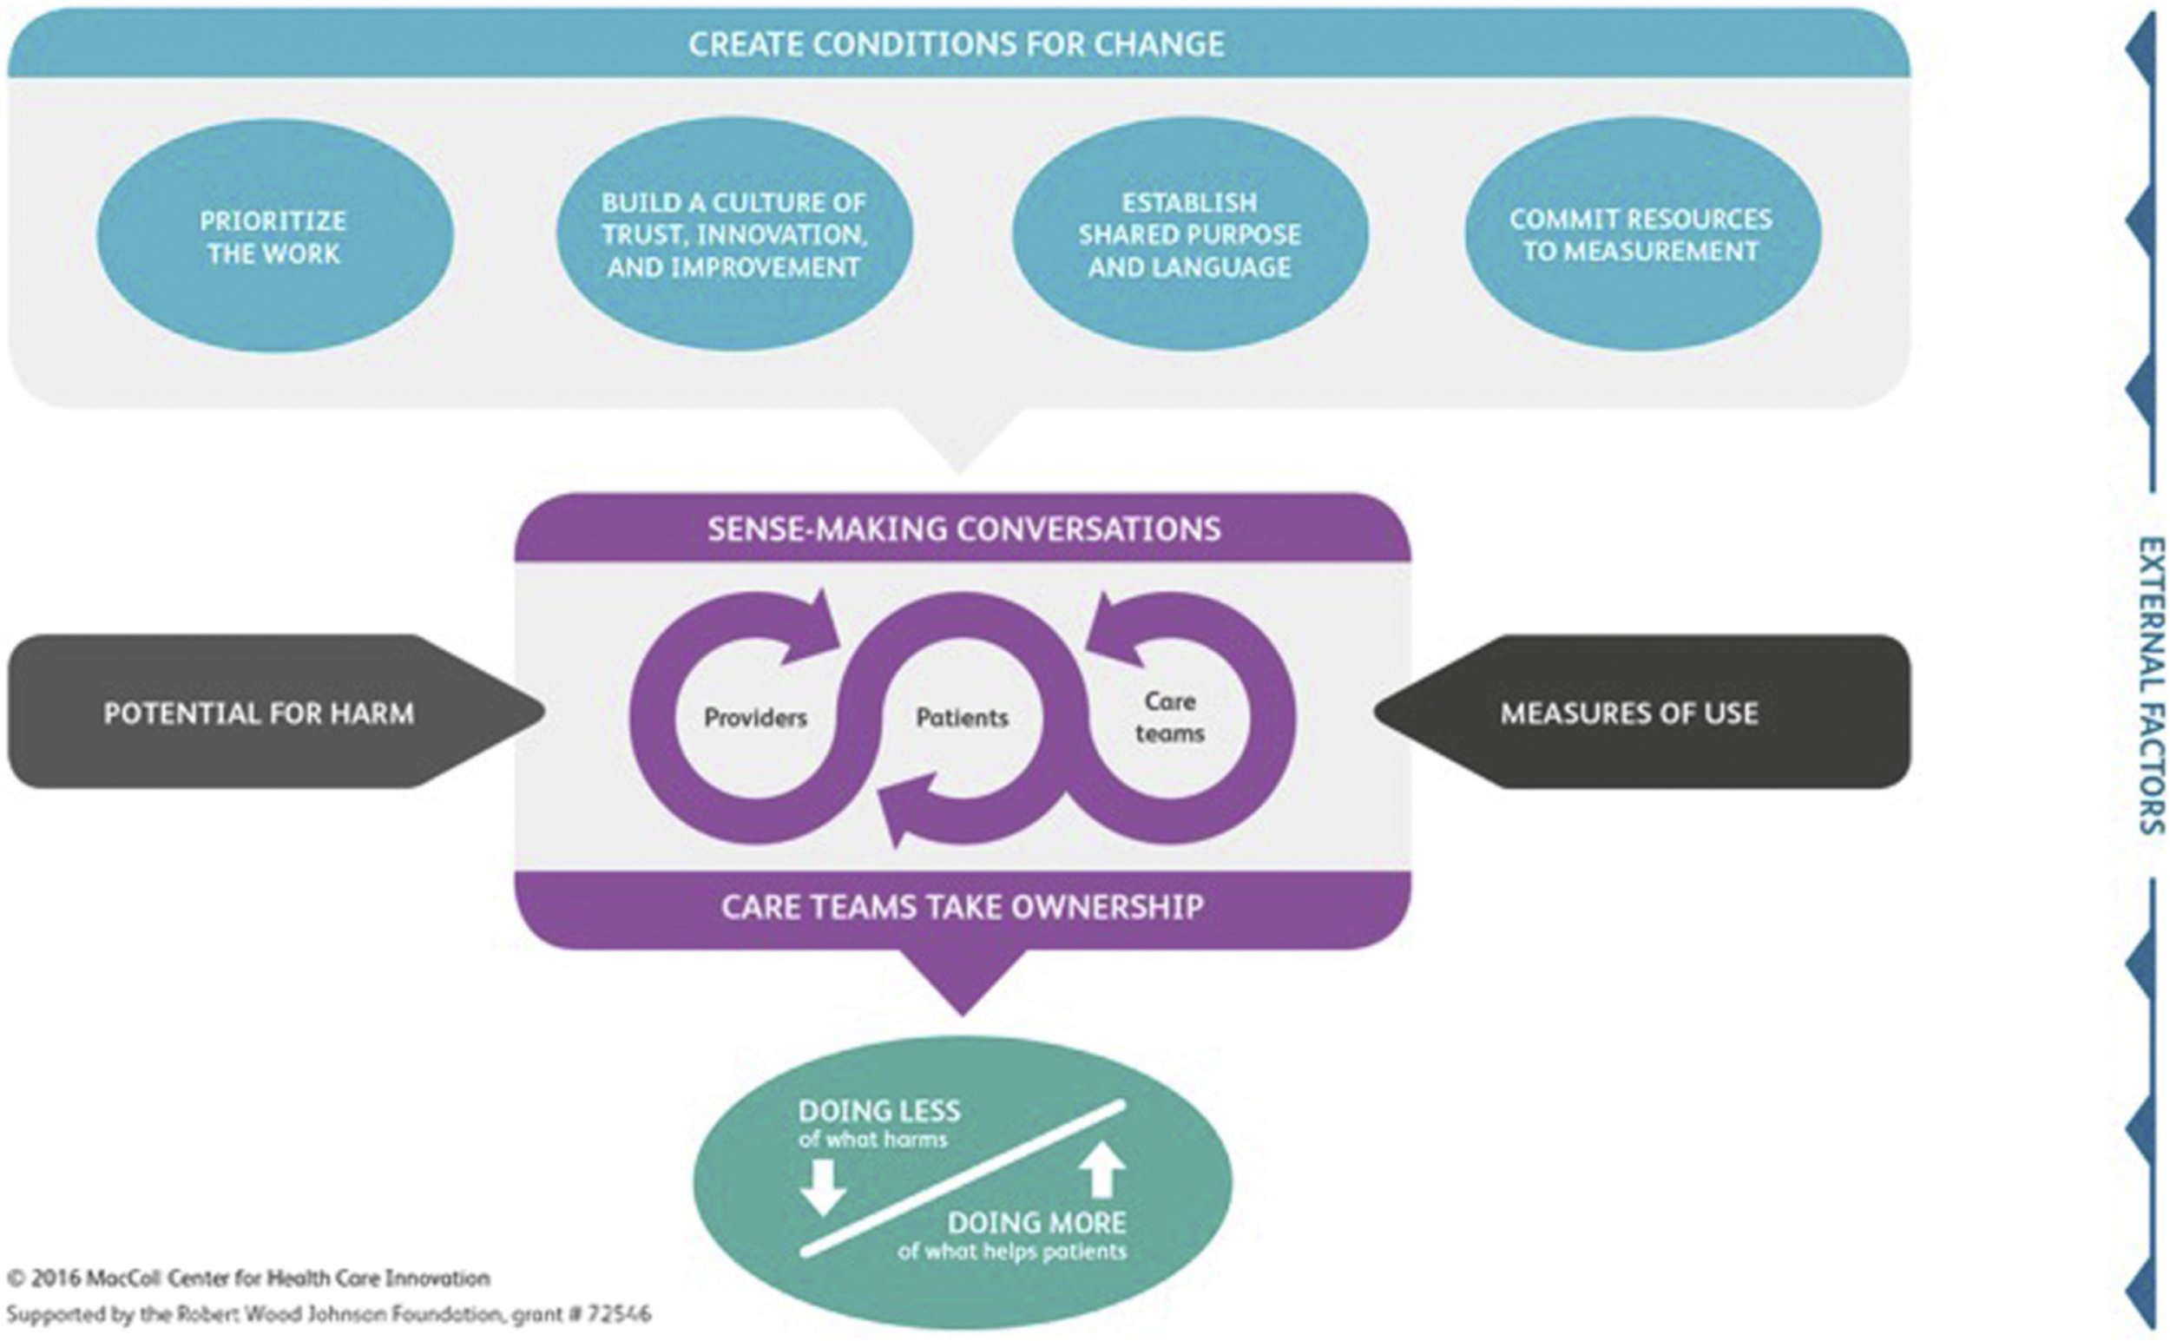

Slide 28
Limitations
Exclusive focus on conscious engagement
Models predicated on a specific approach
Intensive approaches may not be possible or desirable for all low-value care

Slide 29
Case example of de-implementing inhaled corticosteroids for patients with COPD

Slide 30
Exercise
Analyze interview quotes from primary care providers to identify factors that appear to influence de-implementation
Name the phenomenon or factor;
Describe it;
Explain what you think the implication is for de-implementation efforts.
3 workgroups each with set of quotes

Slide 31
Exercise Example
PARTICIPANT: I know that they [guidelines] have changed, I’m not sure when that exactly happened in terms of not using steroids as much for COPD patients as they used to.
PARTICIPANT: When you’re in private practice, if things don’t appear in what you normally read to stay current, then you don’t get familiar with it. It’s not like ‘I’m going to prescribe ICS, let me go read the guidelines about that’. You just don’t do that. One, you don’t have time, and two, you can’t necessarily go find that all out.
PARTICIPANT: I think it’s fair to say I have no idea what the guidelines say.

Slide 32
Exercise Example
Lack of knowledge of guidelines
Description:
PCPs don’t have knowledge of guidelines.
Guidelines change (keeping track of changes is a challenge)
Going and looking up the guidelines isn’t feasible in a patient encounter
Implication: unlearning strategy exclusively via specialty guideline awareness probably not feasible

Slide 33
Exercise
Review quotes for 5 minutes & make notes
Discuss as a group 10 minutes & draft
Broader group discussion

Slide 34
Group 1
INTERVIEWER: Earlier you mentioned how the patients respond to, like taking away their medication. I was wondering if you could talk more about the patient’s role.
PARTICIPANT: Anytime you start and stop a drug, you should discuss it with the patient. Sometimes you’ll tell the patients you don’t think they need a drug, and the patients will tell you that they think it helps.
INTERVIEWER: Could you give me an example of a time when that conversation happened?
PARTICIPANT: With this specific drug? No. But it happens all of the time.

Slide 35
Group 2
INTERVIEWER: Who should be responsible for caring for mild/moderate COPD & for reducing ICS usage for mild-moderate COPD?
PARTICIPANT: Providers, pharmacists. It’s really hard for us to send patients to Pulmonary. They have to travel more than 50 miles from where we are to where Pulmonary is, even with the Choice program.
***
PARTICIPANT: I certainly would not want pulmonary physicians/Pulmonologists involved. That would seem like a tremendous waste of their skills. To some extent, it’s the PCP’s role, but perhaps also, it’s creating an infrastructure to support them in this decision when it’s just providing feedback on, ‘here are patients that you may want to consider stopping ICS’ and coming up with ways to help them in their clinical care. CPRS reminders, something like that.

Slide 36
Group 3
PARTICIPANT: Generally, on one hand I’d like to say in someone who’s on medication they don’t need, you should try to stop it. But deep down there’s a little hesitation that if someone is doing well, why rock the boat?
INTERVIEWER: When you say ‘deep down’, what do you mean?
PARTICIPANT: Well, you just feel that if someone is doing great, let’s not change anything. If I stop the medication, who knows what’s going to happen.

Slide 37

THANK YOU
Conceptual model paper is out in the Journal of Evaluation in Clinical Practice:
https://onlinelibrary.wiley.com/doi/full/10.1111/jep.12855
For further questions: christian.helfrich@va.gov

Slide 38
Bibliography
Ailabouni, N. J., Nishtala, P. S., Mangin, D., & Tordoff, J. M. (2016). Challenges and enablers of deprescribing: a general practitioner perspective. PloS One, 11(4), e0151066.
Bokhof, B., & Junius-Walker, U. (2016). Reducing polypharmacy from the perspectives of general practitioners and older patients: a synthesis of qualitative studies. Drugs & Aging, 33(4), 249-266.
Colla, C. H., Mainor, A. J., Hargreaves, C., Sequist, T., & Morden, N. (2017a). Interventions aimed at reducing use of low-value health services: a systematic review. Medical Care Research and Review, 74(5), 507-550.
Colla, C. H., & Mainor, A. J. (2017b). Choosing Wisely Campaign: Valuable For Providers Who Knew About It, But Awareness Remained Constant, 2014–17. Health Affairs, 36(11), 2005-2011.
Helfrich, C. D., Rose, A. J., Hartmann, C. W., Bodegom‐Vos, L., Graham, I. D., Wood, S. J., ... & Au, D. H. (2018). How the dual process model of human cognition can inform efforts to de‐implement ineffective and harmful clinical practices: A preliminary model of unlearning and substitution. Journal of evaluation in clinical practice.
Hoffmann, T. C., & Del Mar, C. (2017). Clinicians’ expectations of the benefits and harms of treatments, screening, and tests: a systematic review. JAMA internal medicine, 177(3), 407-419.
Kale, M. S., Bishop, T. F., Federman, A. D., & Keyhani, S. (2013). Trends in the overuse of ambulatory health care services in the United States. JAMA internal medicine, 173(2), 142-148.
Keyhani, S., Falk, R., Bishop, T., Howell, E., & Korenstein, D. (2012). The relationship between geographic variations and overuse of healthcare services: a systematic review. Medical care, 50(3), 257-261.
Morgan, D. J., Brownlee, S., Leppin, A. L., Kressin, N., Dhruva, S. S., Levin, L., ... & Elshaug, A. G. (2015). Setting a research agenda for medical overuse. The BMJ, 351.
Morgan, D. J., Dhruva, S. S., Coon, E. R., Wright, S. M., & Korenstein, D. (2018). 2017 Update on medical overuse: a systematic review. JAMA internal medicine, 178(1), 110-115.
Niven, D. J., Mrklas, K. J., Holodinsky, J. K., Straus, S. E., Hemmelgarn, B. R., Jeffs, L. P., & Stelfox, H. T. (2015). Towards understanding the de-adoption of low-value clinical practices: a scoping review. BMC medicine, 13(1), 255.
Norton, W. E., Kennedy, A. E., & Chambers, D. A. (2017). Studying de-implementation in health: an analysis of funded research grants. Implementation Science, 12(1), 144.
Scott, I. A., Soon, J., Elshaug, A. G., & Lindner, R. (2017). Countering cognitive biases in minimising low value care. The Medical Journal of Australia, 206(9), 407-411.
Van Bodegom-Vos, L., Davidoff, F., & Marang-van de Mheen, P. J. (2016). Implementation and de-implementation: two sides of the same coin?. BMJ Qual Saf, bmjqs-2016.
Wang, V., Maciejewski, M. L., Helfrich, C. D., & Weiner, B. J. (2017, December). Working smarter not harder: Coupling implementation to de-implementation. In Healthcare. Elsevier.

