Slide 1
Introduction to Pragmatic Trials
Wynne E. Norton, PhD & Gila Neta, PhD
Program Officers, Implementation Science
Division of Cancer Control and Population Sciences
TIDIRH
December 7, 2018

Slide 2
Overview
Brief review of trials
Introduction to pragmatic trials
PRECIS-2 tool
NIH Collaboratory example
Next steps, resources

Slide 3
Pragmatic Trials and IS
Guidance for hybrid trials (i.e., similar to effectiveness aspect)?
Understand when interventions, practices, and programs may be ready for implementation and generalizable to settings and populations in which it would be applied.

Slide 4
Review of Trials
NIH definition (2014):
A research study in which one or more human subjects are prospectively assigned to one or more interventions (which may include placebo or other control) to evaluate the effects of those interventions on health-related biomedical or behavioral outcomes.
Includes experimental (e.g., randomized control trials, cluster RCTs) and quasi-experimental designs (e.g., interrupted time series, regression discontinuity, non-equivalent control group).

Slide 5
Critiques of Trials
Artificial or optimal settings (vs. normal settings)
Limited generalizability to patient population
Results cannot be replicated outside trial context
Requires significant resources (personnel, funding)
Inefficient, costly, accrual challenges
Esoteric topic area of limited importance to patients
Results are not reported or published
Ethical considerations
Selection bias of participants
Data sets are not available for reproducibility
Others?

Slide 6
Explanatory—Pragmatic Continuum
Schwartz & Lellouch (1967)
Conceptualizing trials along a continuum
Explanatory: Understanding, efficacy trials, laboratory conditions, maximize internal validity, less concerned with external validity
Pragmatic: Decision-making, effectiveness trials, normal conditions, balance external and internal validity
Neither explanatory nor pragmatic is ‘best’—depends on research question, purpose of trial, and potential (or desired) application of trial results

Slide 7
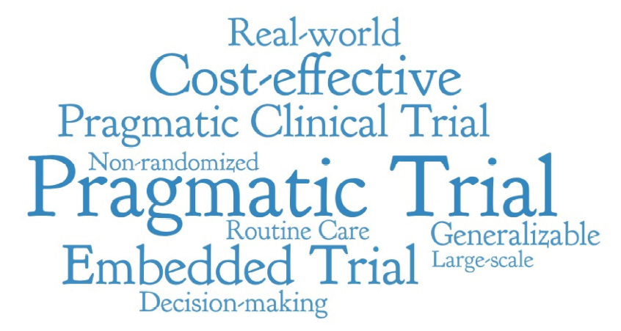

Slide 8
Operationalizing Pragmatic Trials: More than a Trendy Buzz Word
Variability in conceptualization, definition, understanding, and application.
Pragmatic = real-world (what does real-world mean?)
Pragmatic = not RCT design (most pragmatic trials are RCTs)
Pragmatic = broad generalizability (not necessarily)
What makes a study more or less pragmatic?

Slide 9
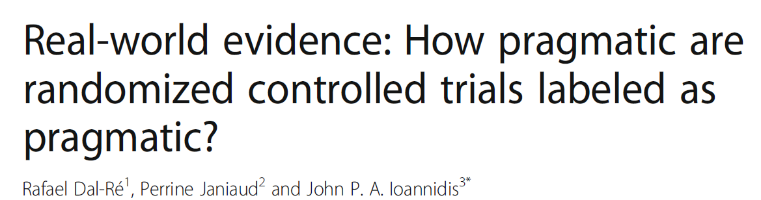
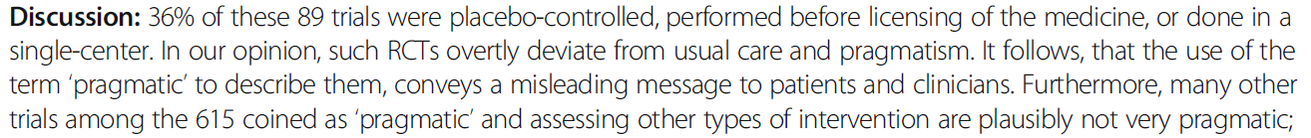
Dal-Re et al. (2018). BMC Medicine. See also Janiaud et al. (2018). JAMA.

Slide 10
PRECIS-2 Tool
PRagmatic Explanatory Continuum Indicator Summary
Loudon et al. (2015). The PRECIS-2 tool: Designing trials that are fit for purpose. BMJ.
9 domains for conceptualizing and operationalizing trials along the explanatory—pragmatic continuum.
Structured guidance for what elements to consider when planning a trial, and how those elements make a trial more or less pragmatic.
Validated tool (interrater reliability, discriminant validity).

Slide 11
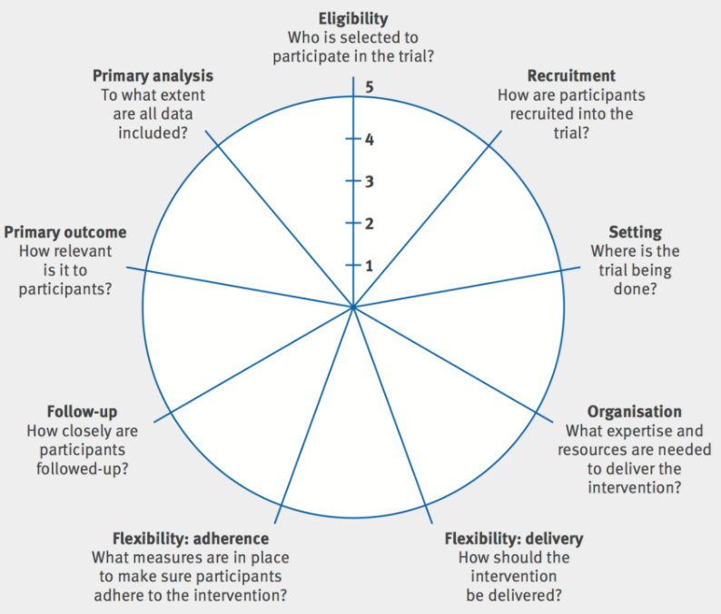
PRECIS-2
Loudon et al., 2015
Notes:
PRECIS-2 Tool:
9 domains (e.g., setting)
Key domain question (Where is the trial being done?)
1-5 scale (1 = very explanatory, 5 = very pragmatic)

Slide 12
PRECIS-2 Domains
(1) Eligibility: To what extent are the participants in the trial similar to those who would receive this intervention if it was part of usual care?
Score 1: Very explanatory approach with lots of exclusion criteria (e.g., those who don’t comply, respond to treatment, are not at high risk for primary outcome; children or elderly).
Score 5: Very pragmatic approach essentially identical to those in usual care.

Slide 13
PRECIS-2 Domains
(2) Recruitment: How much extra effort is made to recruit participants over and above what that would be used in the usual care setting to engage with patients?
Score 1: Very explanatory approach with targeted invitation letters, advertising in newspapers, radio plus incentives, etc. not used in usual care.
Score 5: Very pragmatic approach with recruitment through usual appointments or clinic.

Slide 14
PRECIS-2 Domains
(3) Setting: How different is the setting of the trial and the usual care setting?
Score 1: Very explanatory approach with single site, single academic center, etc.
Score 5: Very pragmatic choice using identical settings to usual care.
(4) Organization: How different are the resources, provider expertise, and the organization of care delivery in the intervention arm of the trial and those available in usual care?
Score 1: Very explanatory approach if trial increases staff levels, gives additional training, require more than usual experience or certification and increase resources.
Score 5: Very pragmatic choice that uses identical organization to usual care.

Slide 15
PRECIS-2 Domains
(5) Flexibility (delivery): How different is the flexibility in how the intervention is delivered and the flexibility likely in usual care?
Score 1: Very explanatory approach if there is a strict protocol, monitoring and measures to improve compliance, with specific advice on allowed co-interventions and complications.
Score 5: Very pragmatic choice with identical flexibility to usual care.

Slide 16
PRECIS-2 Domains
(6) Flexibility (adherence): How different is the flexibility in how participants must adhere to the intervention and the flexibility likely in usual care?
Score 1: Very explanatory approach that involves exclusion based on adherence, and measures to improve adherence if found wanting.
Score 5: Very pragmatic choice involving no more than usual.

Slide 17
PRECIS-2 Domains
(7) Follow-up: How different is the intensity of measurement and follow-up of participants in the trial and the likely follow-up in usual care?
Score 1: Very explanatory approach with more frequent, longer visits, unscheduled visits triggered by primary outcome event or intervening event, and more extensive data collection.
Score 5: Very pragmatic approach with no more than usual follow-up.

Slide 18
PRECIS-2 Domains
(8) Primary outcome: To what extent is the trial’s primary outcome relevant to participants?
Score 1: Very explanatory approach using a surrogate, physiological outcome, central adjudication or use assessment expertise that is not available in usual care, or the outcome is measured at an earlier time than in usual care.
Score 5: Very pragmatic choice where the outcome is of obvious importance to participants.

Slide 19
PRECIS-2 Domains
(9) Primary analysis: To what extent are all data included in the analysis of the primary outcome?
Score 1: Very pragmatic analysis that excludes ineligible post-randomization participants, includes only completers or those following the treatment protocol.
Score 5: Very pragmatic approach using intention to treat with all available data.

Slide 20
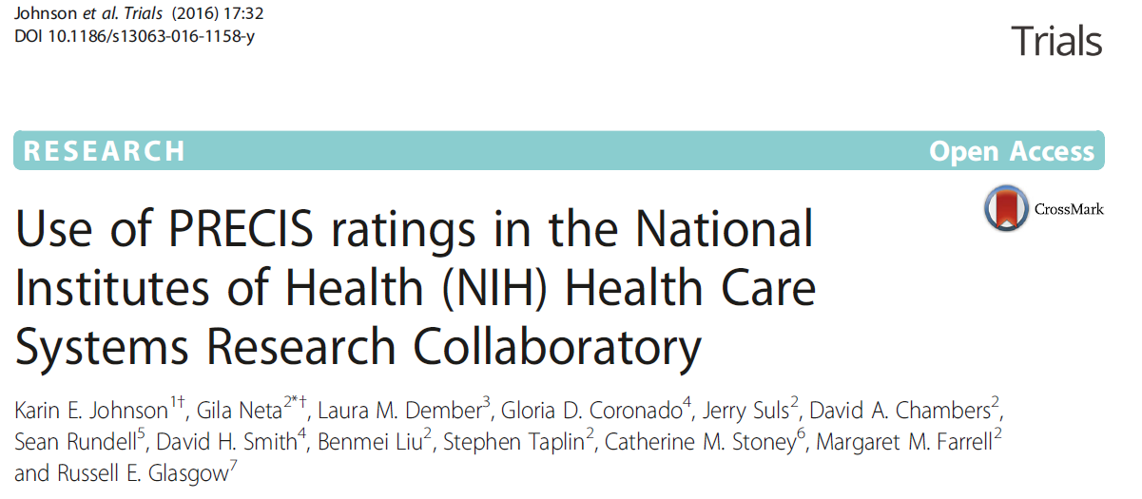
NIH Collaboratory Example

Slide 21
Acknowledgements
Josie Briggs, Wendy Weber, Cathy Meyers, Barbara Wells and Mike Lauer for their initial input on the plans for this project.
Demonstration project team members for input on study interpretation.
Russ Glasgow for his guidance and conducting the trainings.

Slide 22
What is the NIH Health Care Systems Research Collaboratory?
Advances large scale pragmatic clinical trials through demonstration projects.
Studies occur in large and diverse health care settings around the United States.
Trials have a planning (UH2) and implementation (UH3) phase.

Slide 23
Objectives of Using PRECIS-2 in NIH Collaboratory
Measure the degree to which the NIH Collaboratory trials are pragmatic at both the planning (UH2) and implementation (UH3) phases.
Study whether and how trial design changed from UH2 and UH3 phases.
Assess PRECIS-2 usability for assessing pragmatic features across studies and over time.
Provide an opportunity for study teams to better understand the other projects.

Slide 24
Methods: Raters and Training
Raters
Trial PIs or designees (4)
Coordinating Center Staff (1)
NIH staff (6)
Russ Glasgow provided training on using PRECIS-2
Orientation webinar
Practice protocol exercise
Follow-up webinar to discuss results

Slide 25
Methods: Rating Trials
5 trials:
ABATE Infection (Active Bathing to Eliminate Infection)
LIRE (Lumbar Image Reporting with Epidemiology)
PPACT (Collaborative Care for Chronic Pain in Primary Care)
STOP CRC (Strategies and Opportunities to Stop Colon Cancer in Priority Populations)
TiME (Time to Reduce Mortality in End-Stage Renal Disease)
Each trial rated by 8 raters at 2 time points:
UH2 ratings assessed from grant application
UH3 ratings assessed from transition report
Rating form included space for comments.
Resulting ratings/wheels discussed with study PIs.

Slide 26
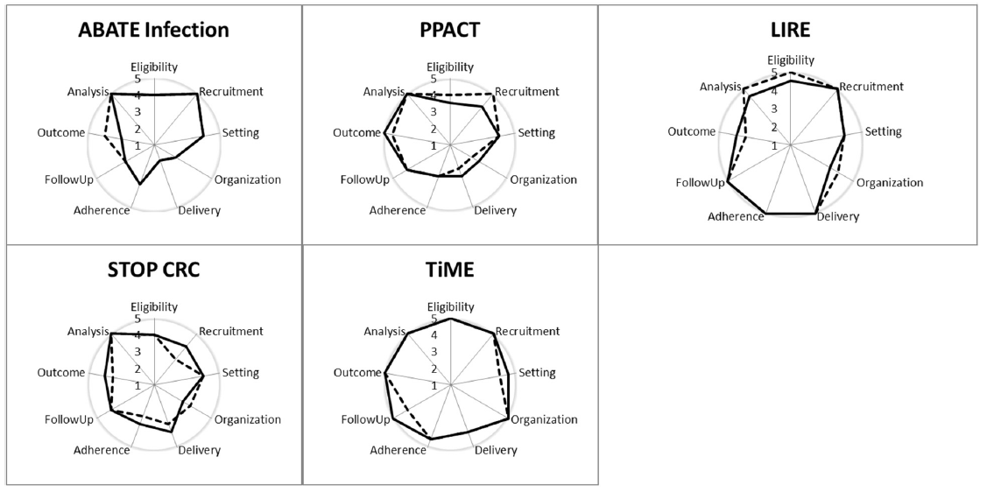

Results
Notes:
Thanks Karin. And perhaps the moment you have all been waiting for, here are the wheels for each of the five trials in our analysis.
These wheels were derived from the 8 rater scores, where each domain shows the median score of the 8 raters’ scores for that domain. As described at the top of the slide, the dashed lines represent the planning or UH2 phase, and the solid lines represent the implementation or UH3 phase. And just to remind you, the closer the lines are to the midpoint of the wheel, the more explanatory the ratings, and the closer the lines are to the outer rung of the wheel, the more pragmatic the ratings.
As you can see from these PRECIS wheels, all five trials were rated to be generally more pragmatic than explanatory, with raters’ comments indicating that raters generally perceived them to closely mirror routine clinical care across multiple domains.
However, you can see some variability by study. Also, you can see some changes from UH2 (dashed line) to UH3 (solid line). I’ll explain a little more about this in one of the next slides. But first,…

Slide 27
Mean Score and Range by Domain
Notes:
…wanted to show the results by domain across the trials. Averaging scores across studies for a given domain, we found that certain domains were generally rated as more pragmatic than others. The most pragmatic domains, as you can see on the right side of the graph, were primary analysis, recruitment and primary outcome. The domains that were least pragmatic but still more pragmatic than explanatory, shown on the left side of the graph, included organization and flexibility in delivery and in adherence. These differences could reflect, in part, that it may be easier to be pragmatic for some domains than for others. For example, it is relatively easy to be pragmatic for patient eligibility by taking all comers; but it is often difficult to be pragmatic when trying to deliver an intervention.
You can also see that there were differences in the variability across the domains. We see this variability as a combination of both the tool – where the greatest variability reflects where we had the most challenges using the tool – and the other is where the actual research question of the individual studies had implications for how they were designed, so there was greater variability in some domains than others because of how the trials were designed.

Slide 28
Interpretation of Results
All five demonstration projects were rated to be more pragmatic than explanatory.
No conclusive changes over time.
Modest but statistically significant interrater agreement.
PRECIS-2 ratings not necessarily definitive but generate a starting point for discussion.

Slide 29
Rating Challenges
Eligibility: Organizational and patient eligibility.
Setting and Organization: How to rate trial procedures relative to usual care in the U.S. given how much health systems vary?
Flexibility of Delivery/Adherence: How to rate trial restrictions relative to usual care quality control protocols?
Primary Outcome: How to rate outcomes that matter to health systems more than patients?
Criteria that pertain to more than one domain (e.g., organizational willingness to participate).

Slide 30
Conclusions
The 5 NIH Collaboratory trials were designed as more pragmatic than explanatory as measured by all PRECIS-2 domains.
Using PRECIS-2 tool helps think through study nuances and could guide implementation (e.g., where to focus training resources).
Suggestions for use and refinement:
Guidance on how to rate an intervention that is designed to change usual care.
Guidance on how care system nuances (for example, data systems) can influence ratings.
People who are familiar with the study team should be involved in discussions.

Slide 31
Resources and Reminders
PRECIS-2 Website, Resources, & Toolkit: http://precis-2.org/
NIH Collaboratory: http://rethinkingclinicaltrials.org/.
Johnson KE, Neta G, Dember LM, Coronado GD, Suls J, Chambers DA, Rundell S, Smith DH, Liu B, Taplin S, Stoney CM, Farrell M, Glasgow RE. Use of PRECIS-2 Ratings in the NIH Healthcare Systems Research Collaboratory. Trials. 2016, 17:32.
*Level of pragmatism is related to overall purpose of study and research question—it is not a marker of study quality.*

Slide 32
Next Steps
Operationalize PRECIS-2 for implementation trials (Norton, Zwarenstein, & Loudon, SCT, 2018; manuscript in development)
Recruitment of providers and clinics?
Delivery of implementation strategies (vs. intervention)
Outcome important to providers, clinic managers, leadership?

Slide 33
Contact Information
Wynne Norton: wynne.norton@nih.gov
Gila Neta: Gila.Neta@nih.gov

Slide 34
Questions? Comments? Discussion?

Slide 35
Thank You!

