Slide 1
Intersectionality and Implementation Science

Slide 2
Rationale
Integration of sex and gender in health research has been prioritized by various funding agencies including NIH, CIHR
NIH asks applicants to explain how they will factor consideration of sex into their research design and analysis
What’s the status in implementation science?

Slide 3
Are sex and gender considered in implementation science?
No mention in seminal textbooks
None of the 159 implementation models/theories/frameworks identified in a scoping review included explicit reference to sex/gender
JCE 2018;100:92-102
None of the 12 Cochrane EPOC reviews published over 1 year addressed sex or gender in the analysis or implications sections
BMC Med Res Methods 2016;16:145

Slide 4
What about other factors/aspects of social identity?
Some literature on developing interventions for specific groups such as Indigenous populations, or other defined populations
e.g. Strategies to optimize breast cancer screening in Cantonese-speaking women in Canada

Slide 5
Intersectionality
Human lives are multidimensional and individuals’ lived realities can’t be understood through single-factor explanations (such as gender, SES)
Aspects of identity such as race, gender, SES are not independent dimensions but are interconnected to shape lived experience
In understanding/explaining human experience, no single aspect of inequality should be given priority over another
Soc Sci Med 2012;74;1712-20

Slide 6
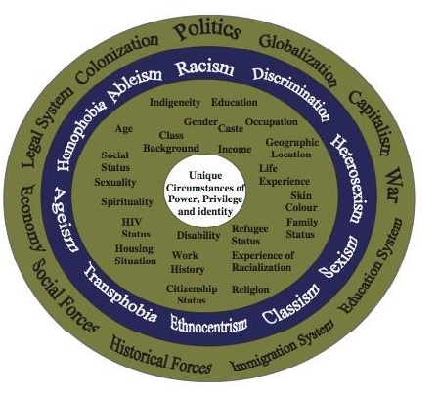
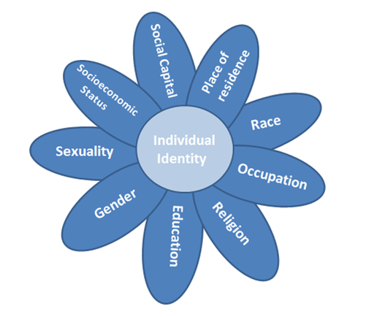
Intersectionality
Intersectionality refers to the variable ways that social locations and systems of oppression/privilege shape the multiple dimensions of people’s lives.

Slide 7
Key components of Intersectionality
1. Multidimensionality and mutual constitution
Individuals can experience privilege and oppression
2. Context
Dimensions of inequality can interact at individual, group and societal levels
Relations of inequality can change over time
3. Social inequality
Unequal access to resources is shaped by interdependent systems of power
Hankivsky 2014

Slide 8
Key components of Intersectionality
4. Disparities within groups
Not everyone within a group is the same
5. Marginalization
Interplay between factors shapes experiences of exclusion/oppression
6. Social isolation
Individuals occupy multiple social locations (race, gender, SES)
7. Matrix of domination
Experiences of domination are distinct from individual characteristics, vary by intersection of social positions
Hankivsky 2014

Slide 9
An Example
You’re developing an implementation strategy to support children exposed to intimate partner violence
Acknowledge that children's identities are intersectional e.g. a child may be a second-generation immigrant, which may affect their experience in a way that differs from their parents
How much do structural inequalities (gender, ability etc.) foster exposure to IPV and to accessing interventions?
What organizational inequalities exist that impact access?
…
Trauma, Violence, Abuse 2016:1-18

Slide 10
Considerations
Team composition
Reflexivity
Research question
Theoretical framework
Identify categories of oppression – with descriptions of how they will be operationalised
Methods – sampling, data collection, analysis
Results – how should intersectionality be considered in the data analysis
Trauma, Violence, Abuse 2016:1-18

Slide 11
Some aspects unique to Implementation Science (IS)
Implementation of an intervention requires decision making on the part of individuals or organizations
Different leadership traits, influenced by intersectionality
Stakeholder engagement may be influenced by intersectionality
Different approaches to consensus building etc.
BMC Med Res Methods 2016;16:145

Slide 12
Some aspects unique to Implementation Science (IS)
Communication strategies may differ and response to different communication strategies (such as persuasive techniques) may differ
Negative stereotypes may impede uptake/outcomes
Female/male clinicians manage female/male patients differently (for some conditions)
School-based interventions to prevent domestic abuse for children reported that LGBT youth felt excluded from the programs
BMC Med Res Methods 2016;16:145

Slide 13
Some questions to ask…
Are theories of behaviour change equally applicable across intersecting variables?
How do these intersecting variables influence evidence implementation?
When and how should implementation interventions be tailored to intersecting variables?
When using collaborative research/PAR, what is the impact of team composition?...
BMC Med Res Methods 2016;16:145

Slide 14
Exercise
How might we modify CFIR to consider intersectionality?

Slide 15
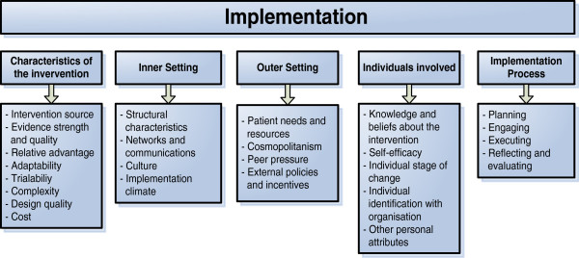
CFIR (Damschroder et al)

Slide 16
Questions?

