Slide 1
FAQ Retrieval for
Question Answering Systems
Miloni Mittal | 2017A3PS0243P
Aman Narsaria | 2018B3A70743P
Under the guidance of - Dr. Yashvardhan Sharma and Ms. Vijay Kumari
May, 2021

Slide 2
Agenda
Need for QA Systems
Flowchart for QA System
Project Flow
Related Models Used
Performance Metrics
Experiments and Results
Web Interface
Future Work
Learning Outcomes
Acknowledgements

Slide 3
The Need for FAQ Retrieval System
All information is usually present in the FAQ section of an organisation’s website (closed domain)
It gets difficult for a user to search through this information
FAQ retrieval can help in making use of this already available information

Slide 4
User asks a query
In closed domain?
Yes
No
Check similar questions in FAQ list
Display list of relevant links from Quora etc.
Yes
No
Display the final answer
Answer present in context
No
Yes
Add question with answer to FAQ list
Display the final answer from context
Flowchart for QA Systems
Highlight source of answer

Slide 5
From previous projects, SBERT had the best results
q-QA technique is a rather recent technique to get the best of both FAQ Question and FAQ Answers (TSUBAKI+BERT, BERT x2)
Tried to incorporate SBERT (qA and qQ) to find similarity between query and FAQs
Literature review
Shifted to exploring models like DistilBERT
BM25 (qQ, q(Q+A)) was implemented
Shifted to BERT
Overview of the Project Flow
Trained doublets
combined
Found a more efficient technique of triplet training

Slide 6
Models Used

Slide 7
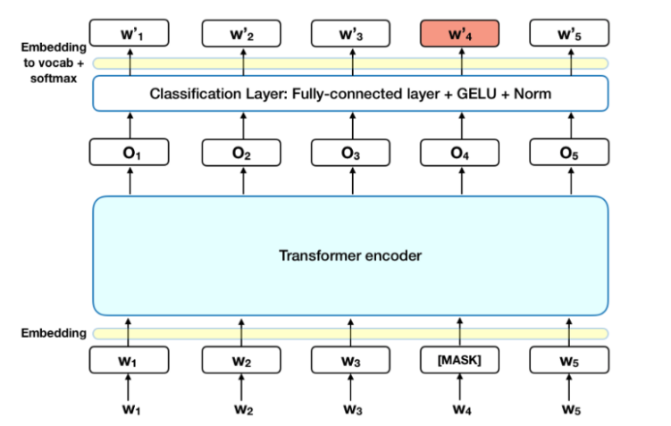
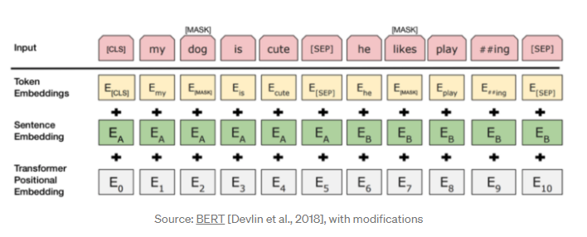
BERT Model
Bidirectional Encoder Representations from Transformers is a state-of-the-art NLP model used to calculate sentence embeddings.
It makes use of Transformer (an attention mechanism) that learns contextual relations between words.

Slide 8
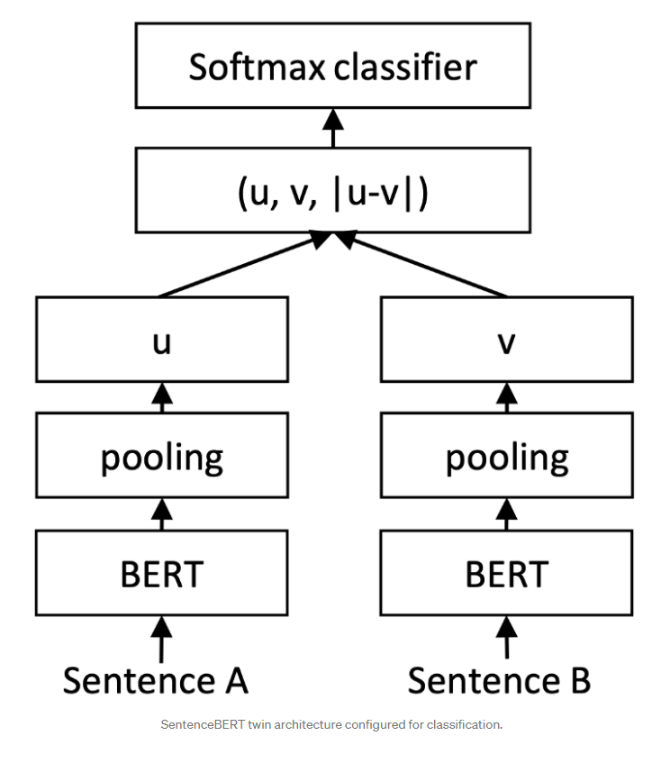
SBERT Model
Sentence - BERT is a modification of the BERT model used to calculate the sentence embeddings.
These embeddings can be compared using cosine similarity/ bm25 similarity to find sentences with similar meaning.

Slide 9
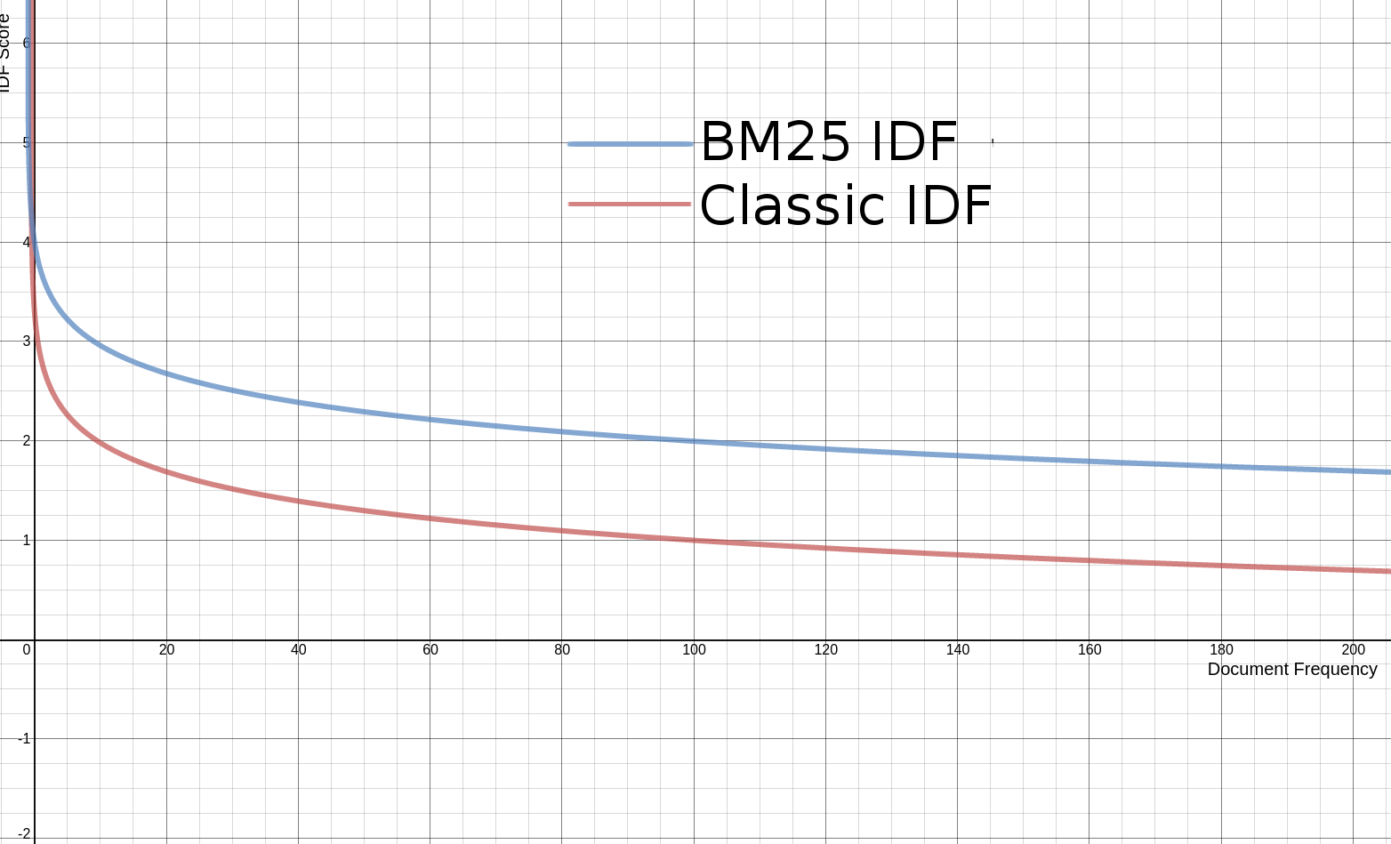
BM25 Model
BM25 is a ranking function used by search engines to estimate relevance of documents to a given search query.
Previous projects had used TF-IDF to calculate similarity score and rank sentences based on that.
But since BM-25 always gives better results than any other similarity score, we have used it as our ranking function.

Slide 10
Performance Metrics Used
Precision at 5
A measure of how many answers are relevant in the top 5 retrieved answers.
Mean Average Precision
A measure of how higher up in the retrieved list the relevant answers are.
Mean Reciprocal Rank
A measure of the rank of the first relevant answer in the retrieved list.

Slide 11
Dataset

Slide 12
FAQIR Dataset
Derived from “maintenance & repair” domain of the Yahoo! Answers community website.
Contains 4313 FAQ pairs and 1233 queries
The FAQ-query pairs are scored based on their relevance as followed:
1- relevant
2- useful
3- useless
4- irrelevant

Slide 13
Experiments and Results

Slide 14
1:1/1:5 Training with SBERT
1:1/1:5 refers to the ratio of answer and answer-dashes for each question in the training dataset
Pre-processing
For SBERT, of A field-
Lower case
Removal of numbers
Training SBERT qA
Built the model
Trained the model
Testing
Select top 10 qA pairs
Sort the qA pairs
Rank them based on their qQ scores.
P@5 | MAP | MRR
0.148 | 0.29 | 0.31
0.194 | 0.353 | 0.372

Slide 15
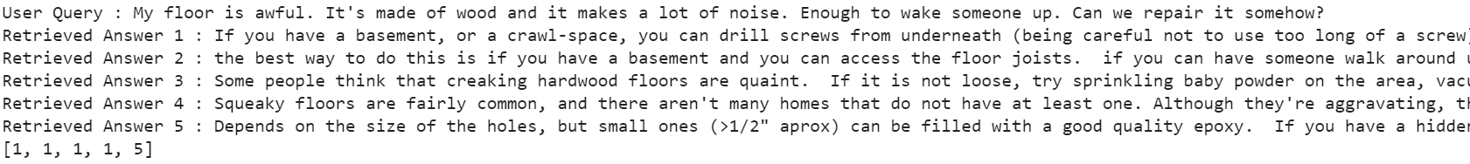
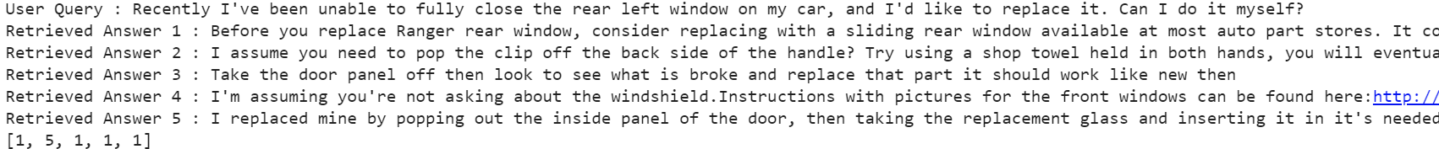
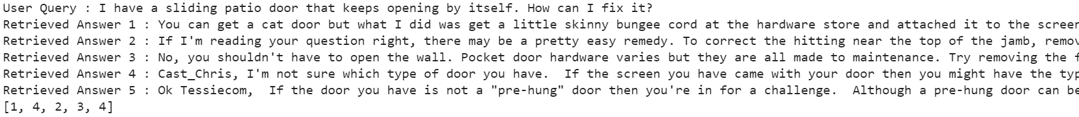
Retrieved FAQ for User Queries

Slide 16
1:5 Training with Distil-BERT
Training qA model
Pre-process the dataset
Built the qA model
Train the qA model
Pre-processing
For DistilBERT, of A field-
Lower case
Removal of numbers
Testing
Calculate qA and qQ Scores
Rank FAQ pairs based on their
0.2*qA score+0.8*qQ score
Training qQ model
Pre-process the dataset
Built the qQ model
Train the qQ model
P@5 | MAP | MRR
0.183 | 0.307 | 0.404

Slide 17
BM25 Query - FAQ Question
Pre-processing
For BM25, of Q field-
Lower case
Removal of stopwords
Removal of punctuation
Removal of numbers
Building BM25 qQ
Pre-process the corpus
Define the corpus
Define the BM25 model
Testing
Pick top 100 results from BM25 qQ
Find the relevance rank as per dataset
Find the performance metrics
P@5 | MAP | MRR
0.3067 | 0.3869 | 0.5716

Slide 18
BM25 Query - (FAQ Question + Answer)
FAQ Question+Answer refers to the concatenation of corresponding FAQ question and answer pair
Pre-processing
For BM25, of Q+A field-
Lower case
Removal of stopwords
Removal of punctuation
Removal of numbers
Testing
Pick top 100 results from BM25 q(Q+A)
Find the relevance rank as per dataset
Find the performance metrics
Building BM25 q(Q+A)
Pre-process the corpus
Define the corpus
Define the BM25 model
P@5 | MAP | MRR
0.3364 | 0.3932 | 0.5992

Slide 19
Retrieved FAQ for User Queries

Slide 20
BM25 Query - (FAQ Question + Answer) -> BERT Query - Answer
Corresponding answer is obtained from FAQ pairs. A-dash is an answer which is not for that question.
Testing
Pick top 100 results from BM25 q(Q+A)
Find the encoding for all FAQ answers
Find the encoding for query
Find the similarity between encodings using cosine similarity
Rerank the previously retrieved questions on similarity score basis
Find the relevance rank as per dataset
Find the performance metrics
Training BERT qA
Form Triplet (question, corresponding answer, answer-dash) Dataset
Build the model (lr=2e-5, epochs=3)
Train the model
Pre-processing
For BM25, of Q+A field-
Lower case
Removal of stopwords
Removal of punctuation
Removal of numbers
For BERT, of A field-
Lower case
Removal of punctuation
Building BM25 q(Q+A)
Pre-process the corpus
Define the corpus
Define the BM25 model
P@5 | MAP | MRR
0.2702 | 0.3232 | 0.5219

Slide 21
BM25 Query - (FAQ Question + Answer) -> BERT Query - Question
Corresponding question obtained from qQ dataset. Q-dash is a question which is not similar to the question.
Testing
Pick top 100 results from BM25 q(Q+A)
Find the encoding for all FAQ questions
Find the encoding for query
Find the similarity between encodings using cosine similarity
Rerank the previously retrieved questions on similarity score basis
Find the relevance rank as per dataset
Find the performance metrics
Pre-processing
For BM25, of Q+A field-
Lower case
Removal of stopwords
Removal of punctuation
Removal of numbers
For BERT, of Q field-
Lower case
Removal of punctuation
Training BERT qQ
Form Triplet (question, paraphrase, question-dash) Dataset
Built the model (lr=2e-5, epochs=3)
Trained the model
Building BM25 q(Q+A)
Pre-process the corpus
Define the corpus
Define the BM25 model
P@5 | MAP | MRR
0.421 | 0.513 | 0.688
Notes:
Initially no preprocessing

Slide 22
All Results
Model | P@5 | MAP | MRR
1:1 training SBERT | 0.148 | 0.29 | 0.31
1:5 training SBERT | 0.194 | 0.353 | 0.372
1:5 training DistilBERT | 0.183 | 0.307 | 0.404
BM25 qQ | 0.3067 | 0.3869 | 0.5716
BM25 q(Q+A) | 0.3364 | 0.3932 | 0.5992
BM25 q(Q+A) + BERT qA | 0.2702 | 0.3232 | 0.5219
BM25 q(Q+A) + BERT qQ | 0.421 | 0.513 | 0.688

Slide 23
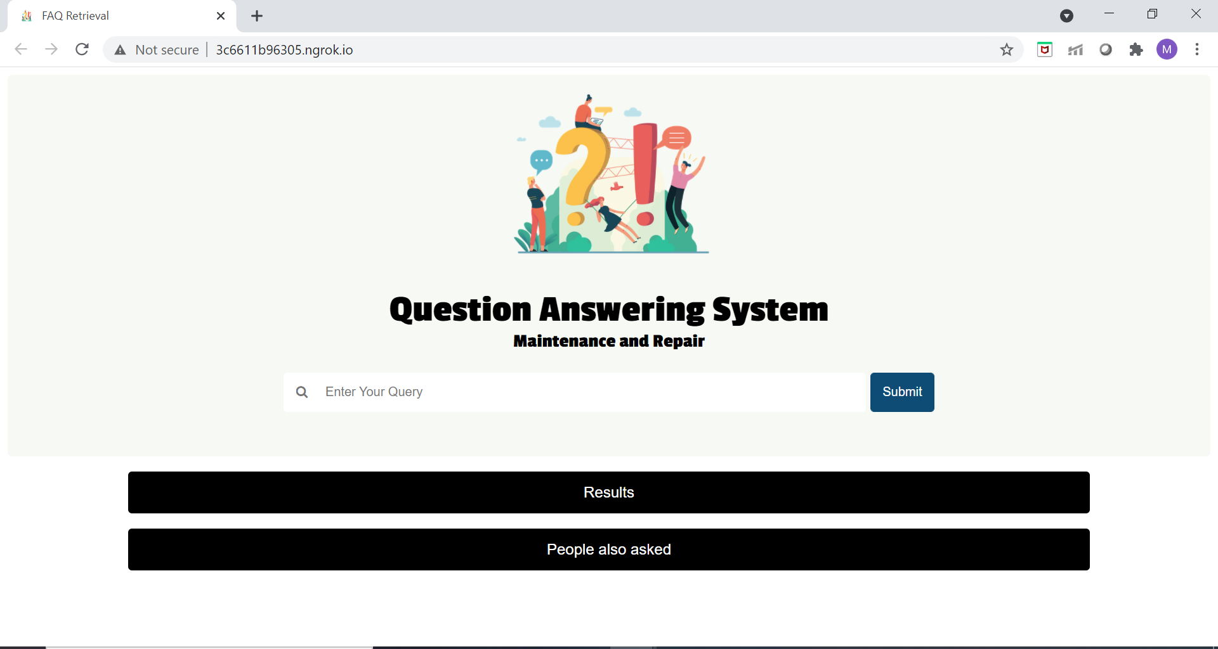
Web Interface - Home Page
Built on BM25 q(Q+A) + BERT qQ

Slide 24
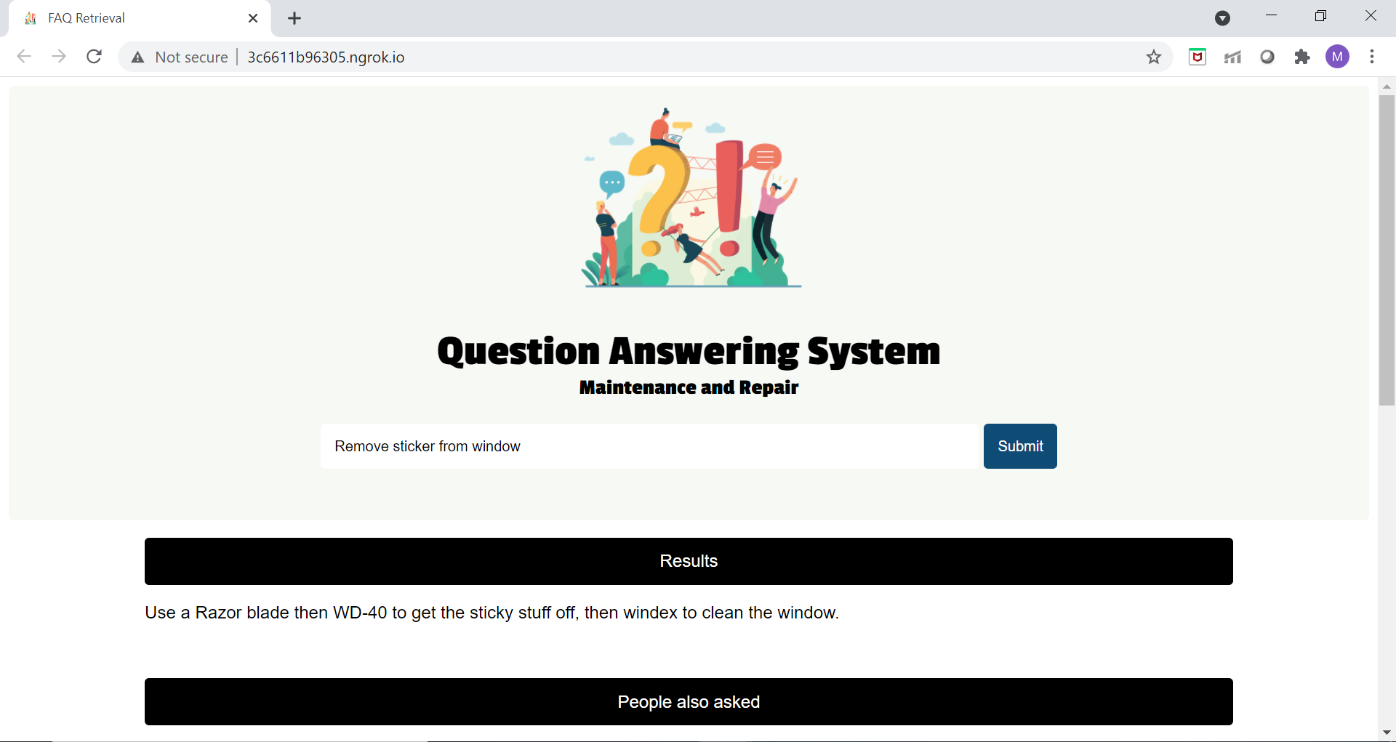
Query 1 - Asking a Query and Getting the Result

Slide 25
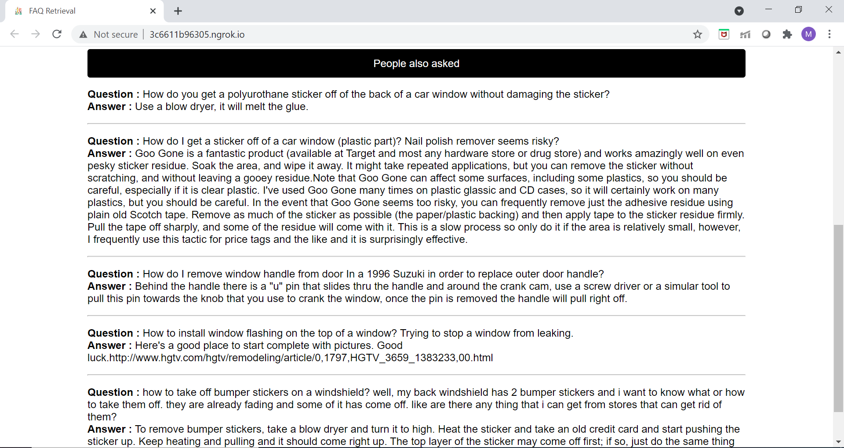
Query 1 - People Also Asked Section

Slide 26
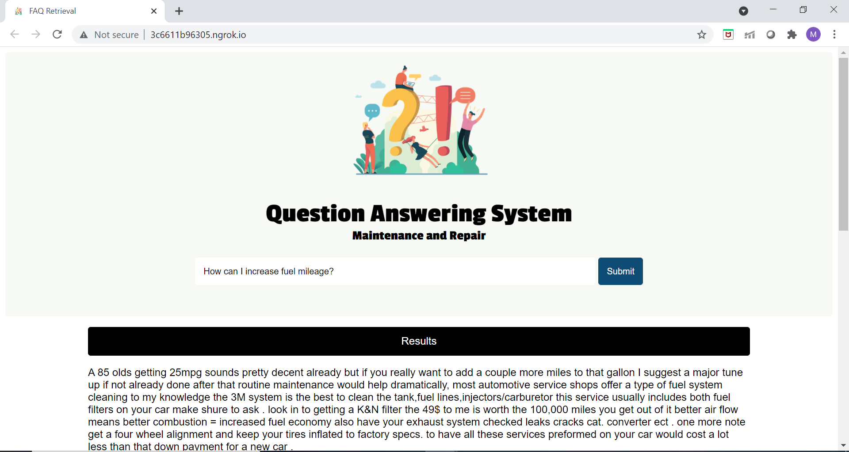
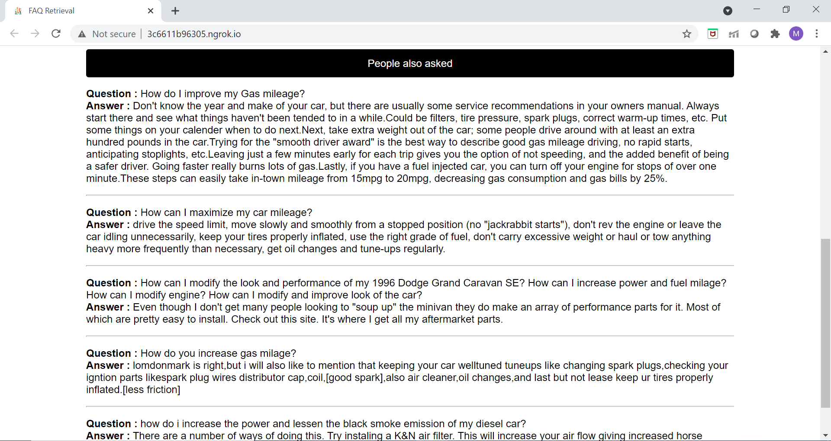
Query 2

Slide 27
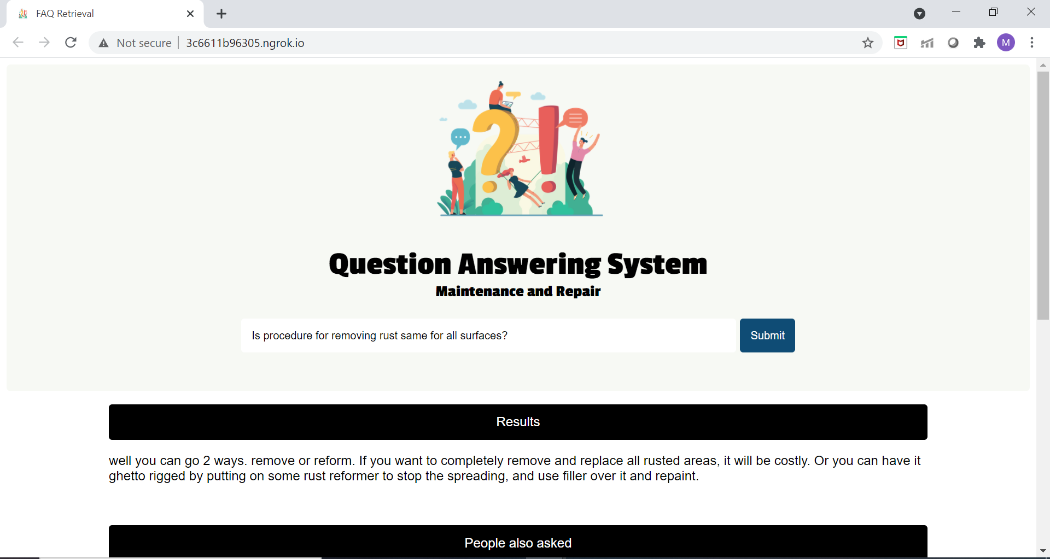
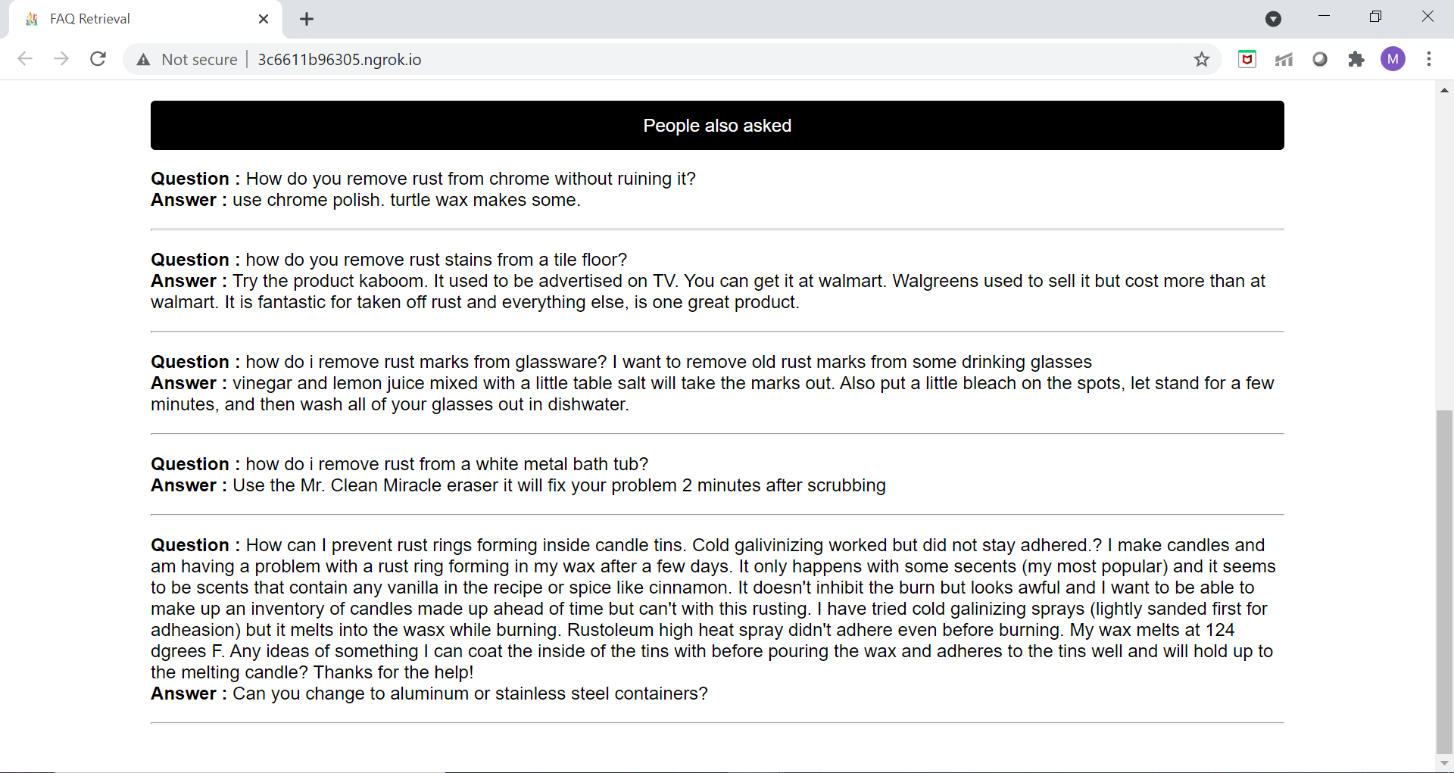
Query 3

Slide 28
Demo
Click here!

Slide 29
Future Work
Points to Remember
Further improving the accuracy of our model by using alternative techniques.
Training and testing on other datasets like COUGH, StackFAQ.
Suggest better question framing (Like “Did you mean?” in Google).
Extend to more generalised FAQs
Triplet BERT training is much more efficient and accurate than doublets.
Even if not mentioned go ahead with pre-processing.

Slide 30
Learning Outcomes
Improved paper reading techniques
Learnt about the working of models like BERT, SBERT, BM25
Worked hands-on on the fine-tuning of these models
Implementation of deep-learning models
Learnt how to build websites using HTML/CSS/JS and Flask
Documentation of the project so as to make it easier for future work.

Slide 31
Acknowledgements
We are very grateful to Yashvardhan Sir for providing us with the opportunity to carry out this project under his guidance. It was indeed a fruitful learning experience for us which we will be carrying on to our professional life as well.
We are very thankful to Vijay Ma’am, who guided us throughout the project at every step of the way and helped us out whenever we got stuck. We truly appreciate her valuable suggestions.

Slide 32
Thank You

