Slide 1
E-COMMERCE APPLICATION CLONE
DETAILED PROJECT REPORT
AMAN NEGI

Slide 2
Title: | E-commerce Application Clone
Technologies: | ReactJs
Domain: | Business
Project Difficulty level: | Medium
Organization: | iNeuron Intelligence Private Limited
Tools used: | Vscode,Jupyter Notebook,Github,

Slide 3
Ecommerce Application clone: This project entails the design and development of a frontend-only E-Commerce Application Clone aimed at providing users with a seamless online shopping experience. The application allows users to browse through a collection of products, explore individual items, and conveniently add desired products to their virtual shopping cart. Key functionalities include a dynamic homepage showcasing available products, category pages for organized browsing, and a user-friendly cart page for managing selected items. Leveraging modern frontend technologies such as React.js and React Router, the application ensures smooth navigation and responsive design across various devices. Data mocking techniques simulate backend API calls, enabling the presentation of sample product data, while local storage facilitates temporary cart item storage. Emphasizing user experience, the design integrates accessibility features, performance optimizations. Development tools such as ESLint, Prettier, and version control systems ensure code quality and collaboration efficiency. Testing strategies encompass unit testing, end-to-end testing, and accessibility testing to guarantee functionality and compliance with standards. Finally, deployment involves hosting the frontend application on static site hosting platforms with continuous integration and deployment pipelines for automated testing and deployment processes. This abstract outlines the comprehensive approach to building a robust frontend solution for an E-Commerce Application Clone, catering to modern development standards and user expectations.

Slide 4
Problem Statement:
Design an “E-Commerce Application Clone” where the users can see the collection of products, and individual products, and add the product to the cart.
Objective:
The goal is to deliver a high-quality e-commerce application clone that not only replicates the core functionalities of an existing platform but also prioritizes user experience, security, scalability, and adaptability to drive customer satisfaction and business success.

Slide 5
Requirements:
Hardware requirements: A working computer to code with active internet connection.
Tools/Software requirements:
Integrated Development Environment (IDE)
Node.js and npm (Node Package Manager)
React.js and React Router
Git: Version control system for tracking changes in codebase.
GitHub: Platforms for hosting and managing Git repositories.
Create React App: Development environments for setting up a local server and building React applications.

Slide 6
Data Collection:
The Products data was taken from api
https://api.pujakaitem.com/api/products

Slide 7

Architecture design

Slide 8
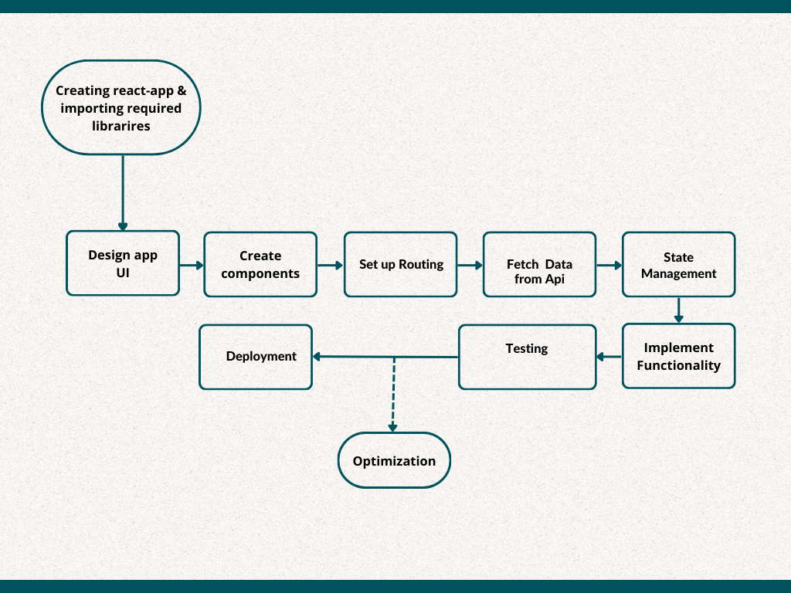
Architecture

Slide 9
User
InterFace

Slide 10
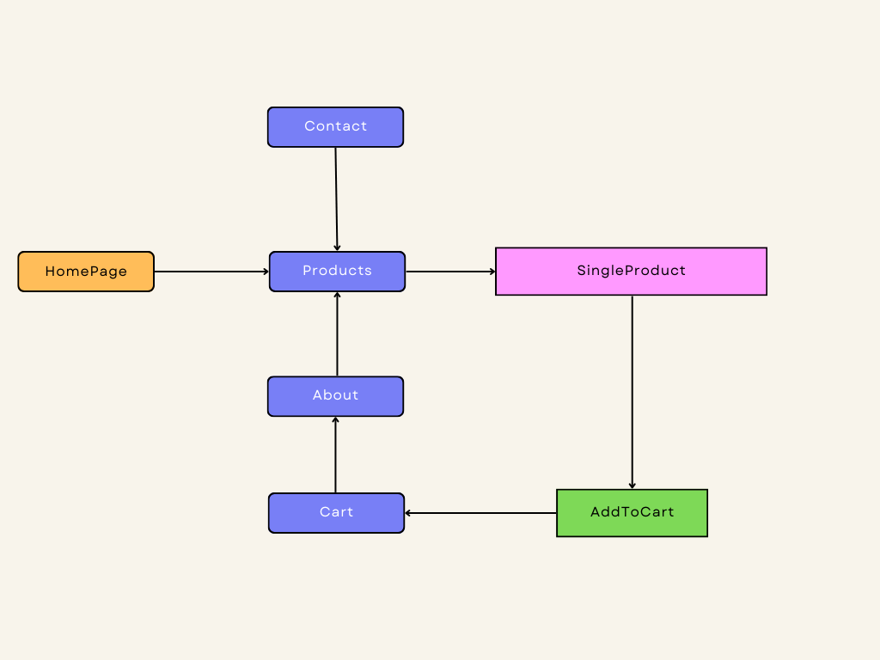

Slide 11
Ecommerce App Workflow
1. Introduction
Our ecommerce app is a fully frontend React application designed to provide users with a seamless shopping experience.
The app consists of four main pages: Home, Products, Contact, and About.
Users can browse through a wide range of products on the Products page, add them to their cart, and contact us for any inquiries.

Slide 12
2. Features Overview
Homepage (Home): Introduces users to our brand and showcases featured products or promotions.
Product Listings (Products): Displays a comprehensive list of products available for purchase. Users can filter products based on their preferences, such as category, price range, or brand.
Product Detail Pages: Provides detailed information about each product, including images, descriptions, and pricing. Users can add products to their cart directly from this page.
Contact Page: Allows users to get in touch with us for any queries, feedback, or support.
CartPage: Add products to users bucket list.

Slide 13
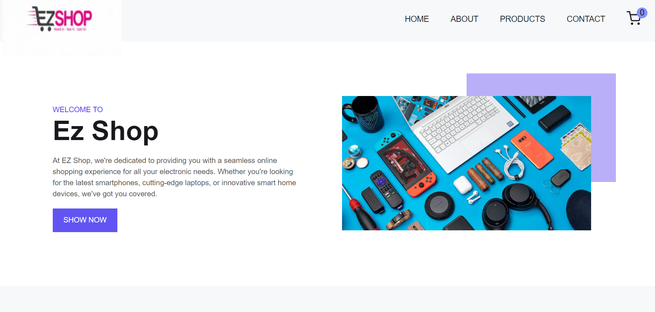
Homepage

Slide 14
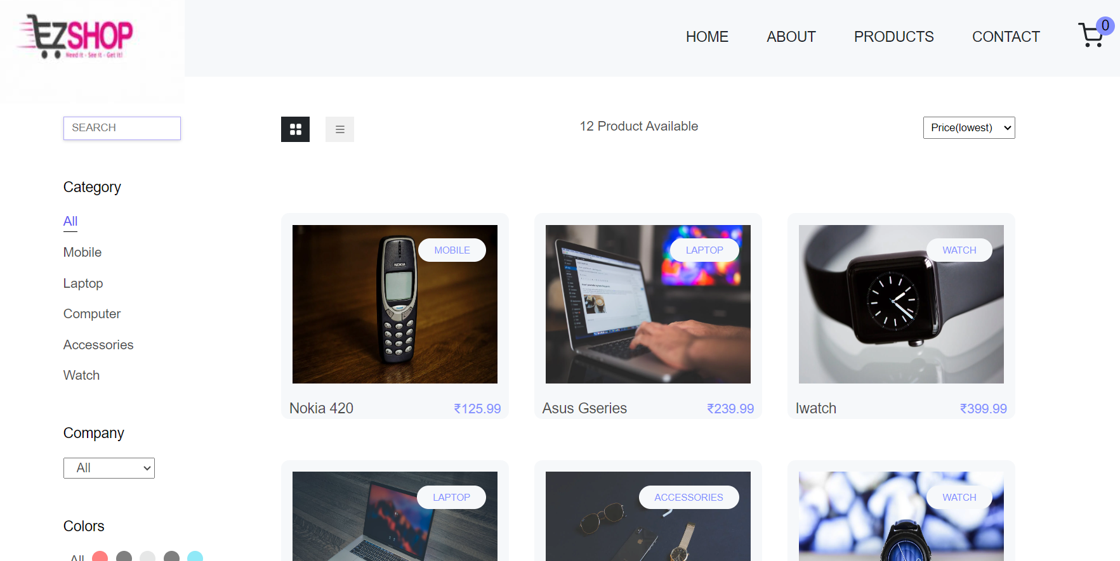
Products page

Slide 15
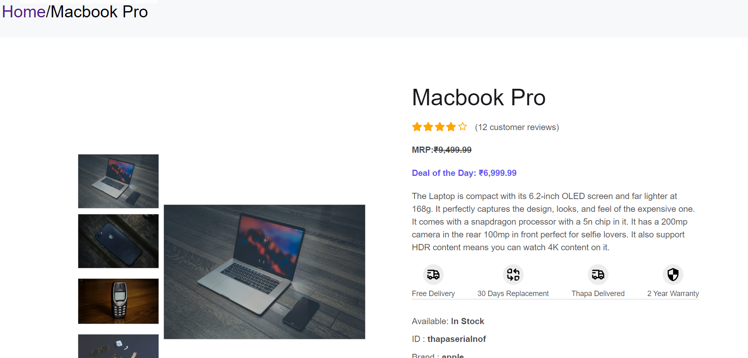
Single Products PAge

Slide 16
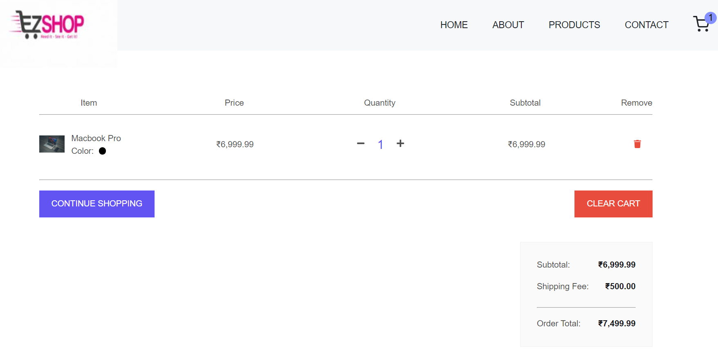
Cart page

Slide 17
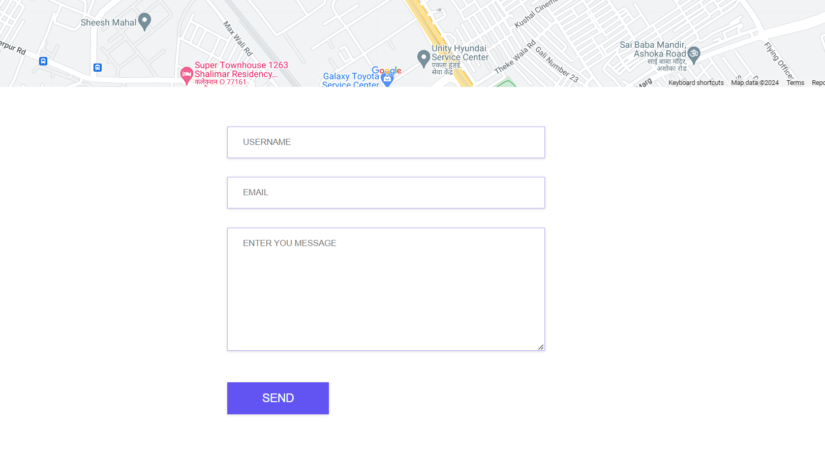
Contact us page

Slide 18
Functionality
1. Product Management
Product data is managed using Context API, allowing for efficient state management within the application.
API calls are made to fetch product data dynamically from external sources, enabling real-time updates and ensuring that users have access to the latest product information.
2. Filtering and Sorting
Users can filter products based on various criteria, such as category, price range, or brand, to quickly find the products they're interested in.
Sorting options are available to organize products based on relevance, price, or popularity, enhancing the browsing experience for users.

Slide 19
3. Cart Functionality
Users can add products to their cart directly from the product detail pages.
The cart displays the selected items, allowing users to review their selections, adjust quantities, and proceed to checkout seamlessly.
4. Technologies Used
The ecommerce app is built entirely with React, leveraging its component-based architecture for modular development.
Context API is utilized for state management, enabling efficient data sharing and manipulation across components.
React Router is used for client-side routing, ensuring smooth navigation between different pages of the app.

Slide 20
Our ecommerce app offers a modern and intuitive shopping experience, powered by React and Context API.
With its user-friendly interface, advanced filtering options, and seamless checkout process, the app aims to meet the diverse needs of our customers and enhance their online shopping journey.
Conclusions

Slide 21
THANK YOU
Aman Negi
Project details location: https://github.com/amannegi11/E-commerce-application-clone
Mail: negiaman1112000@gmail.com
Linkedin: https://www.linkedin.com/in/aman-negi-981882215

