Slide 1
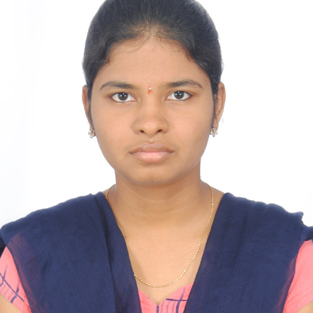



Amrutha Mannepalli
Bachelor of Engineering
Information Technology:2017-2021
Skills
Java
Spring
MongoDB
NodeJS
AngularJS
Components
Services
Routing
Forms & Validation
Testing using Jasmine & Karma
Database
SQL database – MySQL
No SQL database – MongoDB
Web Technologies
HTML5
CSS3
Javascript
ES6
Tools
Github
Postman
Add On skills
Leadership
Workholic
Team management
Analyst/Software Engineer
Bangalore
amrutha.mannepalli@capgemini.com
+91 7780668727
A4
Hands on experience in developing web pages using HTML5, CSS3, Java script, ES6, Angular. Hands on experience in creating microservices with Spring boot , Spring Security , Spring Cloud API Gateway , Eureka server.
Completed the training along with case study using Java Full Stack Angular as the Technology.
Ready to learn new technologies and implement them to further improve my knowledge.
Eager to work in a team of dedicated people and serve a key role in the enhancement and development of the project.
Deals and Coupons Finder Application
Completed end to end case study of Deals and Coupons Finder Application .There are Multiple Microservices. Implemented eureka server and Spring cloud API Gateway. Front End with Angular 12,using Angular Material and Angular CLI. Back End with MongoDB.
Completed the i-Transform Java Full Stack Angular Training
Check out my work on GitHub & Video Profile

