Slide 1
Molecular Simulation
Project : Coding in C++
Authors:
Aman Govind Soni, Abhinav Pratap Singh Bais, Vishal Chauhan, Maheshwari Yadav, Tharun T
Date:
31.04.2023

Slide 2
The Algorithm
First we initialise the configuration of the atoms by spacing them at an optimum distance as per the number of atoms and then calculate and store the initial energy of the configuration
Randomly select an atom and give it a displacement, calculate the new energy of the system as per the minimum image convention and periodic boundary conditions.
If the energy obtained of the new configuration is lesser than the old configuration accept the energy and store it Else calculate the number proportional to the probability 𝑒𝑥𝑝(-ΔE/kT) and generate a random number between 0 and 1, then if the random number generated is lesser than the number corresponding the porbability then accept the configuration else reject it and loop. This is done to avoid stopping the program at any local minima and only stopping the code when we reach the global minima of the potential curve.
Repeat steps until equilibrium is reached or at least >10⁵ MCS[Monte Carlo Step]. (One MCS is the number of displacement moves equal to the number of molecules in the system)

Slide 3
To the CODE

Slide 4
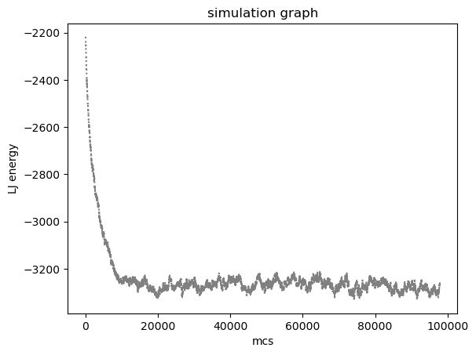
The Graph
Energy of the System (Lenard-Jones Potential)
Number of accepted iterations

Slide 5
Thank You

