Slide 1
Support Vector Machines
Dr. Chetana Gavankar, Ph.D,
IIT Bombay-Monash University Australia
Chetana.gavankar@pilani.bits-pilani.ac.in
Updated – Anita Ramachandran, 2024

Slide 2
Agenda
  Linear Classifiers
  Maximum Margin Classification
  Linear SVM
  Soft Margin SVM
  Nonlinear SVM
  Multi-Class Problem

Slide 3
Linear Classifiers
w x + b>0
f(x,w,b) = sign(w x + b)
w x + b=0
denotes +1
denotes -1
How would you classify this data?
w x + b<0

Slide 4
Linear Classifiers
f(x,w,b) = sign(w x + b)
denotes +1
denotes -1
How would you classify this data?

Slide 5
Linear Classifiers
f(x,w,b) = sign(w x + b)
denotes +1
denotes -1
How would you classify this data?

Slide 6
Linear Classifiers
f(x,w,b) = sign(w x + b)
denotes +1
denotes -1
Any of these would be fine..
..but which is best?

Slide 7
Linear Classifiers
f(x,w,b) = sign(w x + b)
denotes +1
denotes -1
How would you classify this data?
Misclassified
to +1 class

Slide 8
Classifier Margin
f(x,w,b) = sign(w x + b)
f(x,w,b) = sign(w x + b)
denotes +1
denotes -1
denotes +1
denotes -1
Define the margin of a linear classifier as the width that the boundary could be increased by before hitting a datapoint.
Define the margin of a linear classifier as the width that the boundary could be increased by before hitting a datapoint.

Slide 9
Maximum Margin
If hyperplane is oriented such that it is close to some of the points in your training set, new data may lie on the wrong side of the hyperplane, even if the new points lie close to training examples of the correct class.
Solution is maximizing the margin
f(x,w,b) = sign(w x + b)
denotes +1
denotes -1
The maximum margin linear classifier is the linear classifier with the, maximum margin.
This is the simplest kind of SVM (Called an LSVM)
Support Vectors are those datapoints that the margin pushes up against
Linear SVM

Slide 10
Support Vectors
Geometric description of SVM is that the max-margin hyperplane is completely determined by those points that lie nearest to it.
Points that lie on this margin are the support vectors.
The points of our data set which if removed, would alter the position of the dividing hyperplane

Slide 11
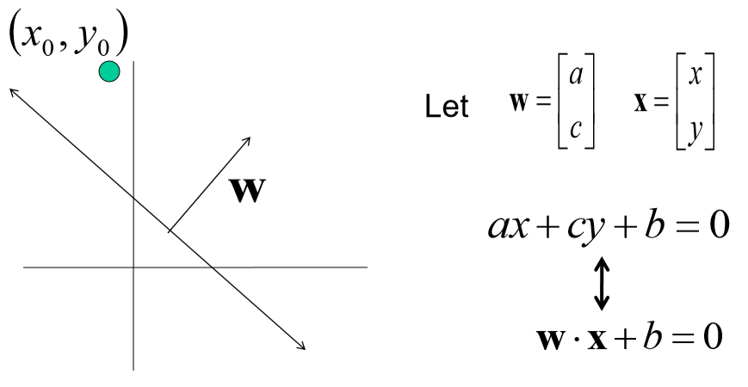
Line with 2 features: R2

Slide 12
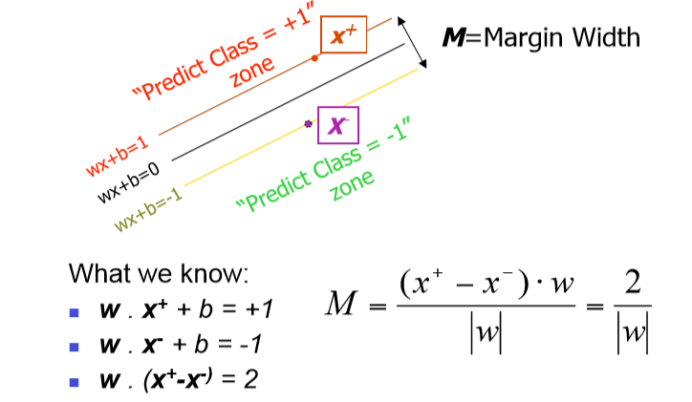
Linear SVM Mathematically

Slide 13
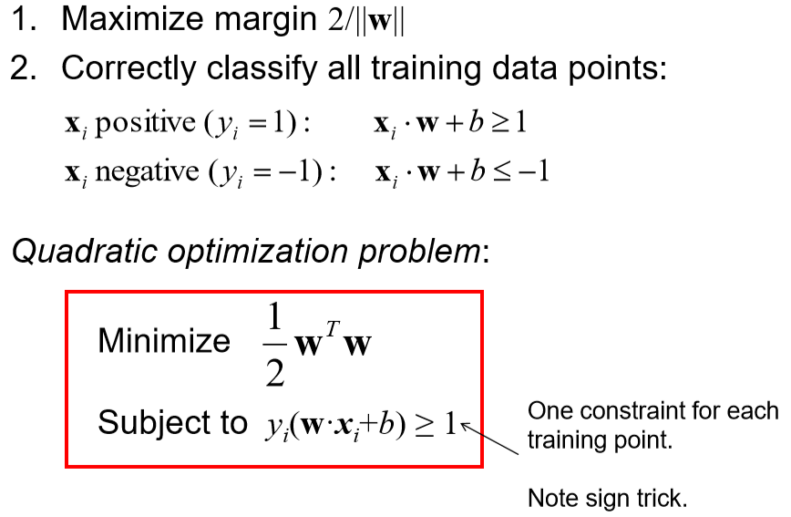
Solving the Optimization Problem

Slide 14
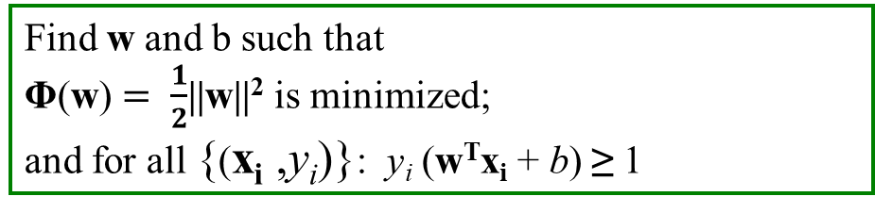
Solving the Optimization Problem
Find w and b such that
Φ(w) $= \frac{1}{2}$||w||² is minimized;
and for all {(x_{i} ,y_{i})}: y_{i} (w^{T}x_{i} + b) ≥ 1
← Primal
Need to optimize a quadratic function subject to linear inequality constraints.
All constraints in SVM are linear
Quadratic optimization problems are a well-known class of mathematical programming problems, and many (rather intricate) algorithms exist for solving them.
The solution involves constructing a dual problem where a Lagrange multiplier α_{i} is associated with every constraint in the primal problem

Slide 15
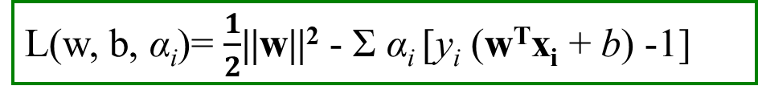
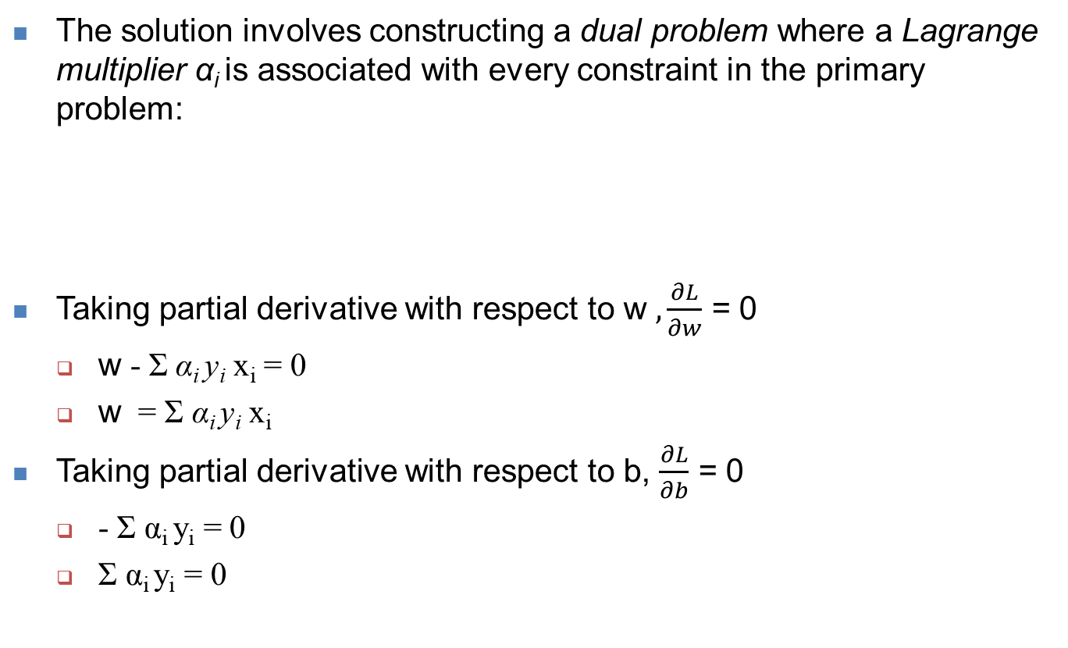
Solving the Optimization Problem
The solution involves constructing a dual problem where a Lagrange multiplier α_{i} is associated with every constraint in the primary problem:
Taking partial derivative with respect to w $, \frac{∂L}{∂w}$ = 0
  w - Σ α_{i} y_{i} x_{i} = 0
  w = Σ α_{i} y_{i} x_{i}
Taking partial derivative with respect to b, $\frac{∂L}{∂b}$ = 0
  - Σ α_{i} y_{i} = 0
  Σ α_{i} y_{i} = 0
L(w, b, α_{i})= $\frac{1}{2}$||w||² - Σ α_{i} [y_{i} (w^{T}x_{i} + b) -1]

Slide 16
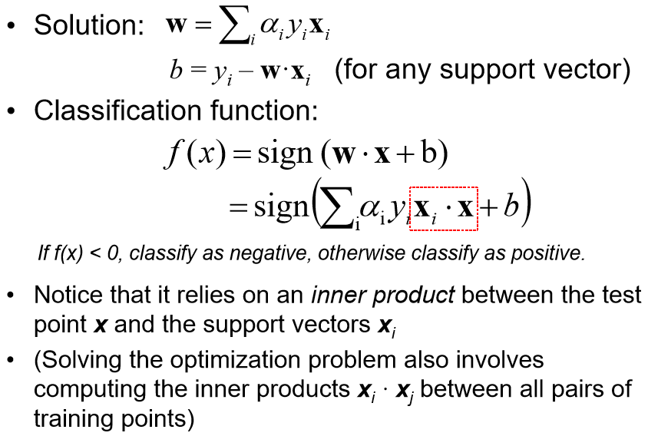
Solving the Optimization Problem

Slide 17
Dataset with noise
denotes +1
denotes -1
Hard Margin: So far we require all data points be classified correctly
- No training error
What if the training set is noisy?

Slide 18
Soft Margin Classification
Slack variables ξ_{i} can be added to allow misclassification of difficult or noisy examples.
What should our quadratic optimization criterion be?
Minimize

Slide 19
Slack Variable
Slack variable as giving the classifier some leniency when it comes to moving around points near the margin.
When C is large, larger slacks penalize the objective function of SVM’s more than when C is small.

Slide 20
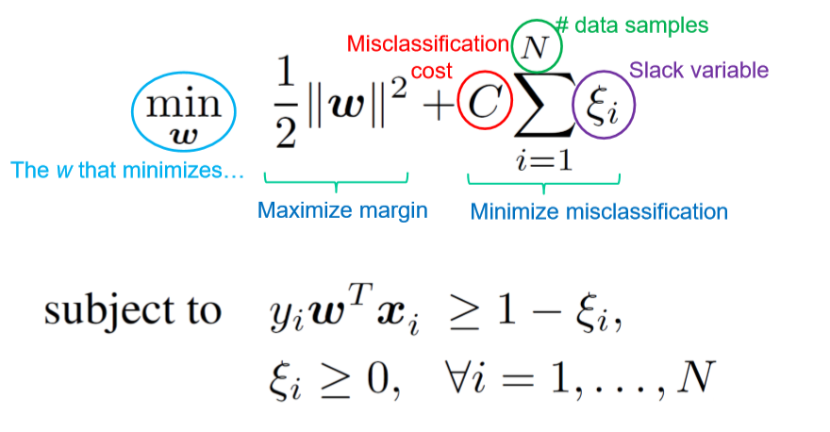
Soft Margin

Slide 21
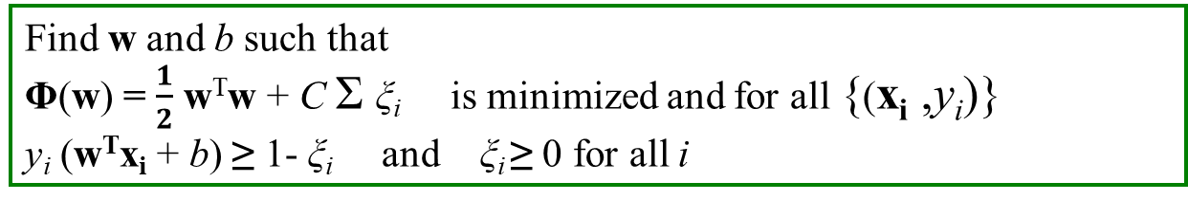
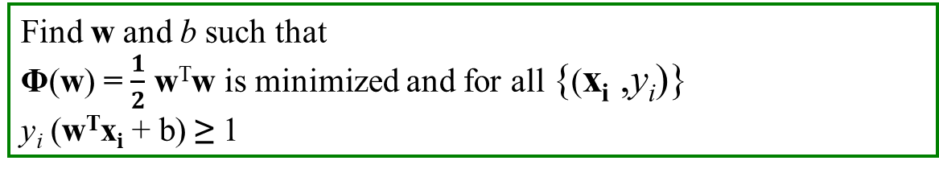
Hard Margin vs Soft Margin
Hard Margin:
Soft Margin incorporating slack variables:
Parameter C can be viewed as a way to control overfitting.
Find w and b such that
Φ(w) = $\frac{1}{2}$ w^{T}w is minimized and for all {(x_{i} ,y_{i})}
y_{i} (w^{T}x_{i} + b) ≥ 1
Find w and b such that
Φ(w) = $\frac{1}{2}$ w^{T}w + C Σ ξ_{i} is minimized and for all {(x_{i} ,y_{i})}
y_{i} (w^{T}x_{i} + b) ≥ 1- ξ_{i} and ξ_{i} ≥ 0 for all i
Ref: https://towardsdatascience.com/support-vector-machines-soft-margin-formulation-and-kernel-trick-4c9729dc8efe

Slide 22
Effect of Margin size v/s misclassification cost
Using a high C value the classifier makes fewer margin violations but ends up with a smaller margin.
Using a low C value the margin is much larger, but many instances end up on the street.
Generalizes better

Slide 23
Support Vector Machines in overlapping class distributions & Kernels

Slide 24
Non-linear SVMs
Datasets that are linearly separable with some noise soft margin work out great:
But what are we going to do if the dataset is just too hard?
How about… mapping data to a higher-dimensional space:
0
x
0
x
x²
0
x

Slide 25
The “Kernel Trick”
The linear classifier relies on dot product between vectors
  x_{i}^{T} . x_{j}
If every data point is mapped into high-dimensional space via some transformation Φ: x → φ(x), the dot product becomes:
K(x_{i}, x_{j})= φ(x_{i})^{T} φ (x_{j})
A kernel function is some function that corresponds to an inner product in some expanded feature space.

Slide 26
SVM Kernels
SVM algorithms use a set of mathematical functions that are defined as the kernel.
Function of kernel is to take data as input and transform it into the required form.
Different SVM algorithms use different types of kernel functions. Example linear, nonlinear, polynomial, and sigmoid etc.

Slide 27
Non-linear SVMs:
Feature spaces
General idea: the original input space can always be mapped to some higher-dimensional feature space where the training set is separable:
Φ: x → φ(x)

Slide 28

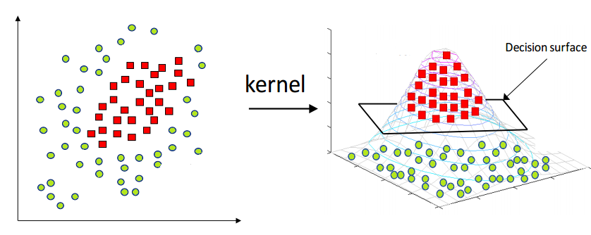
Kernel Trick

Slide 29
Examples of Kernel Functions
Linear: K(x_{i},x_{j})= x_{i} ^{T}x_{j}
Polynomial of power p: K(x_{i},x_{j})= (1+ x_{i} ^{T}x_{j})^{p}
Gaussian (radial-basis function network):
Sigmoid: K(x_{i},x_{j})= tanh(β₀x_{i} ^{T}x_{j} + β₁)

Slide 30
Nonlinear SVM - Overview
SVM locates a separating hyperplane in the feature space and classify points in that space
It does not need to represent the space explicitly, simply by defining a kernel function
The kernel function plays the role of the dot product in the feature space.

Slide 31
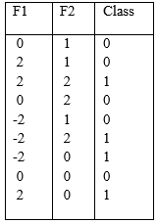
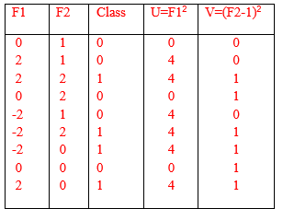
Example

Slide 32
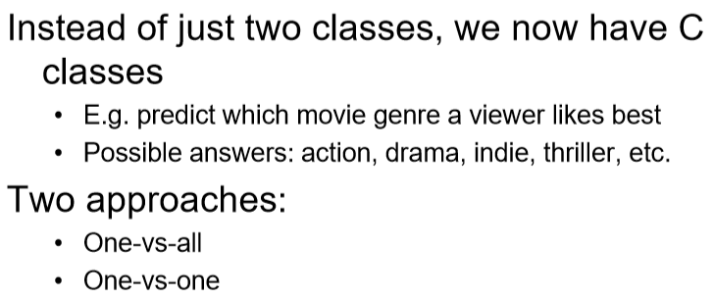
Multi-Class Problem

Slide 33
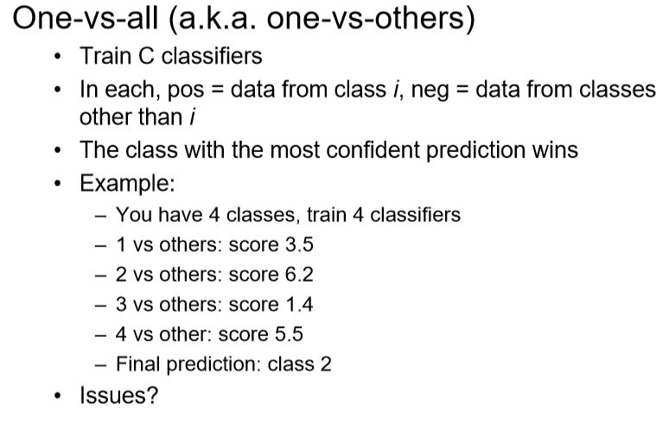
Multi-Class Problem

Slide 34
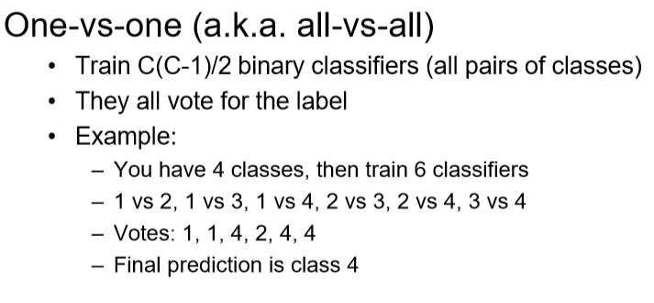
Multi-Class Problem

Slide 35
Good Web References for SVM
http://www.cs.utexas.edu/users/mooney/cs391L/
https://www.coursera.org/learn/machine-learning/home/week/7
https://data-flair.training/blogs/svm-kernel-functions/
MIT 6.034 Artificial Intelligence, Fall 2010
https://stats.stackexchange.com/questions/30042/neural-networks-vs-support-vector-machines-are-the-second-definitely-superior
https://www.sciencedirect.com/science/article/abs/pii/S0893608006002796
https://medium.com/deep-math-machine-learning-ai/chapter-3-support-vector-machine-with-math-47d6193c82be
Radial basis kernel

