Slide 1
Applied Machine Learning
Revision (Mid-sem)
Anita Ramachandran

Slide 2
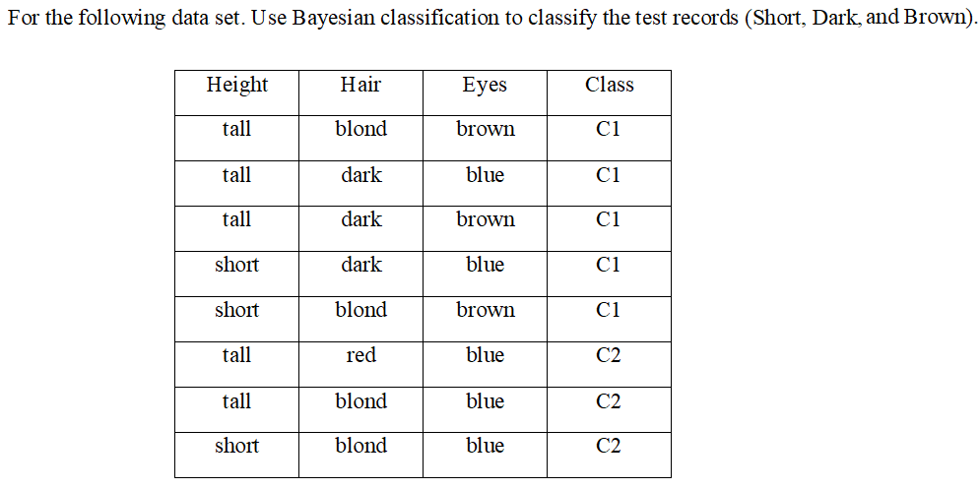
Question 1

Slide 3
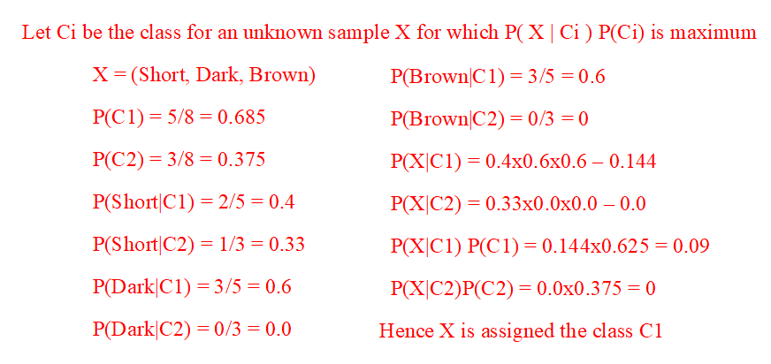
Solution 1

Slide 4
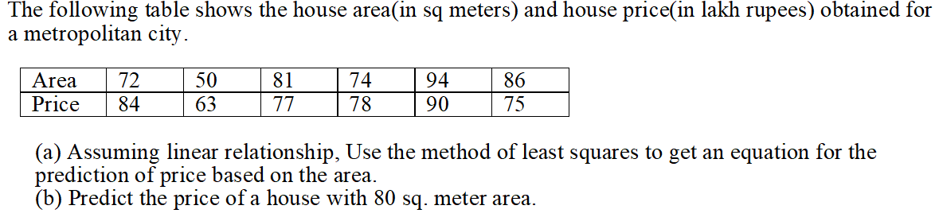
Question 2

Slide 5
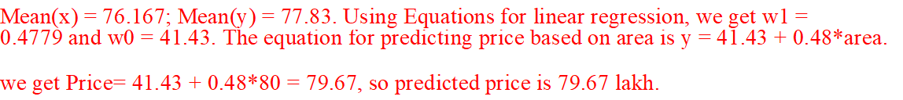
Solution 2

Slide 6
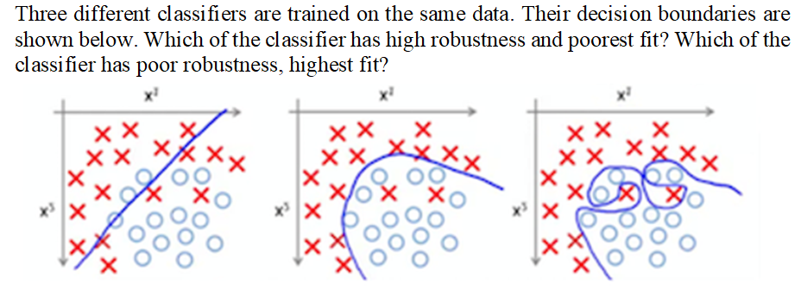
Question 3

Slide 7
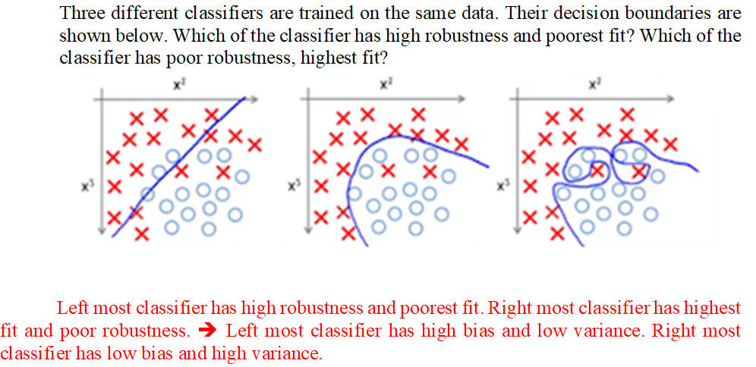
Solution 3

Slide 8
Question 4
Vijay is a certified Data Scientist and he has applied for two companies -Google and Microsoft. He feels that he has a 60% chance of receiving an offer from Google and 50% chance of receiving an offer from Microsoft. If he receives an offer from Microsoft, he has belief that there are 80% chances of receiving an offer Google.
If Vijay receives an offer from Microsoft, what is the probability that he will not receive an offer from Google?
What are his chances of getting an offer from Microsoft, considering he has an offer from Google?

Slide 9
Solution 4
Vijay is a certified Data Scientist and he has applied for two companies -Google and Microsoft. He feels that he has a 60% chance of receiving an offer from Google and 50% chance of receiving an offer from Microsoft. If he receives an offer from Microsoft, he has belief that there are 80% chances of receiving an offer Google.
If Vijay receives an offer from Microsoft, what is the probability that he will not receive an offer from Google?
What are his chances of getting an offer from Microsoft, considering he has an offer from Google?
Ans
P(not g| m) = 0.2
P(M|G)=0.67
Notes:
P(not G | M) = 1-0.8 = 0.2
P(M|G) = P(G|M) P(M) / P(G) = 0.8 x 0.5 / 0.6

Slide 10
Question 5
From an insurance company, people have purchased the travel insurance to be safe and experiencing the world. The below dataset describes the listing purchase transactions in 2015. List at least 6 issues with the below available dataset which are required for Data Pre-processing.

Slide 11
Solution 5
1st and 3rd row are duplicate, should be removed.
‘n/a’ replace with Mean and blank profession should replaced with Mode.
Age & Date of birth are duplicate columns
Sum Insured amounts are in different currencies, should be in same currency.
Date of Purchase & Date of Birth are in different format
₹ 0 Sum Assured should be replaced with the mean value

Slide 12
Question 6
Solve the below and find the equation for hyper plane using linear Support Vector Machine method. Positive Points: {(3, 2), (4, 3), (2, 3), (3, -1)} Negative Points: {(1, 0), (1, -1), (0, 2), (-1, 2)}

Slide 13
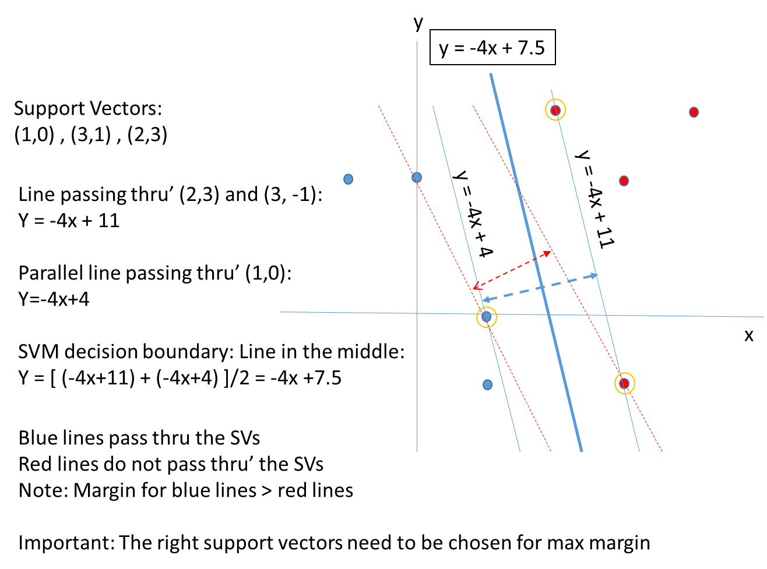
Solution 6
Solve the below and find the equation for hyper plane using linear Support Vector Machine method.
Positive Points: {(3, 2), (4, 3), (2, 3), (3, -1)}
Negative Points: {(1, 0), (1, -1), (0, 2), (-1, 2)}

