Slide 1

Fundament of Simulation Methods

Slide 2
Introduction to Simulation Methods
Simulation:
Numerical Integration of eq describing physical and astrophysical system.
Often involves ODEs or PDEs
Used when analytical solutions are impractical of infeasible.
Concept of ODEs:
ODEs are ubiquitous in physics and astrophysics.
Ex: N’s eq of Motion
Simple Pendulum
Damped Harmonic Oscillation
Radioactive decay
RC Circuit
Population Growth Models
Orbital Decay of Binary Stars.

Slide 3
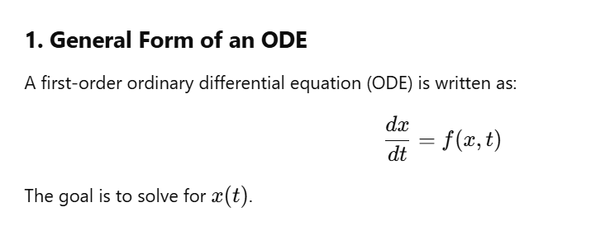

Slide 4
3. Euler’s Method
Basic approach: Uses Taylor expansion to approximate the function at time t+ht + ht+h.
Equation:
Key points:
Simple first-order method.
Errors scale as h².
Works well for small step sizes h, but increasing precision means increasing computation time.
4. Implicit vs. Explicit Euler Method
Explicit Euler Method:
Computes the next step using only known values.
Prone to instability for large step sizes.
Implicit Euler Method:
Computes next step using unknown future values.
Requires solving an equation at each step, often using Newton-Raphson iteration.
More stable than explicit methods.

Slide 5
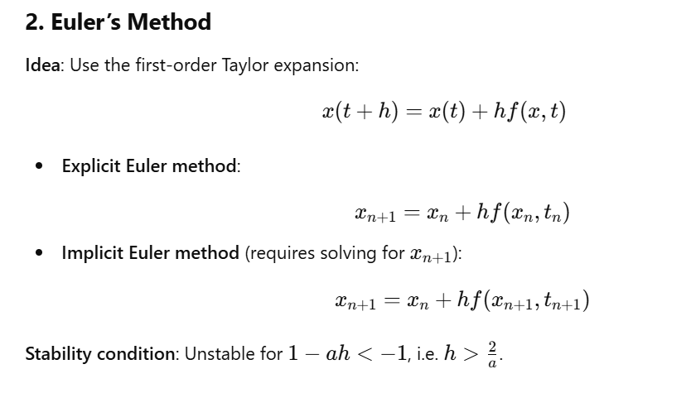

Slide 6
5. Midpoint Method
Improvement over Euler’s Method:
Estimates derivative at the midpoint of the interval (t+h/2)(t + h/2)(t+h/2) instead of at ttt.
Error scales as h3h^3h3 (second-order accuracy).
Implementation challenge:
Requires knowing x(t+h/2)x(t + h/2)x(t+h/2), which is unknown.
Solution: Approximate it using Euler’s method.
6. Runge-Kutta Methods
Generalization of Euler’s method to higher-order accuracy.
Evaluates derivatives at multiple intermediate points in each step.
Types:
RK2 (Second-order Runge-Kutta, related to midpoint method).
RK4 (Fourth-order Runge-Kutta, widely used due to high accuracy with moderate computation cost).

Slide 7
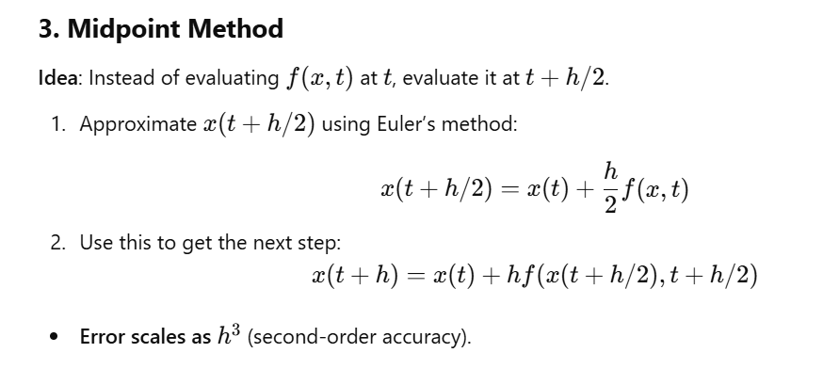

Slide 8
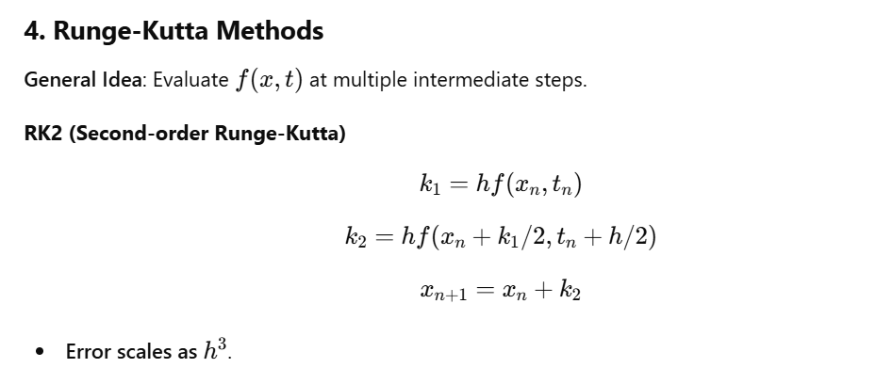
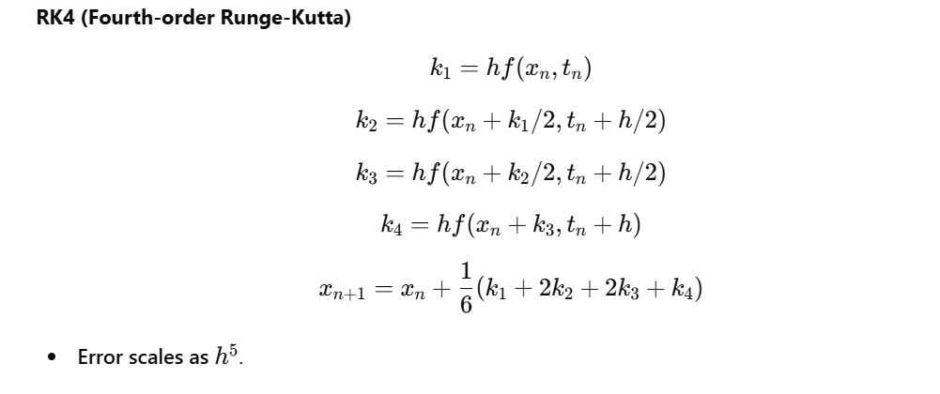

Slide 10
8. Systems of ODEs
When multiple ODEs are coupled (e.g., x and y depend on each other), they must be solved simultaneously.
Example: SIR model for pandemics:
Describes how diseases spread in a population using:
S(t)S(t)S(t) (susceptible fraction).
I(t)I(t)I(t) (infected fraction).
R(t)R(t)R(t) (recovered fraction).
9. Second-Order and Higher-Order ODEs
Higher-order ODEs (like Newton’s equations) can be rewritten as first-order systems.
Example: Simple Pendulum equation.
Example: Newton’s equations of motion in a binary star system.

Slide 11
10. Astrophysical N-Body Problem
Solving the N-body problem numerically:
Newton’s gravitational equations govern motion.
Requires solving 6 ODEs per star (3 for position, 3 for velocity).
Typically solved using Runge-Kutta or Midpoint methods.
Historical Background:
Bernoulli (1710) solved for N=2N = 2N=2.
King Oscar II of Sweden (1885) posed a challenge to solve for N>2N > 2N>2.
Qiudong Wang (1991) found a power series solution, but it was impractical.
Modern approach: Solve numerically using ODE solvers.
11. Computational Implementation
Python Implementation:
Uses numpy and scipy.integrate to solve ODEs efficiently.
Vectorized operations for handling large N-body simulations.

