Slide 1
Proposed Solutions for Dam Inspections
<number>

Slide 2
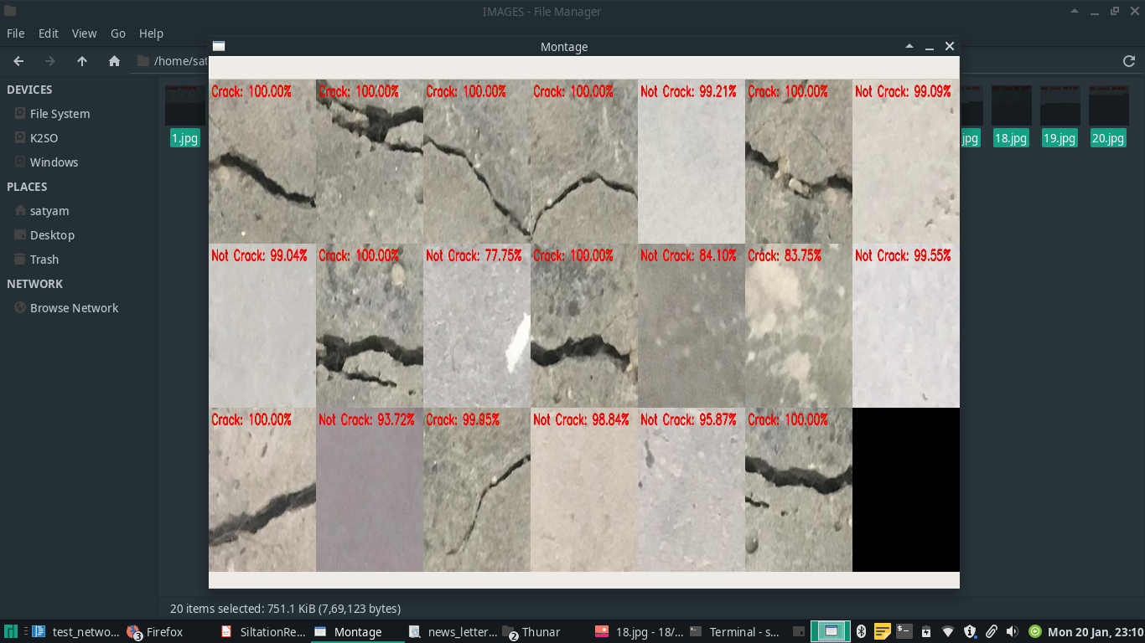

Slide 4
Brief structure:
1.Two siltation removing modules.
2.Made up of a draft tube and a thruster.
3.The thruster pumps clear water from the top of the draft tube to the bottom forming a water jet to remove the silts and sediments.
4.The ROV has an underwater camera and underwater light to capture the image, placed in a transparent container filled with clear water.

Slide 5
Working-Step 1

Slide 6
Step-2

Slide 7
Step- 3

Slide 8
Step-4

Slide 9
Sediment sizes
Boulder >256mm
Cobble 64-256mm
Pebble 2-64mm
Sand 1/16-2mm
Silt 1/256-1/16mm
Clay <1/256mm

