Slide 1
Custom AI-Powered Conversational Chat BOT
10 JUNE 2025
Aman Patial
aman.patial@gmail.com

Slide 2
KEY POINTS
AGENDA
Introduction
Benefits
RAG Architecture
Technical Stack
Tuning Parameters
Sneak Peek
Comparison
Costing

Slide 3
INTRODUCTION
Custom AI Bot
An AI-powered conversational bot that answers user questions based on the content of uploaded private PDF/TEXT documents. It uses OpenAI’s GPT-4 for language understanding and FAISS/PINECONE for document storage and retrieval, enabling natural language Q&A over private, unstructured PDF data.

Slide 4
Customization Significance
Benefits
Tailoring User Experience Enables chatbots to adapt to individual user preferences, ensuring a more engaging interaction to specific needs and styles.
Enhancing Business Objectives Businesses can align interactions with strategic goals, and improving conversion rates
Cheaper long-term You avoid sending full documents to OpenAI every time.
Privacy You control your data; only relevant snippets are shared with OpenAI.
Scalable Works well even if you have 100s of documents.
Faster response time due to smaller prompts.
Context-aware Provides targeted answers from your data, not general knowledge.

Slide 5
RAG - Retrieval-Augmented Generation
Introduction
RAG model combines information retrieval and natural language generation, enabling chatbots to access external data sources while generating human like responses.
RAG models are increasingly used in customer support and virtual assistants, allowing chatbots to provide accurate information and personalized responses based on extensive knowledge bases.

Slide 6
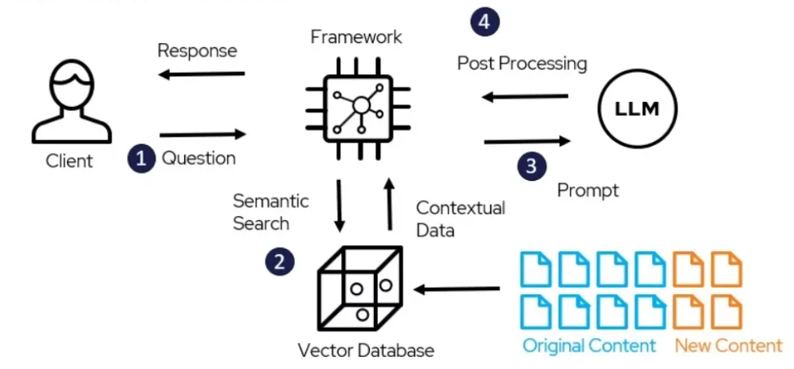
RAG Architecture
Abstract

Slide 7
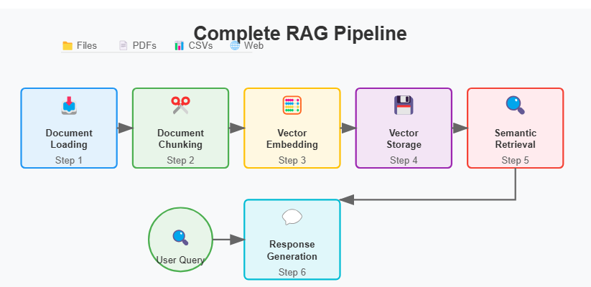
RAG Data Pipeline
Data Flow

Slide 8
RAG Overall
Data Pipeline & Retrieval

Slide 9
Tuning Parameters
Key Flow
🔍 Indexing
💾 Storing
🔎 Retrieval
✨ Synthesis
✅ Evaluation
The choice of embedding model
Database Selection
Retrieval Paradigms
Conditional Generation
Manual Evaluation
The embedding dimension
The embedding dimension
Retrieval Models
Result Rewriting
Automated Evaluation
Text Preprocessing
Storage Layout
Retrieval Fusion
Multimodal Generation
Test Sets & Benchmarks
Meta Data Indexing
Sharding & Distribution
Query Reformulation
Generating Structured Outputs
Online Evaluation
Removing duplicate
Deploying and maintaining vector databases
Result Pruning
Controllable Generation Techniques
Human-AI Team Evaluation
Iterative Generation
Cost/Complexity Analysis

Slide 10
TECHNICAL STACK
High Level
Web UI (User Interface) - Streamlit
Open Source Framework – LangChain
NLP (Natural Language Processing) Engine - Open AI / Claude AI / Gemini / Grok
Embedding Model - Open AI / Claude AI/Gemini / No Open AI
Vector Database – FIASS (local) / Pinecone
Programming Language – Python 3

Slide 11
Sneak Peek
Demo
Streamlit web using FAISS vector store using Langchain framework
Command Line Document Loader Pipeline & FAISS ( Facebook Vector database), OpenAI Web Interface, FIASS
Command Line Document Loader Pipeline & PINE CONE , pine cone web interface

Slide 12
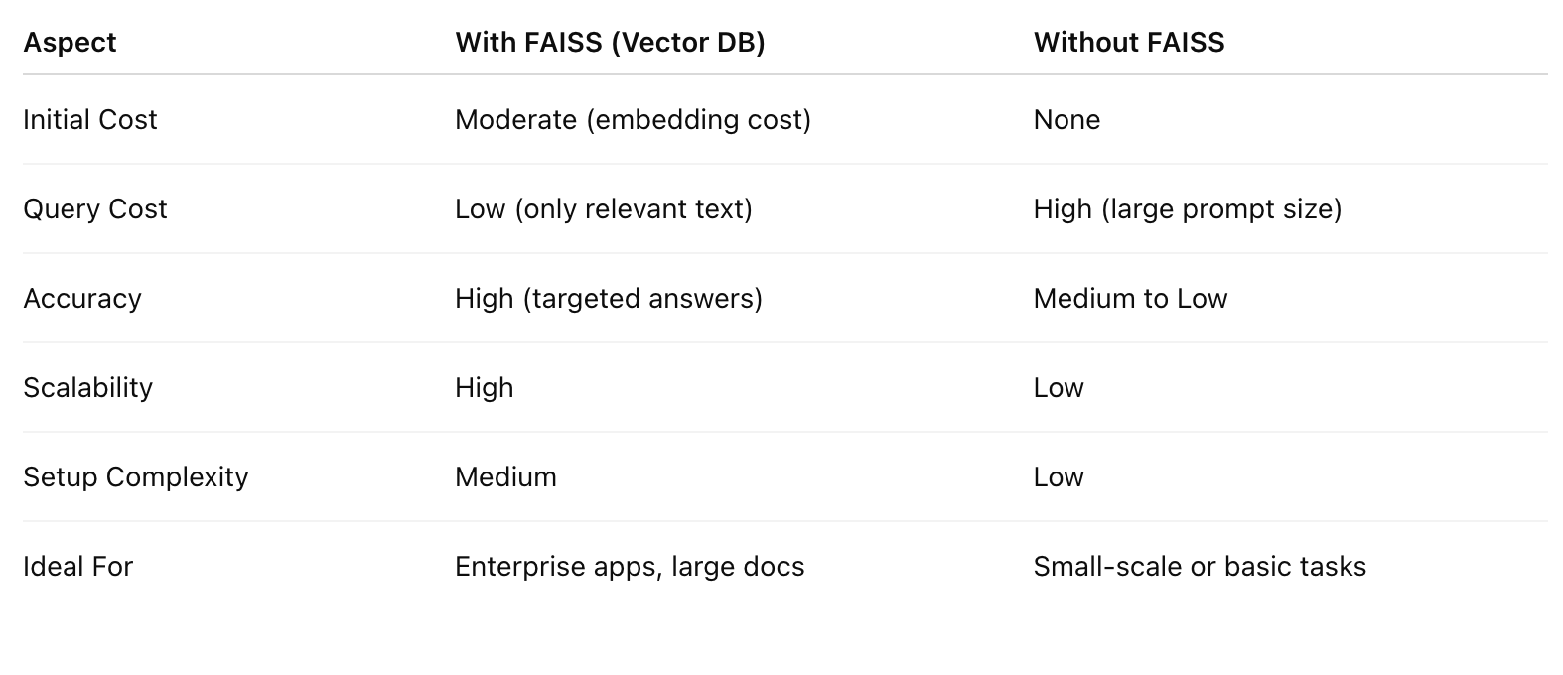
Custom vs Readily Available Solutions
Key Comparisons
Conclusion -Using FAISS with OpenAI is ideal for document-based Q&A systems. It’s more accurate, scalable,
and cost-efficient — perfect for enterprise or production-grade AI applications.

Slide 13
Cost
Guestimates
Embedding cost (one-time): ~$0.10 per 1,000 tokens (text → vector).
Storage cost: Minimal or none (FAISS is in-memory, self-hosted) but little costly in case managed services (Pinecone)
OpenAI API cost: Based only on the size of prompt and response — typically much smaller because only relevant parts of the document are sent.
Self host cost Infrastructure data pipeline and web
Development and testing cost

Slide 14
Thanks
THANK YOU !

