Slide 1

CASE STUDY
PrimeRx Flow
Submitted by Group 10
Team members : Manya Pahwa
Aman Patil
Shakir Lala
Notes:
1

Slide 2
Business & Case Study Overview
BUSINESS OVERVIEW
WHAT WE SET OUT TO IDENTIFY
PrimeRx is a pharmaceutical company operating across the U.S. healthcare landscape. Its flagship product, Nexavir (DRG001), addresses a high-need therapy area with broad prescriber adoption.
We have been asked to analyze PrimeRx's Rx flow, HCP, account, sales, and clinical alert data collected over the last 18 months, and to recommend where the sales team should focus to capture the most valuable commercial opportunities.
1
HCPs and accounts with high alert AND prescription activity
2
Doctors with strong clinical signals but few or no prescriptions
3
Accounts with low prescription activity relative to their doctor base
4
HCPs and accounts the sales team should prioritize next quarter
THE CORE PROBLEM
Doctors are diagnosing patients who may need treatment but not all of them are prescribing our drug. The gap between clinical signal and prescribing behavior is where the commercial opportunity lives.
GOAL
Connect diagnostic activity with prescribing behavior and translate the insights into a clear, data-driven action plan.
2
Notes:
2

Slide 3
Datasets Overview
Three datasets capture different stages of the patient treatment journey and are linked by HCP_ID. Connecting clinical activity to prescribing behavior surfaces missed opportunities and actionable strategies.
Dataset | Rows | Key Columns | Purpose
Alerts | 9,537 | Alert_ID, Alert_Date, HCP_ID, Lab_Result | Clinical alerts tied to doctors indicating potential treatment need
Sales | 5,917 | Prescription_ID, Prescription_Date, HCP_ID, Drug_Name, Drug_ID, Prescription_Volume | Prescription activity across doctors and drugs
Affiliation | 216 | HCP_ID, Account_ID, Account_Name | Maps doctors to hospitals / clinics / accounts
Join key: All three datasets link on HCP_ID. Affiliation extends the join to Account_ID / Account_Name for account-level rollups.
3
Notes:
3

Slide 4
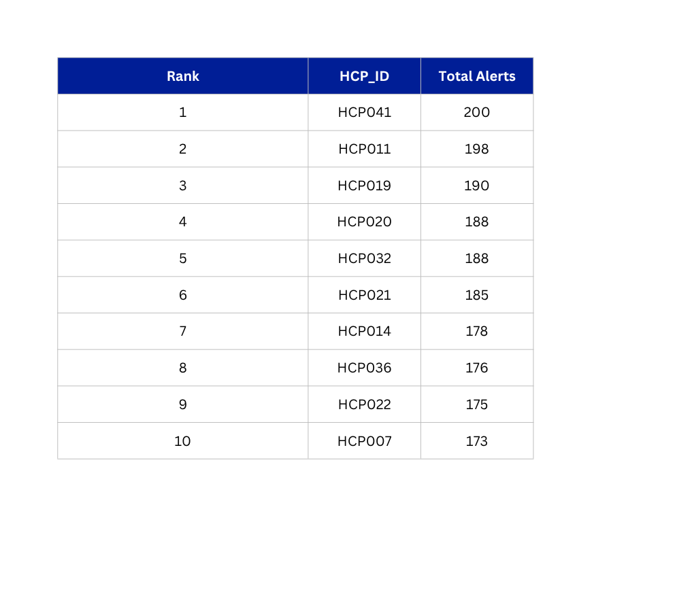
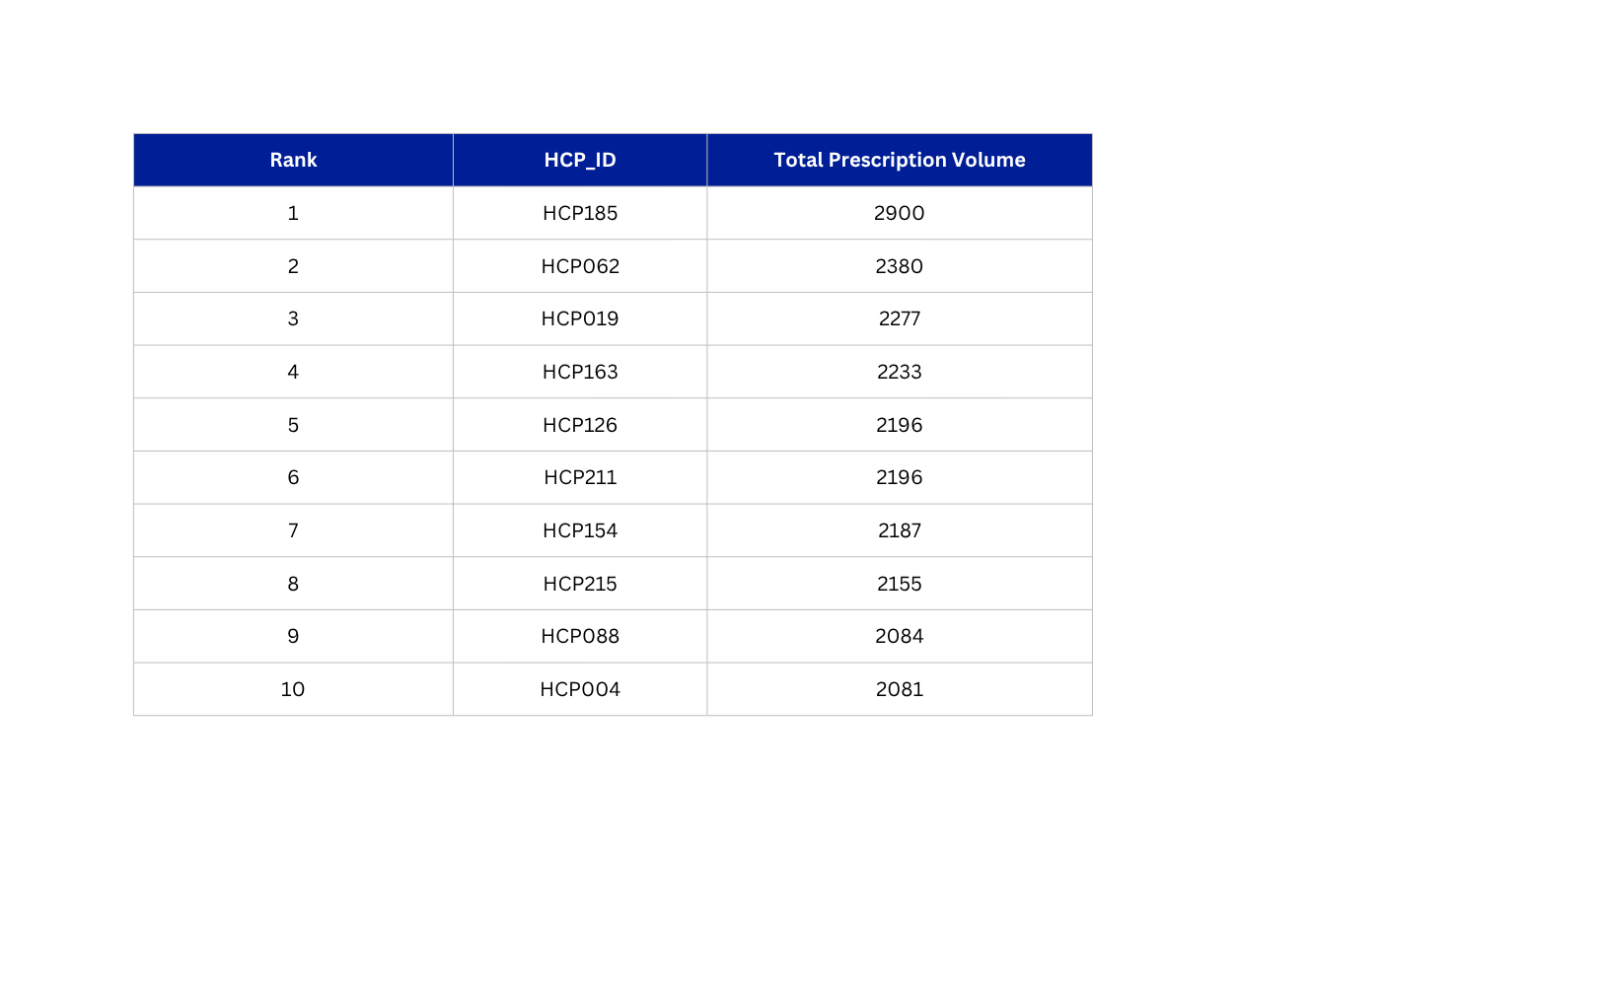
QUESTION 1
Who Are the Most Active Doctors — Are They Helping Our Product?
RANKING 1 — TOP 10 BY ALERT VOLUME
RANKING 2 — TOP 10 BY PRESCRIPTION VOLUME
The Operational Gap: The highest alert doctors are not the same people driving the most volume for us.
That gap is the whole case study in one-chart; strong clinical case is not translating into our prescription for our loudest alerting doctors.
4
Notes:
4

Slide 5
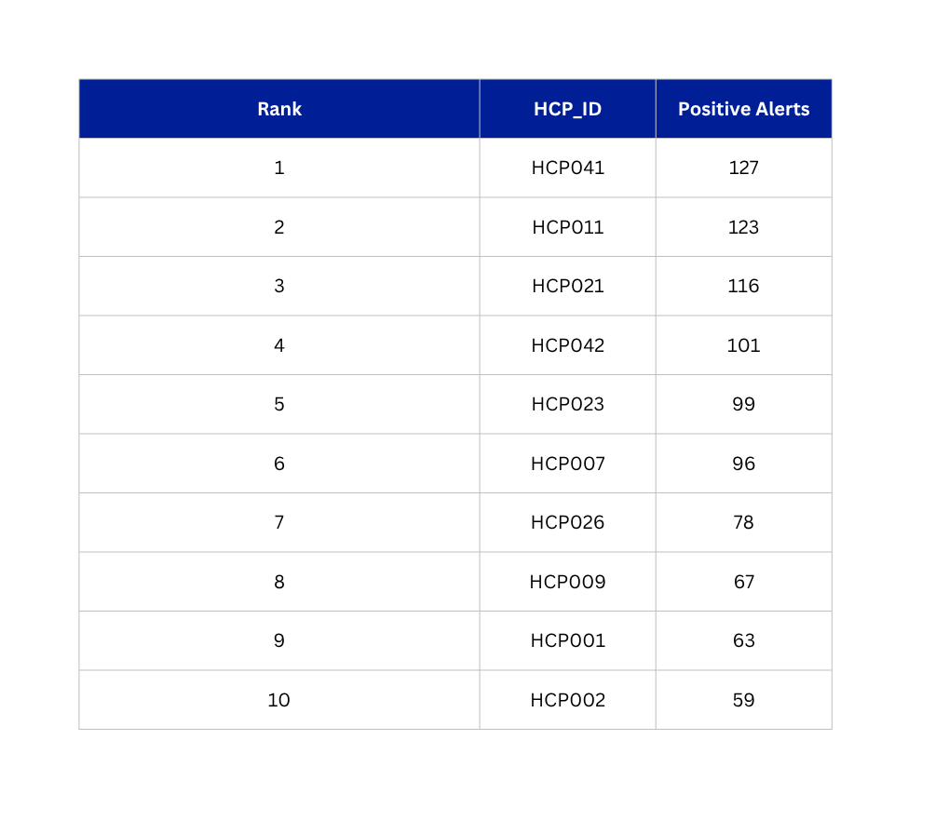
QUESTION 2
Which Doctors See the Need but Don't Act on It?
Positive-alert doctors with zero prescribing activity in the 30 days following their first positive alert.
TOP 10 — NO 30-DAY FOLLOW-UP RX
CONVERSION FUNNEL
≥ 1 Positive Alert
n = 214
Multiple Positive Alerts
n = 198
Multiple Alerts, Zero 30-Day Rx
n = 68
INSIGHTS
  34% of repeat positive alerts HCPs never wrote a script within 30days.
  68 doctors show a repeated undeniable clinical need signal(multiple positive alerts) yet prescribe no drug within 30 days. This is the sharpest “need but” no action cohort in the data.
  HCP041 and HCP011 appear here and in the previous question top alert list-- our highest signal doctor are also our most silent prescribers.
5
Notes:
5

Slide 6
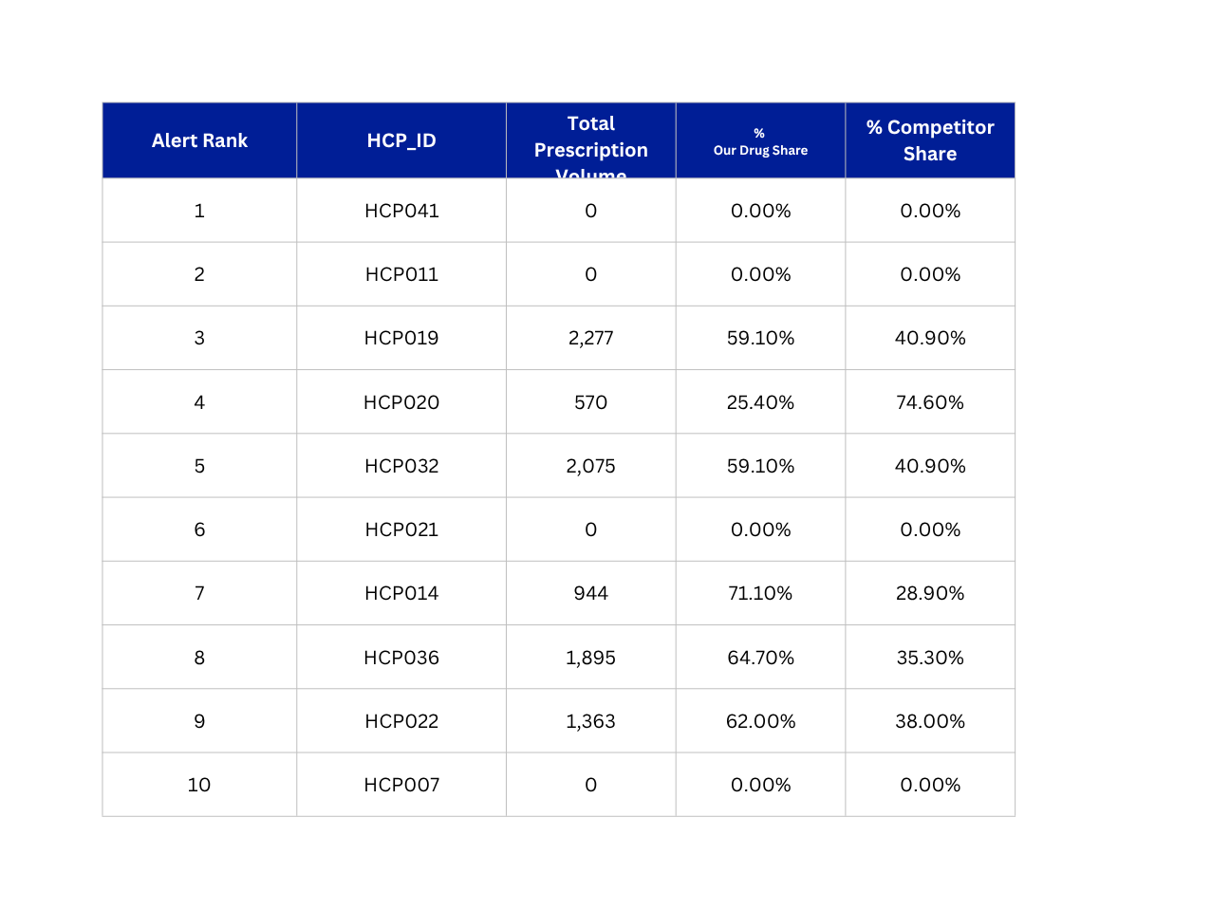
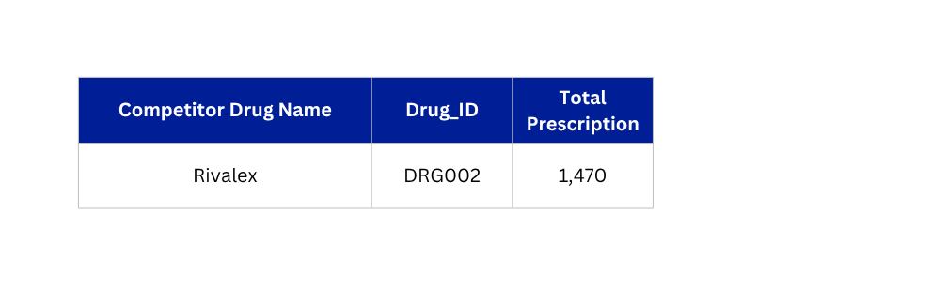
QUESTION 3
Among Our Top Doctors, How Much Business Goes to Competitors?
Top 10 alert-volume HCPs from Q1 — prescription mix between DRG001 and competitor drugs.
MOST-PRESCRIBED
COMPETITOR DRUG
INSIGHTS
  3 of the top 10 alert HCPs (HCP041, HCP011and HCP 021) handed out 0 prescription of any kind pure share loss but not competitor loss.
  Rivalex (DRG002) is the single biggest cometitor threat among our highest signal doctors, out prescribing us head-to-head where we should be winning by right off clinical fit.
6
Notes:
6

Slide 7
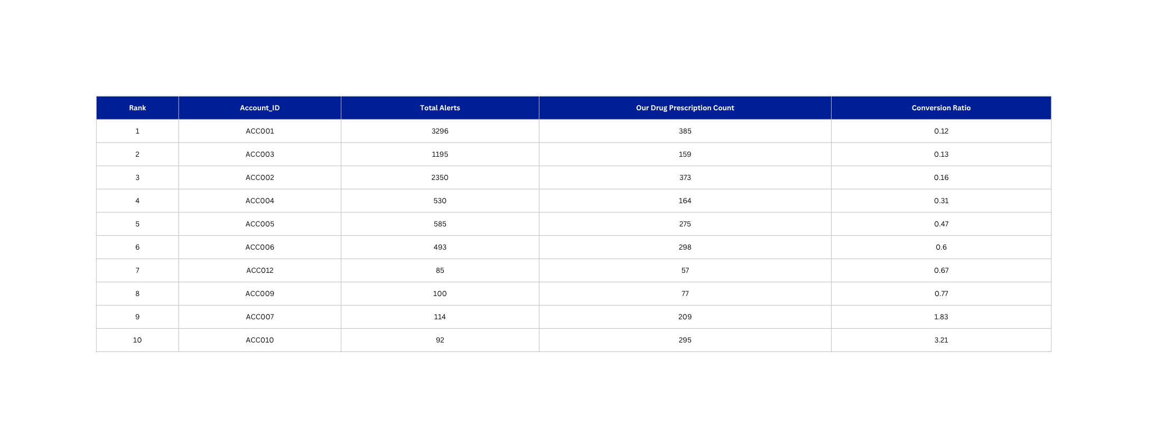
QUESTION 4
Which Hospitals Are Sitting on the Biggest Untapped Opportunity?
Top 10 accounts by alert volume, ranked by lowest prescription conversion ratio.
Conversion Ratio = Our Drug Prescription Count ÷ Total Alert Count. Lower ratio = higher untapped opportunity.
INSIGHTS
  ACC001(Northside General Hospital) leads alert volume but convert at just 0.12 RX per alert – the single largest revenue gap in the hospital network.
  The Top 3 accounts by alert volume all sit under a 0.16 conversion ratio meaning where clinical demand is loudest, our capture is weakest, this is targeting priority list.
7
Notes:
7

Slide 8
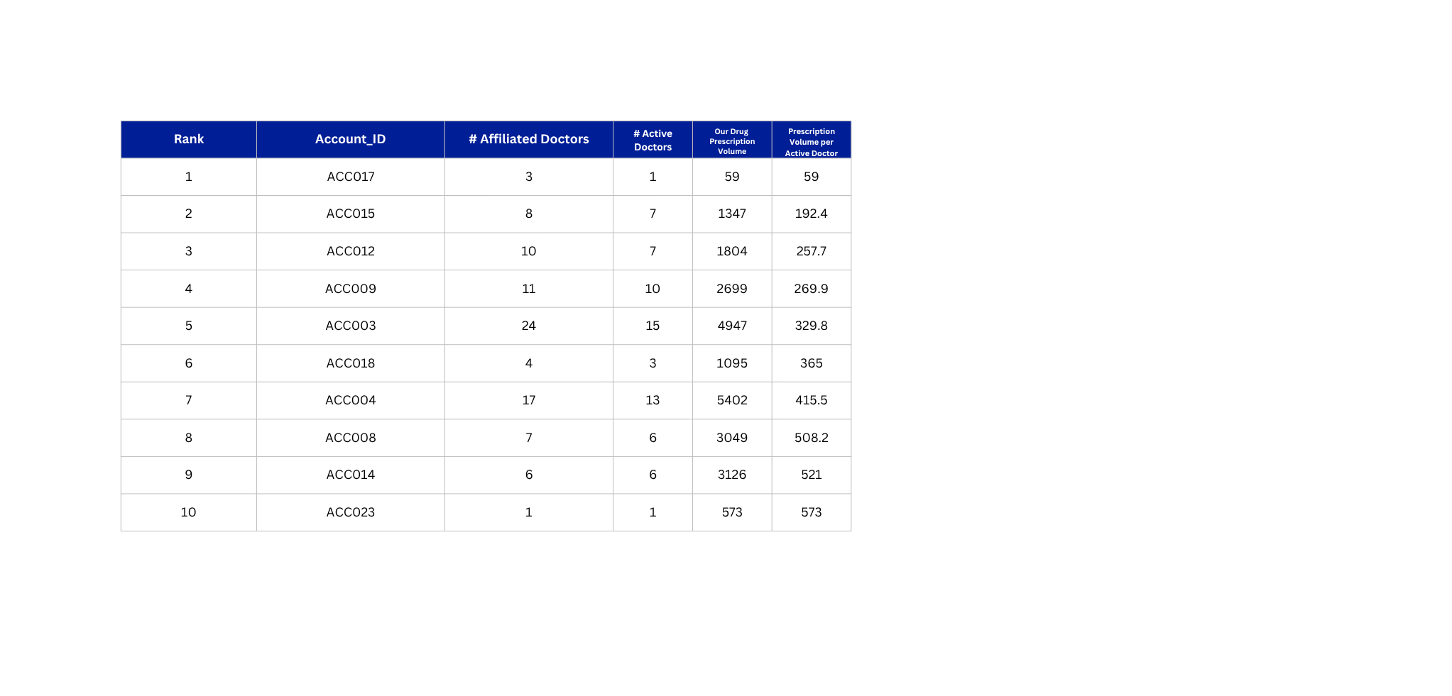
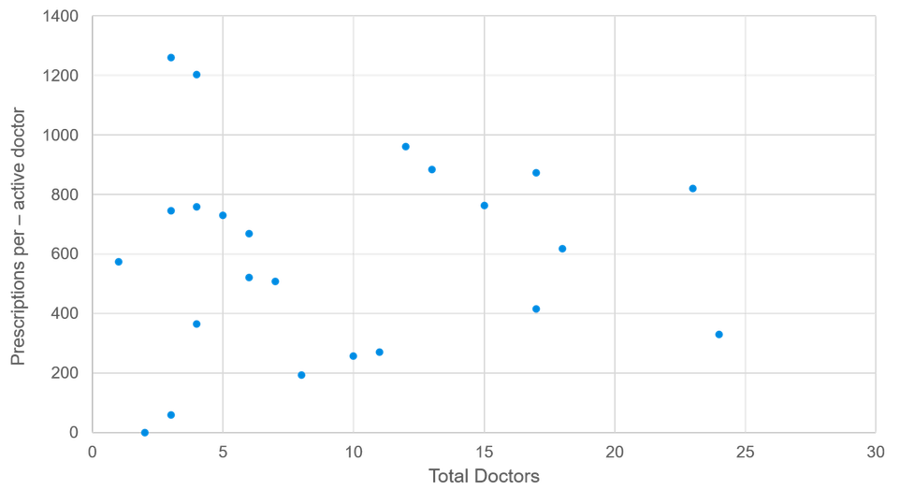
QUESTION 5
Which Accounts Represent the Largest Untapped Prescription Opportunity?
Top 10 accounts by lowest prescriptions-per-active-doctor ratio, with account size vs. efficiency view.
ACCOUNT SIZE VS. RX EFFICIENCY
INSIGHTS
  Large accounts (20+ affiliated doctors, e.g. ACC001, ACC003) don't guarantee efficiency – ACC003 has 24 doctors but only ~330 Rx/active doctor, well below several 10-15 doctor accounts.
  ACC022 (2 doctors) has zero active DRG001 prescribers – complete white space despite generating alerts.
  Smaller accounts show the widest efficiency spread (from 59 to 1,261 Rx/active doctor), signalling rep-level execution gaps rather than account potential.
  Priority: pair account-expansion effort in large, low-efficiency accounts with focused conversion effort in small, zero/low-efficiency accounts.
8
Notes:
8

Slide 9
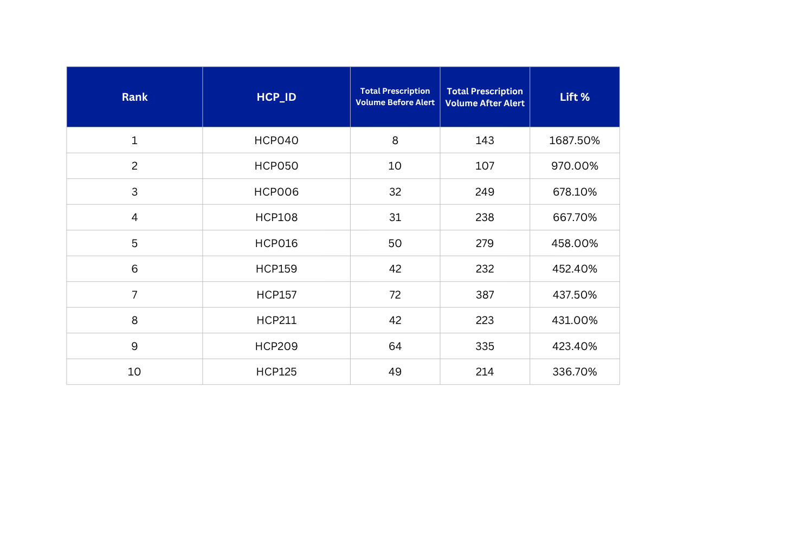
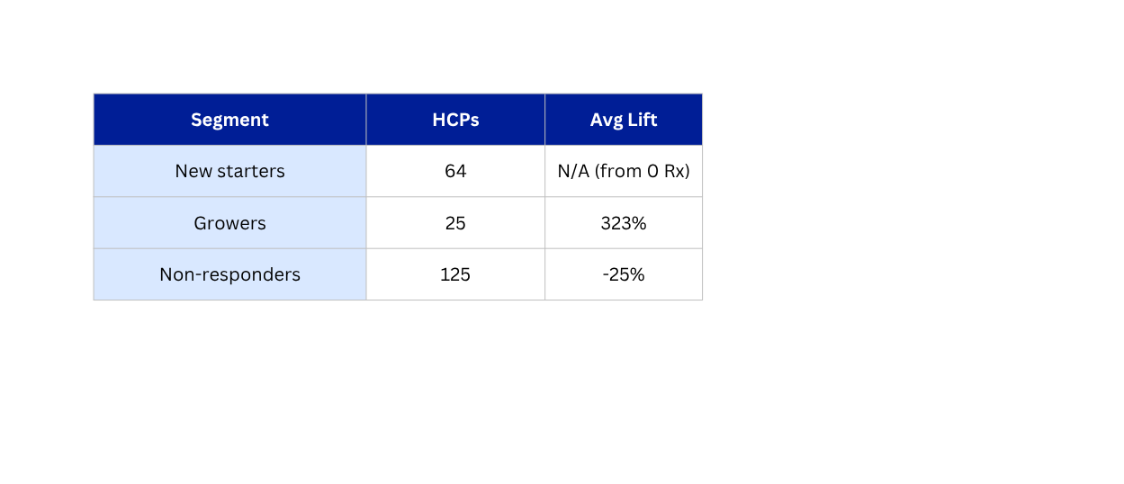
QUESTION 6
Did Alerts Change Doctor Behavior — Before vs. After?
PART A — HCP-LEVEL LIFT (90 DAYS BEFORE / AFTER)
PART B — SEGMENT SUMMARY
INSIGHTS
  The top lift HCPs where low colums prescribers who become meaningfully more active after their first positive alerts-- clearly work as a trigger for existing prescribers.
  None of the previous highest alert HCPs 041,011 appear here confirming they remain non responders even after repeated clinical signals.
Formula
Lift% : (Post Prescription Volume – Pre Prescription Volume) / (Pre Prescription Volume) * 100
  New starters: pre=0, post>0
  Growers: pre>0 and lift% ≥ +20%
  Non-responders: Everything else
10
Notes:
10

Slide 10
QUESTION 7
Commercial HCP Prioritization — Field Force Allocation
40 reps * 20 days/mo * 8 calls/day * 3months— Total rep call capacity per quarter.
Total Capacity / Qtr
=19200 calls/qtr
Segment | HCPs | Suggested % of Calls | Est. Quarterly Calls | Est. Rep Allocation
New Starters | 64 | 40% | 7680 | 16 reps
Growers | 25 | 45% | 6720 | 14 reps
Non-Responders | 125 | 15% | 4800 | 10 reps
Total | 214 | 100% | 19200 | 40 reps
Rationale: High priority for growers – Proven +323% lift, protect momentum & defend vs competitors. Largest share New Starters greatest strategic upside to lock in habitual prescribing. Non-Responders receive lower, selective coverage – weak – 68% avg lift indicates limited call responsiveness; triage to their highest-alert sub-segment.
Trade-off: Capacity is deliberately shifted away from Non-Responders (broadest reach, 125 HCPs, but lowest conversion probability) to Growers and New Starters, where conversion probability and growth potential are known or emerging – choosing lower overall reach in exchange for higher expected ROI per call.
INSIGHTS
11
Notes:
11

Slide 11
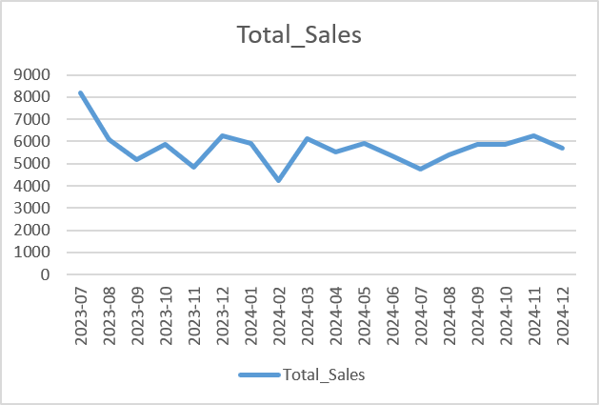
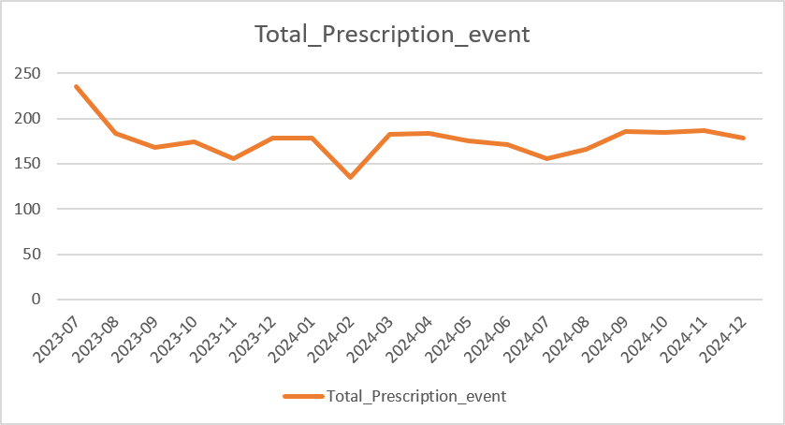
Nexavir Monthly Trend
INSIGHTS
  Steep early decline, then plateau. Volume falls from 8,204 (Jul 2023) to 4,825 (Nov 2023) — a ~41% drop in the first 5 months — before settling into a stable band of roughly 4,800–6,300/month for the remaining 13 months. This reads as post-launch normalization rather than ongoing decline: the business is flat, not shrinking.
  No organic growth trend across 18 months. Dec 2024 (5,711) ends almost exactly where the post-launch baseline sat in late 2023/early 2024 — there's no sustained upward trajectory in aggregate volume. This is the key strategic tension the case is built around: if topline Rx volume isn't growing on its own, the alert-to-treatment pathway (Q6) is the identifiable lever actually available to drive growth, since Growers showed +323% lift when alerts converted.
11
Notes:
11

Slide 12
Summary
  Clinical Disconnect: 68 HCPs with multiple positive alerts wrote zero prescriptions, and 4 of the top 10 highest-alerting doctors prescribe nothing.
  Competitive Leakage: Competitors, primarily Rivalex, are capturing up to ~75% of the prescription volume among our top-alerting doctors.
  Alert Effectiveness: Alerts successfully drive a +323% volume lift for "Growers" and converted 64 "New Starters," but "Non-responders" show strong resistance.
  Account Inefficiencies: Large accounts do not guarantee efficiency; massive accounts like ACC001 yield high alerts but a near-zero (0.12) conversion ratio.
SITUATION
KEY INSIGHTS
  PrimeRX need to optimize the commercial strategy for its flagship drug, Nexavir(DRG001). Analysis of clinical alerts, sales and affiliation data over the last 18 months reveal a gap, doctors are diagnosing patients with high clinical needs but not all of them prescribing Nexavir. The commercial team needs a data driven action plan to deploy its field force of 40 sales reps efficiently to capitalise on the most valuable opportunities.
RECOMMENDATION
EXPECTED IMPACT
  Targeted Rep Allocation: Shift the 19,200 quarterly sales rep calls to prioritize high-yield segments, allocating 40% to New Starters and 35% to Growers. Reduce Non-responder coverage to 25%, triaging only their highest-alert sub-segment.
  Immediate Outreach Sprints: Launch a dedicated outreach sprint specifically targeting the 68 multi-alert/zero-prescription HCPs and the 4 top-alerting doctors who currently write zero prescriptions.
  Competitive Positioning: Deploy direct "win-back" messaging against Rivalex for those high-alert doctors who currently split their market share.
  Account-Level Audits: Re-audit large, underperforming hospitals (like ACC001 and ACC003) for account-level barriers such as formulary restrictions or administrative hurdles, rather than simply increasing sales calls to those doctors.
  Maximized ROI: By deliberately accepting lower total reach (reducing calls to the 125 Non-responders) and heavily targeting segments with proven responsiveness, PrimeRx will generate a significantly higher expected return on investment (ROI) per sales call.
  Protected Market Share: Focusing heavily on New Starters will lock in habitual prescribing behavior before competitors can intervene, while prioritizing Growers will protect existing momentum and defend against the displacement threat posed by Rivalex.
PrimeRx Flow | ProcDNA Case Study · Group 10
12
12
Notes:
12

Slide 13
Thank You
Notes:
19

