Slide 1



Share data.
Keep people safe.
Exposed
Protected
PETs Transformer protects personal data before it leaves your organisation, and proves that it worked.
Beyond Syntax · TrustED challenge · Since AI Hackathon 2026
Notes:
Every organisation shares data: with researchers, partners, the public. PETs Transformer makes sure the people in that data cannot be found, and shows the proof.

Slide 2





Removing names is not enough
Born 7 Feb 1958
A man
Postcode 21290
Lives in Rusko
Exactly one person
among 46,398 hospital visits, with no name in the data
Everyday facts a neighbour, a post or a public register can give away
Notes:
This is the core problem. Taking names out feels safe, but a few ordinary facts are enough to point at one person. From there, the person's ID code, address and every visit are open.

Slide 3









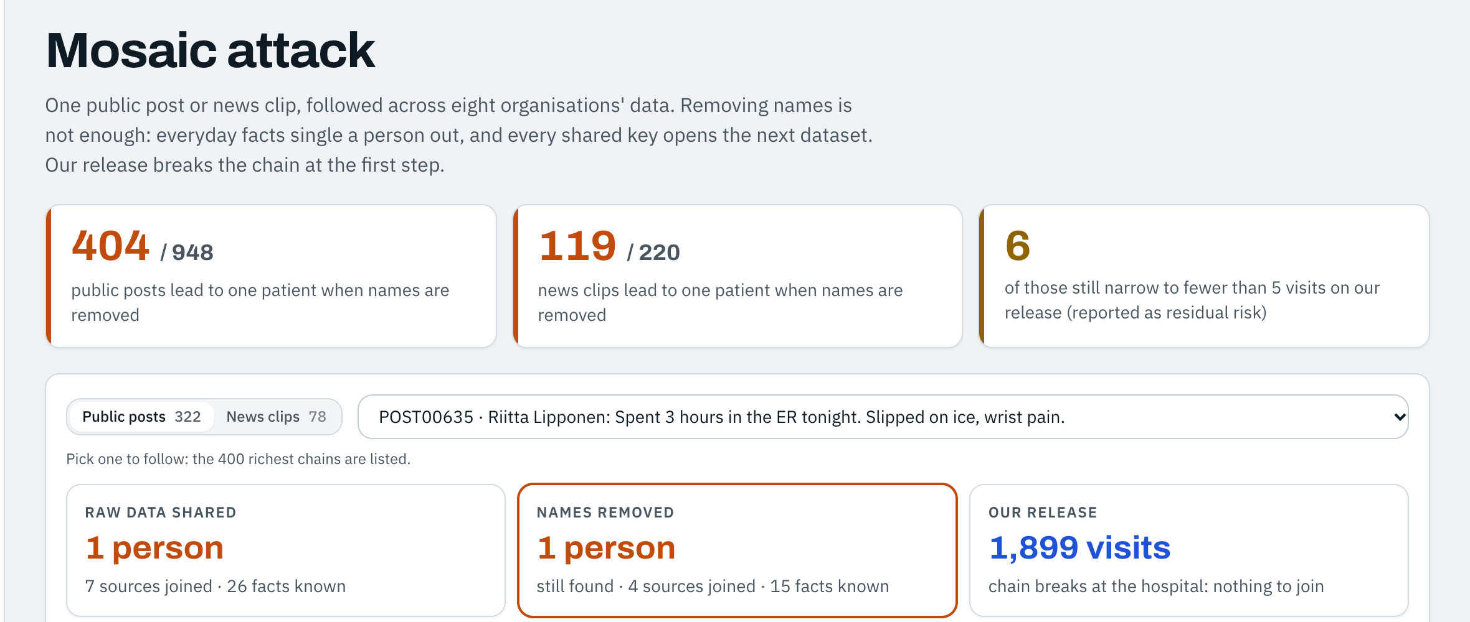
One public post can unlock a whole life
Social post
Hospital
Bank
Energy
School
Work
4 in 10
public posts about a hospital visit lead to one patient, even with names removed
Notes:
The mosaic effect: each dataset alone looks harmless, but one shared key opens the next. The app's Mosaic attack page follows one real post from the challenge data into eight organisations' records.

Slide 4





Five steps, one clear answer
1
2
3
4
5
Bring the data
See the risk
Choose the receiver
Sign it off
Release with proof
Upload files or pick an example
Who could be found, and how
One protection per column, with a reason
A named person approves
The same attack now fails
All on your own computer: nothing is uploaded, and no data goes to any outside service
Notes:
The whole tool is five steps. Anyone who handles data can follow them; nobody needs to know privacy maths.

Slide 5
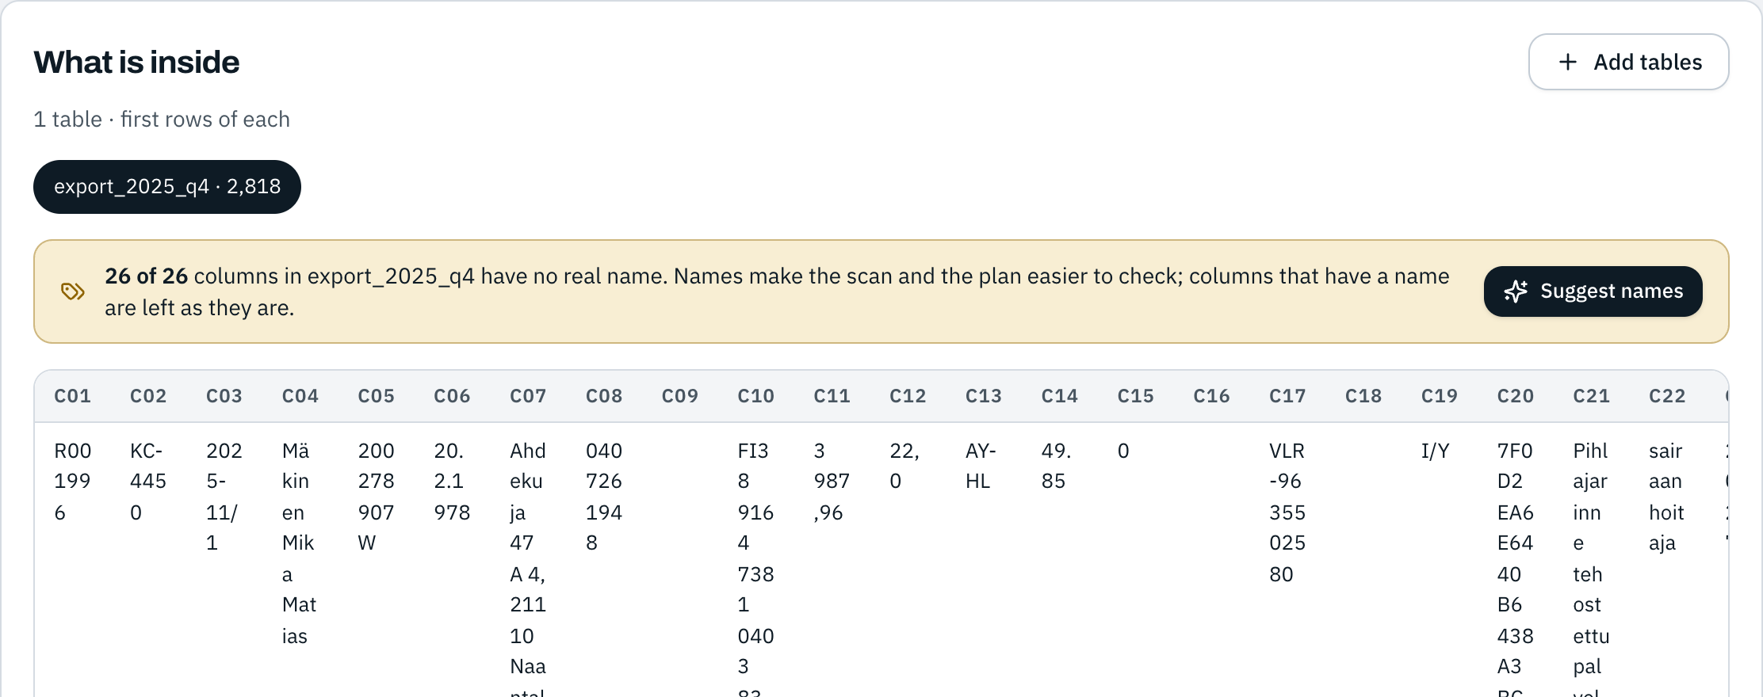

Bring your data, even messy files
STEP 1 OF 5
26 columns called c01, c02 … c26
Real exports often arrive like this. Nobody can protect what nobody can read.
Notes:
This HR export came with no column names at all. Before anything else, the tool tells you so, and offers to fix it.

Slide 6
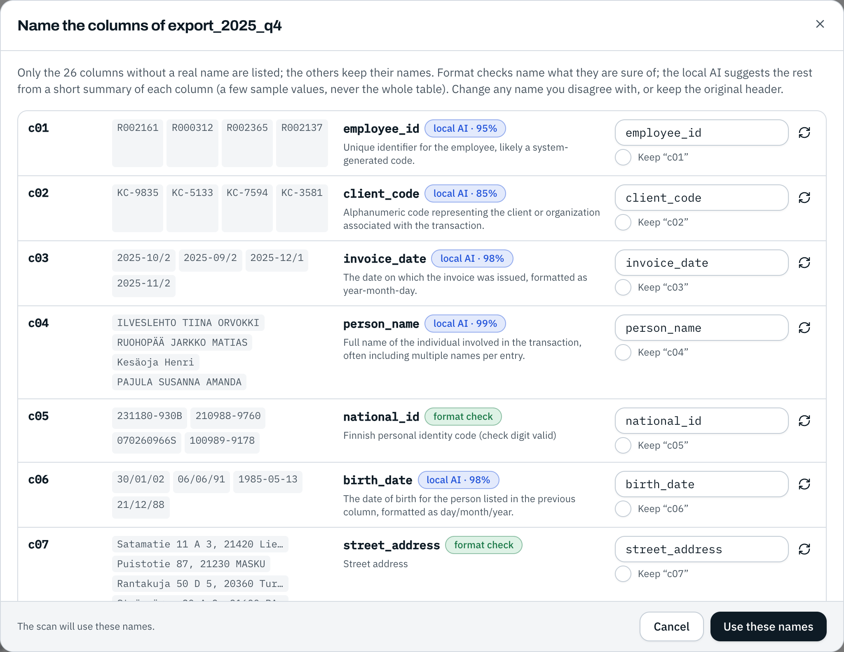




A local AI suggests the names, you decide
STEP 1 OF 5
Suggests clear names
employee_id, birth_date, person_name … each with its meaning
Checks first
ID codes, bank accounts and phones are recognised by their format
You confirm every name
Change any suggestion, or keep the original
Stays on this computer
It sees a few sample values, never the whole table
Notes:
This is where AI helps without taking control. The AI runs locally, sees only a short summary of each column, and only suggests names. Format checks handle what is certain, and a person confirms every name. The release later records which names the AI suggested.

Slide 7
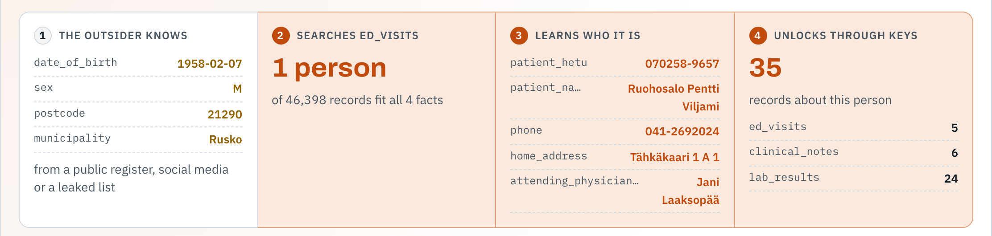


See how one person is found
STEP 2 OF 5
4 everyday facts
1 person
35 records opened
Notes:
The risk scan replays a real attack on your own data: a few public facts, one match, then the name, ID code, phone and every linked record.

Slide 8
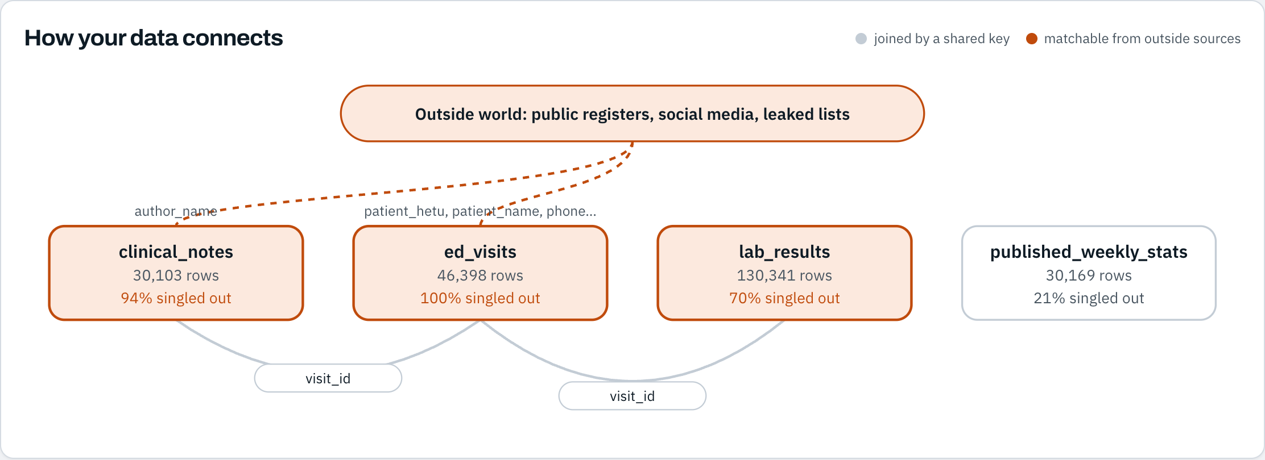

…and how your tables connect
STEP 2 OF 5
One shared key opens the next table
Dashed orange lines: what outsiders could match from public sources
Notes:
The map shows where the risk travels: which columns outsiders can match, and which keys carry one match into every other table.

Slide 9
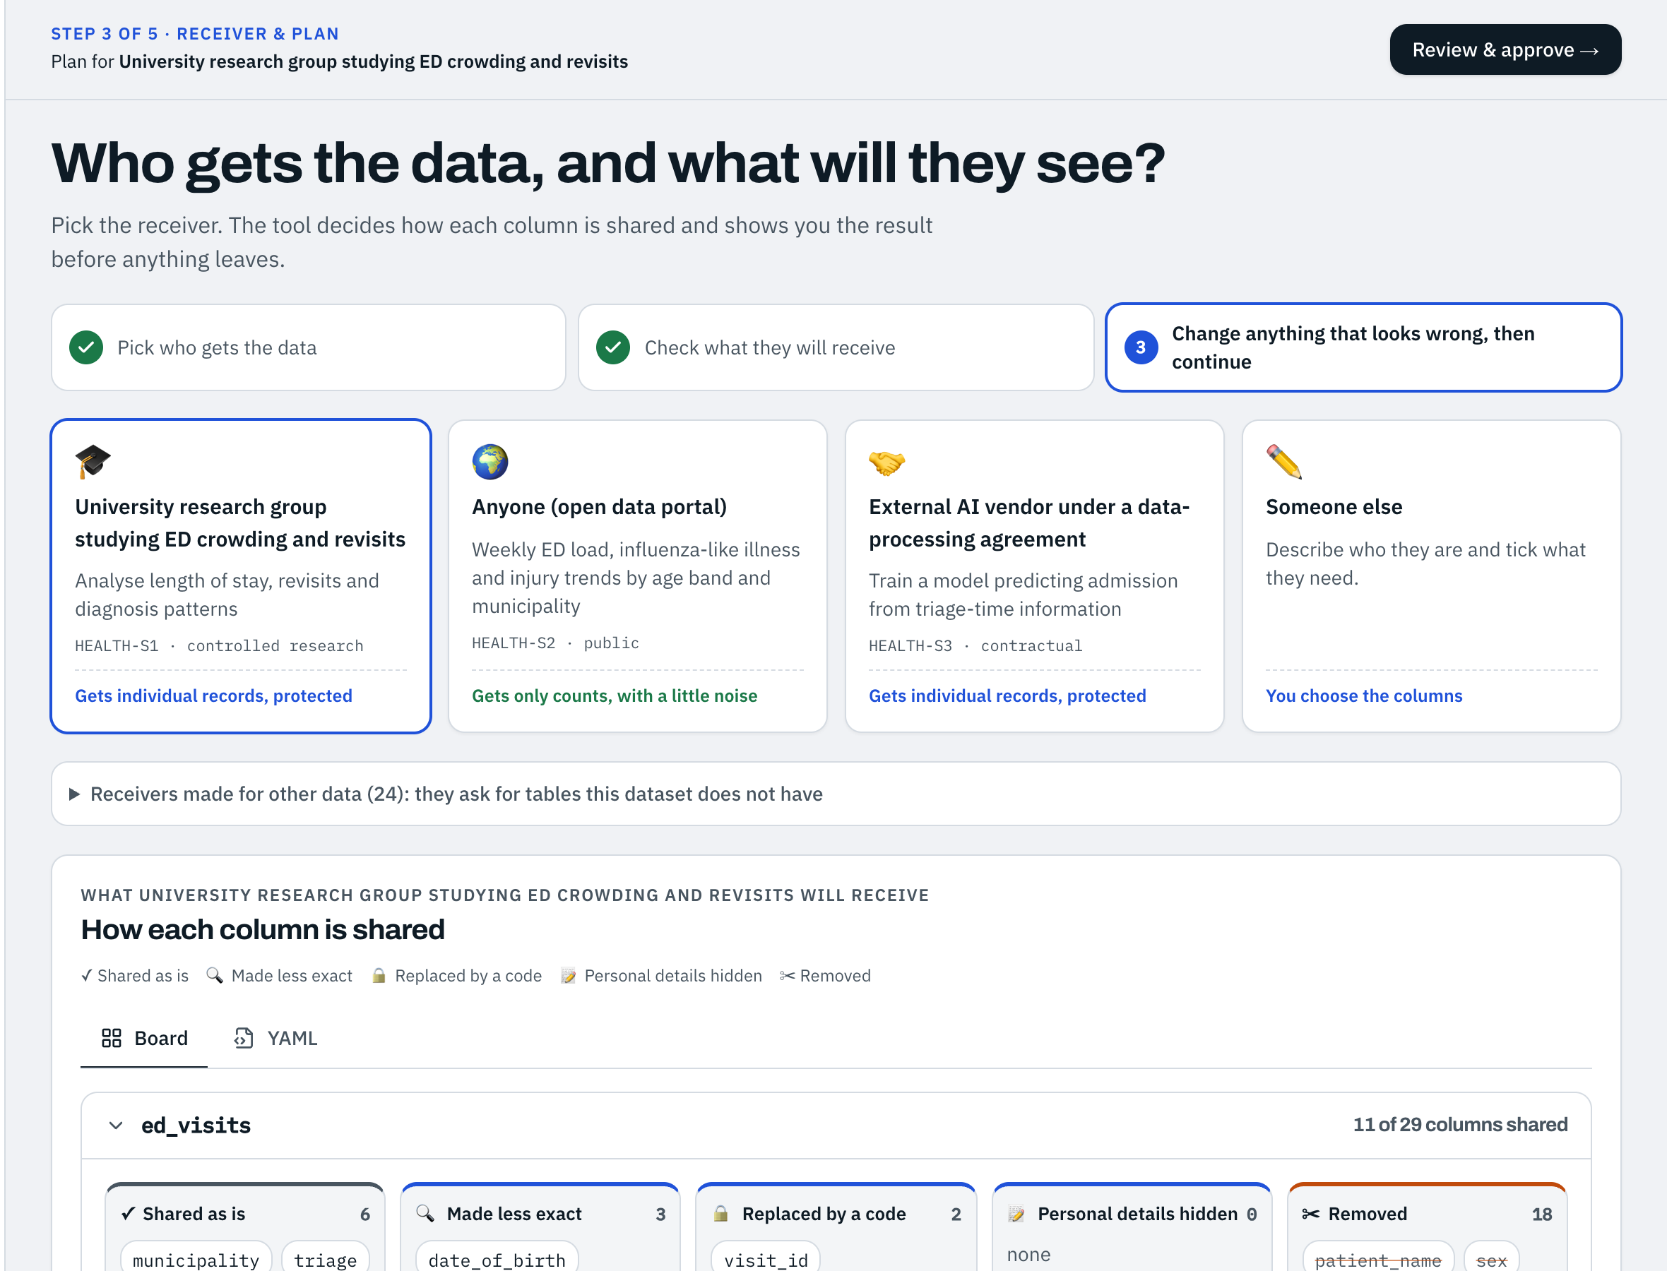


Choose who gets the data
STEP 3 OF 5
A research group
Individual records, protected
The public
Only counts, with a little noise
A partner
Only what the contract needs
Notes:
The same data is protected differently for different people. Pick the receiver; the tool picks one protection per column and explains each choice in plain words.

Slide 10
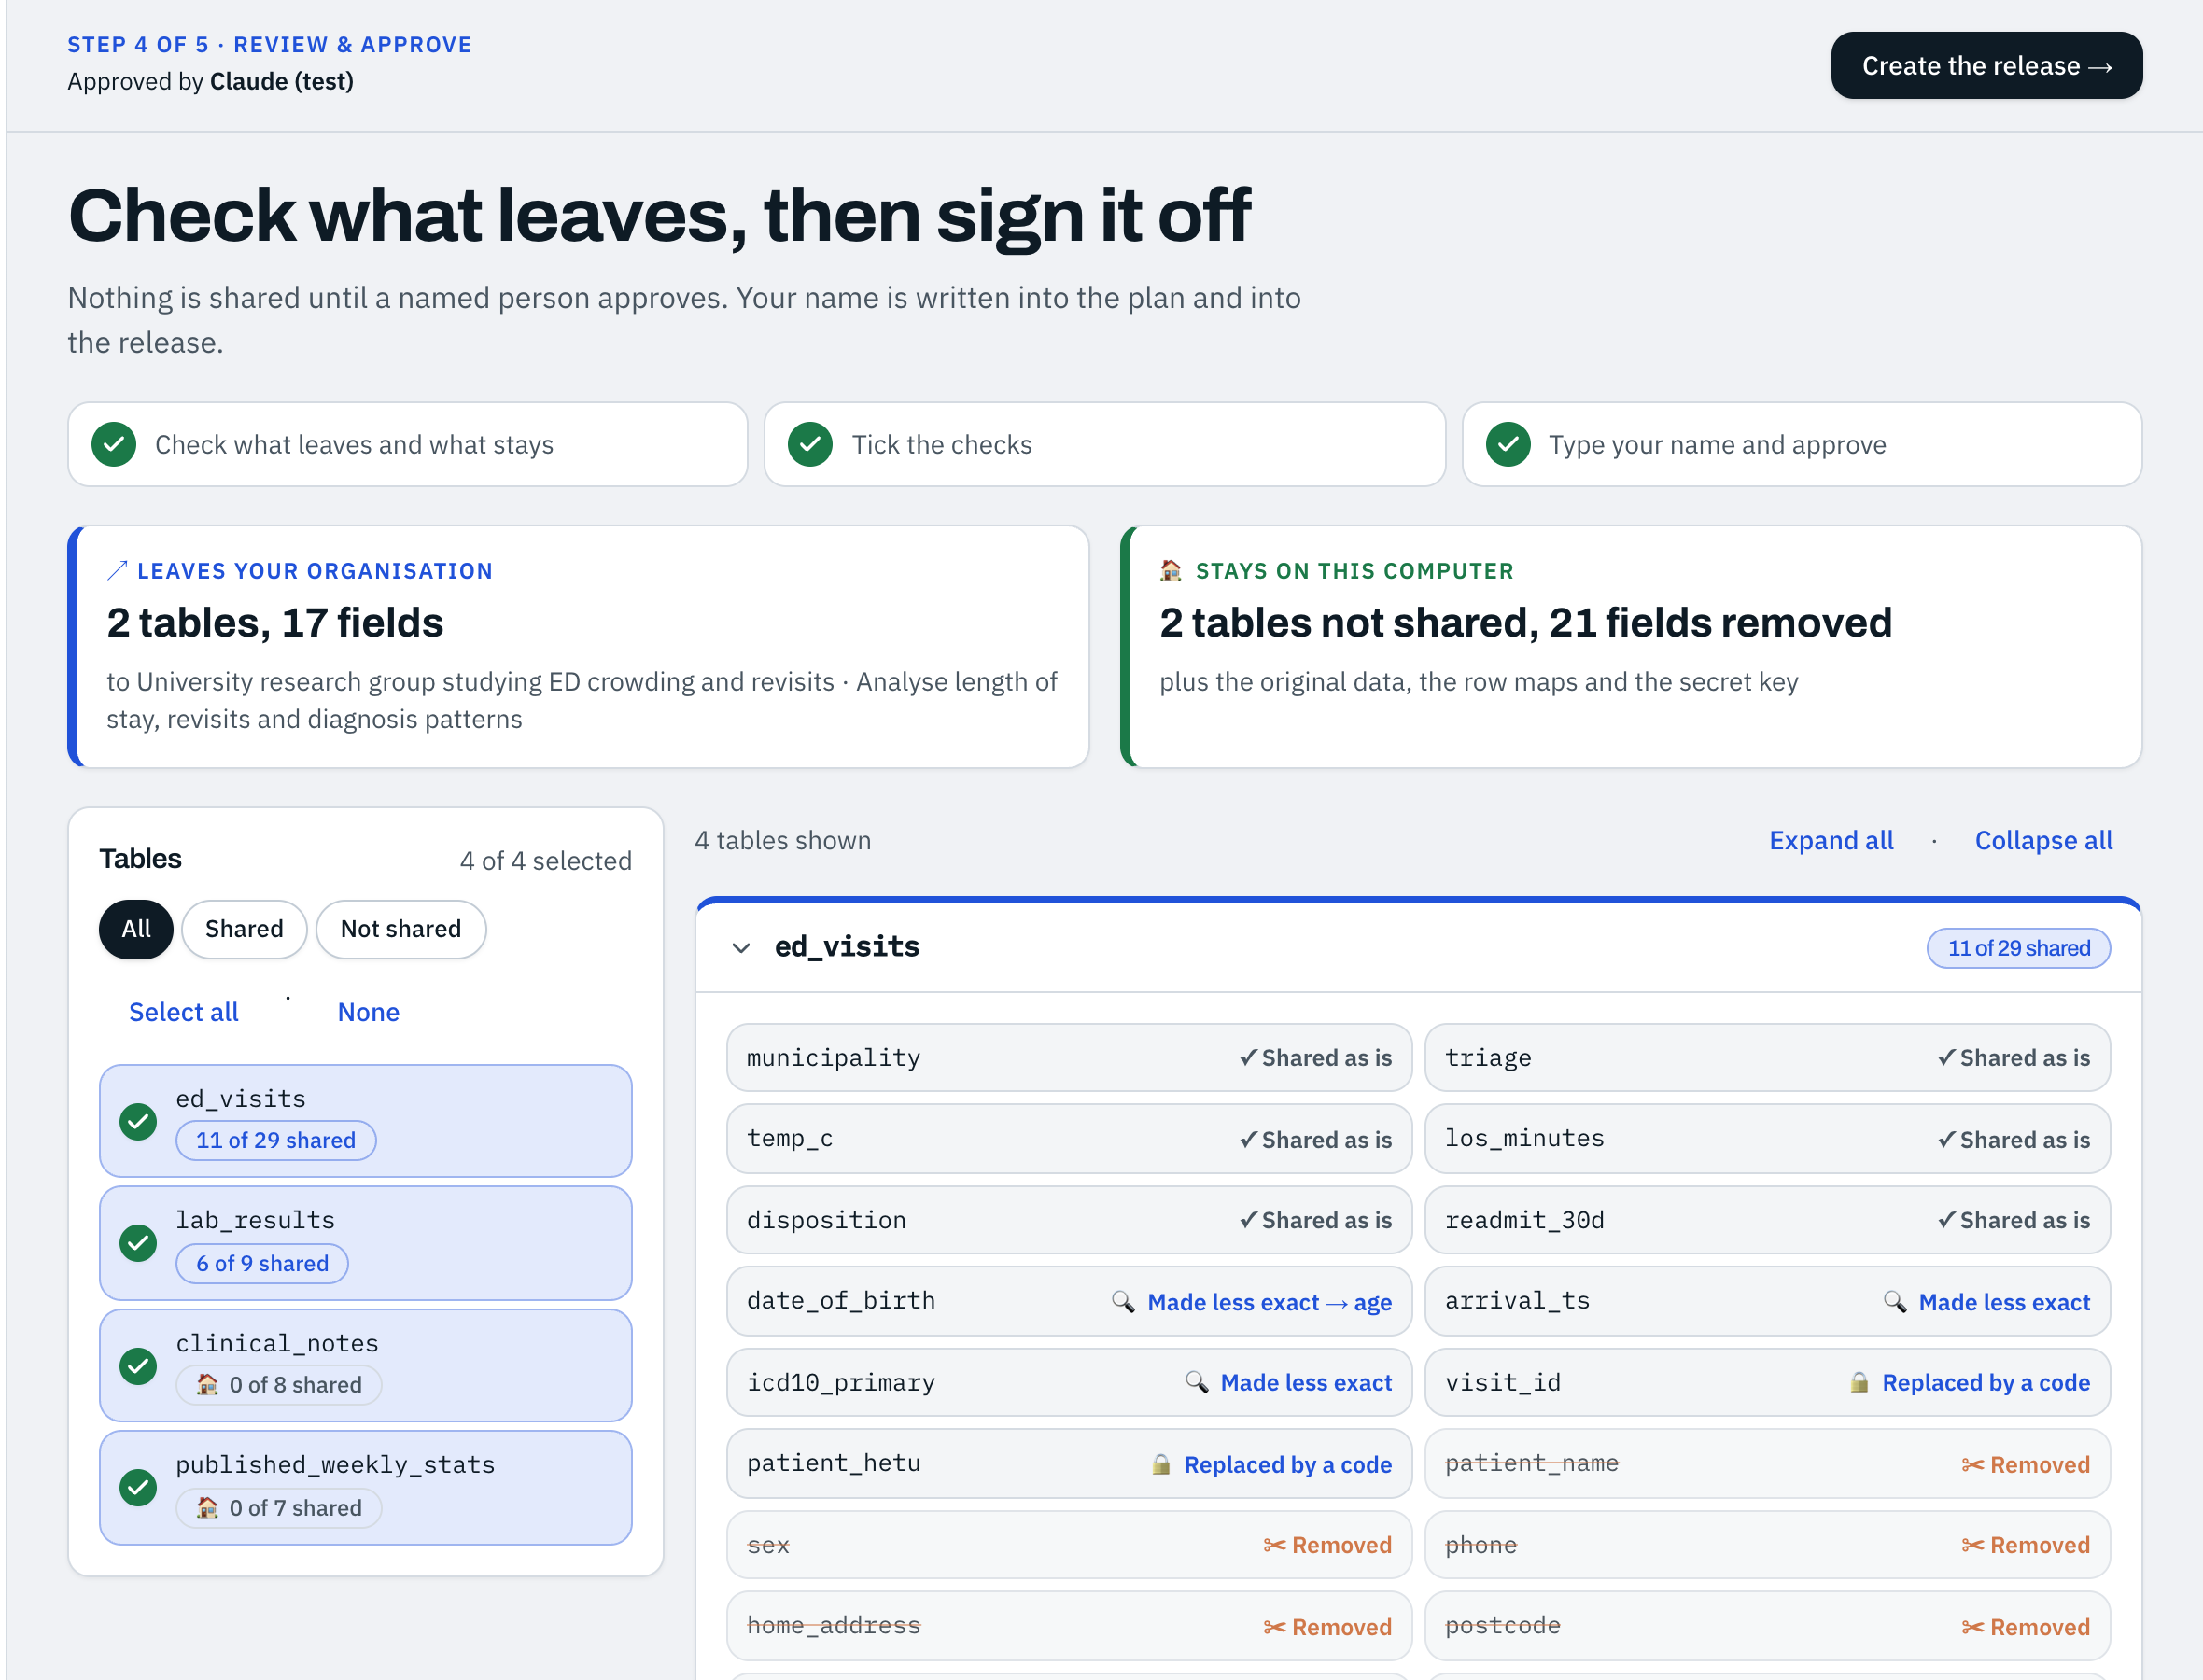
A person signs it off
STEP 4 OF 5
Nothing leaves without a named approval
The approver sees what leaves and what stays, and their name goes into every release
Notes:
Accountability by design: the tool proposes, a person decides. The approver's name travels with the release.

Slide 11
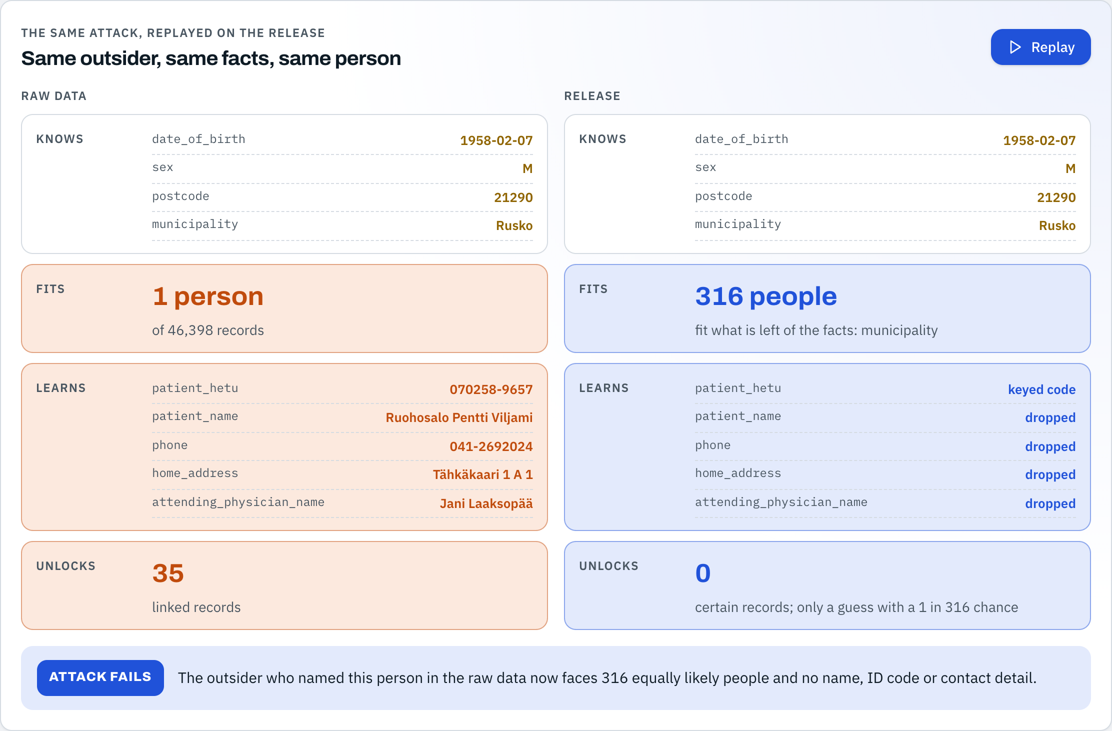

Proof: the same attack now fails
STEP 5 OF 5
BEFORE
AFTER
1 person
316 people
named, with ID code and address
look alike, and no name, ID code or address is left
Notes:
The proof is the same attack, replayed on the release. Before: one person, fully exposed. After: hundreds of equally likely people and nothing to join to other data.

Slide 12







What leaves, and what never leaves
Leaves, to the receiver
Never leaves your computer
Protected tables
Your original data
A record of what was done, and who approved it
The secret key
The link back to real people
Notes:
The receiver gets protected tables and a signed record. Everything that could undo the protection stays with you.

Slide 13
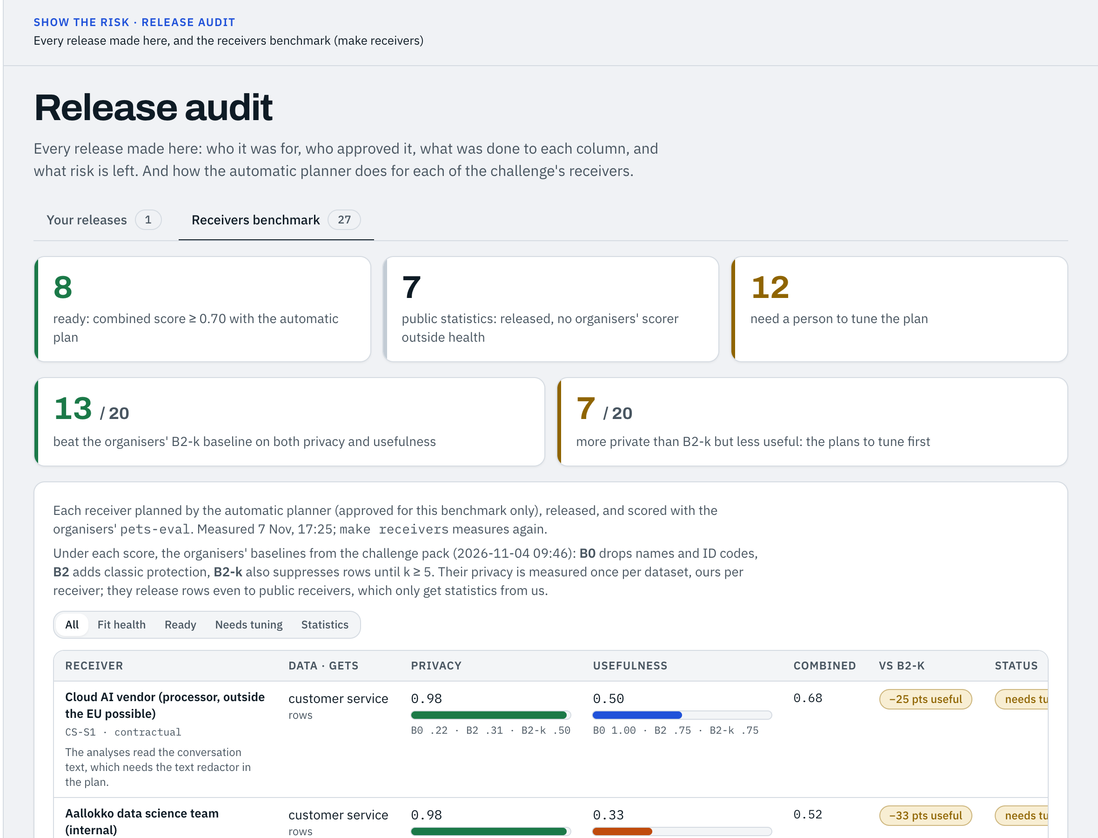

Better than the standard approach
13 of 20
data receivers get safer and more useful data than with the organisers' standard protection
Notes:
We measured all 27 challenge receivers with the organisers' own scorer. Against their standard protection, 13 of the 20 scored receivers get data that is both more private and more useful. The other 7 are more private but less useful, and they are the next plans to tune.

Slide 14
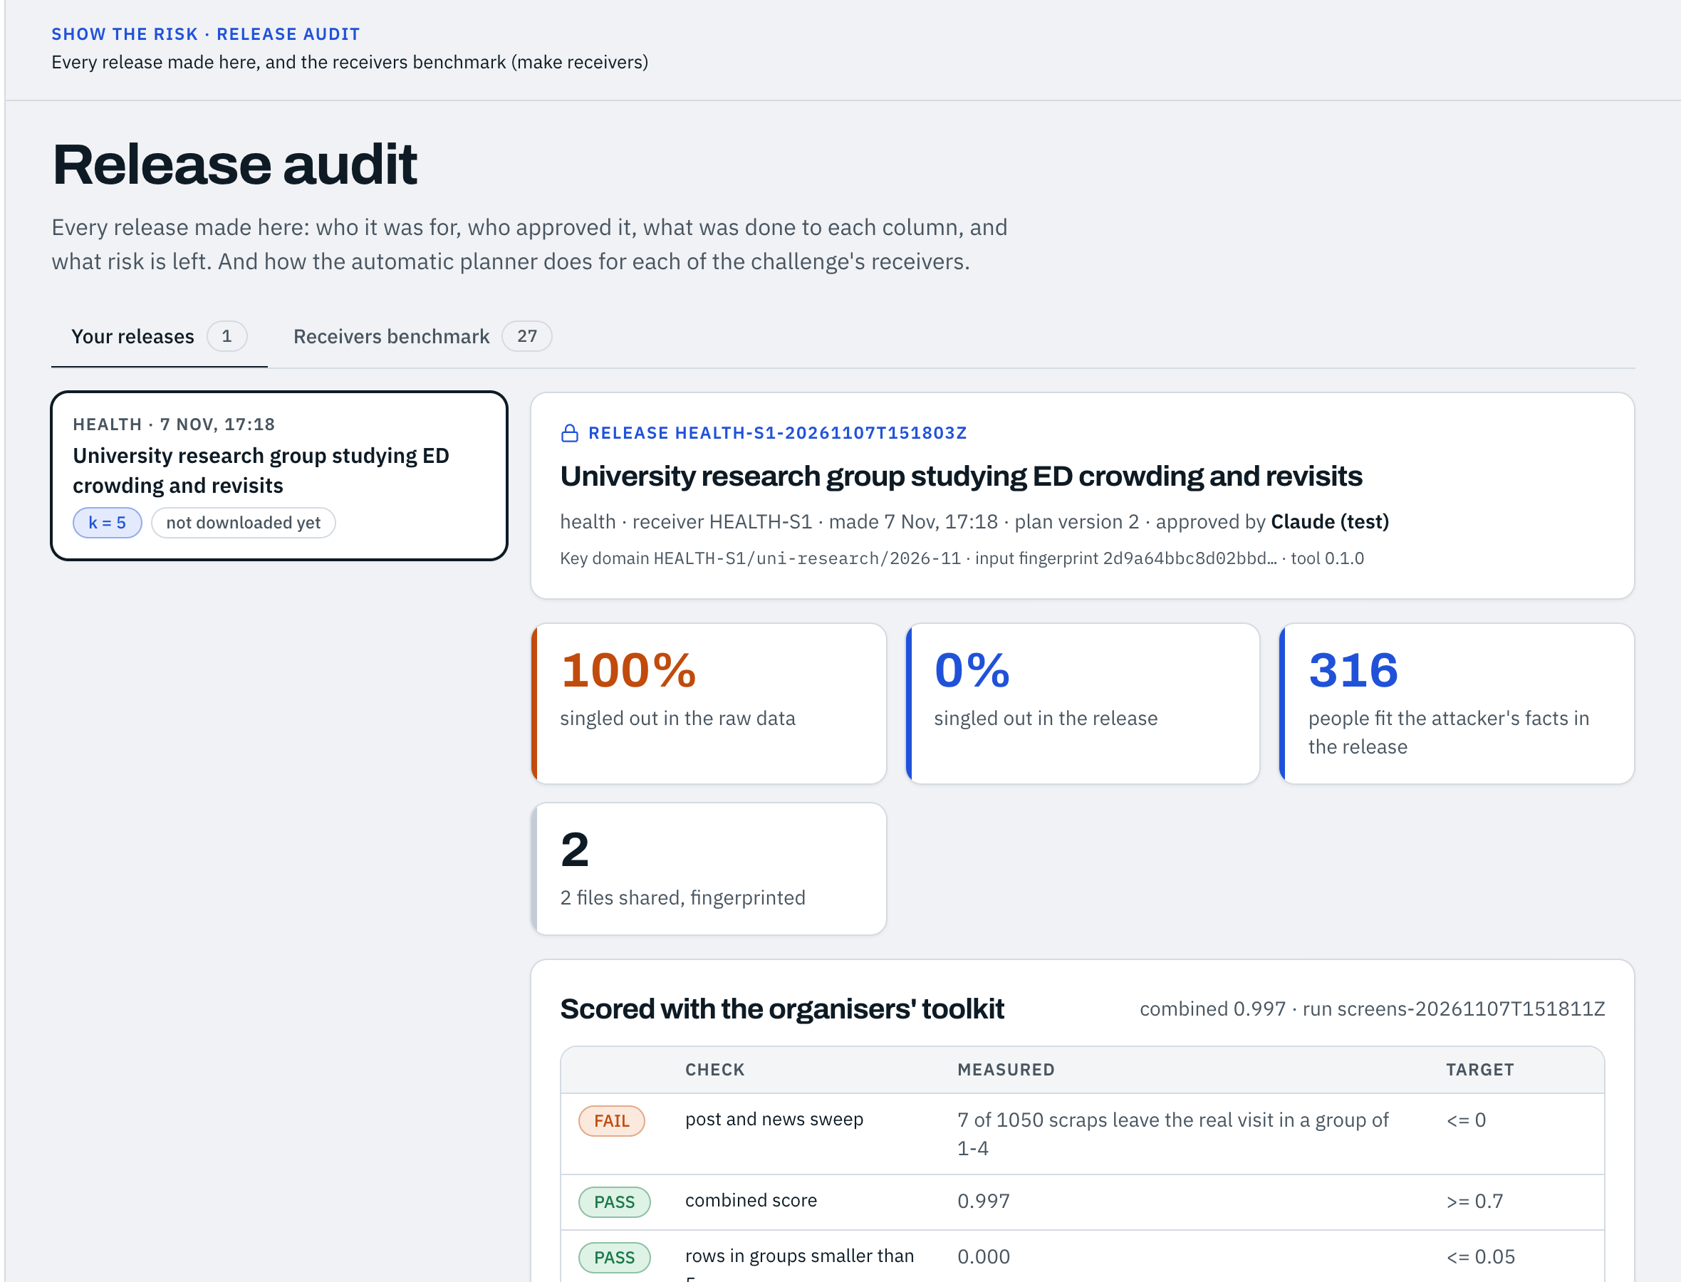
Every release is on record
Who it was for
Who approved it
What was done to each column, and why
The risk that is left
Notes:
Audit-ready: every release keeps its approval, its column decisions with reasons, the attack before and after, and fingerprints of every file shared.

Slide 15

Protect the data.
Keep its value.
See the risk
Protect it
Prove it
See the risk, protect for one receiver, and prove that it worked: all on your own computer.
Thank you · Beyond Syntax
Notes:
Three promises: you see the risk before sharing, the data is protected for exactly one receiver, and the release carries its own proof.

