Slide 1

Supermart Grocery Sales
This project involves an in-depth analysis of the Supermart Grocery Sales dataset, which contains data on orders placed by customers on a grocery delivery application. The primary goal is to explore the data, uncover trends, and build a predictive model to forecast sales. The analysis focuses on understanding key sales drivers, profit margins, and the impact of discounts on customer behavior. The project also includes the development of a machine learning model to predict future sales.

Slide 2
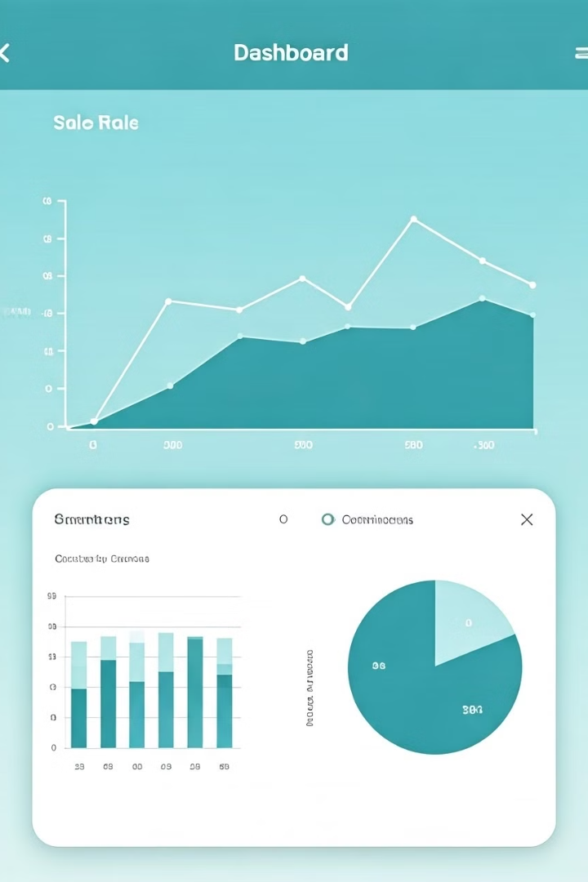
Exploratory Data Analysis (EDA)
Exploratory Data Analysis (EDA) is conducted to gain insights into the dataset. This includes visualizing the distribution of sales by category using box plots, examining sales trends over time by plotting total sales against the order date, and generating a correlation heatmap to understand the relationships between different variables.
These visualizations help in identifying patterns, outliers, and correlations that can inform feature selection and model building. The EDA process provides a comprehensive understanding of the data's characteristics and potential predictive variables.

Slide 3
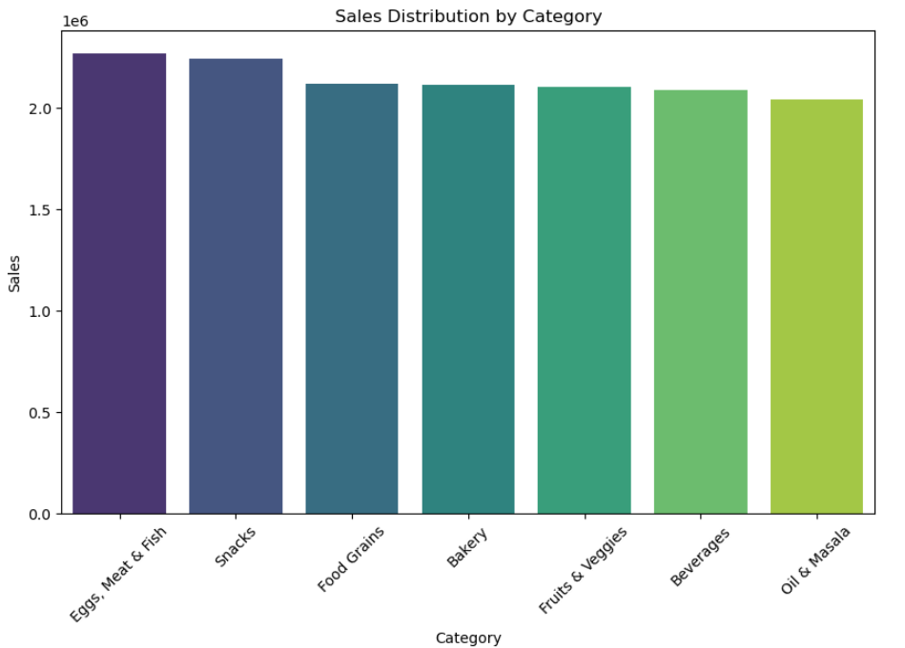
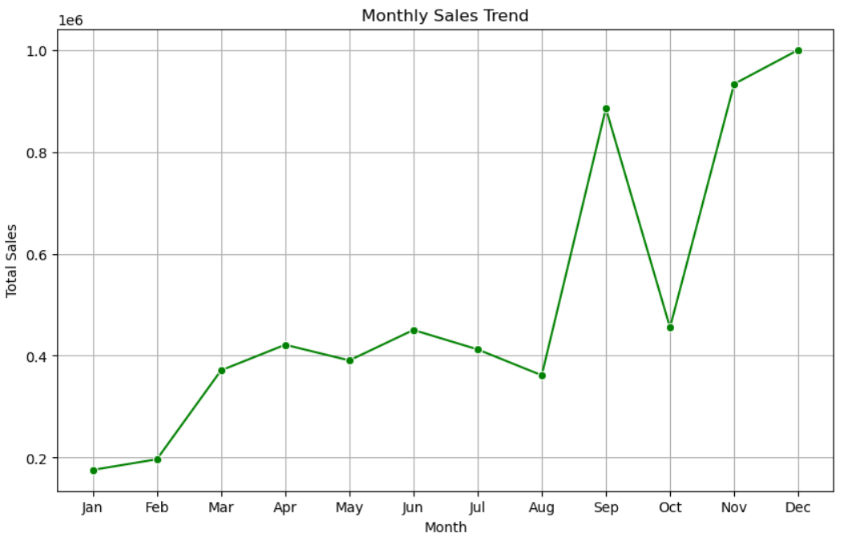

Slide 4
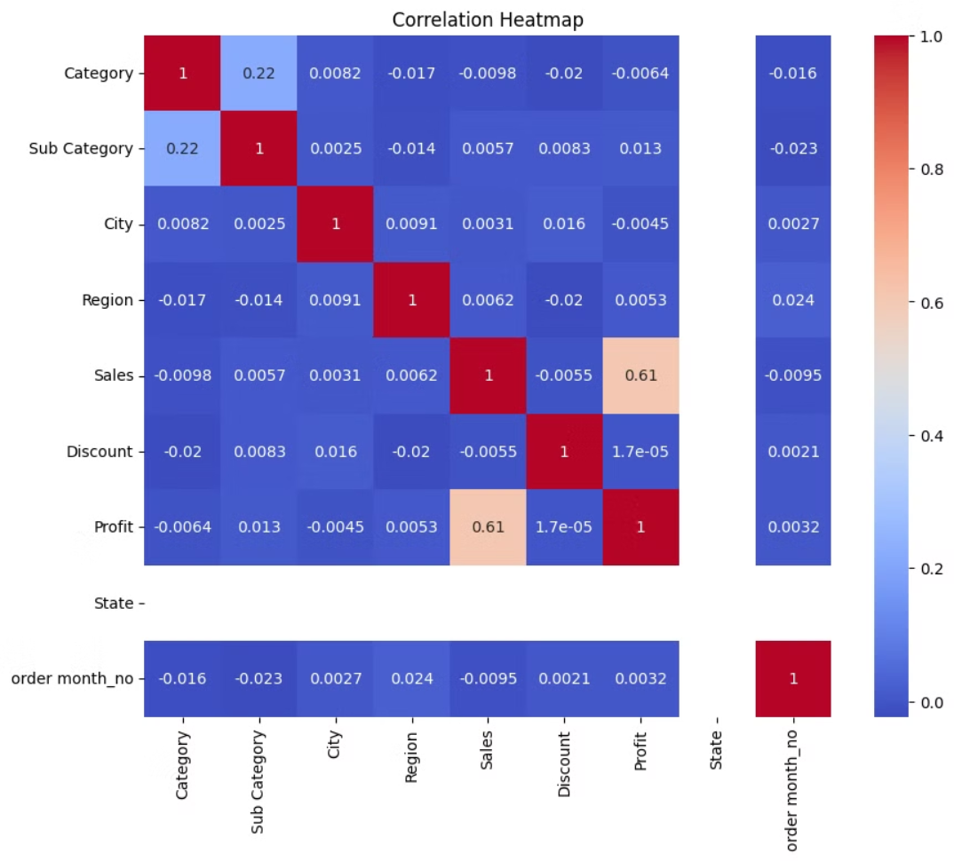

Slide 5
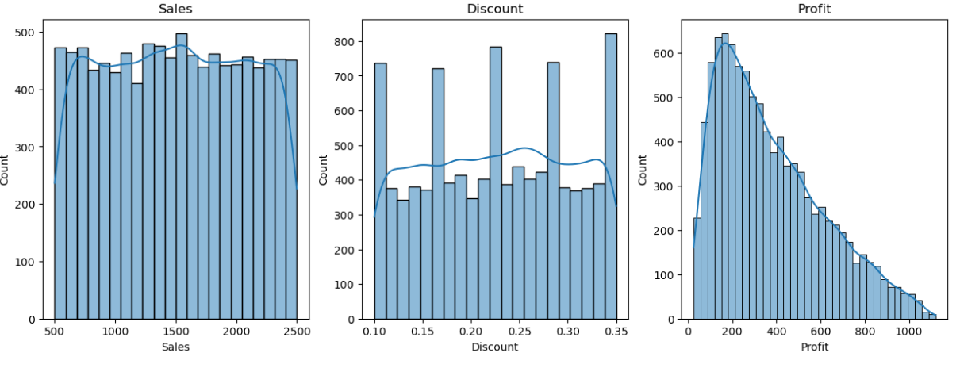

Slide 6
Visualization of Actual vs Predicted Sales
A scatter plot is generated to visualize the relationship between actual and predicted sales values. The plot includes a red line representing the ideal scenario where predicted values match actual values. Deviations from this line indicate the model's prediction errors.
This visualization provides a clear understanding of how well the model's predictions align with the actual sales data. It helps in identifying potential areas where the model may be over- or under-predicting sales, which can inform further model refinement and feature engineering.

Slide 7
Conclusion and Next Steps
The linear regression model provides a reasonable prediction for sales based on the selected features, with an R-squared value indicating a good fit. Further refinement of the model could involve trying different machine learning algorithms, such as decision trees or ensemble methods, to improve predictions.
Next steps include experimenting with more complex models like Random Forest or XGBoost to improve predictions, exploring additional features or interactions between features to enhance model performance, and integrating the model into a dashboard for real-time sales prediction and business analytics.

Slide 8
BUSINESS INSIGHTS
This analysis helps understand the sales trends, category performance, and the impact of discounts on profit.
The top-performing categories are 'Eggs, Meat & Fish', 'Snacks', and 'Fruits & Veggies’.
Sales have shown consistent growth over the years, with a significant increase in 2018.
The correlation between profit and discount is minimal, suggesting that discounts do not significantly impact profit margins.
The linear regression model achieved an R-squared value of -0.0024240538359081576, indicating the proportion of variance explained by the model.
The random forest regression model achieved an R-squared value of -0.16211610179024816, indicating the proportion of variance explained by the model.

