Slide 1


TCS Stock Data Analysis and Prediction
Notes:
1

Slide 2



Data Cleaning & Preprocessing
Missing values are handled using a forward-fill method to ensure data consistency.
Numerical columns are standardized to remove anomalies and prepare data for analysis.
We perform feature engineering by adding moving averages and lag variables for trend analysis.
Notes:
5

Slide 3
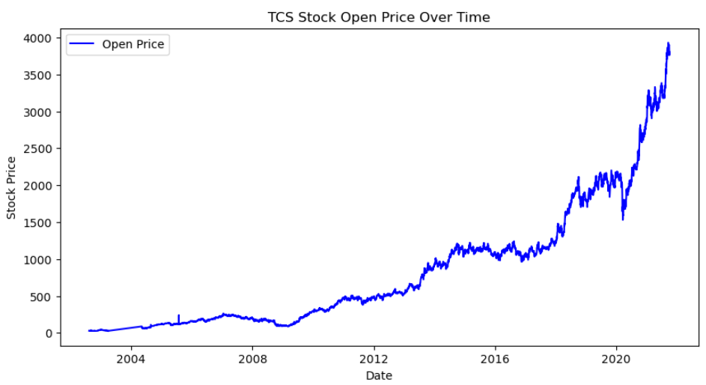
Stock Close Price Over Time
We analyzed historical TCS stock price data to identify trends and patterns.
The analysis revealed price spikes and other noteworthy patterns.
Notes:
6

Slide 4
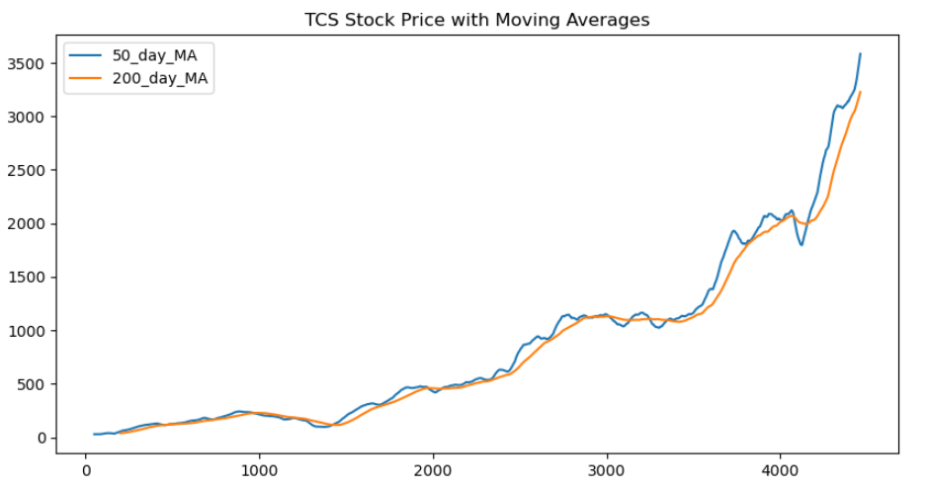
Stock Price with Moving Averages
Notes:
6

Slide 5
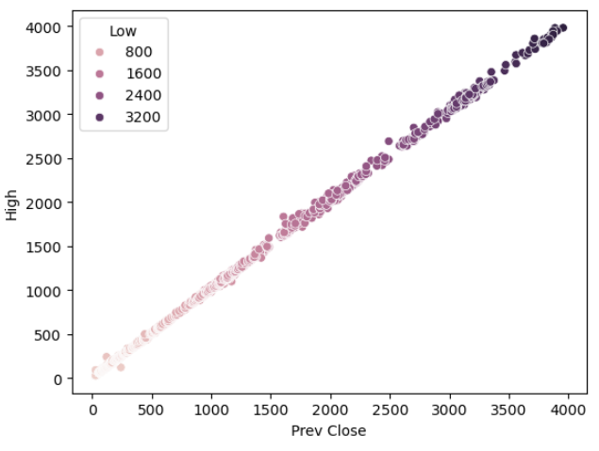
Correlation between Prev close and High prices
Notes:
6

Slide 6
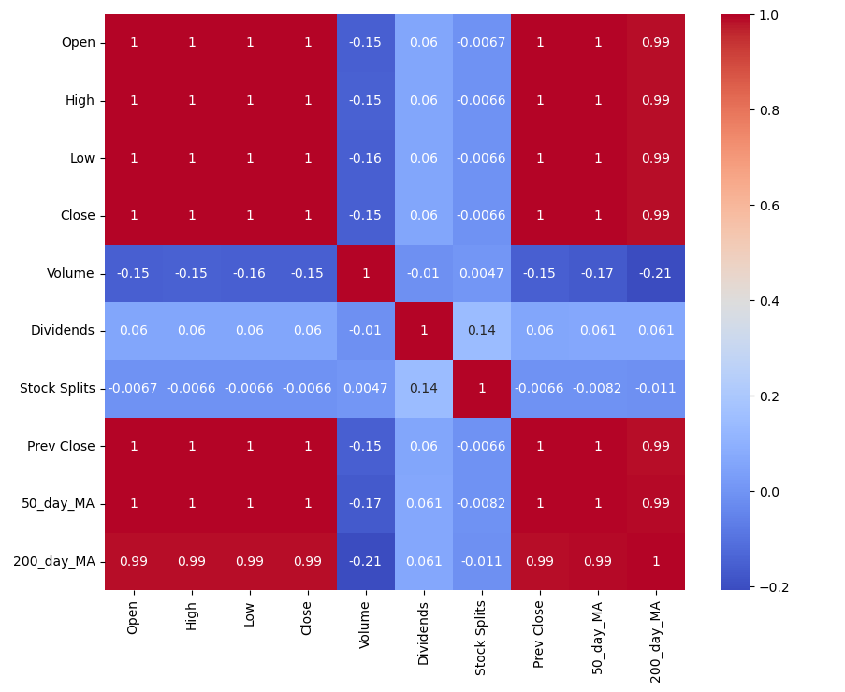
Correlation of features with the target variable
Notes:
6

Slide 7
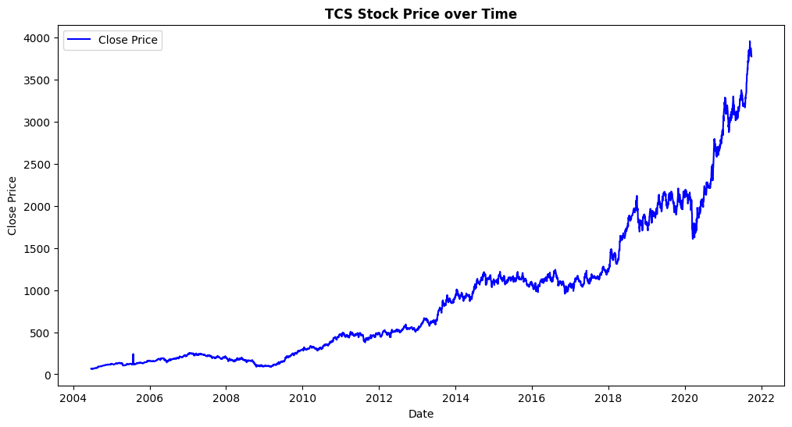
TCS Stock Price over Time
Notes:
6

Slide 8
Conclusion
During our analysis, I started by loading the data and preparing it through data wrangling to make it ready for exploration. Then, I performed Exploratory Data Analysis (EDA) to understand patterns and trends in all the features. After that, I applied feature engineering to improve the dataset for model training. Finally, I implemented four different models to predict stock prices.
Here are the key conclusions from the analysis and predictions:
TCS stock has shown long-term growth – From 2004 to 2023, the stock price has generally increased, with a big jump after 2020.
Stock prices fluctuate daily – While the overall trend is upward, there are ups and downs in open, close, high, and low prices.
Trading volume changes over time – There are periods of high trading activity, often influenced by news, events, or market sentiment.
Stock splits and dividends impact investors – Stock splits increase share count but lower price per share, while dividends provide additional income.
Machine learning models predict stock prices well – RandomForest and XGBoost models performed best, with very high accuracy.
XGBoost may be overfitting – While XGBoost follows actual prices closely, it might be too focused on training data.
LSTM model captures long-term trends – It follows stock price movements well, making it useful for forecasting trends.
Stock prices are hard to predict – Due to market fluctuations, no model is perfect, but advanced models can still provide useful insights.
Notes:
6

