Slide 1
Sales Pipeline Assistant
An AI sales assistant I built and tested on a live HubSpot account. A sales team asks Claude in plain English, and an MCP server answers from pipeline data and keeps HubSpot up to date.
The people
Anthropic
Hosted in the cloud
The CRM
Sales team
reps and managers
Claude
understands and writes
The assistant
(MCP server)
HubSpot
sales records
asks
looks things up
reads, updates
answers
results
live data
6
tools in the MCP server
~2 s
per HubSpot lookup
11 s to 2 s
account lookup after tuning
Exact
forecasts match the HubSpot deal board
Amanpreet Kaur, freelance AI integration developer
Notes:
Overview of the project. Follow the top arrows for the question and the bottom arrows for the answer. The figures below the diagram were all measured on the working build.

Slide 2
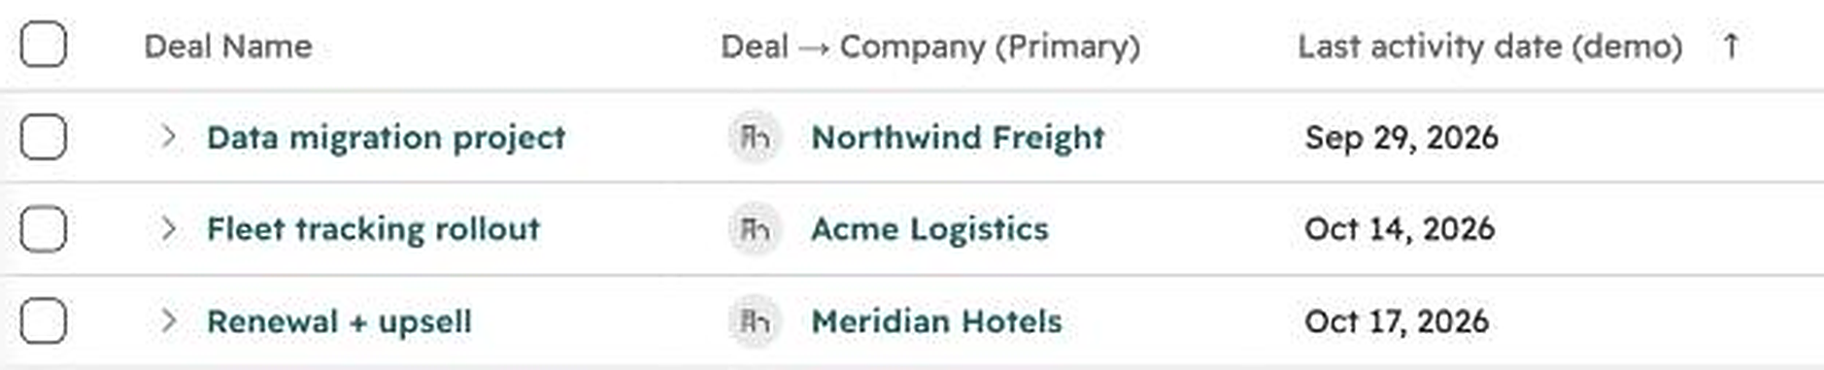
Ask a question. See which deals need attention.
The deals and figures on this slide are dummy data for illustration, not actual client data.
Sales rep
Which deals need attention this week?
Claude
These three first:
Meridian Hotels, $72,000 No activity for 15 days, missed its close date
Acme Logistics, $48,000 No activity for 18 days, contract overdue
Northwind Freight, $30,000 No activity for 33 days
13 of 36 open deals need attention, worth $417,000.
The same three deals in HubSpot, sorted by last activity
Notes:
The rep asks one plain question and gets the three deals to deal with first, each with the reason. The screenshot on the right is the real HubSpot deal board for this pipeline.

Slide 3
How the system is built
People, in Claude
Anthropic
The assistant (MCP server), hosted in the cloud
claude.ai
Claude
connects to
the server
for each user
MCP
Connection
Streamable HTTP, or stdio locally
Per-user sign-in
planned next step
Claude Desktop
MCP tools and rules for Claude
6 tools with read-only and destructive annotations
playbook resource, weekly review prompt, instructions
Claude mobile
Business rules
risk, priority, forecast
unit-tested
Activity log
latency, size, errors
per tool call
Claude Code
developers
MCP over HTTPS, direct
HubSpot
CRM objects
Deals and stages
Companies
Contacts, activity
Data layer: one module per CRM
SQLite module
local CRM for testing
HubSpot module
parallel reads, cache
rate-limit retries
search-delay handling
API
HTTPS with a scoped key
What this demonstrates
MCP server design, CRM integration, safe AI-driven updates with human approval, and automated testing.
Amanpreet Kaur, freelance AI integration developer
Notes:
Follow a request left to right, then down through the server. Claude Code connects directly; the other apps reach the server from Anthropic's cloud, which is why it must be reachable over the internet. Per-user sign-in is dashed because it is a planned next step, not built yet.

