Slide 1

Project Title - Seasonal Agriculture Performance Analysis
Amanpreet Kaur
Vivekananda College, University of Delhi
AICTE STU ID : STU6a393ef1298441782136561

Slide 2

PROBLEM STATEMENT
Agricultural activities are influenced by seasonal variations in environmental conditions, farming practices, resource availability and market conditions. As a result, agricultural performance may differ from one season to another.
However, raw agricultural data does not clearly explain how agricultural performance changes across seasons or what patterns can be observed in different seasonal conditions.
The problem is to analyze the given agricultural dataset and investigate seasonal differences in agricultural performance by identifying meaningful patterns, trends, relationships and variations within the available data.

Slide 3
Project Description
Objectives
Explore and understand the dataset structure and contents
Clean and prepare the data for analysis
Examine how agricultural performance varies across seasons
Identify important seasonal patterns and trends
Investigate relationships between seasonal conditions and agricultural outcomes
Compare relevant groups within different seasons
Apply appropriate statistical and visualization techniques
Develop meaningful conclusions and data-driven recommendations
Expected Outcomes
Perform appropriate data cleaning and preparation
Identify important seasonal patterns across Kharif, Rabi and Zaid
Compare agricultural performance across seasons
Develop evidence-based insights and practical recommendations
Document the complete analysis in a Jupyter Notebook

Slide 4

WHO ARE THE END USERS?
Farmers & Farming Communities: Understand which seasons and crops yield the best returns and plan activities accordingly
Agricultural Scientists & Researchers: e.g. ICAR divisions — Maize Research, Division of Genetics, Soil Science, Crop Physiology
Government & Policy Bodies: Design seasonal support programmes, subsidies and procurement pricing
Environmentalists & Climate Analysts: Study correlations between rainfall, temperature and agricultural output
Agri-input Companies: Align fertilizer, pesticide and irrigation product strategies to seasonal demand
Students & Data Analysts: Practice real-world seasonal data analytics on a structured agriculture dataset

Slide 5

Technology Used
Python: Core programming language
Pandas: Data loading, cleaning, filtering, grouping and aggregation
NumPy: Numerical operations, statistical computations and array handling
Matplotlib: Plotting library for charts, histograms and scatter plots
Seaborn: Statistical visualizations such as boxplots
Google Colab: Cloud-based execution environment used to run the notebook

Slide 6
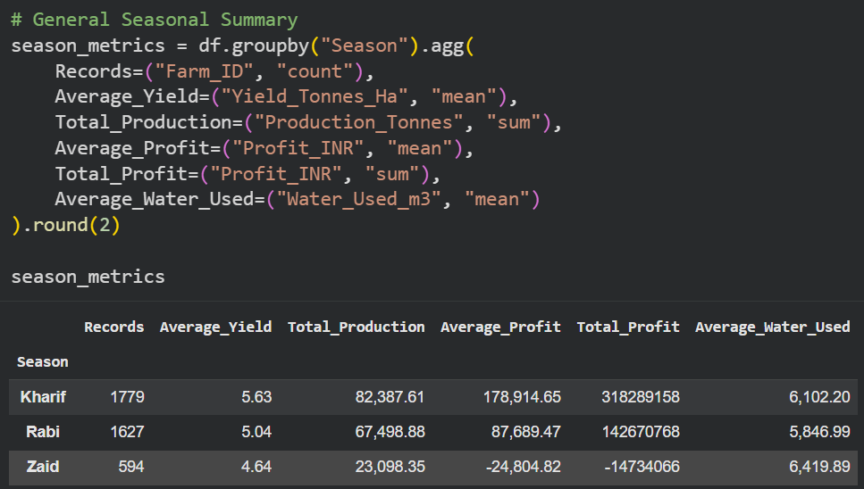
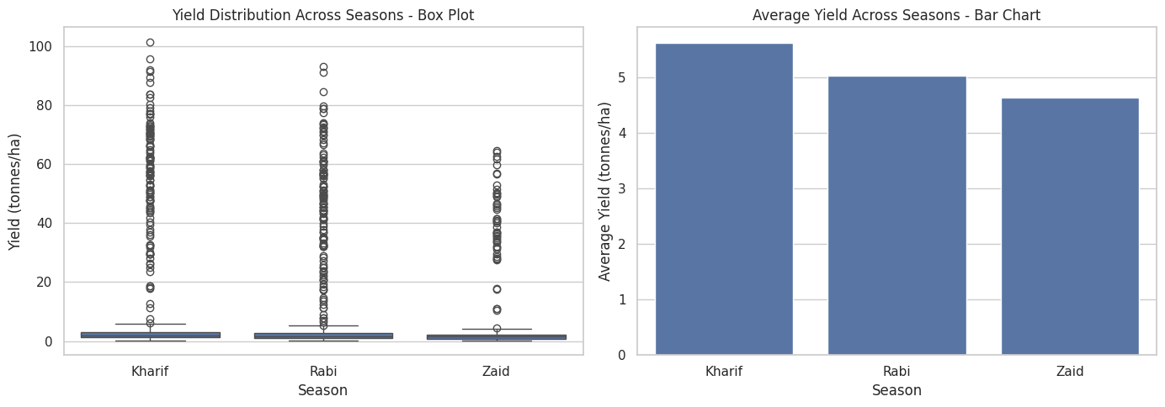
RESULTS

Slide 7
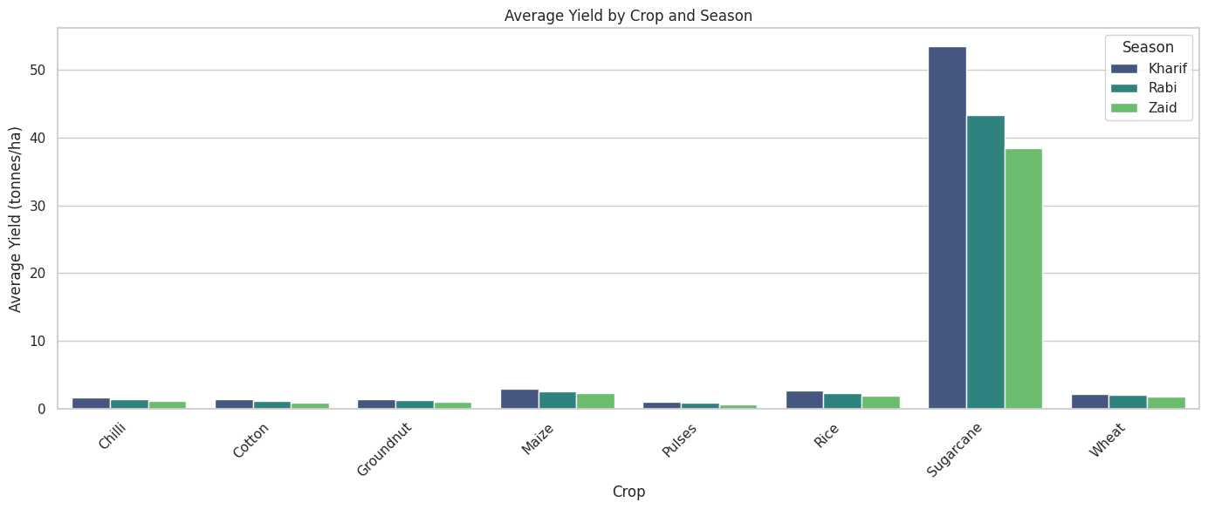
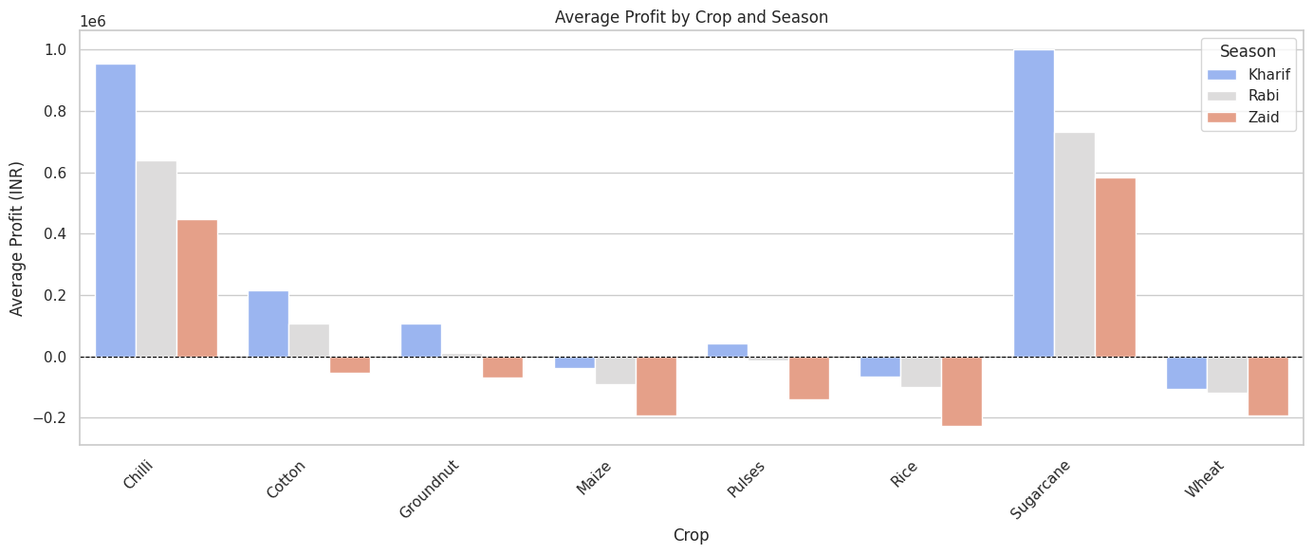
RESULTS
Student Analysis 1: Which crops perform best in each season?
Question: Does crop yield and profit change across Kharif, Rabi and Zaid seasons? Which crops do better in which season?
Why I chose this: Since this project is about seasonal agricultural performance, I wanted to see which crops actually grow better and earn more profit depending on the season.
Results:
Sugarcane: 53.46 t/ha in Kharif
Wheat, Rice and Maize show negative average profits
Limitation: Just because a crop gives high yield does not mean every farmer should grow it. Factors like water availability, soil type and local market prices also matter and are not fully captured here.

Slide 8
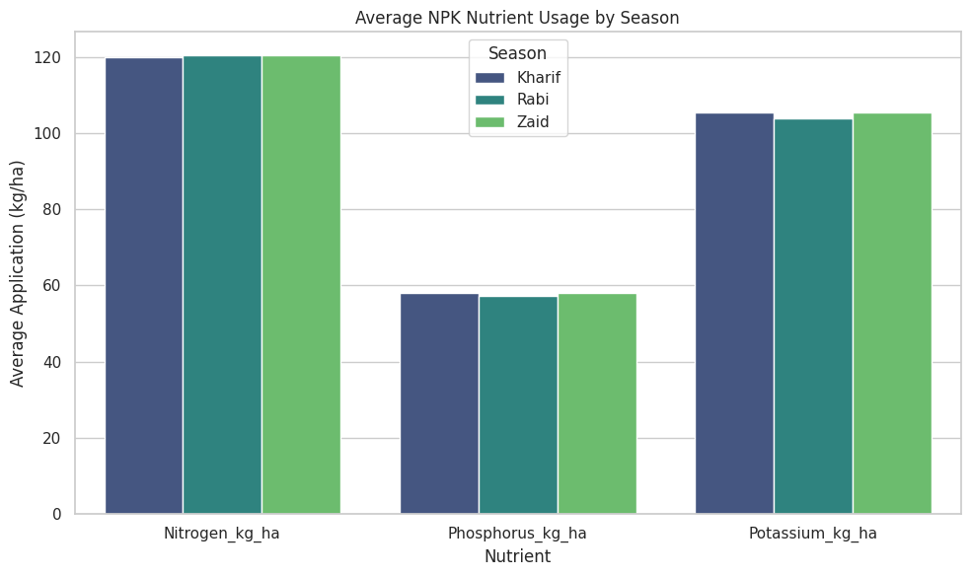
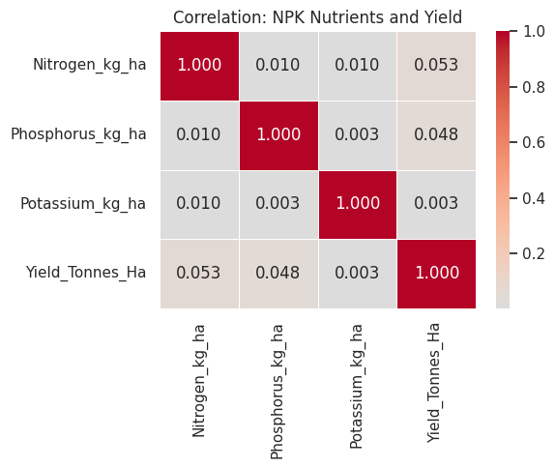
RESULTS
Student Analysis 2: NPK Nutrient Usage Across Seasons
Question: Do farmers apply different amounts of Nitrogen, Phosphorus and Potassium in different seasons? Does using more nutrients mean better yield?
Why I chose this: Nitrogen, Phosphorus and Potassium are the three most important nutrients for crop growth. I wanted to check if seasonal farming practices differ in how these nutrients are used and whether that explains the yield differences we see.
Result: Nitrogen ~120 kg/ha, Phosphorus ~58 kg/ha, Potassium ~105 kg/ha — almost identical across all three seasons
Limitation: This does not mean nutrients are unimportant for crops. It just means that in this dataset everyone is applying similar amounts, so we cannot see a difference. Other factors like rainfall, season and crop type are probably more responsible for yield differences here.

Slide 9
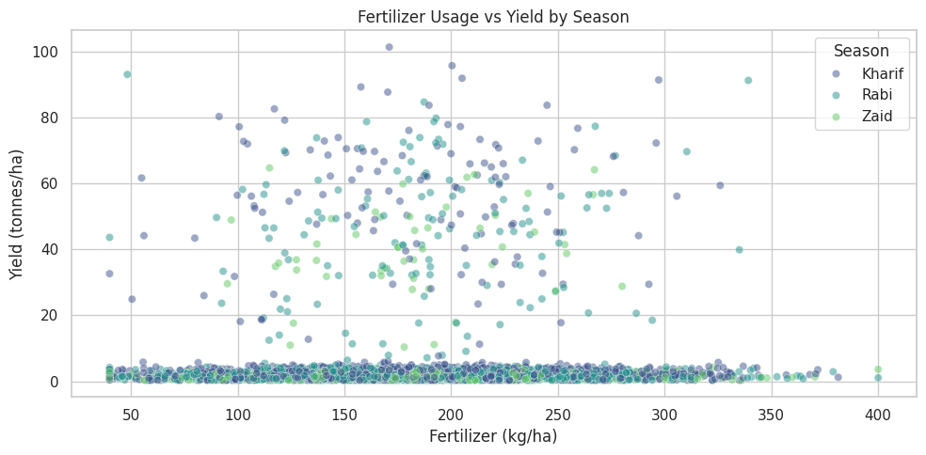
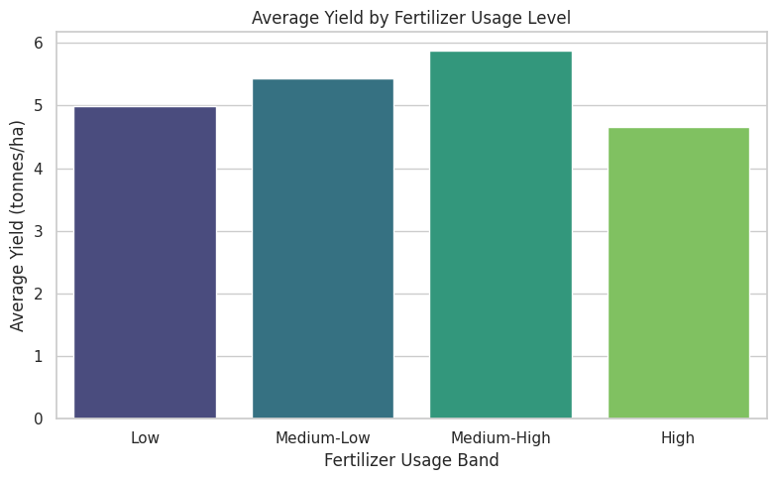
RESULTS
Student Analysis 3: Do Inputs Actually Affect Yield?
Question: If a farmer uses more fertilizer, more pesticide or better quality seeds — do they get a better yield?
Why I chose this: Farmers spend a lot of money on fertilizers, pesticides and good seeds expecting better results. I wanted to check if that investment actually shows up as better yield in the data.
Result: Correlation between fertilizer and yield is almost zero — more does not always mean better
Limitation: This does not mean fertilizers and pesticides are useless. It means this dataset does not show a strong link — possibly because other factors like crop type and season are more dominant. A separate analysis for each crop type might show a different picture.

Slide 10
RESULTS
Key Insights: 1. Kharif season has the highest average yield (5.63 t/ha) and profit (₹1,78,914). Zaid has the lowest yield (4.64 t/ha) and even shows a negative average profit (-₹24,804).
2. Sugarcane gives the highest yield in all three seasons.
3. Wheat, Rice and Maize show negative average profits across all seasons.
4. Drip irrigation gives the highest average yield (6.58 t/ha) compared to flood (4.86), sprinkler (5.16) and rainfed (4.60).
5. Kharif season has the highest disease and pest risk at 54.47% compared to Rabi (40.48%) and Zaid (38.22%).
6. NPK nutrient application is almost identical across all three seasons even though yield is clearly different.
7. Punjab has the highest average yield (6.12 t/ha) among all states. Andhra Pradesh has the lowest (4.63 t/ha).
8. Kharif season also has the best water efficiency (5.89 tonnes per 1000 m³) even though it uses more water in total (6102 m³ on average).

Slide 11
Future scope
Student Analysis 1 — Season-wise Crop Performance
Finding: Kharif gives the best yield and profit. Sugarcane and Chilli are most profitable across all seasons.
Next Step: Build a crop recommendation system that suggests the best crop for a farmer based on their season, location and budget.
Who benefits: Farmers and Agricultural Scientists
Student Analysis 2 — NPK Nutrient Usage Across Seasons
Finding: NPK application is uniform across seasons and shows weak correlation with yield.
Next Step: Design season-specific and crop-specific nutrient plans using soil testing data to optimize NPK usage.
Who benefits: Farmers, Government & Policy Bodies
Student Analysis 3 — Fertilizer, Pesticide and Seed Quality vs Yield
Finding: No strong relationship found between these inputs and yield in this dataset.
Next Step: Conduct a crop-separated analysis to check if the relationship between inputs and yield becomes clearer when each crop is studied individually.
Who benefits: Agri-input Companies, Environmental Analysts

Slide 12
GitHub Link
https://github.com/amanpreet-kaur-103/Seasonal-Agriculture-Performance-Analysis

Slide 13
VOIS Course completion certificate - Course name- Data Visualization

Slide 14
Thank you
.
.

