Slide 1
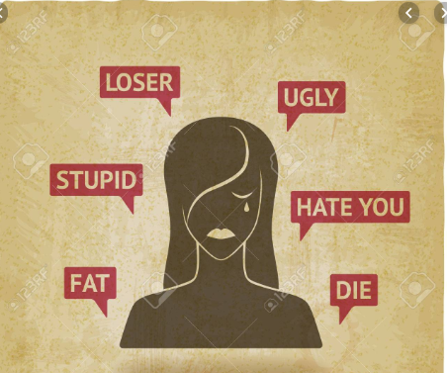
Applying Deep Learning To Identify Toxicity In Online Interactions
Amanpreet Singh
Narayan Acharya

Slide 2
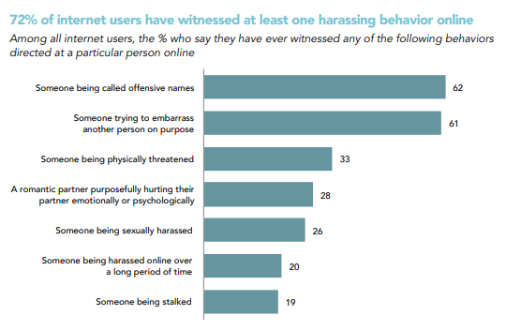
Why is this important?
Amanpreet Singh
Narayan Acharya
The Oxford word of the year in 2018 was toxic.
HateLab Project @ Cardiff University demonstrated consistent link between hate speech and aggravated offenses that happen offline. [Oct ‘19]
Online harassment is also associated with psychological harms as victims of digital abuse are more likely to show signs of depression. [Nov ‘16]
Source: ONLINE HARASSMENT, DIGITAL ABUSE, AND CYBERSTALKING IN AMERICA
Notes:
Toxic: https://languages.oup.com/word-of-the-year/word-of-the-year-2018
HateLab: https://phys.org/news/2019-10-online-speech-crimes-minorities.html
Data & Society Research Institute: https://www.datasociety.net/pubs/oh/Online_Harassment_2016.pdf

Slide 3
Task at hand?
Traditional Approach Pitfalls:
It is an operational challenge given scale of online platforms and context, perspective bias cannot be captured by a model program. Hence, difficult to use traditional approaches.
Our Task:
Identifying toxic behavior using Deep Learning in Wikipedia Comments.
Improve on existing methods using recent state-of-the-art techniques.
Compare different methodologies/ approaches specifically for this task.
Example Healthy Online Interaction:
You, sir, are my hero. Any chance you remember what page that's on?
Example Toxic Online Interactions:
Just shut up and stay shut. Don't edit anymore…
You should be fired, you're a moronic wimp who is too lazy to do research…
The above comments are toxic with the second one sub-categorized as an insult.

Slide 4
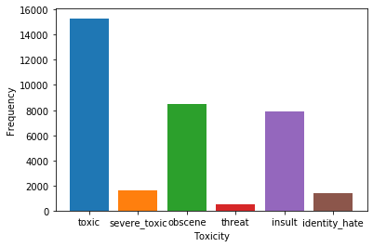
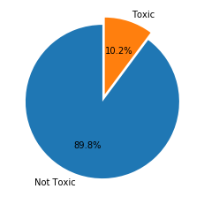
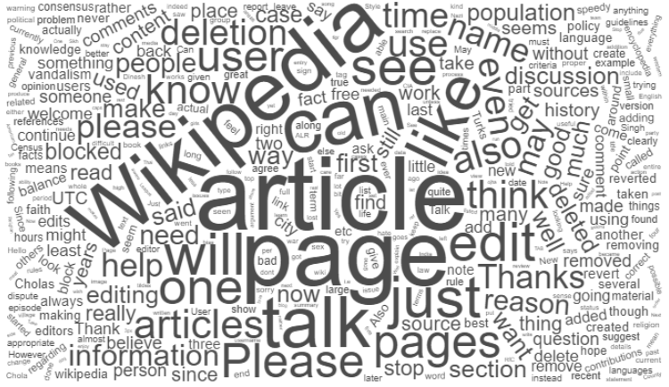
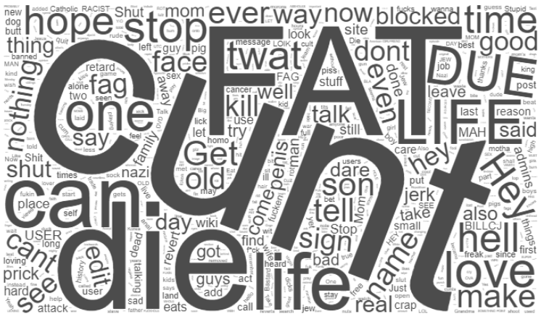
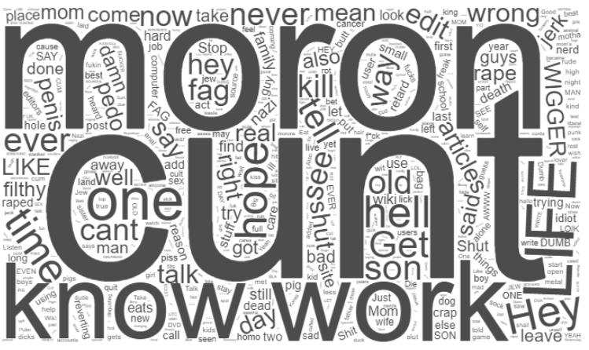
Dataset?
Approximately 160k comments, annotated with 6 classes of toxicity - toxic, severe toxic, obscene, threat, insult and identity hate. This is a slightly modified version of the original dataset available through a Kaggle Challenge.
The dataset contains around 10.2% of toxic comments. Samples for other classes are smaller in size.
Healthy Comments Frequent Words
Toxic Comments Frequent Words

Slide 5
Process Flow?
STEP 0
Clean Data
STEP 4
Vectorize
We apply well known preprocessing techniques for handling punctuation, dates, numbers, etc.
We convert our token into one-dimensional vectors using different word embeddings.
STEP 1
De-Emojize
STEP 5
Model Train
We replace emoticons like :), :(, :0 with their word equivalents like happy, sad angry, etc.
We train our model using different hyper-parameter to fine-tune our model for the task at hand.
STEP 2
Translate
STEP 6
Model Test
We look to replace words that have been written in a different language to English.
We test our model on the validation set. Go back to appropriate step if unsatisfactory results and repeat.
STEP 3
Upsample
STEP 7
Submit to Kaggle
In order to create similar number of samples for each of the prediction classes, we random duplicate samples from the under-represented classes.
We check how we fare with others by submitting our model predictions on the test dataset.

Slide 6
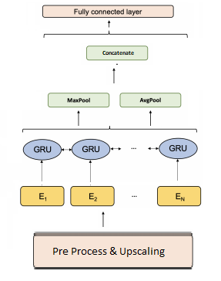
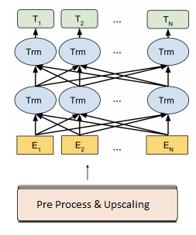
Architecture (Baseline vs State of the Art)
Vanilla BERT
Bi-GRU with Pooling

Slide 7
Experiments & Findings?
Model | Embeddings | Validation Accuracy | Kaggle (AUC) | Max Length | Batch Size | Dataset
Bi-Gru w Pooling [BASELINE] | glove.6B.300d.txt | 0.9834 | 0.97563 | 100 | 1000 | 150k
Bi-Gru w Pooling Upscaling | glove.6B.300d.txt | 0.9775 | 0.98192 | 100 | 1000 | 180k
Bi-Gru w Pooling Upscaling | glove.twitter.27B.200d | 0.9746 | 0.9811 | 100 | 1000 | 180k
BERT w Upscaling | bert-base-uncased | 0.99447 | 0.98382 | 100 | 32 | 180k
 | Multi-Layered DAN | GRU | Bi-GRU with Max Pooling | BERT | RoBERTa
GloVe - 50d
GloVe - 300d
fastText - 300d [Wiki]
fastText - 300d [Crawl]
GloVe - 200d [Twitter]
NOTE: This is reduced version of the experiments table highlighting the best performing models, upscaled datasets and choice of embeddings.

Slide 8
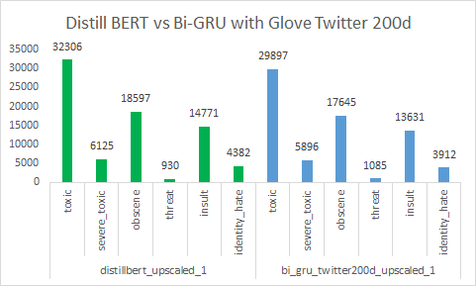
Best Performing Models Comparison Examples
Comment | Distill BERT | Bi-GRU [Glove Twitter 200d]
"make those kickass userboxes" | Toxic | Not Toxic
"this page should be altered to relflect the fact that John Luther Adams is a badass." | Toxic | Not Toxic
"Commandant of Auschwitz" | Not Toxic | Toxic
"How did he die? I just ask because his death was during black death years." | Toxic | Not Toxic
"Babies can't be wealthy." | Not Toxic | Toxic
"Oh, and stop calling everybody racists too." | Not Toxic | Toxic
Comparing Predicted Labels Per Class for
Distill BERT vs Bi-GRU
NOTE: The final metrics are actually based on prediction confidence as a floating point number between 0 and 1. These comparisons are based on rounding off to the nearest integer.

Slide 9
Key Takeaways and Future Work?
Key Takeaways:
The effect of dominating classes can be negated to a great extent if resampling is done carefully. (Point 2 in future work)
There is a tradeoff between the training time and every point of accuracy gained from DANs to BERT.
The power of transfer learning with pre-trained models like variants of BERT.
Pitfalls of a subjective task such as this - comments with profanities are more likely to get marked as toxic
Multi-label classification using a deep learning architecture
Future Work:
Transfer Learning: We wish to try out our models on data from other platforms like Twitter and Reddit. We have already sourced Twitter data and will be working on it soon.
Use Translation to other languages and back to English as a way of augmenting dataset rather than randomly upsampling. This would create new instead of duplicate training samples.
Use “Misspelling Oblivious Word Embeddings” or “MOE” by Facebook Research as an alternate over GloVe and fastText.

