Slide 1
Phishing Data Analysis
Introduction:
The dataset at hand is a comprehensive collection of phishing incidents, capturing essential details such as user information, tests details and timestamps
The purpose of this analysis is to extract meaningful insights from the employee phishing data, enabling us to understand employee behaviour, identify gaps, and observe trends over time
Through a series of data cleaning, processing and visualizations, we aim to uncover patterns that can inform business decisions, enhance employee experience, and optimize overall organisational efficiency

Slide 2
Approach
Data Cleaning and Preparation:
Identified gaps in the data and exported a clean data file for further processing. Tool used: Python
Exploratory Data Analysis (EDA):
Identified department wise analysis, employee tenure and failure rate. Tool used: Tableau
Insight Generation:
Explored the 13 months trend to understand patterns and peak periods, aiding in finding cybersecurity risks and strategic training planning
Recommendations:
Targeted training programs and efficient onboarding can help mitigate future cybersecurity risks

Slide 3
Cleaning the data
Employee Dataset:
Employee: Serial numbers at the end were missing and were filled using the last value
Division: There were null and whitespaces in few cells, which were handled separately
Employee Region: There were null and whitespaces in few cells, which were handled separately
Hire Date : There were 3 different date format, out of which m/dd/yyyy need to be parsed separately. Also, there were invalid dates. It was converted into valid date format keeping leap year and other corner cases in check
Incident Dataset:
Employee: Serial numbers at the end were missing and were filled using the last value
Division: There were null and whitespaces in few cells, which were handled separately
13 Month Results columns: There were nulls in few cells. These were filled with 0’s based on “No of Fails in past 6, 13 months” and “Clicked on Email” column.
No of Fails in past 6, 13 months: There were nulls in few cells. Need to be filled based on “No of Fails in past 6, 13 months” and and “Clicked on Email” column.
Clicked on Link: Only one value – “Yes”. Other values were filled based on “No of Fails in past 6, 13 months”
Device Type Used : There were null values which needed to be filled with ”Unknowns”

Slide 4
Exploratory Data Analysis
Following trends were studied:
No of employees clicked on the phishing link
Failure Rates by Department
Monthly Failures numbers over 13 months
Employee Tenure vs Failure
High Risk Employees Count
Distribution of Employees over no of fails in past 13 months
Correlation between Device type used and Failure rates
Region-wise chart of Employees who clicked on link
Performance of Employees over first 6 months vs last 7 months

Slide 5
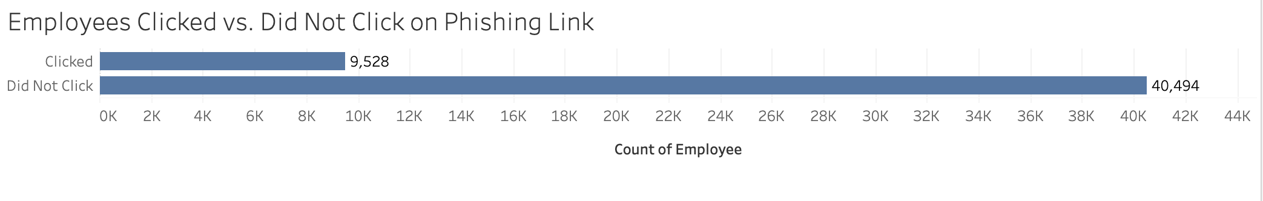
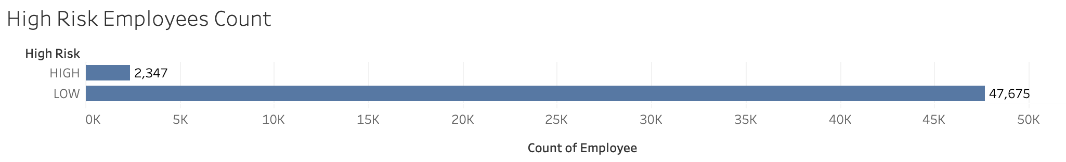
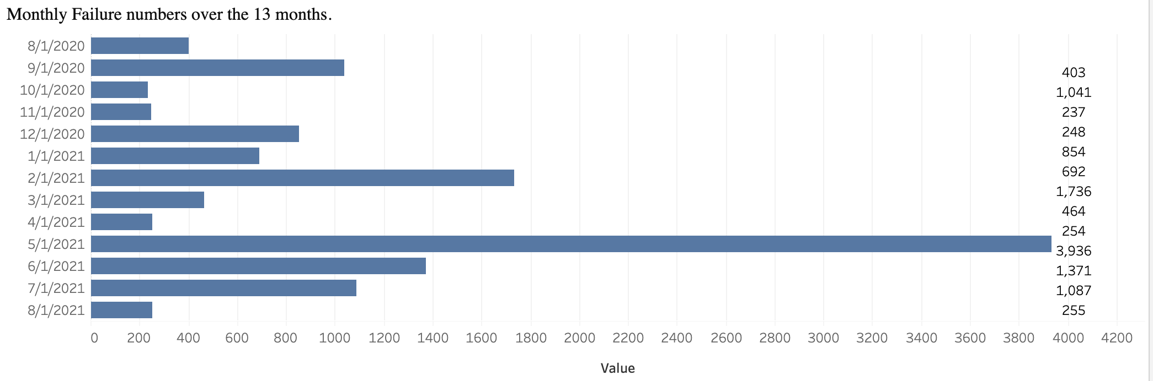
Visualizations

Slide 6
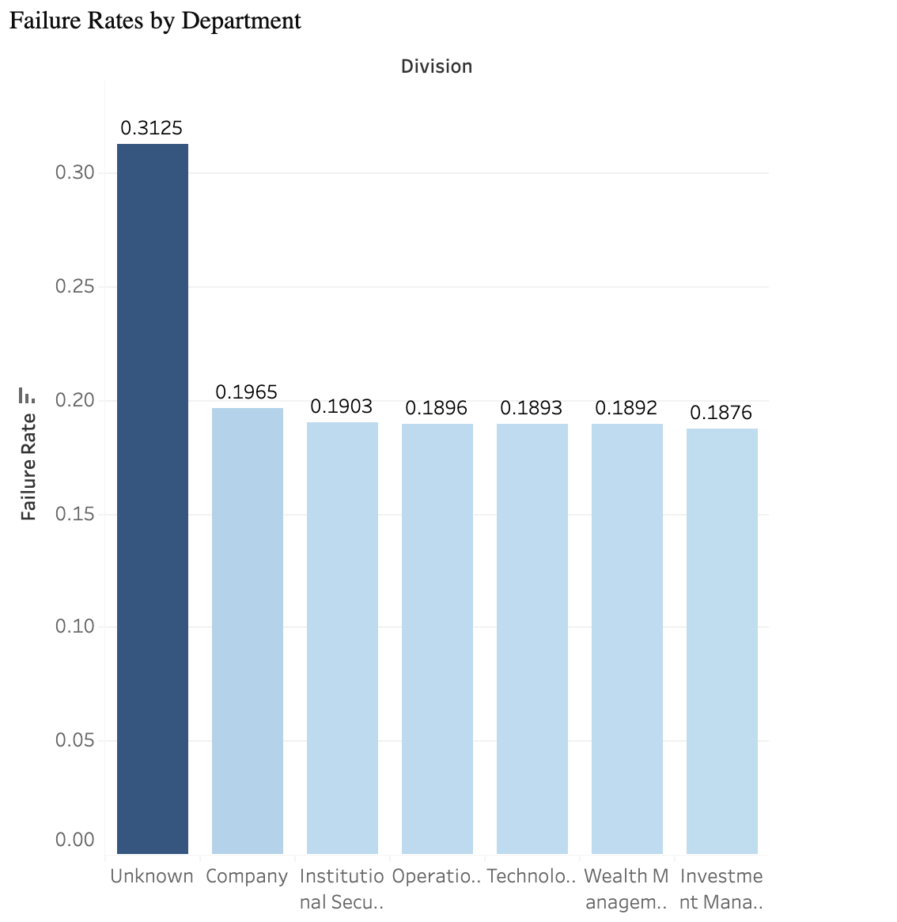
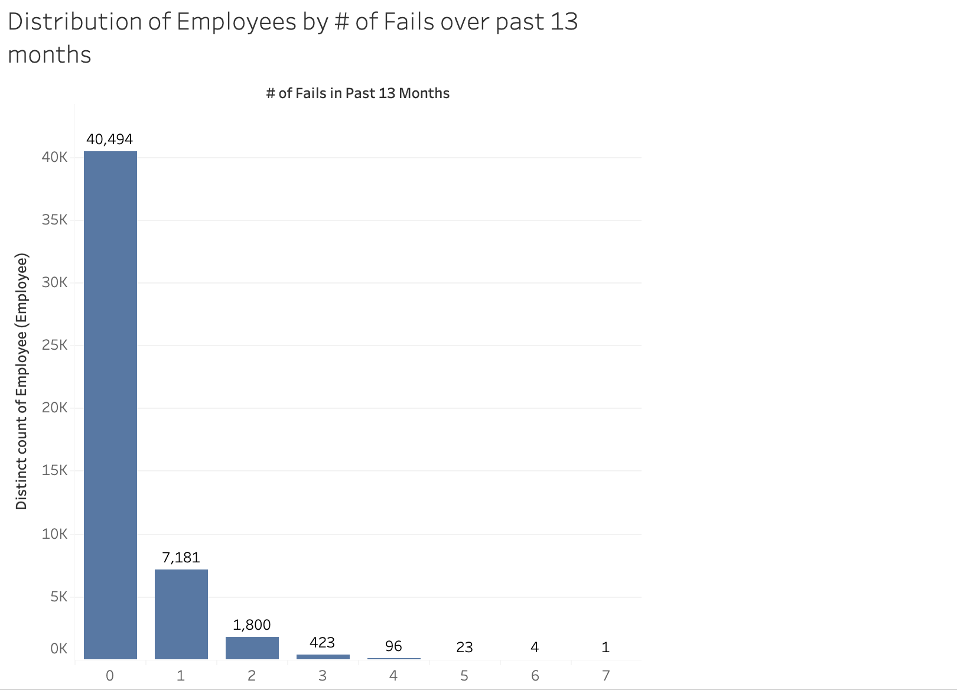

Slide 7
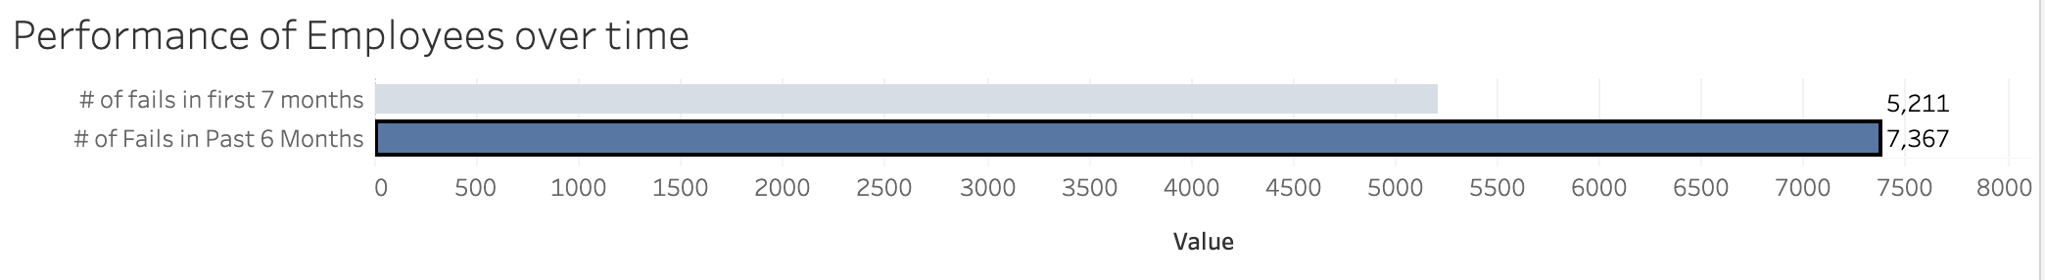
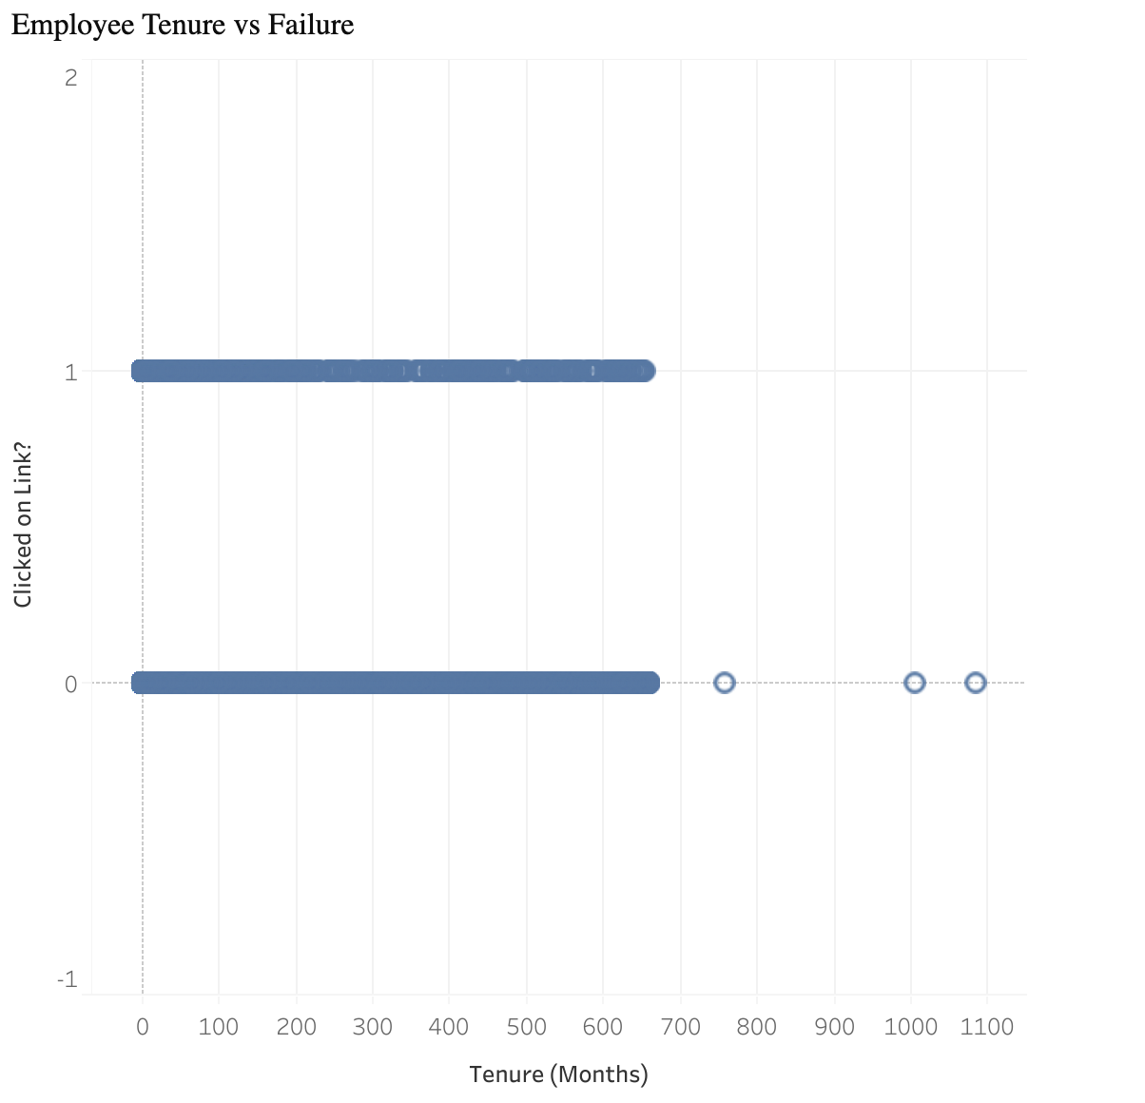

Slide 8
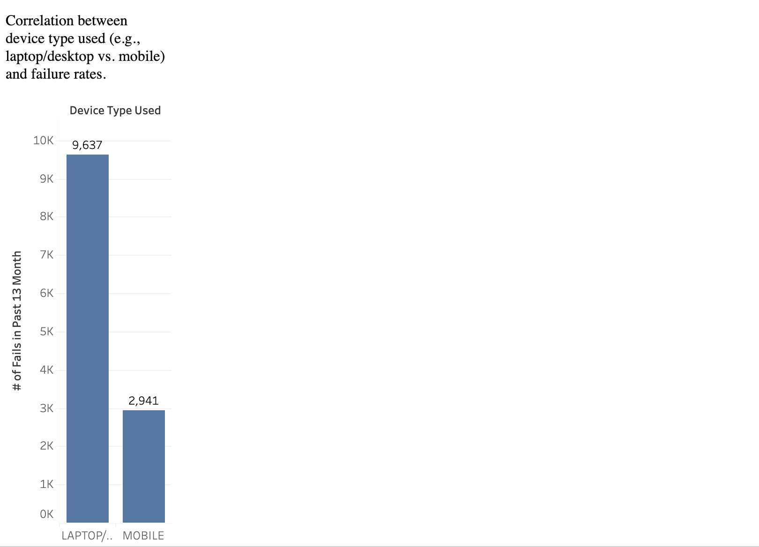
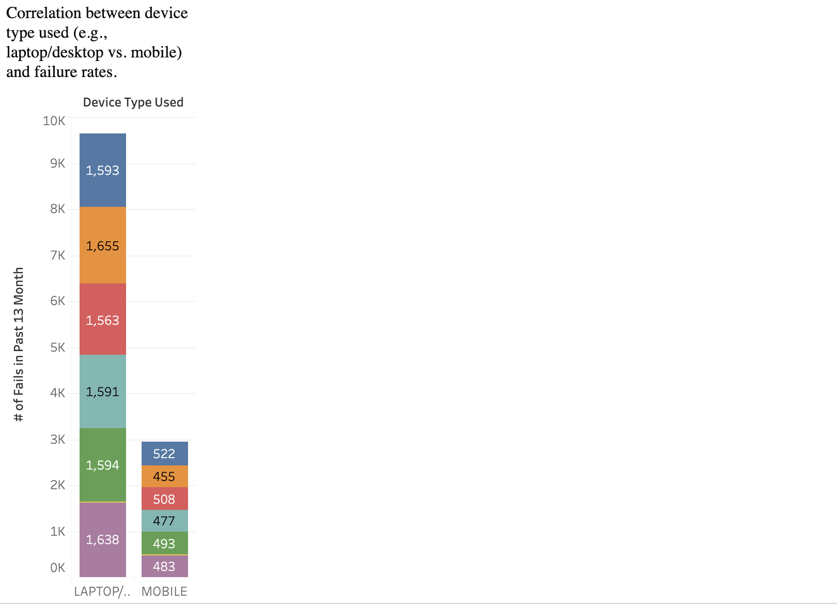

Slide 9
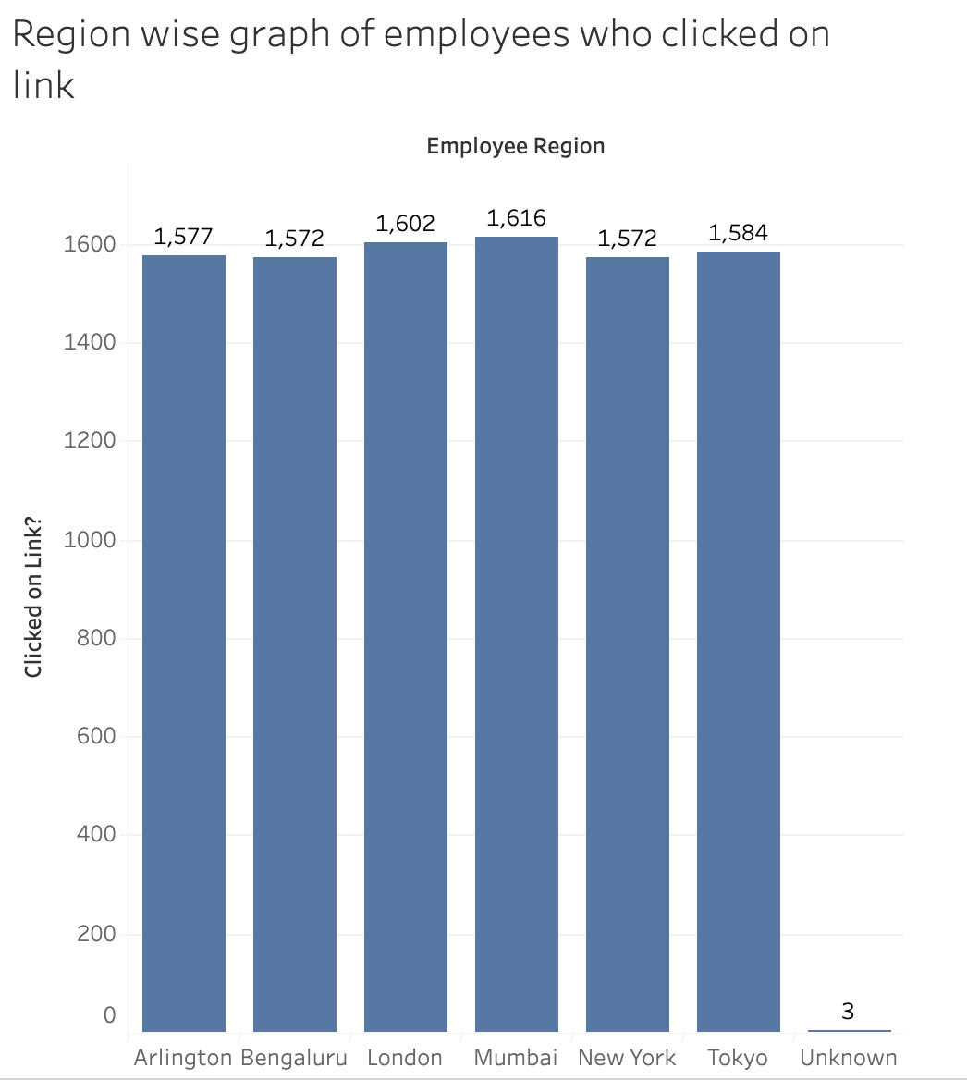
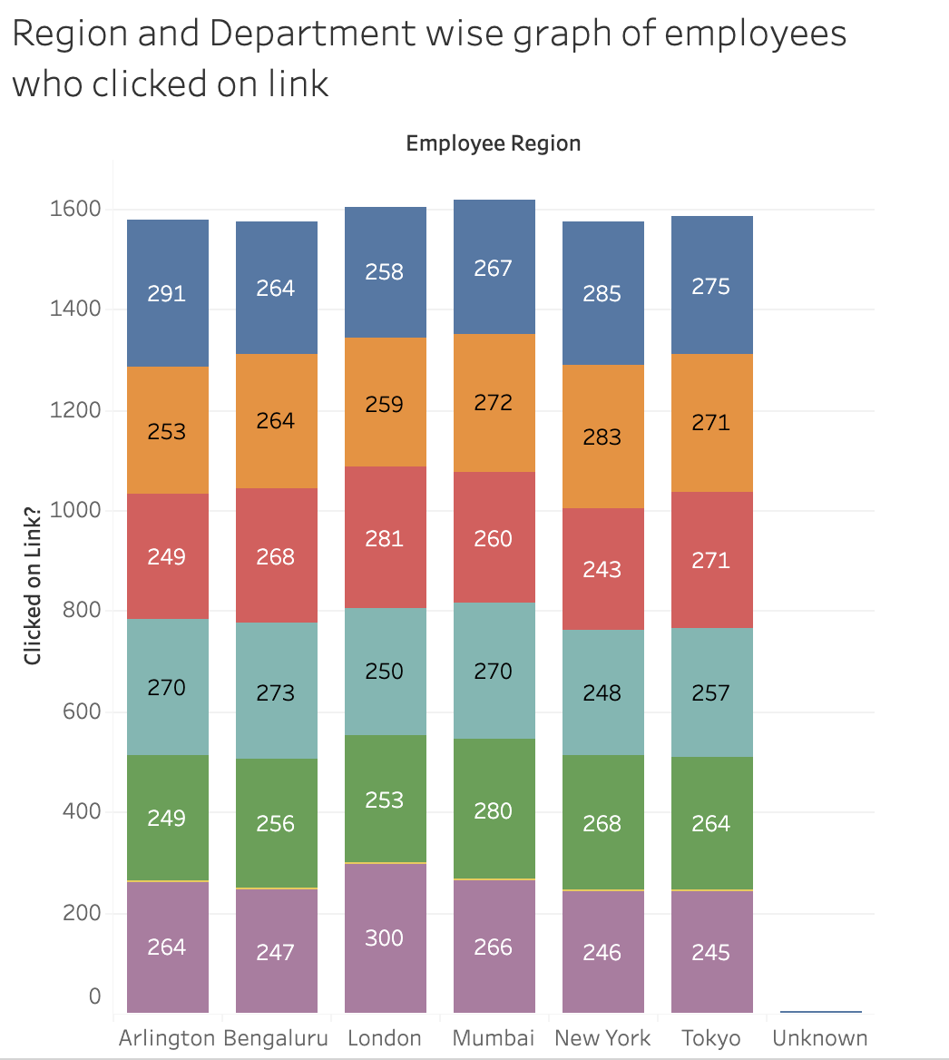

Slide 10
Questions and useful metrics
What % of employees clicked on the phishing link?
Almost 20% employees
Which departments have the highest failure rates ?
The most failure rates were from employees whose department is ”Unknown” and least were from “Investment Management”
Are there specific times of year where failure rates are higher?
Highest failures occur in year 2021 than in 2020
What % of employees are High Risk Employees?
There were a total of 2347 employees (4.69%) which are potential threat to firm in cybersecurity
Distribution of Employees over no of fails in past 13 months:
There are a total of 124 employees who have failed 4 times or more over the past 13 months
Is there any specific trend of new employees failing tests ?
No such trend was observed. It seemed that irrespective of employee age, they failed tests equally
Which Device type had high failure rates?
There were 3.3x more number of failures that occurred through desktop/laptop vs mobile
Which locations are more vulnerable ?
Mumbai, London and Tokyo
How is performance of Employees over first 6 months vs last 7 months?
No of failures have increased more(58.5%) over the past 6 months as compared to the rest of 7 months(41.5%)

Slide 11
Key Insights and their Implications
High risk departments:
This indicates a need for focused training and awareness campaigns in these areas – “Unknown”, “Company” and ”Institutional Securities Group”
Training Effectiveness at start vs recent:
Increased rates have suggested the need for revising training content and methods
High Risk Employees:
These individuals might need targeted interventions and monitoring to reduce their susceptibility to phishing attacks
Device type:
It suggests that phishing tactics might be more successful on desktop/laptop than mobile. Need more tech specifications and security of these devices
Vulnerable employee Locations:
Mumbai, London and Tokyo. Need more rigorous training on these zones

Slide 12
Recommendations
Targeted Training Programs:
Focusing on departments and employee locations with the highest failure rates as mentioned. Customize training sessions to address specific weaknesses observed in these departments
Enhanced Onboarding Process:
Introduce more rigorous phishing awareness training for new employees during their onboarding process to mitigate the potential future risk
Regular Refresher Courses for High Risk Employees:
Implement mandatory quarterly refresher courses for high risk employees, emphasizing recent phishing techniques and examples
Review Access Controls: :
Consider reviewing and potentially limiting access to critical systems for employees with high failure rates until further training or evaluation is completed. Implement multi factor authentication for these employees
Phishing Simulation Frequency:
Increase the frequency of simulated phishing tests to keep employees vigilant and reinforce training
Incentivize Reporting:
Encourage employees to report phishing attempts by recognizing and rewarding diligent behaviour.
Monitor and Adapt:
Continuously monitor phishing test results and adapt training programs based on emerging trends and threat landscapes
More Security for Desktop/Laptops:
Continuously monitor laptops of employees and install latest anti-malwares and security updates and block access to harmful sites or extensions

