Slide 1
Mutual Fund Analytics
Dashboard & Advanced Analytics
Presented By
Program
Date
Aman Kumar Rai
Bluestock Internship
June 2025
Data-Driven Insights · Risk Analytics · Investor Segmentation

Slide 2
Project Overview
🎯 Objective
🛠 Tools Used
Analyze mutual fund performance
and track scheme-level returns
Understand investor behavior
and transaction patterns
Identify risk exposure
through VaR and CVaR metrics
Segment investors into
Healthy vs At-Risk groups
Python
Pandas
NumPy
Matplotlib
Power BI

Slide 3
Dataset Information
10 CSV Files — Complete Data Coverage
Fund Master Data
SIP Records
fund_master.csv · Scheme codes, names, fund house, categories
sip_records.csv · SIP schedules and gap tracking
NAV History
Investor Profile
nav_history.csv · Daily NAV records per scheme
investor_profile.csv · Demographics and risk profile
Investor Transactions
Returns Data
investor_transactions.csv · Buy/sell/SIP transaction logs
returns_data.csv · 1Y / 3Y / 5Y scheme returns
Portfolio Holdings
Expense Ratio
portfolio_holdings.csv · Asset-level holding percentages
expense_ratio.csv · TER and exit load metadata
Benchmark Indices
AUM Data
benchmark_indices.csv · Nifty 50, Sensex daily index values
aum_data.csv · Assets under management by scheme

Slide 4
Data Processing Pipeline
Transforming raw CSV data into analytics-ready datasets
01
02
03
04
05
Data Cleaning
Missing Value Handling
Date Conversion
Feature Engineering
Data Aggregation
Removed duplicates, standardized
fund codes and scheme names
Forward-fill for NAV gaps;
median imputation for returns
Parsed all date fields to
datetime64 for time-series ops
Daily returns, rolling metrics,
SIP gap computation
Monthly/yearly rollups for
Performance & Cohort analysis

Slide 5
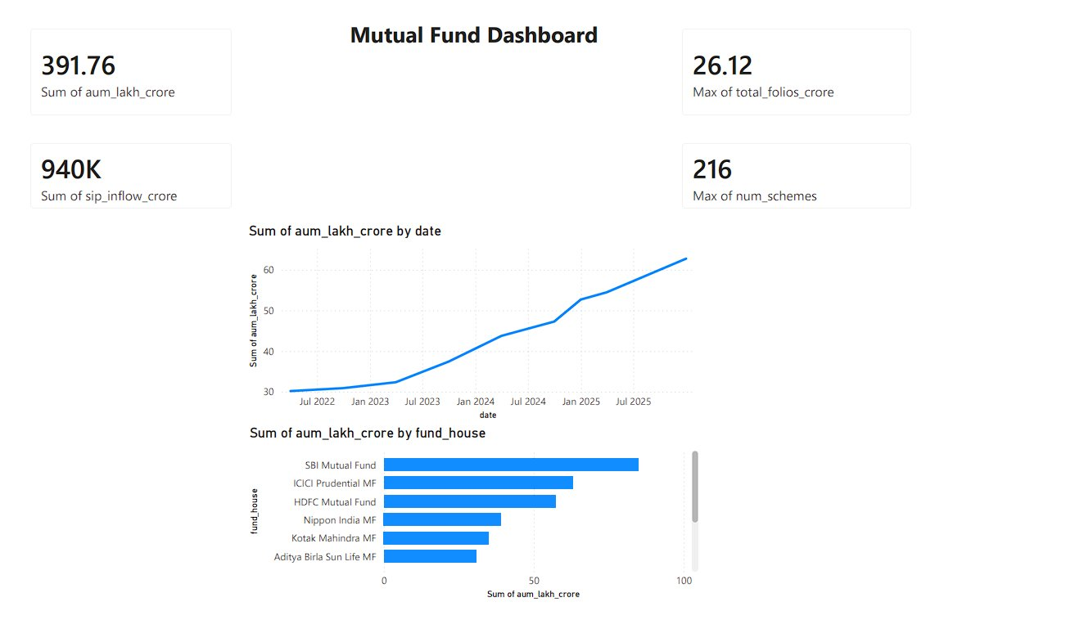
Power BI Dashboard
📊
Fund Performance
NAV trends, returns comparison
👤
Investor Analytics
Cohort & behavior tracking
📈
Benchmark Comparison
Alpha vs Nifty/Sensex
🔍
Interactive Filters
Slice by fund, date, category

Slide 6
VaR & CVaR Risk Analysis
Value at Risk · Conditional Value at Risk · 95% Confidence Level
1
Historical Returns Calculated
Daily log-returns computed from NAV time series for all schemes
2
95% VaR Computed
Worst-case loss at 95th percentile using historical simulation
3
CVaR Computed
Expected loss beyond VaR threshold — tail risk quantification
⚠ Key Finding:
Fund 119599 showed the highest downside risk with maximum VaR and CVaR among all analyzed schemes.

Slide 7
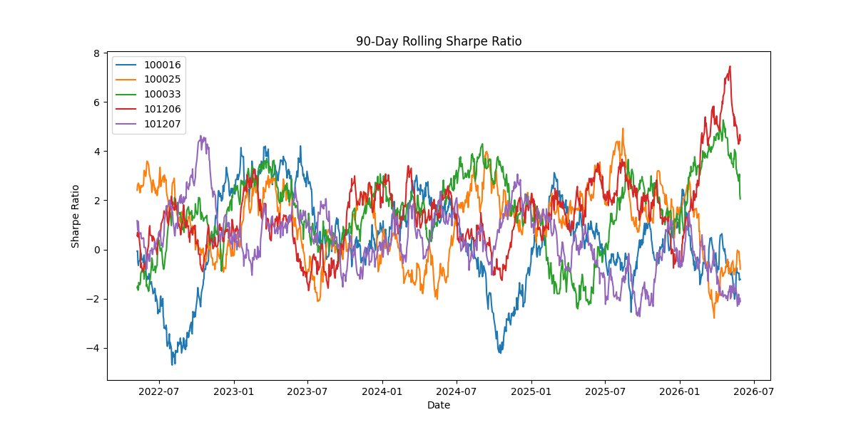
Rolling Sharpe Ratio Analysis
✅ Key Finding: Several schemes achieved Rolling Sharpe Ratio > 2, indicating strong risk-adjusted returns over the analysis period.

Slide 8
Cohort Analysis — Investor Joining Year
👥
Investors grouped by year of first SIP / lump sum transaction
📅
Trend comparison across 5 cohorts: 2020 – 2024
📊
Investment volume and retention rate tracked per cohort
🏆 Key Finding: 2024 investors contributed the majority of total investments, reflecting strong recent growth in fund participation.

Slide 9
Investor Risk Segmentation
Healthy Investors
8,094
67.5%
Regular SIP contribution
Gap ≤ 35 days between SIPs
Consistent investment pattern
At-Risk Investors
3,906
32.5%
SIP gap > 35 days detected
Irregular contribution patterns
Flag for advisor intervention
⚠ Key Finding: ~3,906 investors flagged as At-Risk due to SIP gaps exceeding 35 days — requiring targeted advisor outreach.

Slide 10
Conclusion & Future Scope
✅ Deliverables Completed
🚀 Future Scope
✓
Risk Analysis — VaR & CVaR across all schemes
📡
Real-time NAV Integration via AMFI API feed
✓
Investor Segmentation — Healthy vs At-Risk
🤖
AI-based Recommendation System using collaborative filtering
✓
Recommendation Engine — Personalized fund suggestions
📱
Mobile-friendly investor dashboard
✓
Power BI Dashboard — Interactive visual analytics
🔔
SIP gap alert automation for at-risk investors
Aman Kumar Rai · Bluestock Internship · Mutual Fund Analytics Project · June 2025

