Slide 1
LIBRARY MANAGEMENT
SYSTEM
A DBMS Project
Database Design • ER Modelling • SQL Implementation
By - Aman Raj
Ankit Kumar
Anant Jain
Raunak Kumar

Slide 2
INTRODUCTION
What is LMS?
A Library Management System (LMS) is a software application that automates and manages library operations including book cataloging, issue/return tracking, and member management.
Project Objective
To design and implement a relational database system for a library that efficiently manages books, members (readers), staff, publishers, and transactions.
Technology Used
The system is built using DBMS concepts including ER Diagrams, relational schema, normalization, SQL queries, and proper relationship mapping between entities.

Slide 3
ENTITIES & ATTRIBUTES
Books
Readers
Staff
ISBN, AuthNo, Title, Edition, Category, Price
USER_ID, Firstname, Lastname, Name, Email, Phone no, Address
Staff_id, Name
Publisher
Reports
Auth. System
Publisher_id, Name, YearOfPublication
Reg_no, User_id, Book_No, Issue/Return
LoginID, Password

Slide 4
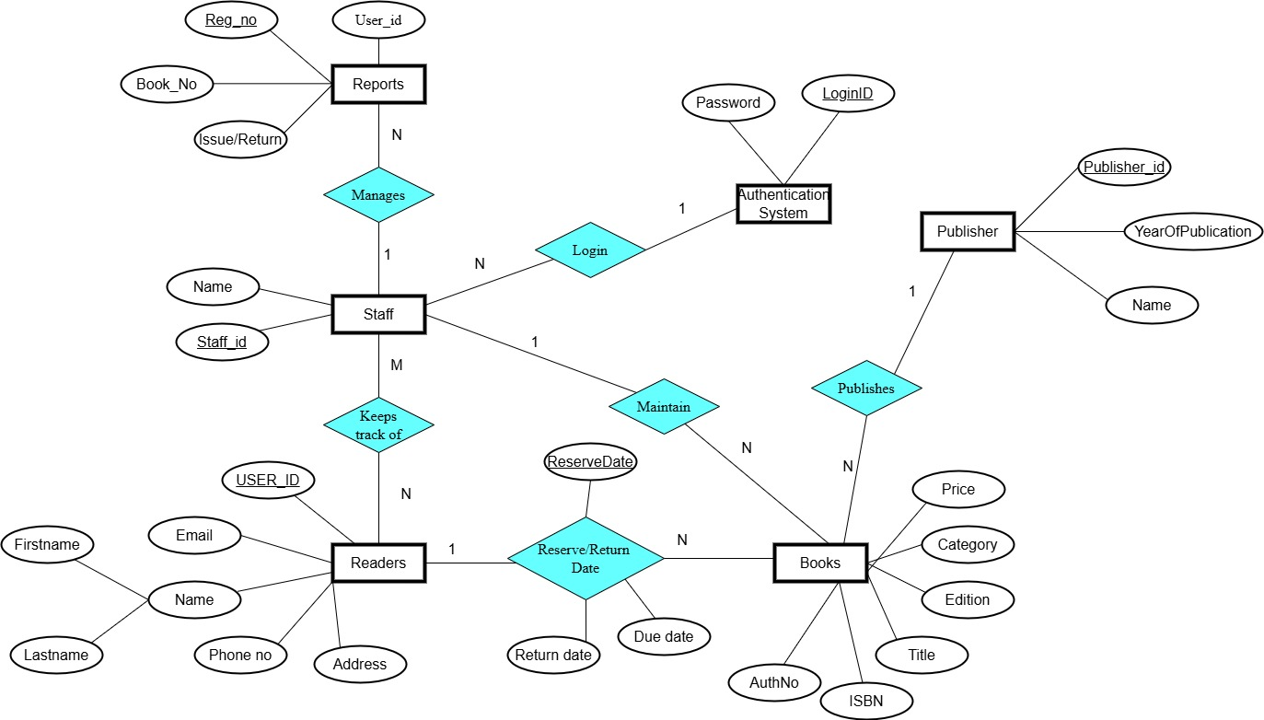
ENTITY RELATIONSHIP (ER) DIAGRAM
Key Relationships Publisher → publishes → Books (1:N) Staff → maintains → Books (N:N) Staff → keeps track of → Readers (M:N) Staff → manages → Reports (1:N) Auth System → login → Staff (1:1) Books → Reserve/Return → Readers (N:N)

Slide 5
RELATIONSHIPS & CARDINALITY
Entity 1
Relationship
Entity 2
Cardinality
Attributes
Publisher
Publishes
Books
1 : N
-
Staff
Maintains
Books
N : N
ReserveDate
Staff
Keeps Track Of
Readers
M : N
Reserve/Return Date, Due date, Return date
Staff
Manages
Reports
1 : N
-
Auth. System
Login
Staff
1 : 1
-

Slide 6
SYSTEM FEATURES
Book Management
Member Management
Add/update/delete books
Track ISBN, author, edition
Category & price management
Reader registration
Store contact & address info
Issue/Return tracking
Staff Operations
Publisher Management
Staff authentication (Login)
Manage issue & return reports
Track reader activity
Publisher registration
Link books to publishers
Year of publication tracking

Slide 7
CONCLUSION
1. Successfully designed a normalized relational database for a Library Management System. 2. ER diagram captures all key entities: Books, Readers, Staff, Publisher, Reports, and Auth System. 3. All relationships and cardinalities are clearly mapped with appropriate attributes. 4. The system supports core library operations: book issue/return, member tracking, and staff login. 5. This DBMS project demonstrates real-world database design principles and SQL implementation.

