Slide 1
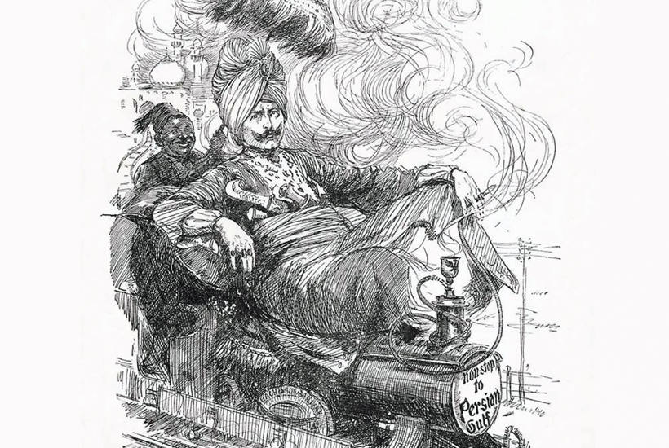
RULER OF THE WORLD

Slide 2

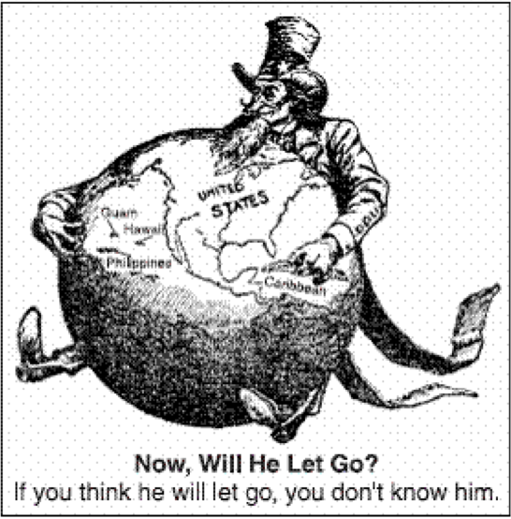
IMPERIALISM

Slide 3
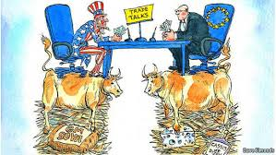
FREE FLOW OF TRADE

Slide 4
THANK YOU

