Slide 1
Constraint Satisfaction Problems
Chapter 5
Section 1 – 3

Slide 2
Constraint satisfaction problems (CSPs)
CSP:
  state is defined by variables X_{i} with values from domain D_{i}
  goal test is a set of constraints specifying allowable combinations of values for subsets of variables
Allows useful general-purpose algorithms with more power than standard search algorithms

Slide 3

Example: Map-Coloring
Variables WA, NT, Q, NSW, V, SA, T
Domains D_{i} = {red,green,blue}
Constraints: adjacent regions must have different colors
e.g., WA ≠ NT

Slide 4

Example: Map-Coloring
Solutions are complete and consistent assignments, e.g., WA = red, NT = green,Q = red,NSW = green,V = red,SA = blue,T = green

Slide 5

Constraint graph
Binary CSP: each constraint relates two variables
Constraint graph: nodes are variables, arcs are constraints

Slide 6
Varieties of CSPs
Discrete variables
  finite domains:
    n variables, domain size d → O(d ^{n}) complete assignments
    e.g., 3-SAT (NP-complete)
  infinite domains:
    integers, strings, etc.
    e.g., job scheduling, variables are start/end days for each job:
    StartJob₁ + 5 ≤ StartJob₃
Continuous variables
  e.g., start/end times for Hubble Space Telescope observations
  linear constraints solvable in polynomial time by linear programming

Slide 7
Varieties of constraints
Unary constraints involve a single variable,
  e.g., SA ≠ green
Binary constraints involve pairs of variables,
  e.g., SA ≠ WA
Higher-order constraints involve 3 or more variables,
  e.g., SA ≠ WA ≠ NT

Slide 8

Example: Cryptarithmetic
Variables: F T U W R O X₁ X₂ X₃
Domains: {0,1,2,3,4,5,6,7,8,9} {0,1}
Constraints: Alldiff (F,T,U,W,R,O)
  O + O = R + 10 · X₁
  X₁ + W + W = U + 10 · X₂
  X₂ + T + T = O + 10 · X₃
  X₃ = F, T ≠ 0, F ≠ 0

Slide 9
Real-world CSPs
Assignment problems
  e.g., who teaches what class
Timetabling problems
  e.g., which class is offered when and where?
Transportation scheduling
Factory scheduling
Notice that many real-world problems involve real-valued variables

Slide 10
Standard search formulation
Let’s try the standard search formulation.
We need:
Initial state: none of the variables has a value (color)
Successor state: one of the variables without a value will get some value.
Goal: all variables have a value and none of the constraints is violated.
NxD
N layers
WA
WA
WA
NT
T
[NxD]x[(N-1)xD]
WA
NT
WA
NT
WA
NT
NT
WA
Equal!
N! x D^N
There are N! x D^N nodes in the tree but only D^N distinct states??

Slide 11
Backtracking (Depth-First) search
Special property of CSPs: They are commutative:
This means: the order in which we assign variables
does not matter.
Better search tree: First order variables, then assign them values one-by-one.
NT
WA
=
WA
NT
D
WA
WA
WA
WA
NT
D^2
WA
NT
WA
NT
D^N

Slide 12

Backtracking example

Slide 13

Backtracking example

Slide 14

Backtracking example

Slide 15

Backtracking example

Slide 16
Improving backtracking efficiency
General-purpose methods can give huge gains in speed:
  Which variable should be assigned next?
  In what order should its values be tried?
  Can we detect inevitable failure early?
  We’ll discuss heuristics for all these questions in the following.

Slide 17

Which variable should be assigned next?
→minimum remaining values heuristic
Most constrained variable:
  choose the variable with the fewest legal values
a.k.a. minimum remaining values (MRV) heuristic
Picks a variable which will cause failure as soon as possible, allowing the tree to be pruned.

Slide 18

Which variable should be assigned next? → degree heuristic
Tie-breaker among most constrained variables
Most constraining variable:
  choose the variable with the most constraints on remaining variables (most edges in graph)

Slide 19

In what order should its values be tried?
→ least constraining value heuristic
Given a variable, choose the least constraining value:
  the one that rules out the fewest values in the remaining variables
Leaves maximal flexibility for a solution.
Combining these heuristics makes 1000 queens feasible

Slide 20
Rationale for MRV, DH, LCV
In all cases we want to enter the most promising branch, but we also want to detect inevitable failure as soon as possible.
MRV+DH: the variable that is most likely to cause failure in a branch is assigned first. The variable must be assigned at some point, so if it is doomed to fail, we’d better found out soon. E.g X1-X2-X3, values 0,1, neighbors cannot be the same.
LCV: tries to avoid failure by assigning values that leave maximal flexibility for the remaining variables. We want our search to succeed as soon as possible, so given some ordering, we want to find the successful branch.

Slide 21

Can we detect inevitable failure early?
→ forward checking
Idea:
  Keep track of remaining legal values for unassigned variables
  that are connected to current variable.
  Terminate search when any variable has no legal values

Slide 22

Forward checking
Idea:
  Keep track of remaining legal values for unassigned variables
  Terminate search when any variable has no legal values

Slide 23

Forward checking
Idea:
  Keep track of remaining legal values for unassigned variables
  Terminate search when any variable has no legal values

Slide 24

Forward checking
Idea:
  Keep track of remaining legal values for unassigned variables
  Terminate search when any variable has no legal values

Slide 25
2) Consider the constraint graph on the right.
The domain for every variable is [1,2,3,4].
There are 2 unary constraints:
- variable “a” cannot take values 3 and 4.
- variable “b” cannot take value 4.
There are 8 binary constraints stating that variables
connected by an edge cannot have the same value.
a) [5pts] Find a solution for this CSP by using the following
heuristics: minimum value heuristic, degree heuristic,
forward checking. Explain each step of your answer.
b
a
c
e
d
CONSTRAINT GRAPH

Slide 26
2) Consider the constraint graph on the right.
The domain for every variable is [1,2,3,4].
There are 2 unary constraints:
- variable “a” cannot take values 3 and 4.
- variable “b” cannot take value 4.
There are 8 binary constraints stating that variables
connected by an edge cannot have the same value.
a) [5pts] Find a solution for this CSP by using the following
heuristics: minimum value heuristic, degree heuristic,
forward checking. Explain each step of your answer.
MVH→ a=1 (for example)
FC+MVH→ b=2
FC+MVH+DH→ c=3
FC+MVH→ d=4
FC→ e=1
b
a
c
e
d
CONSTRAINT GRAPH

Slide 27
Constraint propagation
Forward checking only checks consistency between assigned and non-assigned states. How about constraints
between two unassigned states?
NT and SA cannot both be blue!
Constraint propagation repeatedly enforces constraints locally

Slide 28

Arc consistency
Simplest form of propagation makes each arc consistent
X →Y is consistent iff
  for every value x of X there is some allowed y
consistent arc.
constraint propagation propagates arc consistency on the graph.

Slide 29

Arc consistency
Simplest form of propagation makes each arc consistent
X →Y is consistent iff
  for every value x of X there is some allowed y
inconsistent arc.
remove blue from source→ consistent arc.

Slide 30

Arc consistency
Simplest form of propagation makes each arc consistent
X →Y is consistent iff
  for every value x of X there is some allowed y
If X loses a value, neighbors of X need to be rechecked:
i.e. incoming arcs can become inconsistent again
(outgoing arcs will stay consistent).
this arc just became inconsistent

Slide 31

Arc consistency
Simplest form of propagation makes each arc consistent
X →Y is consistent iff
  for every value x of X there is some allowed y
If X loses a value, neighbors of X need to be rechecked
Arc consistency detects failure earlier than forward checking
Can be run as a preprocessor or after each assignment
# arcs
Time complexity: O(n²d³)
d^2 for checking, each node can be checked d times at most

Slide 32
Arc Consistency
This is a propagation algorithm. It’s like sending messages to neighbors on the graph! How do we schedule these messages?
Every time a domain changes, all incoming messages need to be re-send. Repeat until convergence → no message will change any domains.
Since we only remove values from domains when they can never be part of a solution, an empty domain means no solution possible at all → back out of that branch.
Forward checking is simply sending messages into a variable that just got its value assigned. First step of arc-consistency.

Slide 33
Try it yourself
[R,B,G]
[R,B,G]
[R]
[R,B,G]
[R,B,G]
Use all heuristics including arc-propagation to solve this problem.

Slide 34
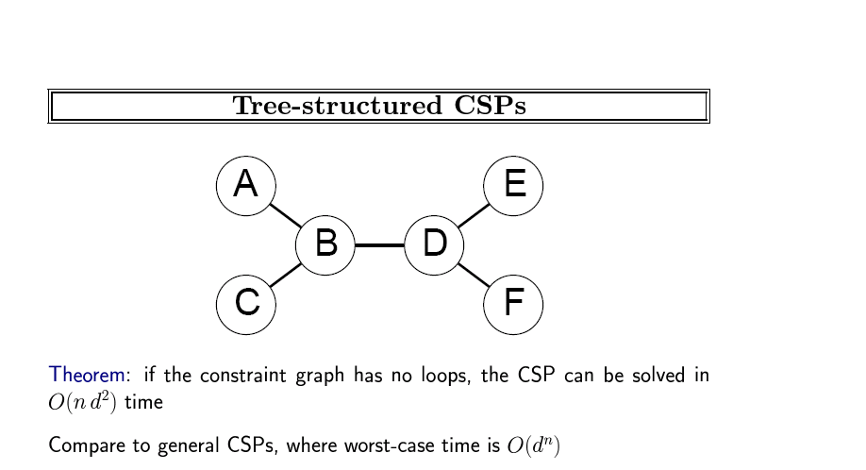

Slide 35
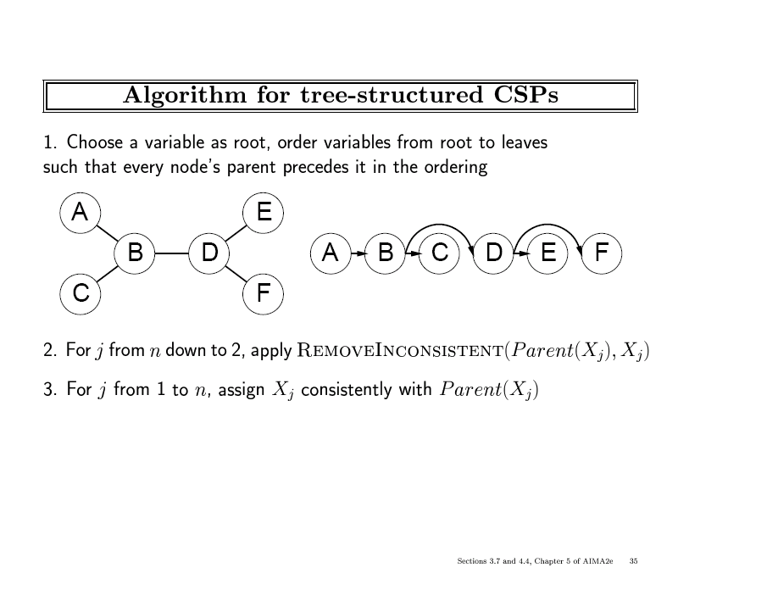
B
G
R
R
G
B
B
R
G
a priori
constrained
nodes
B
G
B
R
G
R
G
B
Note: After the backward pass, there is guaranteed
to be a legal choice for a child node for any of its
leftover values.
This removes any inconsistent values from Parent(Xj),
it applies arc-consistency moving backwards.

Slide 36
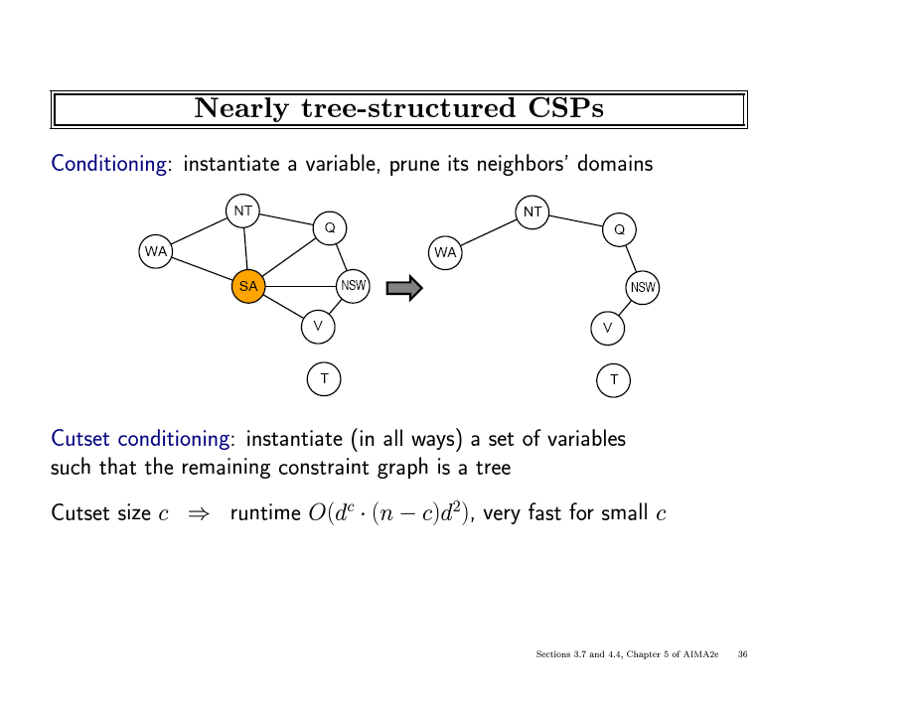

Slide 37
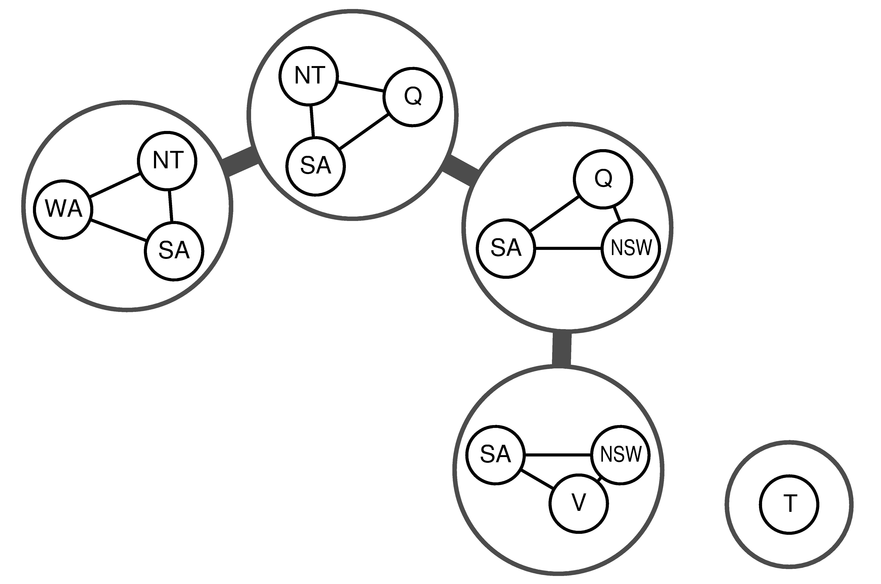
Junction Tree Decompositions

Slide 38
Local search for CSPs
Note: The path to the solution is unimportant, so we can
apply local search!
To apply to CSPs:
  allow states with unsatisfied constraints
  operators reassign variable values
Variable selection: randomly select any conflicted variable
Value selection by min-conflicts heuristic:
  choose value that violates the fewest constraints
  i.e., hill-climb with h(n) = total number of violated constraints

Slide 39

Example: 4-Queens
States: 4 queens in 4 columns (4⁴ = 256 states)
Actions: move queen in column
Goal test: no attacks
Evaluation: h(n) = number of attacks

Slide 40
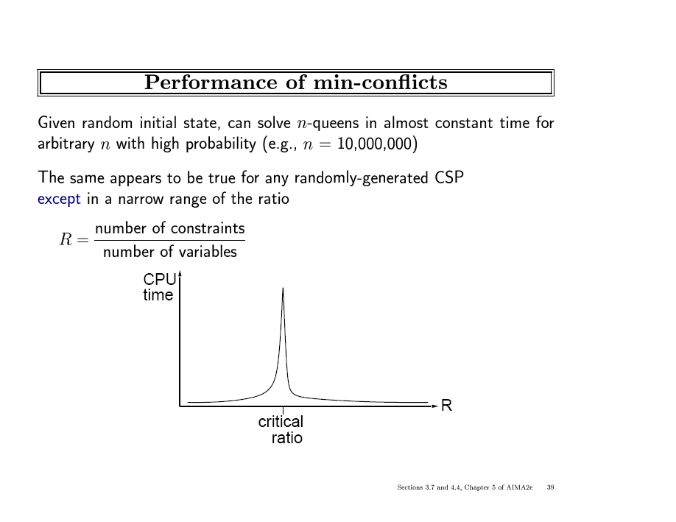

Slide 41
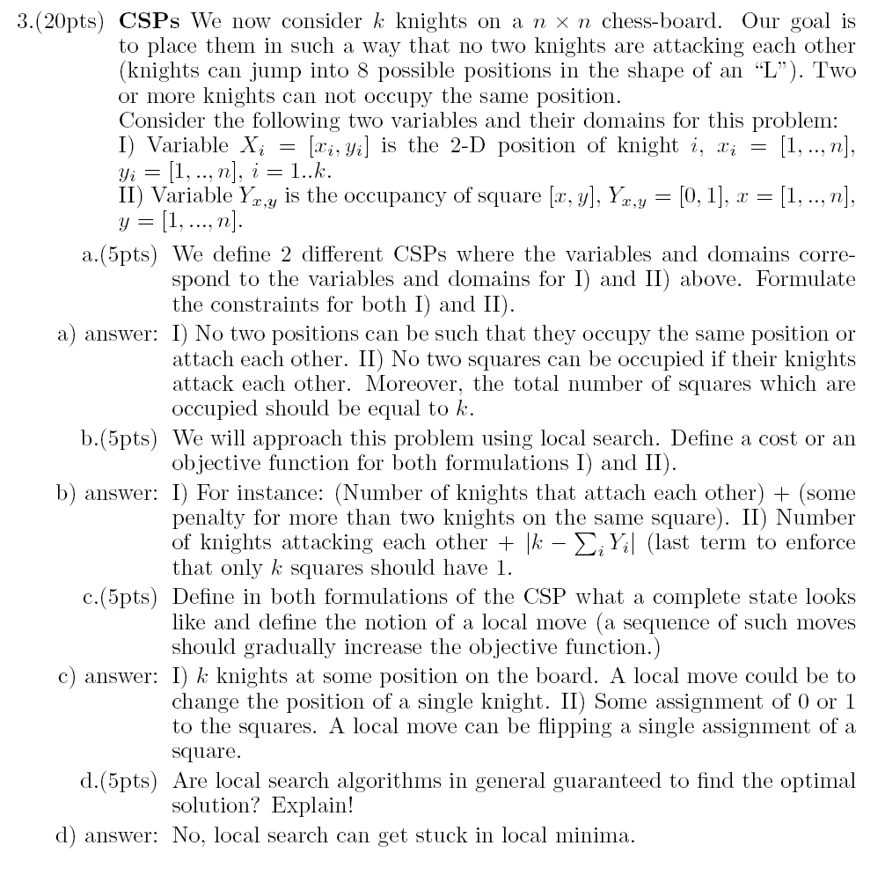

Slide 45
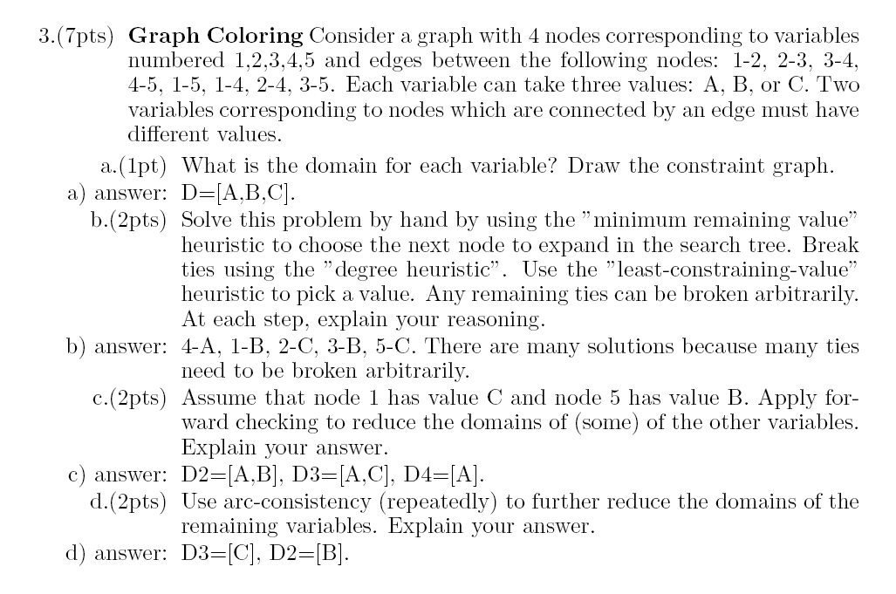

Slide 50
Summary
CSPs are a special kind of problem:
  states defined by values of a fixed set of variables
  goal test defined by constraints on variable values
Backtracking = depth-first search with one variable assigned per node
Variable ordering and value selection heuristics help significantly
Forward checking prevents assignments that guarantee later failure
Constraint propagation (e.g., arc consistency) does additional work to constrain values and detect inconsistencies
Iterative min-conflicts is usually effective in practice

