Slide 1
First-Order Logic
Chapter 8

Slide 2
Problem of Propositional Logic
☹ Propositional logic has very limited expressive power
  E.g., cannot say "pits cause breezes in adjacent
  squares“ except by writing one sentence for each
  square.
  We won’t to be able to say this in one single sentence:
  “for all squares and pits, pits cause breezes in adjacent
  squares.
  First order logic will provide this flexibility.

Slide 3
First-order logic
Propositional logic assumes the world contains facts that are true or false.
First-order logic
assumes the world contains
  Objects: people, houses, numbers, colors, baseball games, wars, …
  Relations between objects: red, round, prime, brother of, bigger than, part of, comes between, …

Slide 4
Relations
Some relations are properties: they state
some fact about a single object: Round(ball), Prime(7).
n-ary relations state facts about two or more objects: Married(John,Mary), Largerthan(3,2).
Some relations are functions: their value is another object: Plus(2,3), Father(Dan). father of, best friend, third inning of, one more than, beginning of . . .

Slide 5
Examples
“One plus two equals three.”
Objects: one, two, three, one plus two; Relation: equals; Function: plus. (“One plus two” is a name for the object that is obtained by applying the function “plus” to the objects “one” and “two.” “Three” is another name for this object.)

Slide 6
Examples
• “Squares neighboring the wumpus are smelly.”
Objects: wumpus, squares; Property: smelly; Relation: neighboring.
• “Evil King John ruled England in 1200.”
Objects: John, England, 1200; Relation: ruled; Properties: evil, king.

Slide 7
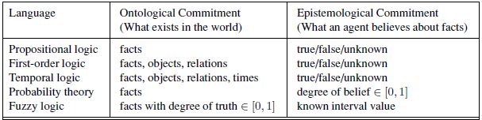
Formal languages and their ontological and epistemological commitments

Slide 8
Models for FOL: Example
The domain of a model is the set of objects or domain elements it contains. The domain is required to be nonempty—every possible world must contain at least one object.
a relation is just the set of tuples of objects that are related.
A tuple is a collection of objects arranged in a fixed order and is written with angle
brackets surrounding the objects.

Slide 9
Models for FOL: Example
Richard the Lionheart, King of England from 1189 to 1199; his younger brother, the evil King John, who ruled from 1199 to 1215; the left legs of Richard and John; and a crown.

Slide 10
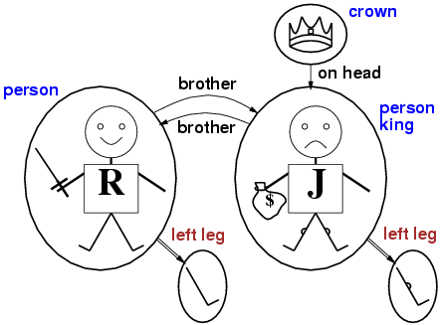
Models for FOL: Example

Slide 11
FOL Syntax
Constant symbols ⬄objects
Predicate Symbols ⬄Relations
Function Symbols ⬄Functions
Each symbol needs an interpretation:
“Richard” refers to the person Richard.
“Brother” refers to the brother relation.
“LeftLeg” refers to the mapping object→leftleg.

Slide 12
Terms
Terms are logical expressions that refer to an object.
There are 2 kinds of those:
  constant symbols: Table, Computer
  function symbols: LeftLeg(Pete), Plus(2,3).

Slide 13
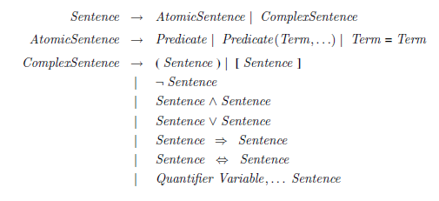
FOL Syntax

Slide 14
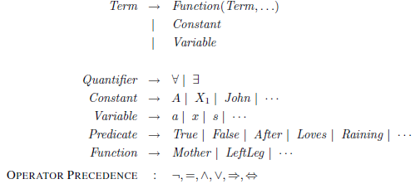
FOL Syntax

Slide 15
Atomic Sentences
Sentences in logic state facts that are true or false.
Properties and n-ary relations do just that:
LargerThan(2,3) (means 2>3) is false.
Richard the Lionheart is the brother of King John
Brother (Richard , John).
Atomic sentences can have complex terms as arguments.
Married(Father (Richard),Mother (John))
states that Richard the Lionheart’s father is married to King John’s mother

Slide 16
Atomic sentences
An atomic sentence is true in a given model if the relation referred to by the predicate symbol holds among the objects referred to by the arguments.

Slide 17
Complex Sentences
We make complex sentences with connectives (just like in proposition logic).
binary
relation
function
property
objects
connectives

Slide 18
Complex Sentences
￢Brother (LeftLeg(Richard), John)
Brother (Richard , John) ∧ Brother (John,Richard)
King(Richard ) ∨ King(John)
￢King(Richard) ⇒ King(John) .

Slide 19
Quantifiers
First-order logic contains two standard quantifiers, called universal and existential
Universal quantification (∀)
“All kings are persons”
∀ x King(x) ⇒ Person(x)
“For all x, if x is a king, then x is a person.”
variable

Slide 20
interpretation
x → Richard the Lionheart,
x → King John,
x → Richard’s left leg,
x → John’s left leg,
x → the crown
Richard the Lionheart is a king ⇒ Richard the Lionheart is a person.
King John is a king ⇒ King John is a person.
Richard’s left leg is a king ⇒ Richard’s left leg is a person.
John’s left leg is a king ⇒ John’s left leg is a person.
The crown is a king ⇒ the crown is a person.
the implication is true whenever its premise is false—regardless of the truth of the conclusion.
To construct logical sentences we need a quantifier to make it true or false.

Slide 21
Existential quantification (∃)
Universal quantification makes statements about every object.
about some object : use an existential quantifier.
King John has a crown on his head
∃ x Crown(x) ∧ OnHead(x, John)
the sentence ∃x P says that P is true for at least one object x. More
precisely, ∃x P is true in a given model if P is true in at least one extended interpretation that assigns x to a domain element. That

Slide 22
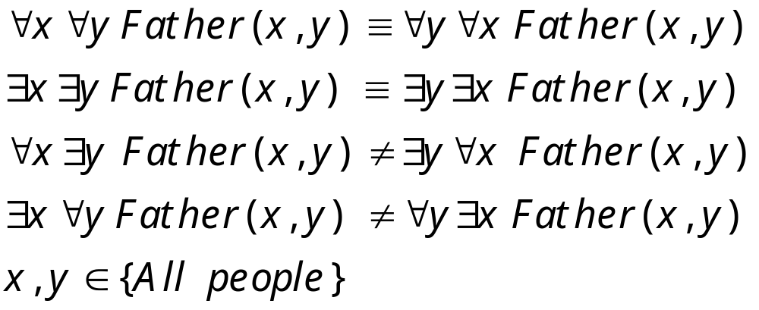
Nested Quantifiers
Combinations of universal and existential quantification are possible:
Binary relation:
“x is a father of y”.
Quiz :which is which: Everyone is the father of someone.
Everyone has everyone as a father
There is a person who has everyone as a father.
There is a person who has a father
There is a person who is the father of everyone.
Everyone has a father.

Slide 23
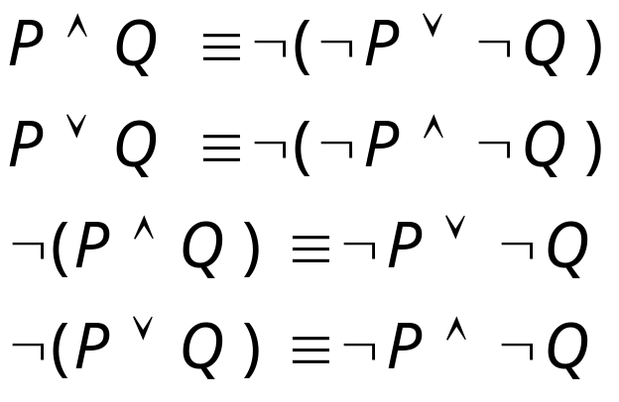
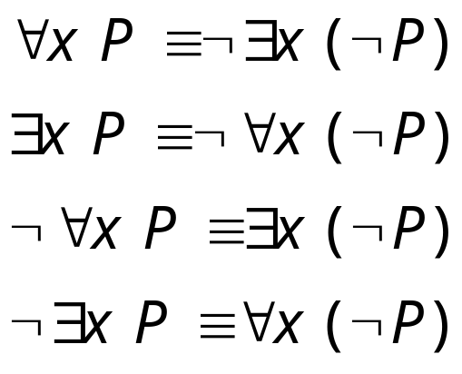
De Morgan’s Law for Quantifiers
De Morgan’s Rule
Generalized De Morgan’s Rule
Rule is simple: if you bring a negation inside a disjunction or a conjunction,
always switch between them (or →and, and → or).
Equality symbol: Father(John)=Henry.
This relates two objects.

Slide 24


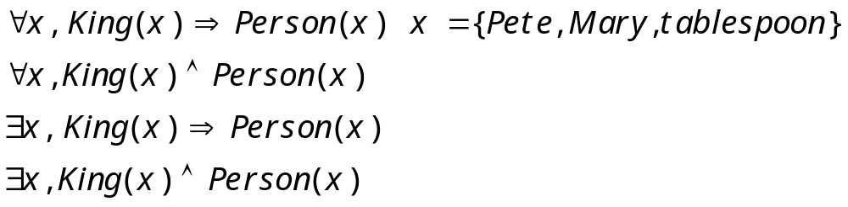
Common mistakes to avoid
⇒ is the main connective with ∀
is the main connective with
All of these must be true!
King(Pete) AND Person(Pete)
King(Mary) AND Person(Mary)
King(Tablespoon) AND Person(Tablespoon)
One of these should be true!
if King(Pete) then Person(Pete)
if King(Mary) then Person(Mary)
If King(Tablespoon) then Person(Tablespoon)
too strong
too weak

Slide 25


Using FOL
We want to TELL things to the KB, e.g.
TELL(KB, )
We also want to ASK things to the KB,
ASK(KB, )
The KB should return the list of x’s for which Person(x) is true: {x/John,x/Richard,...}

Slide 26
Examples
The kinship domain:
Brothers are siblings
  ∀x,y Brother(x,y) => Sibling(x,y)
One's mother is one's female parent
  ∀m,c Mother(c) = m ⇔ (Female(m) ∧ Parent(m,c))
“Sibling” is symmetric
  ∀x,y Sibling(x,y) ⇔ Sibling(y,x)
Some may be considered axioms, others as theorems which can be derived
from the axioms.

Slide 27
Using FOL
The set domain:
∀s Set(s) ⇔ (s = {} ) ∨ (∃x,s₂ Set(s₂) ∧ s = {x|s₂})
¬∃x,s {x|s} = {}
∀x,s x ∈ s ⇔ s = {x|s}
∀x,s x ∈ s ⇔ [ ∃y,s₂} (s = {y|s₂} ∧ (x = y ∨ x ∈ s₂))]
∀s₁,s₂ s₁ ⊆ s₂ ⇔ (∀x x ∈ s₁ ⇒ x ∈ s₂)
∀s₁,s₂ (s₁ = s₂) ⇔ (s₁ ⊆ s₂ ∧ s₂ ⊆ s₁)
∀x,s₁,s₂ x ∈ (s₁ ∩ s₂) ⇔ (x ∈ s₁ ∧ x ∈ s₂)
∀x,s₁,s₂ x ∈ (s₁ ∪ s₂) ⇔ (x ∈ s₁ ∨ x ∈ s₂)
This constitutes a possible set of axioms for set theory

Slide 28
Knowledge base for the wumpus world
property of time t
Perception
  ∀t,s,b Percept([s,b,Glitter],t) ⇒ Glitter(t)
Reflex
  ∀t Glitter(t) ⇒ BestAction(Grab,t)
object (percept)

Slide 29
KB For Wumpus World
Suppose a wumpus-world agent is using an FOL KB and perceives a smell and a breeze (but no glitter) at t=5:
  Tell(KB,Percept([Smell,Breeze,None],5))
  Ask(KB,∃a BestAction(a,5))
I.e., does the KB entail some best action at t=5?
Answer: Yes, {a/Shoot} ← substitution (binding list)
relation: smell, breeze,
no glitter and t=5 is true

Slide 30
Deducing hidden properties
∀x,y,a,b Adjacent([x,y],[a,b]) ⇔
[a,b] ∈ {[x+1,y], [x-1,y],[x,y+1],[x,y-1]}
Properties of squares:
∀s,t At(Agent,s,t) ∧ Breeze(t) ⇒ Breezy(s)
Squares are breezy near a pit:
  Diagnostic rule: infer cause from effect
  Causal rule---infer effect from cause
property of square

Slide 31
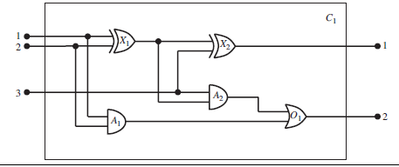
The electronic circuits domain

Slide 32
knowledge-engineering process :
1. Identify the task:
The knowledge engineer must delineate the range of questions that the knowledge base will support and the kinds of facts that will be available for each specific problem instance.
There are many reasoning tasks associated with digital circuits.
If all the inputs are high, what is the output of gate A2?
What are all the gates connected to the first input terminal?
Does the circuit contain feedback loops?

Slide 33
2. Assemble the relevant knowledge
The knowledge engineer might already be an expert in the domain, or might need to work with real experts to extract what they know—a process called knowledge acquisition.
At this stage, the knowledge is not represented formally.
The idea is to understand the scope of the knowledge base, as determined by the task, and to understand how the domain actually works.

Slide 34
Assemble the relevant knowledge - contd…
What do we know about digital circuits? For our purposes, they are composed of wires and gates. Signals flow along wires to the input terminals of gates, and each gate produces a signal on the output terminal that flows along another wire. To determine what these signals will be, we need to know how the gates transform their input signals.

Slide 35
Decide on a vocabulary of predicates, functions, and constants:translate the
important domain-level concepts into logic-level names. This involves many questions
of knowledge-engineering style.
Encode general knowledge about the domain:

Slide 36
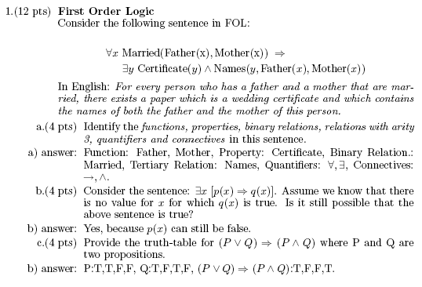

Slide 40
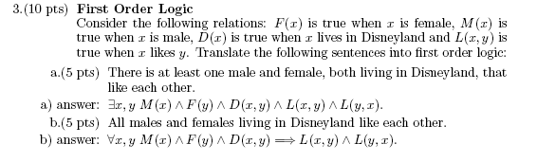

Slide 44
Summary
First-order logic:
  objects and relations are semantic primitives
  syntax: constants, functions, predicates, quantifiers
Increased expressive power: sufficient to define wumpus world

