Slide 1

Welcome to CompSci 171 spring 2007
Introduction to AI.
http://www.ics.uci.edu/~welling/teaching/ICS171spring07/ICS171spring07.html
Instructor: Max Welling, welling@ics.uci.edu
Office hours: Fr. 12-1pm in BH 4028
Teaching Assistant: Tuan Nguyen
Reader: Natalia Flerova
Book: Artificial Intelligence, A Modern Approach
Russell & Norvig
Prentice Hall

Slide 2
Grading:
-Homework (0%, required)
-Quizzes (each other week) (20%)
-One project (20%)
-A midterm (20%)
-A Final Exam (40%)
Graded Quizzes/Exams
-Will be distributed and discussed in class
Grading Disputes:
Turn in your work for regrading at the discussion section to the TA within 1 week.
Note: we will regrade the entire paper: so your new grade could be higher or lower.
Course related issues can be addressed in the first 10 minutes of every class.

Slide 3
Academic (Dis)Honesty
It is each student’s responsibility to be familiar with UCI’s current policies on academic honesty
Violations can result in getting an F in the class (or worse)
Please take the time to read the UCI academic honesty policy
  in the Fall Quarter schedule of classes
  or at: http://www.reg.uci.edu/REGISTRAR/SOC/adh.html
Academic dishonesty is defined as:
  Cheating
  Dishonest conduct
  Plagiarism
  Collusion

Slide 4
Syllabus:
Lecture 1. Introduction: Goals, history (Ch.1)
Lecture 2. Agents (Ch.2)
Lecture 3-4. Uninformed Search (Ch.3)
Lecture 5-6 Informed Search (Ch.4)
Lecture 7-8. Constraint satisfaction (Ch.5). → Project
Lecture 9-10 Games (Ch.6)
Lecture 11. Midterm
Lecture 12-13. Propositional Logic (Ch.7)
Lecture 14-15. First Order Logic (Ch.8)
Lecture 16-17. Inference in logic (Ch.9)
Lecture 18 Uncertainty (Ch.13)
Lecture 19. Philosophical Foundations (Ch.26).
Lecture 20. AI Present and Future (Ch.27).
Final
This is a very rough syllabus. It is almost certainly the case that
we will deviate from this. Some chapters will be treated only partially.

Slide 5
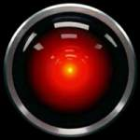
Meet HAL
2001: A Space Odyssey
  classic science fiction movie from 1969
HAL
  part of the story centers around an intelligent computer called HAL
  HAL is the “brains” of an intelligent spaceship
  in the movie, HAL can
    speak easily with the crew
    see and understand the emotions of the crew
    navigate the ship automatically
    diagnose on-board problems
    make life-and-death decisions
    display emotions
In 1969 this was science fiction: is it still science fiction?
http://www.youtube.com/watch?v=LE1F7d6f1Qk

Slide 6
Different Types of Artificial Intelligence
Modeling exactly how humans actually think
  cognitive models of human reasoning
Modeling exactly how humans actually act
  models of human behavior (what they do, not how they think)
Modeling how ideal agents “should think”
  models of “rational” thought (formal logic)
  note: humans are often not rational!
Modeling how ideal agents “should act”
  rational actions but not necessarily formal rational reasoning
  i.e., more of a black-box/engineering approach
Modern AI focuses on the last definition
  we will also focus on this “engineering” approach
  success is judged by how well the agent performs
  -- modern methods are also inspired by cognitive & neuroscience (how people think).

Slide 7

Acting humanly: Turing Test
Turing (1950) "Computing machinery and intelligence":
"Can machines think?" → "Can machines behave intelligently?"
Operational test for intelligent behavior: the Imitation Game
Suggested major components of AI:
- knowledge representation
- reasoning,
- language/image understanding,
- learning
Can you think of a theoretical system that could beat the Turing test
yet you wouldn’t find it very intelligent?

Slide 8
Acting rationally: rational agent
Rational behavior: Doing that was is expected to maximize
one’s “utility function” in this world.
An agent is an entity that perceives and acts.
A rational agent acts rationally.
This course is about designing rational agents
Abstractly, an agent is a function from percept histories to actions:
[f: P* → A]
For any given class of environments and tasks, we seek the agent (or class of agents) with the best performance
Caveat: computational limitations make perfect rationality unachievable
  → design best program for given machine resources

Slide 9
Academic Disciplines important to AI.
Philosophy Logic, methods of reasoning, mind as physical
system, foundations of learning, language,
rationality.
Mathematics Formal representation and proof, algorithms,
computation, (un)decidability, (in)tractability,
probability.
Economics utility, decision theory, rational economic agents
Neuroscience neurons as information processing units.
Psychology/ how do people behave, perceive, process Cognitive Science information, represent knowledge.
Computer building fast computers
engineering
Control theory design systems that maximize an objective
function over time
Linguistics knowledge representation, grammar

Slide 10
History of AI
1943 McCulloch & Pitts: Boolean circuit model of brain
1950 Turing's "Computing Machinery and Intelligence"
1956 Dartmouth meeting: "Artificial Intelligence" adopted
1950s Early AI programs, including Samuel's checkers
program, Newell & Simon's Logic Theorist,
Gelernter's Geometry Engine
1965 Robinson's complete algorithm for logical reasoning
1966—73 AI discovers computational complexity
Neural network research almost disappears
1969—79 Early development of knowledge-based systems
1980-- AI becomes an industry
1986-- Neural networks return to popularity
1987-- AI becomes a science
1995-- The emergence of intelligent agents

Slide 11
State of the art
Deep Blue defeated the reigning world chess champion Garry Kasparov in 1997
Proved a mathematical conjecture (Robbins conjecture) unsolved for decades
No hands across America (driving autonomously 98% of the time from Pittsburgh to San Diego)
During the 1991 Gulf War, US forces deployed an AI logistics planning and scheduling program that involved up to 50,000 vehicles, cargo, and people
NASA's on-board autonomous planning program controlled the scheduling of operations for a spacecraft
Proverb solves crossword puzzles better than most humans
Stanford vehicle in Darpa challenge completed autonomously a 132 mile desert track in 6 hours 32 minutes.

Slide 12
Consider what might be involved in building a “intelligent” computer….
What are the “components” that might be useful?
  Fast hardware?
  Foolproof software?
  Chess-playing at grandmaster level?
  Speech interaction?
    speech synthesis
    speech recognition
    speech understanding
  Image recognition and understanding ?
  Learning?
  Planning and decision-making?

Slide 13
Can we build hardware as complex as the brain?
How complicated is our brain?
  a neuron, or nerve cell, is the basic information processing unit
  estimated to be on the order of 10 ¹¹ neurons in a human brain
  many more synapses (10 ¹⁴) connecting these neurons
  cycle time: 10 ⁻³ seconds (1 millisecond)
How complex can we make computers?
  10⁶ or more transistors per CPU
  supercomputer: hundreds of CPUs, 10 ⁹ bits of RAM
  cycle times: order of 10 ⁻ ⁸ seconds
Conclusion
  YES: in the near future we can have computers with as many basic processing elements as our brain, but with
    far fewer interconnections (wires or synapses) than the brain
    much faster updates than the brain
  but building hardware is very different from making a computer behave like a brain!

Slide 14
Must an Intelligent System be Foolproof?
A “foolproof” system is one that never makes an error:
  Types of possible computer errors
    hardware errors, e.g., memory errors
    software errors, e.g., coding bugs
    “human-like” errors
  Clearly, hardware and software errors are possible in practice
  what about “human-like” errors?
An intelligent system can make errors and still be intelligent
  humans are not right all of the time
  we learn and adapt from making mistakes
    e.g., consider learning to surf or ski
      we improve by taking risks and falling
      an intelligent system can learn in the same way
Conclusion:
  NO: intelligent systems will not (and need not) be foolproof

Slide 15
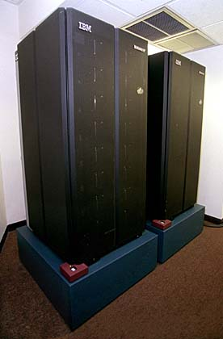

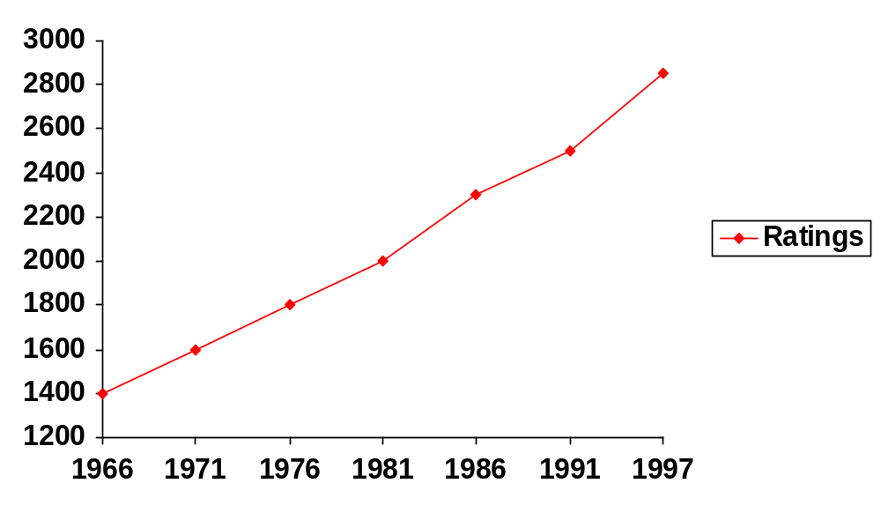
Can Computers play Humans at Chess?
Chess Playing is a classic AI problem
  well-defined problem
  very complex: difficult for humans to play well
Conclusion: YES: today’s computers can beat even the best human
Garry Kasparov (current World Champion)
Deep Blue
Deep Thought
Points Ratings

Slide 16
Can Computers Talk?
This is known as “speech synthesis”
  translate text to phonetic form
    e.g., “fictitious” -> fik-tish-es
  use pronunciation rules to map phonemes to actual sound
    e.g., “tish” -> sequence of basic audio sounds
Difficulties
  sounds made by this “lookup” approach sound unnatural
  sounds are not independent
    e.g., “act” and “action”
    modern systems (e.g., at AT&T) can handle this pretty well
  a harder problem is emphasis, emotion, etc
    humans understand what they are saying
    machines don’t: so they sound unnatural
Conclusion: NO, for complete sentences, but YES for individual words

Slide 17
Can Computers Recognize Speech?
Speech Recognition:
  mapping sounds from a microphone into a list of words.
  Hard problem: noise, more than one person talking,
  occlusion, speech variability,..
  Even if we recognize each word, we may not understand its meaning.
Recognizing single words from a small vocabulary
    systems can do this with high accuracy (order of 99%)
    e.g., directory inquiries
      limited vocabulary (area codes, city names)
      computer tries to recognize you first, if unsuccessful hands you over to a human operator
      saves millions of dollars a year for the phone companies

Slide 18
Recognizing human speech (ctd.)
Recognizing normal speech is much more difficult
  speech is continuous: where are the boundaries between words?
    e.g., “John’s car has a flat tire”
  large vocabularies
    can be many tens of thousands of possible words
    we can use context to help figure out what someone said
      try telling a waiter in a restaurant:
      “I would like some dream and sugar in my coffee”
  background noise, other speakers, accents, colds, etc
  on normal speech, modern systems are only about 60% accurate
Conclusion: NO, normal speech is too complex to accurately recognize, but YES for restricted problems
  (e.g., recent software for PC use by IBM, Dragon systems, etc)

Slide 19
Can Computers Understand speech?
Understanding is different to recognition:
  “Time flies like an arrow”
    assume the computer can recognize all the words
    but how could it understand it?
      1. time passes quickly like an arrow?
      2. command: time the flies the way an arrow times the flies
      3. command: only time those flies which are like an arrow
      4. “time-flies” are fond of arrows
    only 1. makes any sense, but how could a computer figure this out?
      clearly humans use a lot of implicit commonsense knowledge in communication
Conclusion: NO, much of what we say is beyond the capabilities of a computer to understand at present

Slide 20
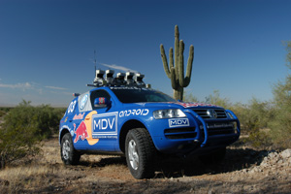
Can Computers Learn and Adapt ?
Learning and Adaptation
  consider a computer learning to drive on the freeway
  we could code lots of rules about what to do
  and/or we could have it learn from experience
  machine learning allows computers to learn to do things without explicit programming
Conclusion: YES, computers can learn and adapt, when presented with information in the appropriate way
Darpa’s Grand Challenge. Stanford’s “Stanley” drove
150 without supervision in the Majove dessert

Slide 21
Can Computers “see”?
Recognition v. Understanding (like Speech)
  Recognition and Understanding of Objects in a scene
    look around this room
    you can effortlessly recognize objects
    human brain can map 2d visual image to 3d “map”
Why is visual recognition a hard problem?
Conclusion: mostly NO: computers can only “see” certain types of objects under limited circumstances: but YES for certain constrained problems (e.g., face recognition)

Slide 22
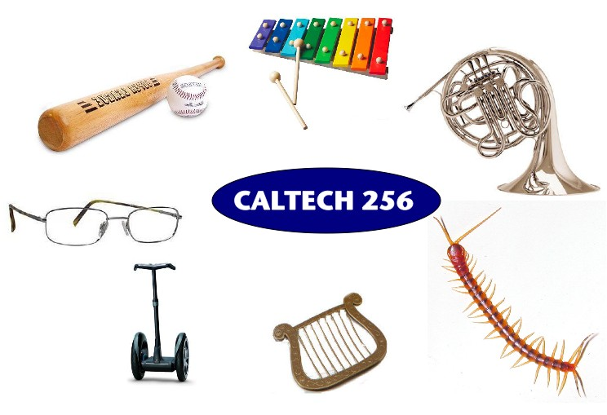
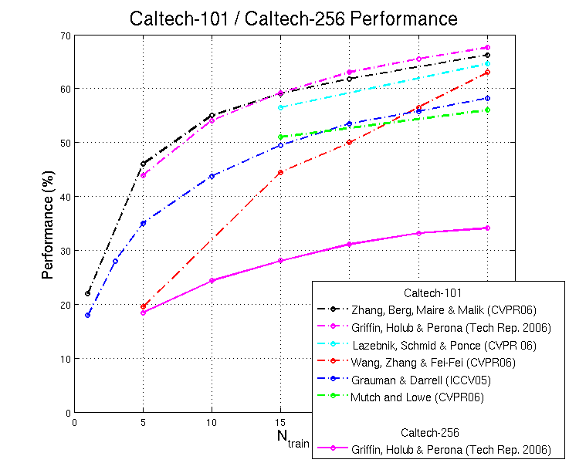
In the computer vision community
research compete to improve recognition
performance on standard datasets

Slide 23
Can Computers plan and make decisions?
Intelligence
  involves solving problems and making decisions and plans
  e.g., you want to visit your cousin in Boston
    you need to decide on dates, flights
    you need to get to the airport, etc
    involves a sequence of decisions, plans, and actions
What makes planning hard?
  the world is not predictable:
    your flight is canceled or there’s a backup on the 405
  there is a potentially huge number of details
    do you consider all flights? all dates?
      no: commonsense constrains your solutions
  AI systems are only successful in constrained planning problems
Conclusion: NO, real-world planning and decision-making is still beyond the capabilities of modern computers
  exception: very well-defined, constrained problems: mission planning for satelites.

Slide 24
Intelligent Systems in Your Everyday Life
Post Office
  automatic address recognition and sorting of mail
Banks
  automatic check readers, signature verification systems
  automated loan application classification
Telephone Companies
  automatic voice recognition for directory inquiries
Credit Card Companies
  automated fraud detection
Computer Companies
  automated diagnosis for help-desk applications
Netflix:
  movie recommendation
Google:
  Search Technology

Slide 25
AI Applications: Consumer Marketing
Have you ever used any kind of credit/ATM/store card while shopping?
  if so, you have very likely been “input” to an AI algorithm
All of this information is recorded digitally
Companies like Nielsen gather this information weekly and search for patterns
  general changes in consumer behavior
  tracking responses to new products
  identifying customer segments: targeted marketing, e.g., they find out that consumers with sports cars who buy textbooks respond well to offers of new credit cards.
  Currently a very hot area in marketing
How do they do this?
  Algorithms (“data mining”) search data for patterns
  based on mathematical theories of learning
  completely impractical to do manually

Slide 26
AI Applications: Identification Technologies
ID cards
  e.g., ATM cards
  can be a nuisance and security risk:
    cards can be lost, stolen, passwords forgotten, etc
Biometric Identification
  walk up to a locked door
    camera
    fingerprint device
    microphone
    iris scan
  computer uses your biometric signature for identification
    face, eyes, fingerprints, voice pattern, iris pattern

Slide 27
AI Applications: Predicting the Stock Market
Value of
the Stock
?
?
time in days
The Prediction Problem
  given the past, predict the future
  very difficult problem!
  we can use learning algorithms to learn a predictive model from historical data
    prob(increase at day t+1 | values at day t, t-1,t-2....,t-k)
  such models are routinely used by banks and financial traders to manage portfolios worth millions of dollars

Slide 28
AI-Applications: Machine Translation
Language problems in international business
  e.g., at a meeting of Japanese, Korean, Vietnamese and Swedish investors, no common language
  or: you are shipping your software manuals to 127 countries
  solution; hire translators to translate
  would be much cheaper if a machine could do this!
How hard is automated translation
  very difficult!
  e.g., English to Russian
      “The spirit is willing but the flesh is weak” (English)
      “the vodka is good but the meat is rotten” (Russian)
  not only must the words be translated, but their meaning also!
Nonetheless....
  commercial systems can do alot of the work very well (e.g.,restricted vocabularies in software documentation)
  algorithms which combine dictionaries, grammar models, etc.
  see for example babelfish.altavista.com

Slide 29
Summary of Today’s Lecture
Artificial Intelligence involves the study of:
  automated recognition and understanding of speech, images, etc
  learning and adaptation
  reasoning, planning, and decision-making
AI has made substantial progress in
  recognition and learning
  some planning and reasoning problems
AI Applications
  improvements in hardware and algorithms => AI applications in industry, finance, medicine, and science.
AI Research
  many problems still unsolved: AI is a fun research area!
Assigned Reading
  Chapter 1 in the text

