Slide 1
Learning from Observations
Chapter 18
Section 1 – 4

Slide 2
Outline
Learning agents
Inductive learning
Nearest Neighbors

Slide 3
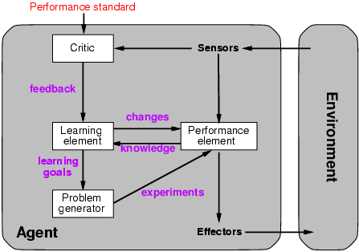
Learning agents
Sometimes we want to invest time and effort to observe the feedback
from our environment to our actions in order to improve these actions
so we can more effectively optimize our utility in the future.

Slide 4
Learning element
Design of a learning element is affected by
  Which components of the performance element are to be learned (e.g. learn to stop for traffic light)
  What feedback is available to learn these components (e.g. visual feedback form camera)
  What representation is used for the components
  (e.g. logic, probabilistic descriptions, attributes,...)
Type of feedback:
  Supervised learning: correct answers for each example (label).
  Unsupervised learning: correct answers not given.
  Reinforcement learning: occasional rewards

Slide 5


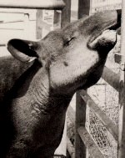

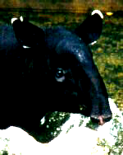

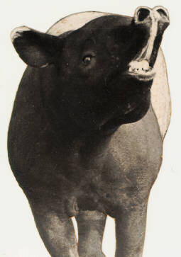
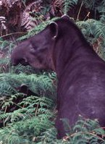
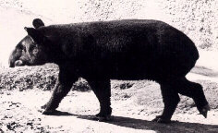

Two Examples of Learning Object Categories.
Here is your training set (2 classes):

Slide 6
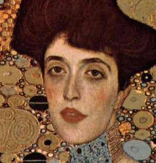
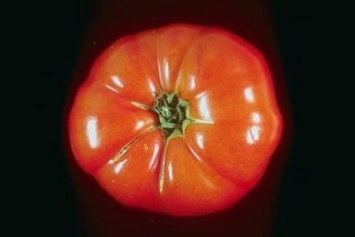
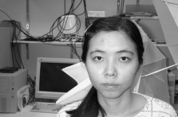
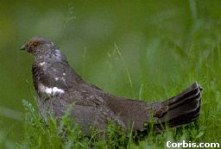
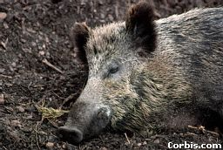
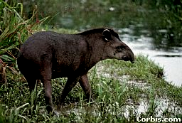
Here is your test set:
Does it belong to one of the above classes?

Slide 7
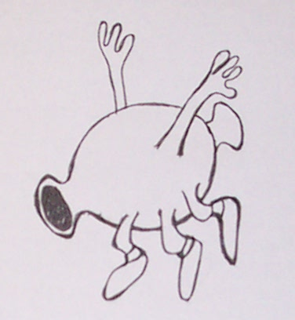
Learning from 1 Example
Copied from P. Perona
talk slides.
S. Savarese, 2003
Notes:
Having said that, we all know that the human visual system can do much better than today’s computer vision algorithms. We learn a vast number of different objects and object categories in our life time. In many cases we never had the luxury of hundreds of training examples.
For example, here I show a member of a new object category that most of you have never seen. Now let’s see if you are able to find another member of this new category in the following picture.

Slide 8
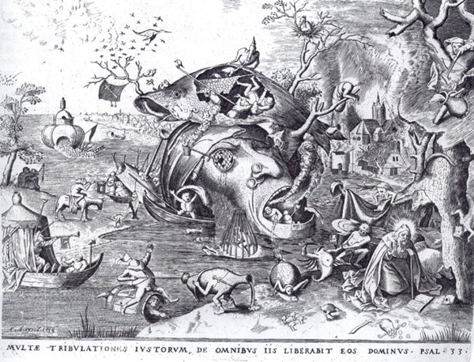
P. Buegel, 1562

Slide 9
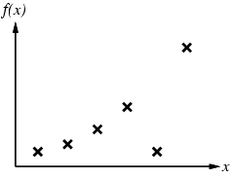
Inductive learning
Simplest form: learn a function from examples
f is the target function
An example is a pair (x, f(x))
Problem: find a hypothesis h
such that h ≈ f
given a training set
of examples

Slide 10
Inductive learning method
Construct/adjust h to agree with f on training set
(h is consistent if it agrees with f on all examples)
E.g., curve fitting:

Slide 11
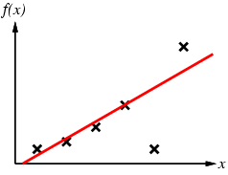
Inductive learning method
Construct/adjust h to agree with f on training set
(h is consistent if it agrees with f on all examples)
E.g., curve fitting:

Slide 12
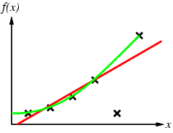
Inductive learning method

Slide 13
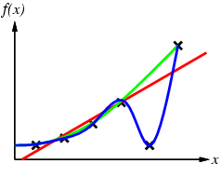
Inductive learning method

Slide 14
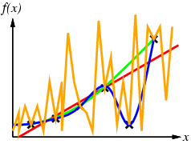
Inductive learning method
which curve is best?

Slide 15
Inductive learning method
Ockham’s razor: prefer the simplest hypothesis consistent with data

Slide 16

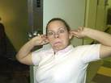
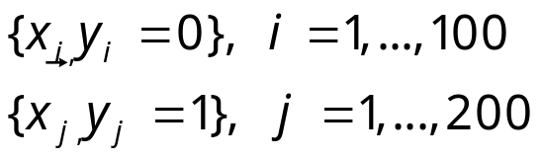

Supervised Learning I
Example: Imagine you want to classify versus
Data: 100 monkey images and 200 human images with labels what is what.
where x represents the greyscale of the image pixels and
y=0 means “monkey” while y=1 means “human”.
Task: Here is a new image: monkey or human?

Slide 17
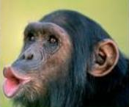
1 nearest neighbors
(your first ML algorithm!)
Idea:
Find the picture in the database which is closest to your query image.
Check its label.
Declare the class of your query image to be the same as that of the
closest picture.
query
closest image

Slide 18
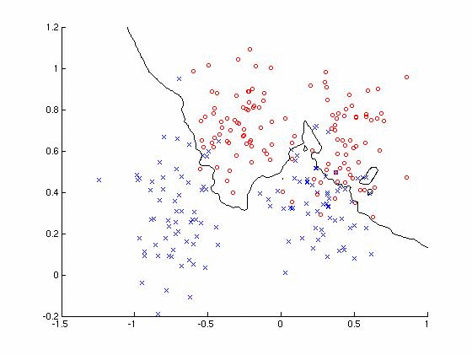
1NN Decision Surface
decision curve

Slide 19
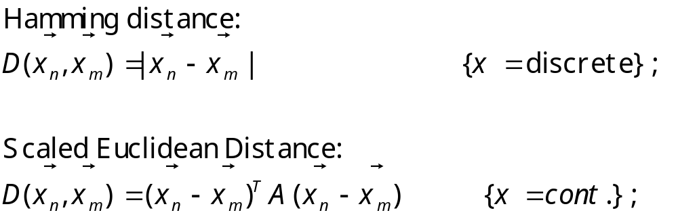
Distance Metric
How do we measure what it means to be “close”?
Depending on the problem we should choose an appropriate “distance” metric (or more generally, a (dis)similarity measure)
  -Demo: http://www.comp.lancs.ac.uk/~kristof/research/notes/nearb/cluster.html
  -Matlab Demo.

Slide 20
Remarks on NN methods
We only need to construct a classifier that works locally for each query.
Hence: We don’t need to construct a classifier everywhere in space.
Classifying is done at query time. This can be computationally taxing
at a time where you might want to be fast.
Memory inefficient.
Curse of dimensionality: imagine many features are irrelevant / noisy
→ distances are always large.
Very flexible, not many prior assumptions.
k-NN variants robust against “bad examples”.

Slide 21
Summary
Learning agent = performance element + learning element
For supervised learning, the aim is to find a simple hypothesis approximately consistent with training examples
Decision tree learning + boosting
Learning performance = prediction accuracy measured on test set

