Slide 1
Methods of Proof
Chapter 7, second half.
http://www.symantec.com/specprog/university/

Slide 2
Proof methods
Proof methods divide into (roughly) two kinds:
  Application of inference rules:
  Legitimate (sound) generation of new sentences from old.
  Resolution
  Forward & Backward chaining
  Model checking
  Searching through truth assignments.
    Improved backtracking: Davis--Putnam-Logemann-Loveland (DPLL)
    Heuristic search in model space: Walksat.

Slide 3
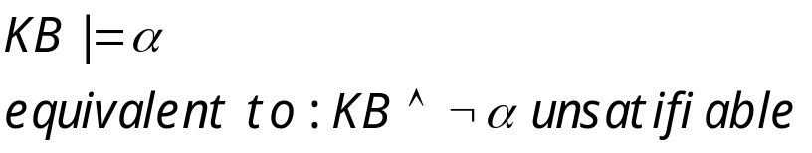

Normal Form
We like to prove:
We first rewrite into conjunctive normal form (CNF).
literals
A “conjunction of disjunctions”
(A ∨ ¬B) ∧ (B ∨ ¬C ∨ ¬D)
Clause
Clause
Any KB can be converted into CNF.
In fact, any KB can be converted into CNF-3 using clauses with at most 3 literals.

Slide 4

Example: Conversion to CNF
B_{1,1} ⇔ (P_{1,2} ∨ P_{2,1})
Eliminate ⇔, replacing α ⇔ β with (α ⇒ β)∧(β ⇒ α).
  (B_{1,1} ⇒ (P_{1,2} ∨ P_{2,1})) ∧ ((P_{1,2} ∨ P_{2,1}) ⇒ B_{1,1})
2. Eliminate ⇒, replacing α ⇒ β with ¬α∨ β.
  (¬B_{1,1} ∨ P_{1,2} ∨ P_{2,1}) ∧ (¬(P_{1,2} ∨ P_{2,1}) ∨ B_{1,1})
3. Move ¬ inwards using de Morgan's rules and double-negation:
  (¬B_{1,1} ∨ P_{1,2} ∨ P_{2,1}) ∧ ((¬P_{1,2} ∧ ¬P_{2,1}) ∨ B_{1,1})
4. Apply distributive law (∧ over ∨) and flatten:
  (¬B_{1,1} ∨ P_{1,2} ∨ P_{2,1}) ∧ (¬P_{1,2} ∨ B_{1,1}) ∧ (¬P_{2,1} ∨ B_{1,1})

Slide 5
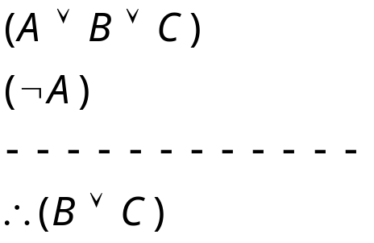
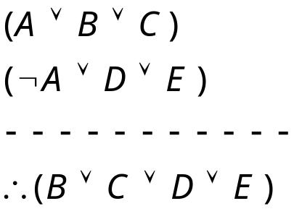
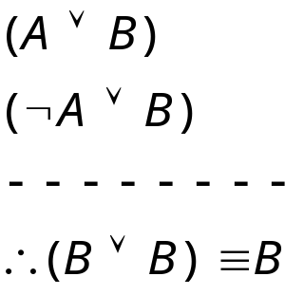
Resolution
Resolution: inference rule for CNF: sound and complete!
“If A or B or C is true, but not A, then B or C must be true.”
“If A is false then B or C must be true, or if A is true
then D or E must be true, hence since A is either true or
false, B or C or D or E must be true.”
Simplification

Slide 6
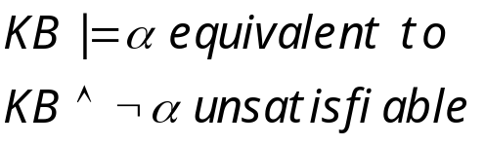


Resolution Algorithm
The resolution algorithm tries to prove:
Generate all new sentences from KB and the query.
One of two things can happen:
We find which is unsatisfiable. I.e. we can entail the query.
We find no contradiction: there is a model that satisfies the sentence
(non-trivial) and hence we cannot entail the query.

Slide 7

Resolution example
KB = (B_{1,1} ⇔ (P_{1,2}∨ P_{2,1})) ∧¬ B_{1,1}
α = ¬P_{1,2}
True!
False in
all worlds

Slide 8



Horn Clauses
Resolution can be exponential in space and time.
If we can reduce all clauses to “Horn clauses” resolution is linear in space and time
A clause with at most 1 positive literal.
e.g.
Every Horn clause can be rewritten as an implication with
a conjunction of positive literals in the premises and a single
positive literal as a conclusion.
e.g.
1 positive literal: definite clause
0 positive literals: Fact or integrity constraint:
e.g.
Forward Chaining and Backward chaining are sound and complete
with Horn clauses and run linear in space and time.

Slide 9
Try it Yourselves
7.9 page 238: (Adapted from Barwise and Etchemendy (1993).) If the unicorn is mythical, then it is immortal, but if it is not mythical, then it is a mortal mammal. If the unicorn is either immortal or a mammal, then it is horned. The unicorn is magical if it is horned.
Derive the KB in normal form.
Prove: Horned, Prove: Magical.

Slide 10
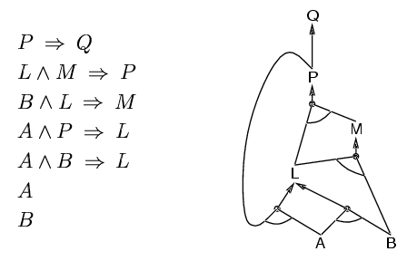
Forward chaining
Idea: fire any rule whose premises are satisfied in the KB,
  add its conclusion to the KB, until query is found
AND gate
OR gate
Forward chaining is sound and complete for Horn KB

Slide 11
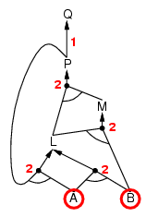
Forward chaining example
“OR” Gate
“AND” gate

Slide 12
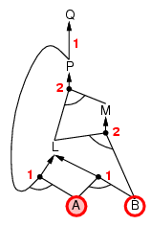
Forward chaining example

Slide 13
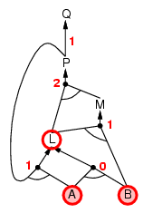
Forward chaining example

Slide 14
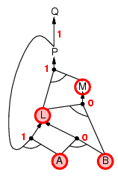
Forward chaining example

Slide 15
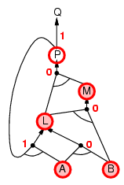
Forward chaining example

Slide 16
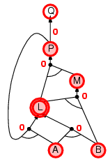
Forward chaining example

Slide 17
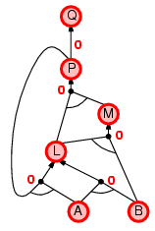
Forward chaining example

Slide 18
Backward chaining
Idea: work backwards from the query q
    check if q is known already, or
    prove by BC all premises of some rule concluding q
    Hence BC maintains a stack of sub-goals that need to be proved to get to q.
Avoid loops: check if new sub-goal is already on the goal stack
Avoid repeated work: check if new sub-goal
  has already been proved true, or
  has already failed

Slide 19
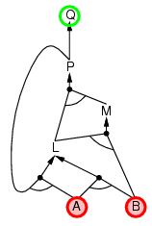
Backward chaining example

Slide 20
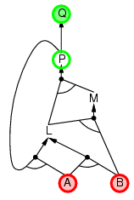
Backward chaining example

Slide 21
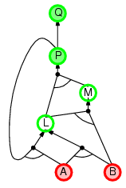
Backward chaining example

Slide 22
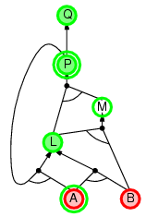
Backward chaining example
we need P to prove
L and L to prove P.

Slide 23
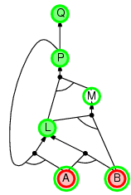
Backward chaining example

Slide 24
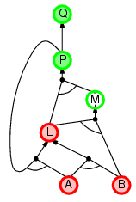
Backward chaining example

Slide 25
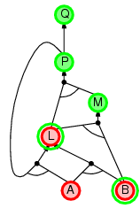
Backward chaining example

Slide 26
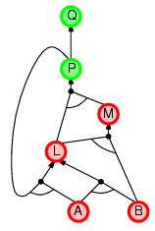
Backward chaining example

Slide 27
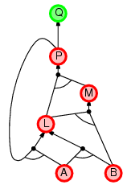
Backward chaining example

Slide 28
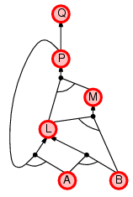
Backward chaining example

Slide 29
Forward vs. backward chaining
FC is data-driven, automatic, unconscious processing,
  e.g., object recognition, routine decisions
May do lots of work that is irrelevant to the goal
BC is goal-driven, appropriate for problem-solving,
  e.g., Where are my keys? How do I get into a PhD program?
Complexity of BC can be much less than linear in size of KB

Slide 30
Model Checking
Two families of efficient algorithms:
Complete backtracking search algorithms: DPLL algorithm
Incomplete local search algorithms
  WalkSAT algorithm

Slide 31
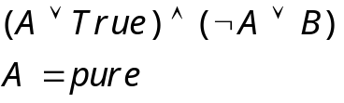
The DPLL algorithm
Determine if an input propositional logic sentence (in CNF) is
satisfiable. This is just backtracking search for a CSP.
Improvements:
  Early termination
    A clause is true if any literal is true.
    A sentence is false if any clause is false.
  Pure symbol heuristic
    Pure symbol: always appears with the same "sign" in all clauses.
    e.g., In the three clauses (A ∨ ¬B), (¬B ∨ ¬C), (C ∨ A), A and B are pure, C is impure.
    Make a pure symbol literal true. (if there is a model for S, then making a pure symbol true is also a model).
  3 Unit clause heuristic
    Unit clause: only one literal in the clause
    The only literal in a unit clause must be true.
    Note: literals can become a pure symbol or a
    unit clause when other literals obtain truth values. e.g.

Slide 32
The WalkSAT algorithm
Incomplete, local search algorithm
Evaluation function: The min-conflict heuristic of minimizing the number of unsatisfied clauses
Balance between greediness and randomness

Slide 33
Hard satisfiability problems
Consider random 3-CNF sentences. e.g.,
(¬D ∨ ¬B ∨ C) ∧ (B ∨ ¬A ∨ ¬C) ∧ (¬C ∨ ¬B ∨ E) ∧ (E ∨ ¬D ∨ B) ∧ (B ∨ E ∨ ¬C)
  m = number of clauses (5)
  n = number of symbols (5)
  Hard problems seem to cluster near m/n = 4.3 (critical point)

Slide 34
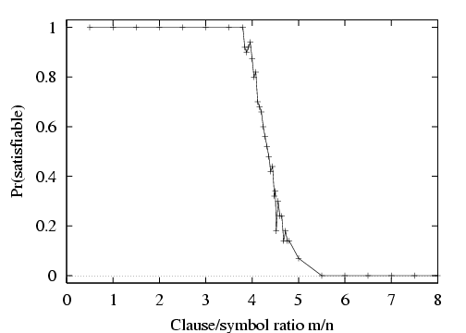
Hard satisfiability problems

Slide 35
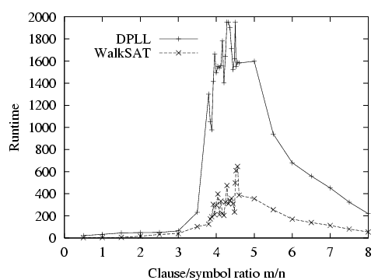
Hard satisfiability problems
Median runtime for 100 satisfiable random 3-CNF sentences, n = 50

Slide 36
Inference-based agents in the wumpus world
A wumpus-world agent using propositional logic:
  ¬P_{1,1} (no pit in square [1,1])
  ¬W_{1,1} (no Wumpus in square [1,1])
  B_{x,y} ⇔ (P_{x,y+1} ∨ P_{x,y-1} ∨ P_{x+1,y} ∨ P_{x-1,y}) (Breeze next to Pit)
  S_{x,y} ⇔ (W_{x,y+1} ∨ W_{x,y-1} ∨ W_{x+1,y} ∨ W_{x-1,y}) (stench next to Wumpus)
  W_{1,1} ∨ W_{1,2} ∨ … ∨ W_{4,4} (at least 1 Wumpus)
  ¬W_{1,1} ∨ ¬W_{1,2} (at most 1 Wumpus)
  ¬W_{1,1} ∨ ¬W_{8,9}
  …
⇒ 64 distinct proposition symbols, 155 sentences

Slide 37
Expressiveness limitation of propositional logic
KB contains "physics" sentences for every single square
For every time t and every location [x,y],
L_{x,y} ∧ FacingRight^{t} ∧ Forward^{t} ⇒ L_{x+1,y}
Rapid proliferation of clauses.
First order logic is designed to deal with this through the
introduction of variables.
t
t+1
position (x,y) at time t of the agent.

Slide 38
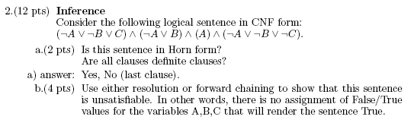
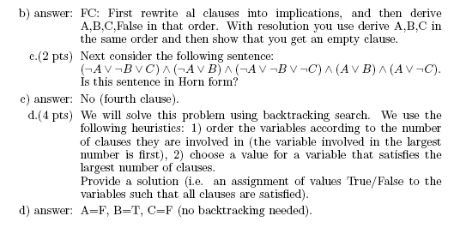

Slide 43
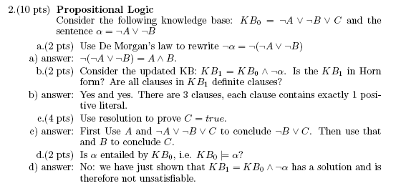

Slide 48
Summary
Logical agents apply inference to a knowledge base to derive new information and make decisions
Basic concepts of logic:
  syntax: formal structure of sentences
  semantics: truth of sentences wrt models
  entailment: necessary truth of one sentence given another
  inference: deriving sentences from other sentences
  soundness: derivations produce only entailed sentences
  completeness: derivations can produce all entailed sentences
Wumpus world requires the ability to represent partial and negated information, reason by cases, etc.
Resolution is complete for propositional logic
Forward, backward chaining are linear-time, complete for Horn clauses
Propositional logic lacks expressive power

