Slide 1
Uncertainty
Chapter 13

Slide 2
Uncertainty
Let action A_{t} = leave for airport _{t} minutes before flight
Will A_{t} get me there on time?
Problems:
  partial observability (road state, other drivers' plans, etc.)
  noisy sensors (traffic reports)
  uncertainty in action outcomes (flat tire, etc.)
  immense complexity of modeling and predicting traffic
Hence a purely logical approach either
  risks falsehood: “A₂₅ will get me there on time”, or
  leads to conclusions that are too weak for decision making:
“A₂₅ will get me there on time if there's no accident on the bridge and it doesn't rain and my tires remain intact etc etc.”
(A₁₄₄₀ might reasonably be said to get me there on time but I'd have to stay overnight in the airport …)

Slide 3
Probability to the Rescue
Probability
  Model agent's degree of belief, given the available evidence.
  A₂₅ will get me there on time with probability 0.04
Probability in AI models our ignorance, not the true state of the
world.
The statement “With probability 0.7 I have a cavity” means:
I either have a cavity or not, but I don’t have all the necessary
information to know this for sure.

Slide 4
diagnosing a dental patient’s toothache.
Diagnosis—whether for medicine, automobile repair, or whatever—almost always involves
uncertainty.
Toothache ⇒ Cavity .
Toothache ⇒ Cavity ∨ GumProblem ∨ Abscess . . .
Cavity ⇒ Toothache .
But this rule is not right either; not all cavities cause pain. The only way to fix the rule is to make it logically exhaustive: to augment the left-hand side with all the qualifications required for a cavity to cause a toothache.

Slide 5
Trying to use logic to cope with a domain like medical diagnosis thus fails for three main reasons:
Laziness: It is LAZINESS too much work to list the complete set of antecedents or consequents needed to ensure an exceptionless rule and too hard to use such rules.
• Theoretical ignorance: Medical science has no complete theory for the domain.
• Practical ignorance: Even if we know all the rules, we might be uncertain about a particular patient because not all the necessary tests have been or can be run.

Slide 6
Probability
Probabilistic assertions summarize effects of
  laziness: failure to enumerate exceptions, qualifications, etc.
  ignorance: lack of relevant facts, initial conditions, etc.
Subjective probability:
Probabilities relate propositions to agent's own state of knowledge
e.g., P(A₂₅ | no reported accidents at 3 a.m. ) = 0.06
Probabilities of propositions change with new evidence:
e.g., P(A₂₅ | no reported accidents at 5 a.m.) = 0.15

Slide 7
Making decisions under uncertainty
Suppose I believe the following:
  P(A₂₅ gets me there on time | …) = 0.04
  P(A₉₀ gets me there on time | …) = 0.70
  P(A₁₂₀ gets me there on time | …) = 0.95
  P(A₁₄₄₀ gets me there on time | …) = 0.9999
Which action to choose?
Depends on my preferences for missing flight vs. time spent waiting, etc.
  Utility theory is used to represent and infer preferences
  Decision theory = probability theory + utility theory

Slide 8
Syntax
Capital letter: random variable
lower case: single value
Basic element: random variable
Similar to propositional logic: possible worlds defined by assignment of values to random variables.
Boolean random variables
  e.g., Cavity (do I have a cavity?)
Discrete random variables
  e.g., Weather is one of <sunny,rainy,cloudy,snow>
Domain values must be exhaustive and mutually exclusive
Elementary proposition constructed by assignment of a value to a random variable: e.g., Weather = sunny, Cavity = false (abbreviated as ¬cavity)
Complex propositions formed from elementary propositions and standard logical connectives e.g., Weather = sunny ∨ Cavity = false

Slide 9
Syntax
Atomic event: A complete specification of the state of the world about which the agent is uncertain
  E.g., if the world consists of only two Boolean variables Cavity and Toothache, then there are 4 distinct atomic events:
    Cavity = false ∧ Toothache = false
    Cavity = false ∧ Toothache = true
    Cavity = true ∧ Toothache = false
    Cavity = true ∧ Toothache = true
Atomic events are mutually exclusive and exhaustive
if some atomic event is true,
then all other other atomic
events are false.
There is always some atomic event true.
Hence, there is exactly 1 atomic event true.

Slide 10
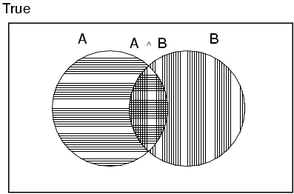
Axioms of probability
For any propositions A, B
  0 ≤ P(A) ≤ 1
  P(true) = 1 and P(false) = 0
  P(A ∨ B) = P(A) + P(B) - P(A ∧ B)
true in all worlds e.g. P(a OR NOT(a))
false in all worlds: P(a AND NOT(a))
Think of P(a) as the number of worlds
in which a is true divided by the total number
of possible worlds.

Slide 11
Prior probability
Prior or unconditional probabilities of propositions
  e.g., P(Cavity = true) = 0.1 and P(Weather = sunny) = 0.72 correspond to belief prior to arrival of any (new) evidence
Probability distribution gives values for all possible assignments:
  P(Weather) = <0.72,0.1,0.08,0.1> (normalized, i.e., sums to 1)
Joint probability distribution for a set of random variables gives the probability of every atomic event on those random variables
  P(Weather,Cavity) = a 4 × 2 matrix of values:
Weather = sunny rainy cloudy snow
Cavity = true 0.144 0.02 0.016 0.02
Cavity = false 0.576 0.08 0.064 0.08
Every question about a domain can be answered by the joint distribution

Slide 12
Conditional probability
Conditional or posterior probabilities
  e.g., P(cavity | toothache) = 0.8 i.e., given that toothache=true is all I know.
Note that P(cavity|toothache) is a 2x2 array, normalized over columns.
If we know more, e.g., cavity is also given, then we have
  P(cavity | toothache,cavity) = 1
New evidence may be irrelevant, allowing simplification, e.g.,
  P(cavity | toothache, sunny) = P(cavity | toothache) = 0.8

Slide 13
Conditional probability
Definition of conditional probability:
  P(a | b) = P(a ∧ b) / P(b) if P(b) > 0
Product rule gives an alternative formulation:
  P(a ∧ b) = P(a | b) P(b) = P(b | a) P(a)
A general version holds for whole distributions, e.g.,
  P(Weather,Cavity) = P(Weather | Cavity) P(Cavity)
(View as a set of 4 × 2 equations, not matrix mult.)
Chain rule is derived by successive application of product rule:
  P(X₁, …,X_{n}) = P(X₁,...,X_{n-1}) P(X_{n} | X₁,...,X_{n-1})
  = P(X₁,...,X_{n-2}) P(X_{n-1} | X₁,...,X_{n-2}) P(X_{n} | X₁,...,X_{n-1})
  = …
  = π_{i= 1}^n P(X_{i} | X₁, … ,X_{i-1})

Slide 14

Inference by enumeration
Start with the joint probability distribution:
For any proposition a, sum the atomic events where it is true: P(a) = Σ_{ω:ω╞a} P(ω)
P(a)=1/7 + 1/7 + 1/7 = 3/7

Slide 15

Inference by enumeration
Start with the joint probability distribution:
For any proposition a, sum the atomic events where it is true: P(a) = Σ_{ω:ω╞a} P(ω)
P(toothache) = 0.108 + 0.012 + 0.016 + 0.064 = 0.2

Slide 16

Inference by enumeration
Start with the joint probability distribution:
Can also compute conditional probabilities:
P(¬cavity | toothache) = P(¬cavity ∧ toothache)
P(toothache)
= 0.016+0.064
0.108 + 0.012 + 0.016 + 0.064
= 0.4

Slide 17
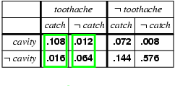
Normalization
Denominator can be viewed as a normalization constant α
P(Cavity | toothache) = α x P(Cavity,toothache)
  = α x [P(Cavity,toothache,catch) + P(Cavity,toothache,¬ catch)]
  = α x [<0.108,0.016> + <0.012,0.064>]
  = α x <0.12,0.08> = <0.6,0.4>
General idea: compute distribution on query variable by fixing evidence variables and summing over hidden variables

Slide 18

general inference procedure
We begin with the case in which the query involves a single variable, X (Cavity in the example).
Let E be the list of evidence variables (just Toothache in the example),
let e be the list of observed values for them,
and let Y be the remaining unobserved variables (just Catch in the example). The query is P(X | e) and can be evaluated as
where the summation is over all possible ys (i.e., all possible combinations of values of the unobserved variables Y).
Notice that together the variables X, E, and Y constitute the complete
set of variables for the domain,
so P(X, e, y) is simply a subset of probabilities from the full joint distribution.

Slide 19
Inference by enumeration
Typically, we are interested in
the posterior joint distribution of the query variables Y
given specific values e for the evidence variables E
Let the hidden variables be H = X - Y - E
Then the required summation of joint entries is done by summing out the hidden variables:
  P(Y | E = e) = αP(Y,E = e) = αΣ_{h}P(Y,E= e, H = h)
The terms in the summation are joint entries because Y, E and H together exhaust the set of random variables
Obvious problems:
  Worst-case time complexity O(d^{n}) where d is the largest arity
  Space complexity O(d^{n}) to store the joint distribution
  How to find the numbers for O(d^{n}) entries

Slide 20
Independence
expand the full joint distribution by adding a fourth variable, Weather .
The full joint distribution then becomes P(Toothache, Catch, Cavity,Weather ), which has
2 × 2 × 2 × 4 = 32 entries.

Slide 21
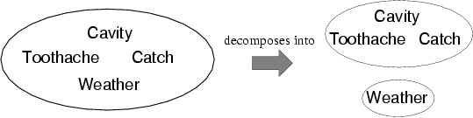
Independence
A and B are independent iff
P(A|B) = P(A) or P(B|A) = P(B) or P(A, B) = P(A) P(B)
  P(Toothache, Catch, Cavity, Weather)
  = P(Toothache, Catch, Cavity) P(Weather)
32 entries reduced to 12;
for n independent biased coins, O(2^{n}) →O(n)
Absolute independence powerful but rare
Dentistry is a large field with hundreds of variables, none of which are independent. What to do?

Slide 22
Conditional independence
P(Toothache, Cavity, Catch) has 2³ – 1 = 7 independent entries
If I have a cavity, the probability that the probe catches in it doesn't depend on whether I have a toothache:
  (1) P(catch | toothache, cavity) = P(catch | cavity)
The same independence holds if I haven't got a cavity:
  (2) P(catch | toothache,¬cavity) = P(catch | ¬cavity)
Catch is conditionally independent of Toothache given Cavity:
  P(Catch | Toothache,Cavity) = P(Catch | Cavity)
Note: catch and toothache are not independent, they are conditionally independent
given that I know cavity.

Slide 23
Conditional independence cont.
Write out full joint distribution using chain rule:
P(Toothache, Catch, Cavity)
  = P(Toothache | Catch, Cavity) P(Catch, Cavity)
  = P(Toothache | Catch, Cavity) P(Catch | Cavity) P(Cavity)
  = P(Toothache | Cavity) P(Catch | Cavity) P(Cavity)
I.e., 2 + 2 + 1 = 5 independent numbers
In most cases, the use of conditional independence reduces the size of the representation of the joint distribution from exponential in n to linear in n.
Conditional independence is our most basic and robust form of knowledge about uncertain environments.

Slide 24
Bayes' Rule
Product rule P(a∧b) = P(a | b) P(b) = P(b | a) P(a)
⇒ Bayes' rule: P(a | b) = P(b | a) P(a) / P(b)
or in distribution form
P(Y|X) = P(X|Y) P(Y) / P(X) = αP(X|Y) P(Y)
Useful for assessing diagnostic probability from causal probability:
  P(Cause|Effect) = P(Effect|Cause) P(Cause) / P(Effect)
  E.g., let M be meningitis, S be stiff neck:
    P(m|s) = P(s|m) P(m) / P(s) = 0.8 × 0.0001 / 0.1 = 0.0008
  Note: even though the probability of having a stiff neck given meningitis is very large (0.8), the posterior probability of meningitis given a stiff neck is still very small (why?).
  P(s|m) is more ‘robust’ than P(m|s). Imagine a new disease appeared
  which would also cause a stiff neck, then P(m|s) changes but P(s|m) not.

Slide 25
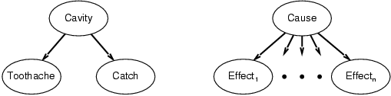
Bayes' Rule and conditional independence
P(Cavity | toothache ∧ catch)
  = αP(toothache ∧ catch | Cavity) P(Cavity)
  = αP(toothache | Cavity) P(catch | Cavity) P(Cavity)
This is an example of a naïve Bayes model:
  P(Cause,Effect₁, … ,Effect_{n}) = P(Cause) π_{i}P(Effect_{i}|Cause)
Total number of parameters is linear in n
A naive Bayes classifier computes: P(cause|effect1, effect2...)

Slide 26
The Naive Bayes Classifier
Imagine we have access to the probabilities of
P(disease)
P(symptoms|disease)=P(headache|disease)P(backache|disease)....
Then, the probability of a disease is computed using Bayes rule:
P(disease|symptoms) = constant x P(symptoms|disease) x P(disease)

Slide 27
Learning a Naive Bayes Classifier
What to do if we only have observations from a doctors office?
For instance:
flu1→ headache, fever, muscle ache
lungcancer1 → short breath, breast pain
flu2 → headache, fever, cough
....
In general {(x1,y1), (x2,y2), (x3,y3),....}
symptoms (attributes)
disease (label)
P(disease = y) = # people with disease y = fraction of people with disease y
total # of people in dataset
P(symptom_A=x_A|disease = y) = # people with disease y that have symptom A
total # people with disease y

Slide 28
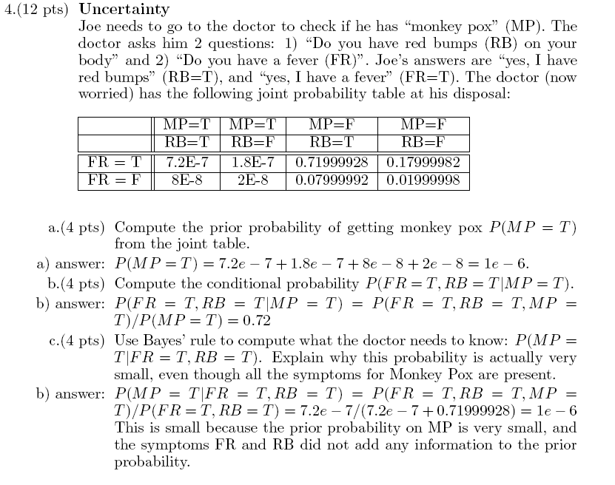

Slide 29
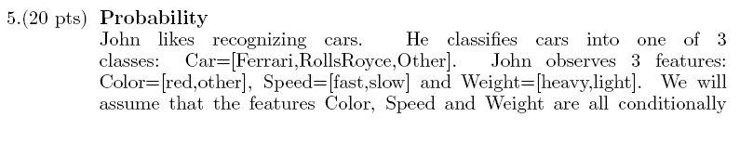
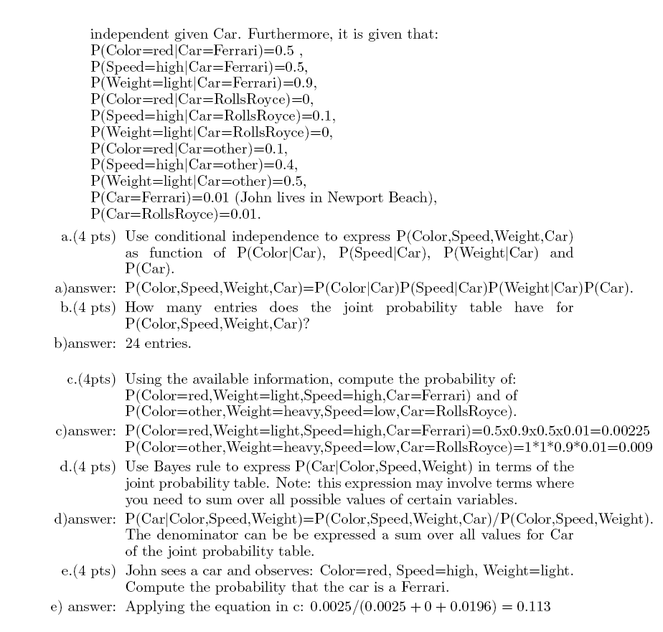

Slide 30
Summary
Probability is a rigorous formalism for uncertain knowledge
Joint probability distribution specifies probability of every atomic event
Queries can be answered by summing over atomic events
For nontrivial domains, we must find a way to reduce the joint size
Independence and conditional independence provide the tools

