Slide 1
Logical Agents
Chapter 7

Slide 2
Outline
Knowledge-based agents
Wumpus world
Logic in general - models and entailment
Propositional (Boolean) logic
Equivalence, validity, satisfiability
Inference rules and theorem proving
  forward chaining
  backward chaining
  resolution

Slide 3

Knowledge bases
Knowledge base = set of sentences in a formal language
Declarative approach to building an agent (or other system):
  Tell it what it needs to know
Then it can Ask itself what to do - answers should follow from the KB
Agents can be viewed at the knowledge level
  i.e., what they know, regardless of how implemented
Or at the implementation level
  i.e., data structures in KB and algorithms that manipulate them

Slide 4

A simple knowledge-based agent
The agent must be able to:
  Represent states, actions, etc.
  Incorporate new percepts
  Update internal representations of the world
  Deduce hidden properties of the world
  Deduce appropriate actions

Slide 5

Wumpus World PEAS description
Performance measure
  gold +1000, death -1000
  -1 per step, -10 for using the arrow
Environment
  Squares adjacent to wumpus are smelly
  Squares adjacent to pit are breezy
  Glitter iff gold is in the same square
  Shooting kills wumpus if you are facing it
  Shooting uses up the only arrow
  Grabbing picks up gold if in same square
  Releasing drops the gold in same square
Sensors: Stench, Breeze, Glitter, Bump, Scream
Actuators: Left turn, Right turn, Forward, Grab, Release, Shoot

Slide 6
Wumpus world characterization
Fully Observable No – only local perception
Deterministic Yes – outcomes exactly specified
Episodic No – sequential at the level of actions
Static Yes – Wumpus and Pits do not move
Discrete Yes
Single-agent? Yes – Wumpus is essentially a natural feature

Slide 7

Exploring a wumpus world

Slide 8

Exploring a wumpus world

Slide 9

Exploring a wumpus world

Slide 10

Exploring a wumpus world

Slide 11

Exploring a wumpus world

Slide 12

Exploring a wumpus world

Slide 13

Exploring a wumpus world

Slide 14

Exploring a wumpus world

Slide 15
Logic in general
Logics are formal languages for representing information such that conclusions can be drawn
Syntax defines the sentences in the language
Semantics define the "meaning" of sentences;
  i.e., define truth of a sentence in a world
E.g., the language of arithmetic
  x+2 ≥ y is a sentence; x2+y > {} is not a sentence
  x+2 ≥ y is true iff the number x+2 is no less than the number y
  x+2 ≥ y is true in a world where x = 7, y = 1
  x+2 ≥ y is false in a world where x = 0, y = 6

Slide 16
Entailment
Entailment means that one thing follows from another:
KB ╞ α
Knowledge base KB entails sentence α if and only if α is true in all worlds where KB is true
  E.g., the KB containing “the Giants won” and “the Reds won” entails “Either the Giants won or the Reds won”
  E.g., x+y = 4 entails 4 = x+y
  Entailment is a relationship between sentences (i.e., syntax) that is based on semantics

Slide 17

Models
Logicians typically think in terms of models, which are formally structured worlds with respect to which truth can be evaluated
We say m is a model of a sentence α if α is true in m
M(α) is the set of all models of α
Then KB ╞ α iff M(KB) ⊆ M(α)
  E.g. KB = Giants won and Reds
  won
  α = Giants won

Slide 18

Entailment in the wumpus world
Situation after detecting nothing in [1,1], moving right, breeze in [2,1]
Consider possible models for KB assuming only pits
3 Boolean choices ⇒ 8 possible models

Slide 19

Wumpus models

Slide 20

Wumpus models
KB = wumpus-world rules + observations

Slide 21

Wumpus models
KB = wumpus-world rules + observations
α₁ = "[1,2] is safe", KB ╞ α₁, proved by model checking

Slide 22
Wumpus models
KB = wumpus-world rules + observations

Slide 23

Wumpus models
KB = wumpus-world rules + observations
α₂ = "[2,2] is safe", KB ╞ α₂

Slide 24
Inference
KB ├_{i} α = sentence α can be derived from KB by procedure i
Soundness: i is sound if whenever KB ├_{i} α, it is also true that KB╞ α – An inference algorithm that derives only entailed sentences.
Completeness: i is complete if whenever KB╞ α, it is also true that KB ├_{i} α - An inference algorithm is complete if it can derive any sentence that is entailed.
Preview: we will define a logic (first-order logic) which is expressive enough to say almost anything of interest, and for which there exists a sound and complete inference procedure.
That is, the procedure will answer any question whose answer follows from what is known by the KB.

Slide 25
Sentences are physical configurations of the agent,
and reasoning is a process of constructing new physical configurations from old ones.
Logical reasoning should ensure that the new configurations represent aspects of the world that actually follow from the aspects that the old configurations represent.

Slide 26
formal grammar of propositional logic
A BNF (Backus-Naur Form) grammar of sentences in propositional logic.
Sentence -> AtomicSentence |Complex Sentence
AtomicSentence ->True | False |Symbol
Symbol ->P |Q |R ) . . .
ComplexSentence -> ¬Sentence
( ( Sentence ^ Sentence )
| ( Sentence V Sentence)
| ( Sentence Sentence )
| ( Sentence Sentence )

Slide 27
Propositional logic: Syntax
Propositional logic is the simplest logic – illustrates basic ideas
  If S is a sentence, ¬S is a sentence (negation)
  If S₁ and S₂ are sentences then
  And: S₁ ∧ S₂ is a sentence (conjunction)
  Or: S₁ ∨ S₂ is a sentence (disjunction)
  Implies : S₁ ⇒ S₂ is a sentence (implication)
  Iff : S₁ ⇔ S₂ is a sentence (biconditional)

Slide 28
Propositional logic: Semantics
Each model specifies true/false for each proposition symbol
  E.g. P_{1,2} P_{2,2} P_{3,1}
  false true false
With three symbols, 8 possible models, can be enumerated automatically.
¬S is true iff S is false
S₁ ∧ S₂ is true iff S₁ is true and S₂ is true
S₁ ∨ S₂ is true iff S₁is true or S₂ is true
S₁ ⇒ S₂ is true iff S₁ is false or S₂ is true
i.e., is false iff S₁ is true and S₂ is false
S₁ ⇔ S₂ is true iff S₁⇒S₂ is true andS₂⇒S₁ is true
Simple recursive process evaluates an arbitrary sentence, e.g.,
¬P_{1,2} ∧ (P_{2,2} ∨ P_{3,1}) = true ∧ (true ∨ false) = true ∧ true = true
Rules for evaluating truth with respect to a model m:

Slide 29

Truth tables for connectives
S₁ ⇒ S₂ is true iff S₁ is false or S₂ is true
i.e., is false iff S₁is true and S₂ is false
S₁ ⇔ S₂ is true iff S₁⇒S₂ is true andS₂⇒S₁ is true

Slide 30
Wumpus world sentences
Let P_{i,j} be true if there is a pit in [i, j].
Let B_{i,j} be true if there is a breeze in [i, j].
There is no pit in [1,1] - R₁: ٦P_{1,1}
A square is breezy if and only if there is a pit in neighboring square.
  R₂: B_{1,1} ⇔ (P_{1,2} ∨ P_{2,1})
  R₃: B_{2,1} ⇔ (P_{1,1} ∨ P_{2,2} ∨ P_{3,1})
  Introducing Breeze percepts in first two squares
  R_{4:} ¬B_{1,1}
  R₅ : B_{2,1}

Slide 31

Inference by enumeration
Depth-first enumeration of all models is sound and complete
For n symbols, we have 2^{n} models . time complexity is O(2^{n}),
space complexity is O(n)- enumeration id DFS

Slide 32

Logical equivalence
Two sentences are logically equivalent iff true in same models: α ≡ ß iff α╞ β and β╞ α

Slide 33
Validity and satisfiability
A sentence is valid if it is true in all models,
  e.g., True, A ∨¬A, A ⇒ A, (A ∧ (A ⇒ B)) ⇒ B
  Valid sentences are also known as tautologies
Validity is connected to inference via the Deduction Theorem:
  KB ╞ α if and only if (KB ⇒ α) is valid
A sentence is satisfiable if it is true in some model
  e.g., A∨ B, C
A sentence is unsatisfiable if it is true in no models
  e.g., A∧¬A
Satisfiability is connected to inference via the following:
  KB ╞ α if and only if (KB ∧¬α) is unsatisfiable
  assume β to be false and show that it leads to a contradiction with known axioms α.( refutation or proof by contradiction)
  α ╞ β iff (α ➢ β) is unsatisfiable –

Slide 34
Reasoning Patterns in Propositional Logic
Patterns of Inferences - Inference Rules.
Modus Ponens - α→β, α
β
(Wumpus ahead٨wumpus Alive) →Shoot and (Wumpus ahead٨wumpus Alive)
inference is shoot
And Elimination – from a conjunction any of the conjuncts can be inferred.
α٨β (Wumpus ahead٨wumpus Alive) wumpus Alive can be inferred.
β
Ξ for ↔ elimination yields two inference rules.
α↔β_______ and (α→β) ٨ (β→ α)
(α→β) ٨ (β→ α) α↔β

Slide 35
Using Inference rules and equivalences in the wumpus world KB (R1:R5)
R₁: ٦P_{1,1}
R₂:B_{1,1} ↔(P_{1,2}٧P_{2,1})
R₃:B_{2,1} ↔(P_{1,1} ٧ P_{2,2}٧P_{3,1} )
R₄: ٦B_{1,1}
R₅:B_{2,1}
Using R₁:R₅ how to prove ٦P_{1,2} (no pit in [1,2]
applying Bi conditional elimination to R₂
R₆: (B_{1,1} →(P_{1,2}٧P_{2,1})) ٨ ((P_{1,2}٧P_{2,1}) ↔ B_{1,1} )
applying And Elimination to R₆
R₇: (P_{1,2}٧P_{2,1}) → B_{1,1} )
Logical equivalences for contrapositives gives
R₈:(٦B_{1,1} → ٦(P_{1,2}٧P_{2,1}))
apply Modes ponens with R₈ & percept R₄
R₉: ٦(P_{1,2}٧P_{2,1})
apply de Morgan’s rule gives conclusion that neither[1,2] nor[2,1]contains pit.
R₁₀:٦P_{1,2} ٨ ٦ P_{2,1}

Slide 36
Proof methods
Proof methods divide into (roughly) two kinds:
        Application of inference rules
    Legitimate (sound) generation of new sentences from old
    Proof = a sequence of inference rule applications
    Can use inference rules as operators in a standard search algorithm
    Typically require transformation of sentences into a normal form
  Model checking
    truth table enumeration (always exponential in n)
    improved backtracking, e.g., Davis--Putnam-Logemann-Loveland (DPLL)
    heuristic search in model space (sound but incomplete)
    e.g., min-conflicts-like hill-climbing algorithms

Slide 37
Resolution
- single inference rule, that yields a complete inference algorithm when coupled with any complete search algorithm.
The agent returns from [2,1] to [1,1] and then goes to [1,2] and receives stench, no breeze. Let us add the following facts to KB
R₁₁: ٦B_{1,2}
R₁₂:B_{1,2} ↔(P_{1,1} ٧ P_{2,2}٧P_{1,3} )
R₁₃: ٦P_{2,2}
R₁₄:٦P_{1,3}
applying Bi conditional elimination to R_{3 , followed} by modes ponens with R₅
R₁₅:(P_{1,1} ٧ P_{2,2}٧P_{3,1} )
Application of the resolution rule: the literal ٦ P_{2,2 in} R_{13 resolves with literal} P_{2,2 in} R₁₅
R₁₆: P_{1,1} ٧P_{3,1}
The literal ٦P_{1,1 in} R₁ resolves with literal P_{1,1 in} R_{16 to give}
R₁₇: P_{3,1}

Slide 38
Resolution - single inference rule
In english : If there is a pit in one of [1,1] [2,2] and [3,1] and it’s not in [2,2] then it is in [1,1] or [3,1]
In english : If there is a pit in [1,1] or [3,1] and it’s not in [1,1] then it is in [3,1] – R₁₇
The above two inference steps is an example for unit resolution inference rule.
i.e the unit resolution rule takes a clause (disjunction of literals) and a literal and produce a new clause .
Unit clause – a single literal.(disjunction of one literal)
l₁ ∨ ..l_{i} ∨… ∨ l_{k}, m₁ ∨ … m_{j} ∨… ∨ m_{n}
l_{i} ∨ … ∨ l_{i-1} ∨ l_{i+1} ∨ … ∨ l_{k} ∨ m₁ ∨ … ∨ m_{j-1} ∨ m_{j+1} ∨... ∨ m_{n}
L_{i,} m_{j are complementary literals}
Resolution takes two clauses and produces a new clause containing all the literal of two original clauses except the two complementary literals.
l₁ ∨ l2 , ¬l₁ ∨ l2
____________
l₁ ∨ l₃
E.g., P_{1,3} ∨ P_{2,2}, ¬P_{2,2}
P_{1,3}

Slide 39
Resolution
* Resolution is sound and complete for propositional logic
* Factoring : removal of multiple copies of literals.
Resolve (AVB) with (AV ¬ B) we get (AVA) which is reduced to A.
Refutation Completeness: Given A is true. But cannot generate the consequence AVB, but can use resolution to answer the question whether AVB is true.
Resolution is used to confirm or refute not enumerate true sentences.
Resolution applies to disjunction of literals.
CNF- Conjuctive Normal form. – every sentence of propositional logic is logically equivalent to a conjunction of disjunction of literals.

Slide 40
Conversion to CNF
R₂: B_{1,1} ⇔ (P_{1,2} ∨ P_{2,1})
1.Eliminate ⇔, replacing α ⇔ β with (α ⇒ β)∧(β ⇒ α)
(B_{1,1} ⇒ (P_{1,2} ∨ P_{2,1})) ∧ ((P_{1,2} ∨ P_{2,1}) ⇒ B_{1,1})
2. Eliminate ⇒, replacing α ⇒ β with ¬α∨ β.
3. Move ¬ inwards using de Morgan's rules and double-negation:
4. Apply distributivity law (∧ over ∨) and flatten:
(➢B1,1  P1,2  P2,1)  (➢P1,2  B1,1)  (➢P2,1  B1,1)
(➢B1,1  P1,2  P2,1)  ((➢P1,2  ➢P2,1)  B1,1)
(➢B1,1  P1,2  P2,1)  (➢(P1,2  P2,1)  B1,1)

Slide 41
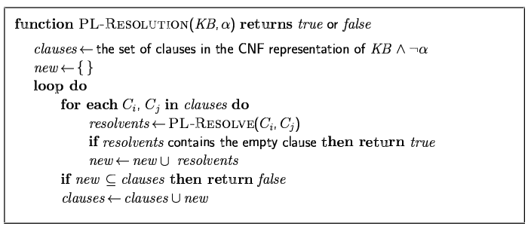
Resolution algorithm
Proof by contradiction, i.e., show KB∧¬α unsatisfiable

Slide 42

Resolution example
KB = (B_{1,1} ⇔ (P_{1,2}∨ P_{2,1})) ∧¬ B_{1,1} α = ¬P_{1,2}

Slide 43
Forward and backward chaining
Horn Form (restricted)
  KB = conjunction of Horn clauses
  Horn clause =
    proposition symbol; or
    (conjunction of symbols) ⇒ symbol
  E.g., C ∧ (B ⇒ A) ∧ (C ∧ D ⇒ B)
Modus Ponens (for Horn Form): complete for Horn KBs
α₁, … ,α_{n}, α₁ ∧ … ∧ α_{n} ⇒ β
β
Can be used with forward chaining or backward chaining.
These algorithms are very natural and run in linear time

Slide 44
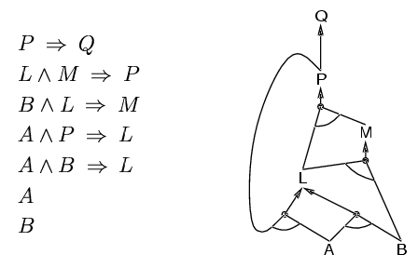
Forward chaining
Idea: fire any rule whose premises are satisfied in the KB,
  add its conclusion to the KB, until query is found

Slide 45
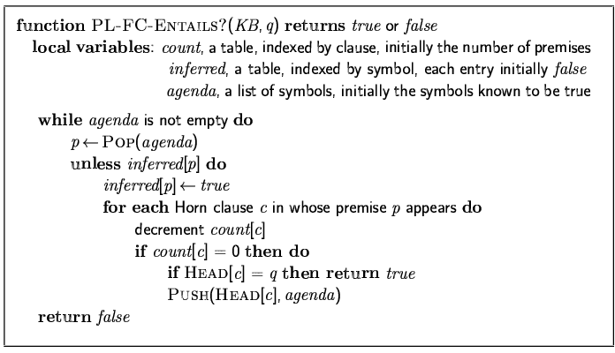
Forward chaining algorithm
Forward chaining is sound and complete for Horn KB

Slide 46
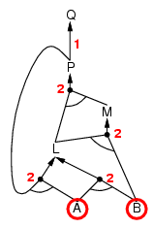
Forward chaining example

Slide 47
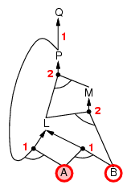
Forward chaining example

Slide 48
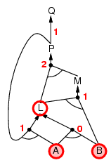
Forward chaining example

Slide 49
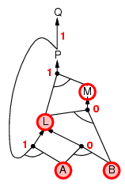
Forward chaining example

Slide 50
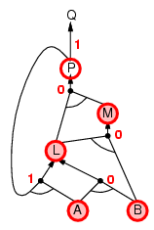
Forward chaining example

Slide 51
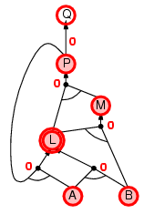
Forward chaining example

Slide 52
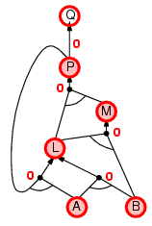
Forward chaining example

Slide 53

Forward chaining example

Slide 54
Proof of completeness
FC derives every atomic sentence that is entailed by KB
  FC reaches a fixed point where no new atomic sentences are derived
  Consider the final state as a model m, assigning true/false to symbols
  Every clause in the original KB is true in m
    a₁ ∧ … ∧ a_{k ⇒} b
  Hence m is a model of KB
  If KB╞ q, q is true in every model of KB, including m

Slide 55
Backward chaining
Idea: work backwards from the query q:
  to prove q by BC,
    check if q is known already, or
    prove by BC all premises of some rule concluding q
Avoid loops: check if new subgoal is already on the goal stack
Avoid repeated work: check if new subgoal
  has already been proved true, or
  has already failed

Slide 56
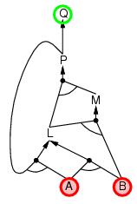
Backward chaining example

Slide 57
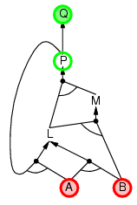
Backward chaining example

Slide 58
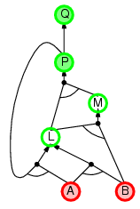
Backward chaining example

Slide 59
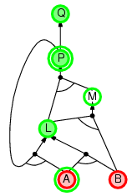
Backward chaining example

Slide 60
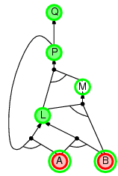
Backward chaining example

Slide 61
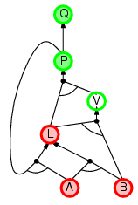
Backward chaining example

Slide 62
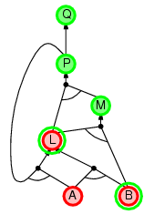
Backward chaining example

Slide 63
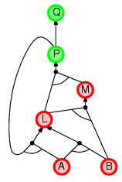
Backward chaining example

Slide 64
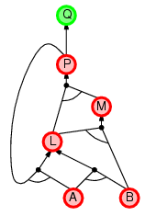
Backward chaining example

Slide 65
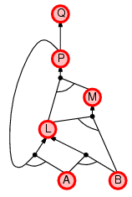
Backward chaining example

Slide 66
Forward vs. backward chaining
FC is data-driven, automatic, unconscious processing,
  e.g., object recognition, routine decisions
May do lots of work that is irrelevant to the goal
BC is goal-driven, appropriate for problem-solving,
  e.g., Where are my keys? How do I get into a PhD program?
Complexity of BC can be much less than linear in size of KB

Slide 67
Efficient propositional inference
Two families of efficient algorithms for propositional inference:
Complete backtracking search algorithms
DPLL algorithm (Davis, Putnam, Logemann, Loveland)
Incomplete local search algorithms
  WalkSAT algorithm

Slide 68
The DPLL algorithm
Determine if an input propositional logic sentence (in CNF) is satisfiable.
Improvements over truth table enumeration:
  Early termination
    A clause is true if any literal is true.
    A sentence is false if any clause is false.
  Pure symbol heuristic
    Pure symbol: always appears with the same "sign" in all clauses.
    e.g., In the three clauses (A ∨ ¬B), (¬B ∨ ¬C), (C ∨ A), A and B are pure, C is impure.
    Make a pure symbol literal true.
  Unit clause heuristic
    Unit clause: only one literal in the clause
    The only literal in a unit clause must be true.

Slide 69
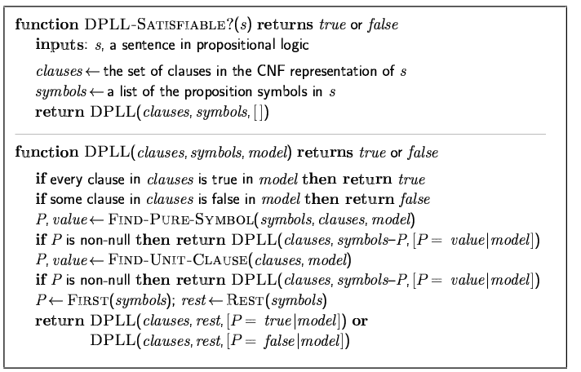
The DPLL algorithm

Slide 70
The WalkSAT algorithm
Incomplete, local search algorithm
Evaluation function: The min-conflict heuristic of minimizing the number of unsatisfied clauses
Balance between greediness and randomness

Slide 71
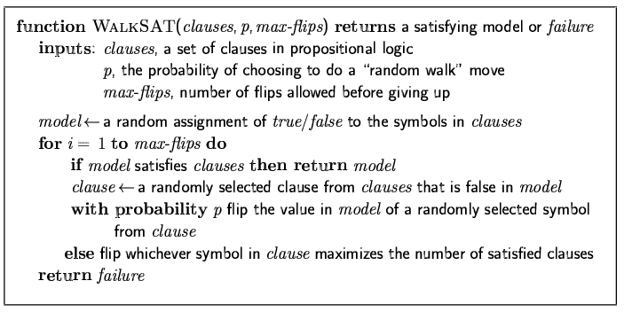
The WalkSAT algorithm

Slide 72
Hard satisfiability problems
Consider random 3-CNF sentences. e.g.,
(¬D ∨ ¬B ∨ C) ∧ (B ∨ ¬A ∨ ¬C) ∧ (¬C ∨ ¬B ∨ E) ∧ (E ∨ ¬D ∨ B) ∧ (B ∨ E ∨ ¬C)
  m = number of clauses
  n = number of symbols
  Hard problems seem to cluster near m/n = 4.3 (critical point)

Slide 73
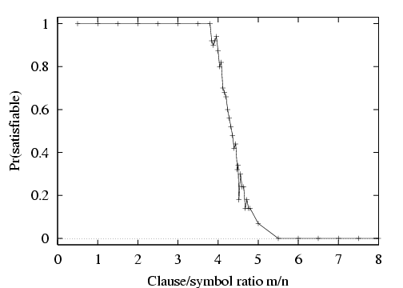
Hard satisfiability problems

Slide 74
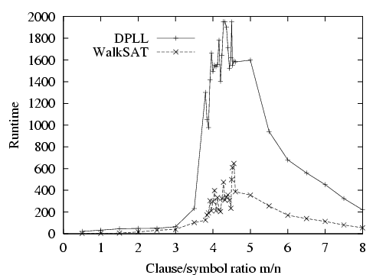
Hard satisfiability problems
Median runtime for 100 satisfiable random 3-CNF sentences, n = 50

Slide 75
Inference-based agents in the wumpus world
A wumpus-world agent using propositional logic:
  ¬P_{1,1}
  ¬W_{1,1}
  B_{x,y} ⇔ (P_{x,y+1} ∨ P_{x,y-1} ∨ P_{x+1,y} ∨ P_{x-1,y})
  S_{x,y} ⇔ (W_{x,y+1} ∨ W_{x,y-1} ∨ W_{x+1,y} ∨ W_{x-1,y})
  W_{1,1} ∨ W_{1,2} ∨ … ∨ W_{4,4}
  ¬W_{1,1} ∨ ¬W_{1,2}
  ¬W_{1,1} ∨ ¬W_{1,3}
  …
⇒ 64 distinct proposition symbols, 155 sentences

Slide 76
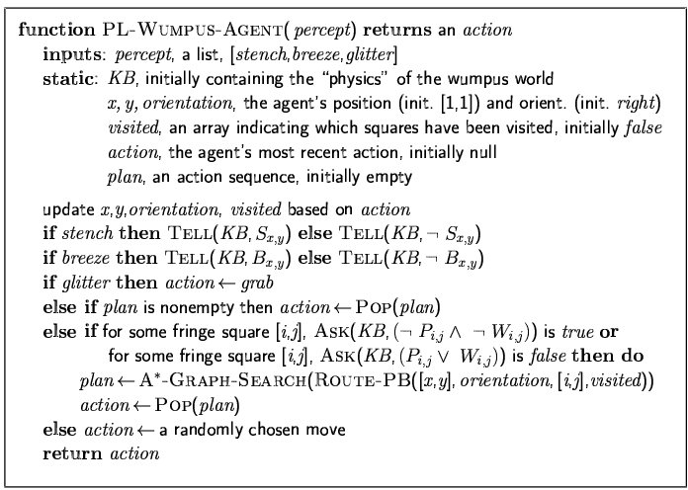

Slide 77
Expressiveness limitation of propositional logic
KB contains "physics" sentences for every single square
For every time t and every location [x,y],
L_{x,y} ∧ FacingRight^{t} ∧ Forward^{t} ⇒ L_{x+1,y}
Rapid proliferation of clauses
t
t

Slide 78
Summary
Logical agents apply inference to a knowledge base to derive new information and make decisions
Basic concepts of logic:
  syntax: formal structure of sentences
  semantics: truth of sentences wrt models
  entailment: necessary truth of one sentence given another
  inference: deriving sentences from other sentences
  soundness: derivations produce only entailed sentences
  completeness: derivations can produce all entailed sentences
Wumpus world requires the ability to represent partial and negated information, reason by cases, etc.
Resolution is complete for propositional logic
Forward, backward chaining are linear-time, complete for Horn clauses
Propositional logic lacks expressive power

