Slide 1
Supermarket_Sales
File created on: 25/06/21 6:37:31 PM GMT+05:30

Slide 2
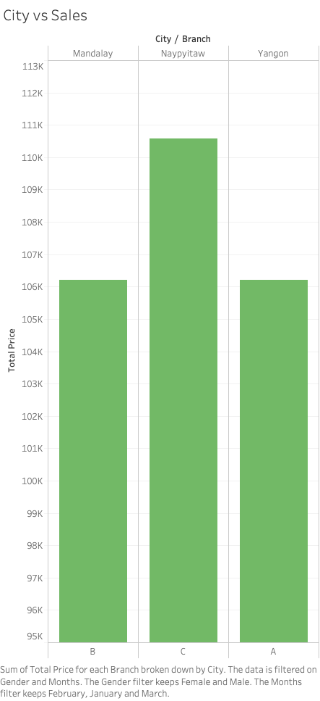

Slide 3
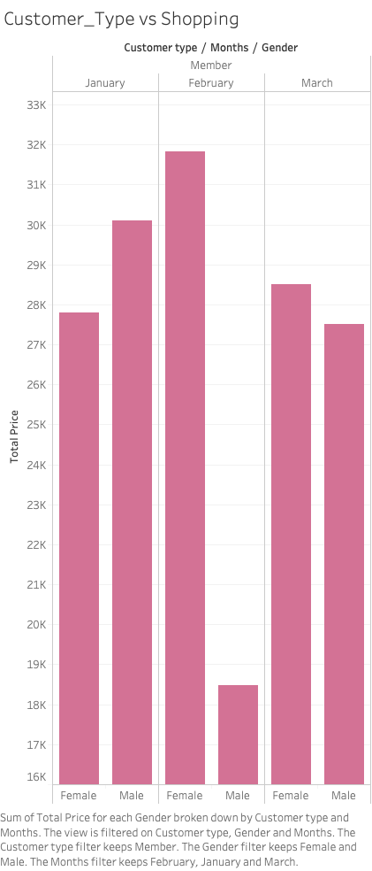

Slide 4


Slide 5
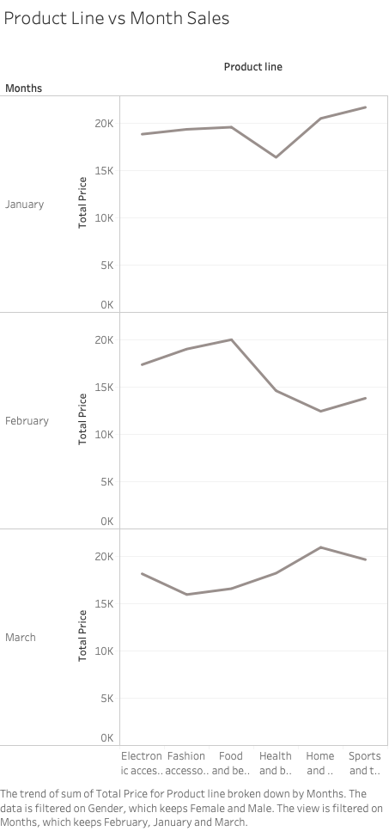

Slide 6


