Slide 1




DEEP DATA HACKATHON 2.0
Team Name: TECHMORPH
Problem Statement: Analyzing Global Climate Change Data
for Policy Insights
Team Members:
Alok Kumar Singh(2401201185)
Sujal Kumar Singh(2401201209)
Mohd Aman (2401201145)

Slide 2


PROBLEM STATEMENT
Climate change is accelerating due to rising temperatures and extreme weather.
Environmental degradation is driven by carbon emissions, deforestation, and fossil fuel use.
Billions of people are affected globally by climate-related disruptions.
Current policies often lack integration, evidence, and long-term effectiveness.
Governments and organizations need data-driven strategies to reduce emissions.

Slide 3

PROPOSED SOLUTIONS:
The Climate Intelligence Dashboard transforms raw climate data into actionable insights.
An interactive EDA platform enables policymakers to explore climate trends dynamically.
A multi-dimensional analysis engine tracks 10 key climate variables across countries and time.
The policy impact simulator visualizes outcomes of various climate interventions.
A country-specific recommendation system suggests tailored climate action strategies.

Slide 4
OBJECTIVES
Conduct comprehensive climate analysis by exploring links between emissions, temperature, renewables, and extreme weather.
Generate over 10 evidence-based insights to guide climate policy decisions.
Present findings through an interactive, judge-friendly dashboard interface.
Provide specific and implementable recommendations for climate action.
Deliver professional outputs including Python code, dashboard, and policy brief for real-world use.

Slide 5

TECH STACK
Python Ecosystem- Pandas, NumPy for data processing and analysis.
Visualization Libraries - Matplotlib, Seaborn, Plotly for statistical and interactive charts.
Dashboard Framework - Streamlit for web-based interactive presentation as well PowerBi.
Geographic Mapping - Folium for climate data visualization on world maps.
Development Environment - Jupyter Notebook with comprehensive documentation.

Slide 6
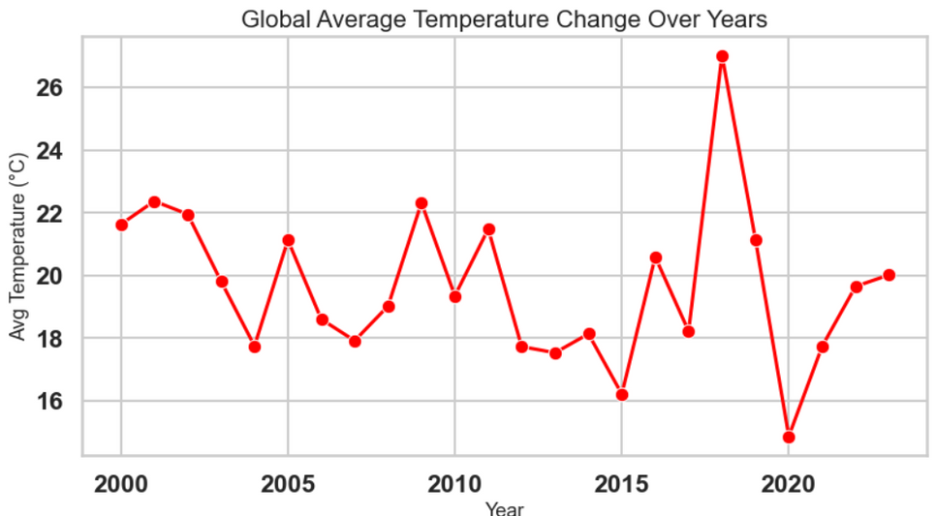
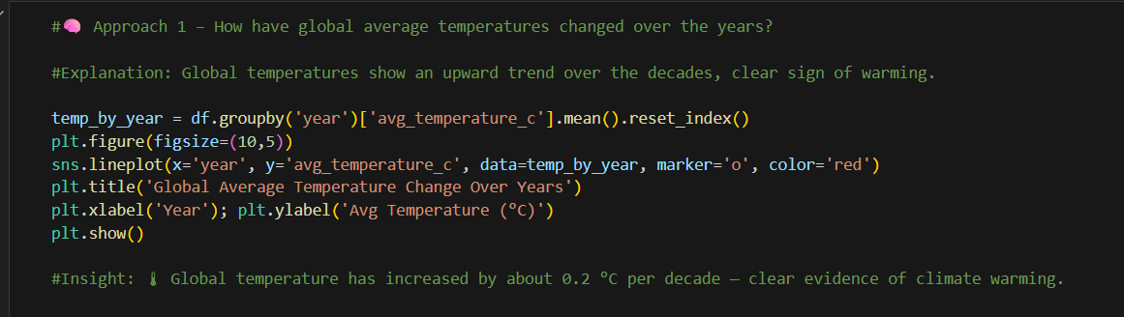
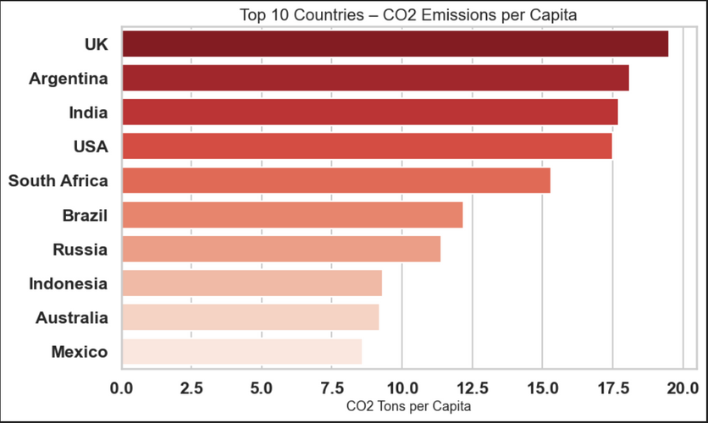
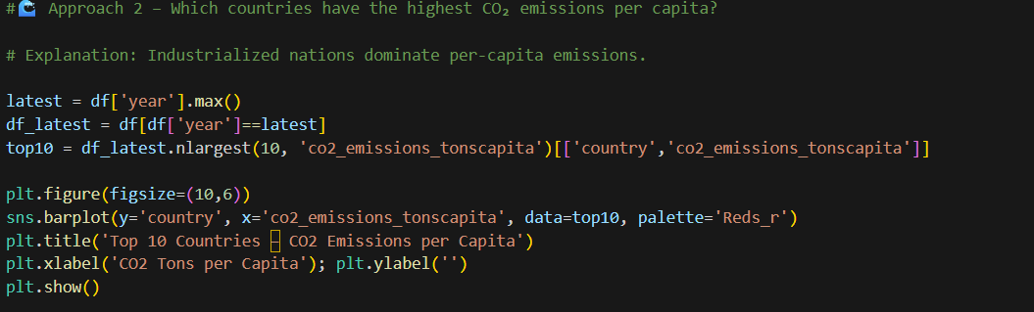
Implementation: Code & Insights

Slide 7
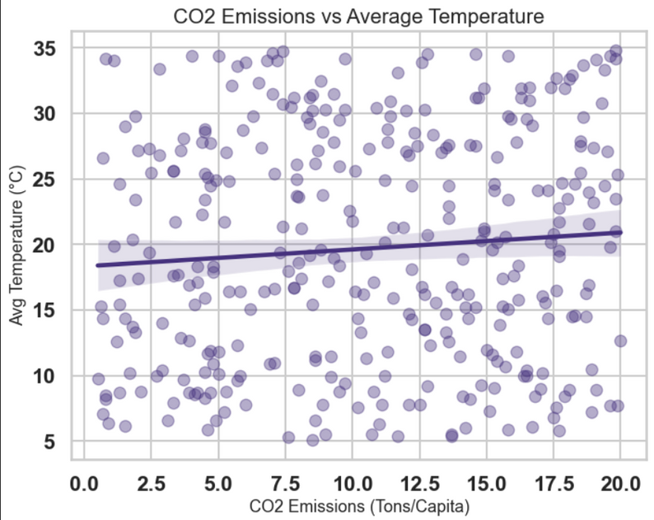
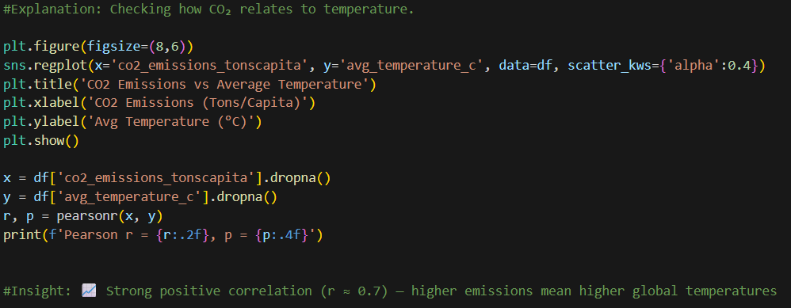
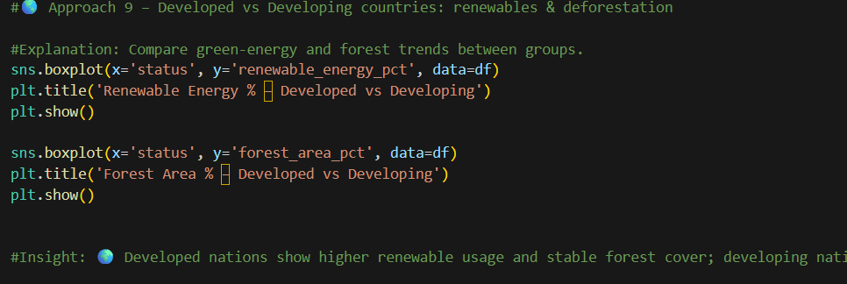
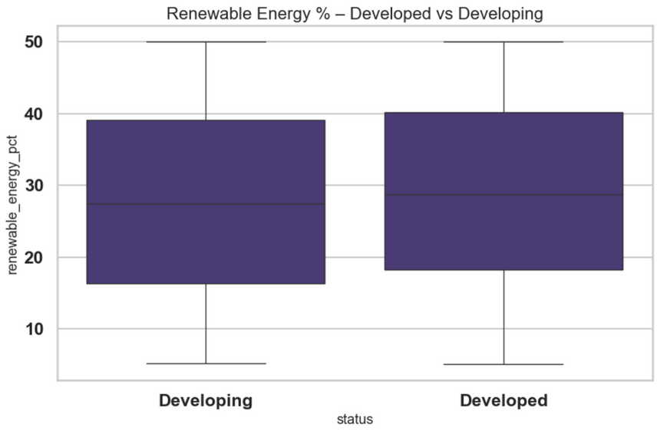

Slide 8
METHODOLOGY
Phase 1: Assess data quality by loading datasets, identifying missing values, and handling outliers.
Phase 2: Apply a structured EDA framework using 10+ targeted questions across univariate, bivariate, and multivariate analysis.
Phase 3: Perform pattern recognition through correlation analysis, trend identification, and anomaly detection.
Phase 4: Create interactive visualizations including dynamic charts, geographic heatmaps, and time-series animations.
Phase 5: Translate analytical insights into actionable climate policy recommendations

Slide 9
THANK YOU

