Slide 1
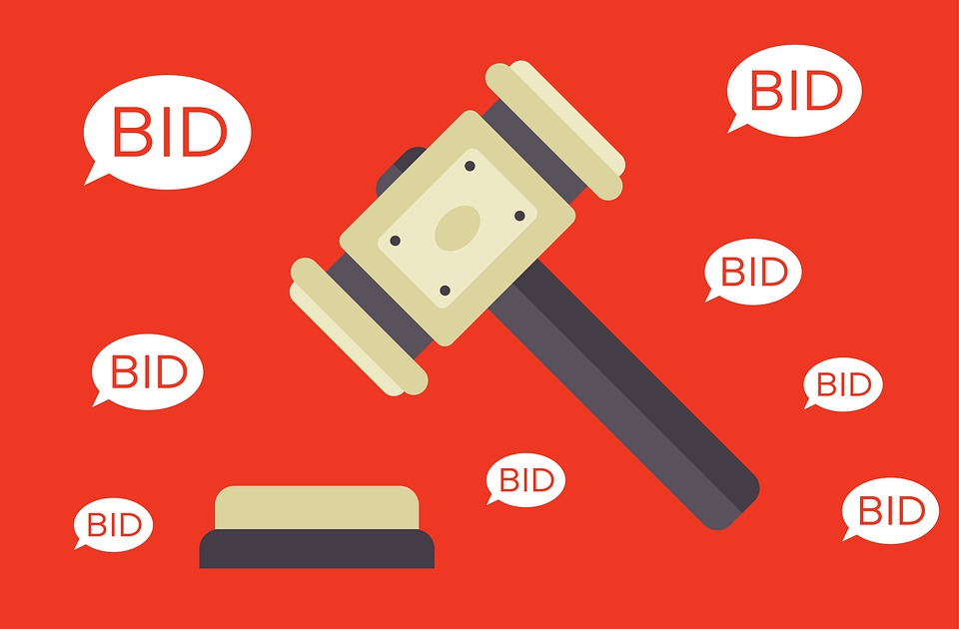
Auction Portal
CS 307 - System Practicum
GROUP - 6
Aman Saini (B19149)
Gaurav Kumar (B19082)
Anmolpreet Singh (B19070)
Kratika Gupta (B19169)
Aayush Sharma(B19229)
Shreya Aggarwal (B19115)

Slide 2
Introduction
Designed an Auction Portal using TCP Server & Client implementation.
Admin on Server will add items and start the Auction.
Multiple Bidders can join as different clients.
Time bound bidding in 3 Rounds

Slide 3
Tools Used
Socket Programming in C
Multithreading
Select statement for Concurrency
File Descriptors

Slide 4
Features
Single Server handles Multiple Clients using threads.
Items name will be displayed before Auction.
Only registered Bidders can take part.
Each Bidder will get to know Bid of other Bidders.
If Highest Bidder quits, bid will be replaced with previous highest bid.
Bidder will be removed in case of violation of the rules.

Slide 5
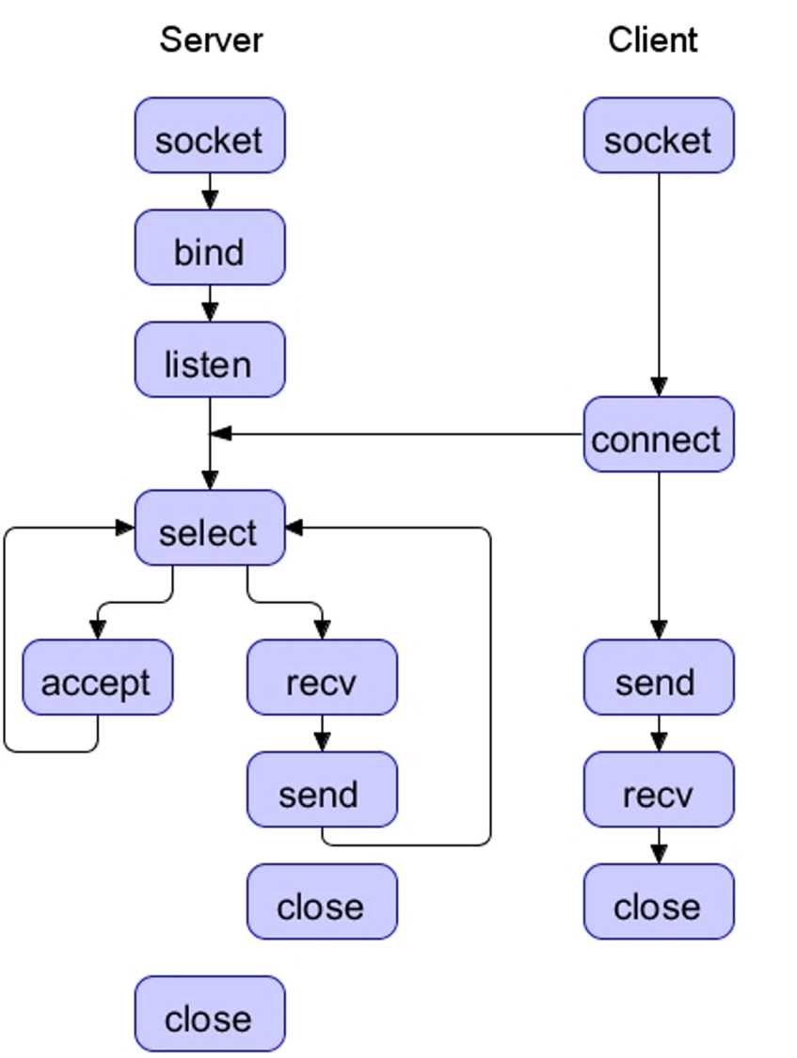
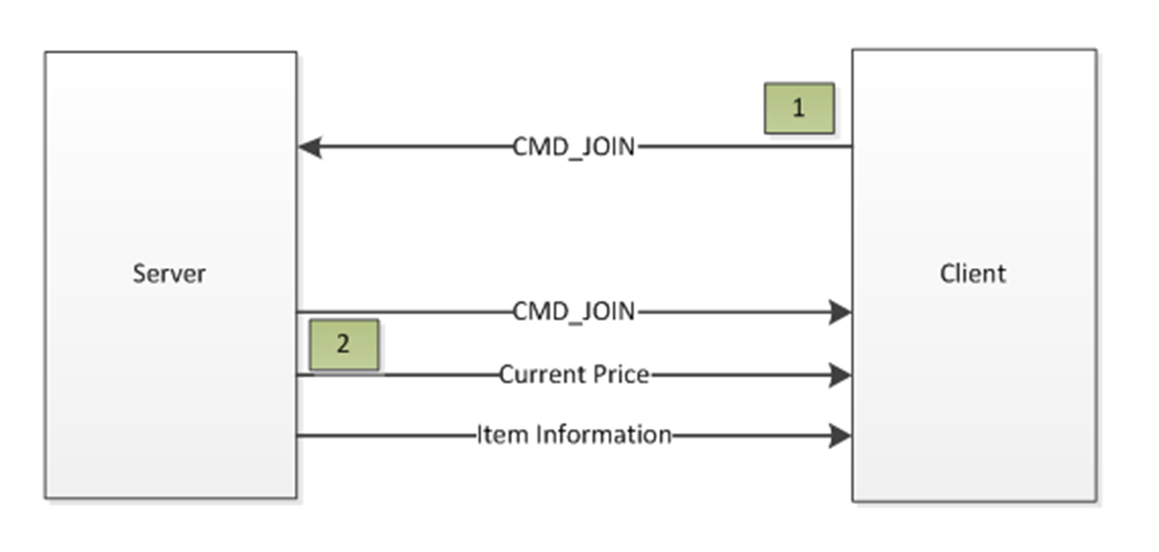
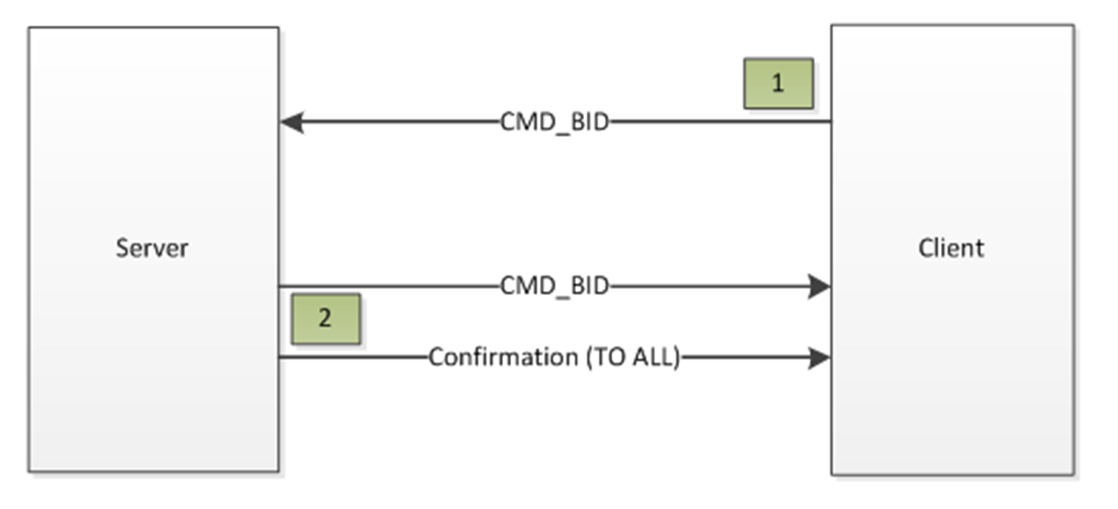
Architecture Diagram
Joining Bid
Server/Client Connection with multiple clients
Bid Sharing with all clients

Slide 6
Server
Establish Socket Connection & wait for client.
Create a Thread for Auction.
Registers New Bidders.
Will start the Auction.
Uses Select() to monitor multiple File descriptors.
Use Utility.c file to support operations.

Slide 7
Challenges
Handling multiple clients at the same time and broadcasting live information instantaneously to all the clients was a challenge for us.
Also doing spam control by not allowing a client to do multiple bids less than the minimum increment in bid.

Slide 8
2. Client
Client will connect to Server.
Get Option to Login/Sign-in
Credentials will be sent to Server for Validation.
Bidder will be informed when Auction Begins.
Bidded amount will be sent to server & other clients.
Highest Bidder will deposit money & get the item.
Can Deposit money into his account after sending a Serial ID to the server.

Slide 9
Demo

Slide 10
References
https://www.geeksforgeeks.org/socket-programming-cc/
https://www.tutorialspoint.com/multithreading-in-c
https://www.educative.io/edpresso/c-reading-data-from-a-file-using-fread

Slide 11
THANK-YOU

