Slide 1
Partizzle
MERN Stack

Slide 2

Team
AMANDEEP SINGH (Leader)
RITIK BHATNAGAR

Slide 3

Technology Used
HTML
CSS
VANILLA JAVASCRIPT
BOOTSTRAP
REACT JS
NODE JS
MONGOBD

Slide 4

Minimum Requirements
SCREEN SIZE ABOVE 250PX WIDTH
ANY OPERATING SYSTEM
ANY DEVICE WITH WEB BROWSER (CHROME RECOMMENDED)
INTERNET CONNECTION

Slide 5
Modules
Home Page

Slide 6
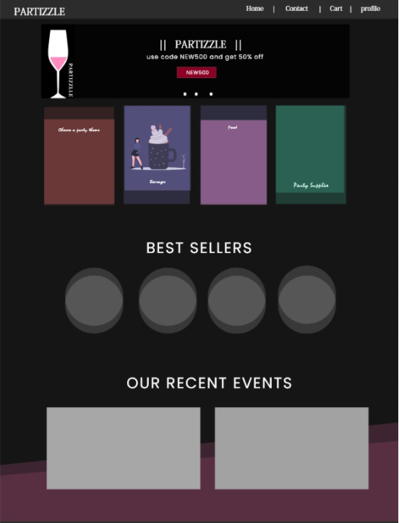
Rough design

