Slide 1


Develop an AI System for Automatically analysing Customer feedback
MSc Student: Aman Seth
Supervisors: Prof. Wenjia Wang(UEA)
Ms. Ilona Utting (Wex Photo Video)

Slide 2
Wex PHOTO VIDEO OBJECTIVES
Customer Profiling and Predictive Analysis
Personalised Advertising and Communication
Customer Feedback Analysis
Segmentation and Targeted Marketing
Customer Engagement and Problem Resolution

Slide 3
Content
Introduction
Problem Statement
Aim and Objectives
Main Challenges
AI System Design
Best model selection
WEB APPLICATION – BEST MODEL DEPLOYMENT
Conclusion and Future work

Slide 4
INTRODUCTION
Covers the design and approaches explored to perform Customer Feedback Analysis, dissecting the sentiments behind the customer reviews on platforms like Trustpilot and Power Reviews for Wex Photo Video.
Delves into the preprocessing steps and feature extraction techniques used to prepare the data for analysis.
Presents the results obtained from various supervised machine learning algorithms, including logistic regression, support vector machines etc. Furthermore, the presentation highlights the implementation and outcomes of the state-of-the-art BERT (distilBERT) model.
A detailed comparison of the performance metrics of these models is provided to illustrate the effectiveness and accuracy of each approach in sentiment classification.

Slide 5
Problem statement
After analysing the current pain points for Call Centre Management team at Wex while performing CFA, below are a few problems identified:-
CCM team performs CFA manually for every single review platform which requires time and effort consumption.
Possible late response to a serious query / complaint by a customer.
Lack of automation.

Slide 6


Sample customer reviews
Trust pilot & Power Reviews

Slide 7
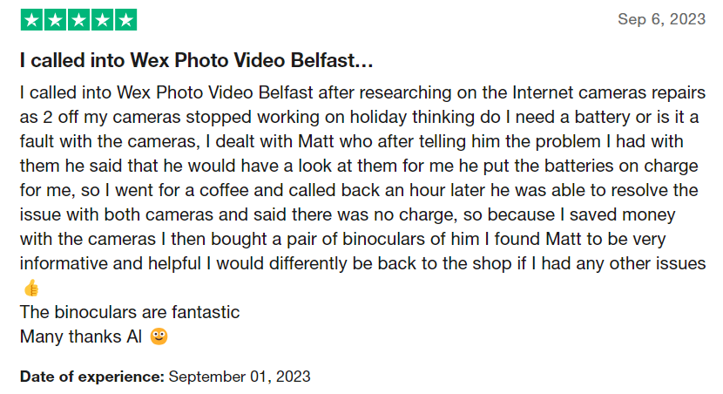
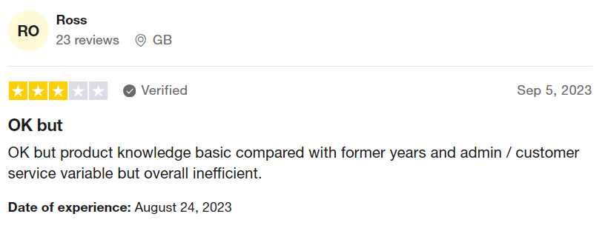
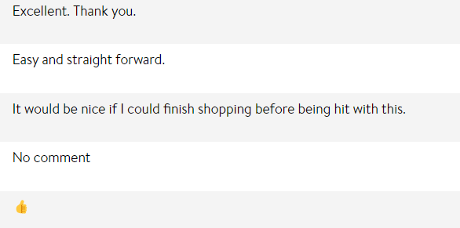
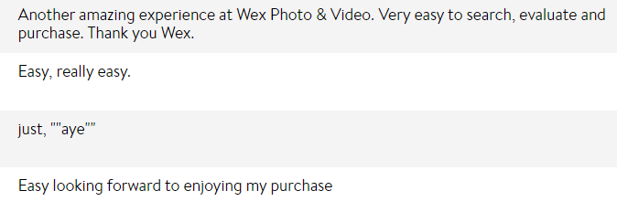

Slide 8
AIM and OBJECTIVES
Aim: To Develop an AI/ML System for Automatically Analysing Customer Feedback Analysis in Real Time
Objectives:-
Scrape review websites for customer comments
Deploy supervised learning ML models on extracted data to classify sentiments behind customer reviews (only Positive/Negative/Neutral)
Deploy BERT (Bidirectional Encoder Representations from Transformers) language DL model on extracted data
Classify possible issues behind customer sentiments using spaCy (NLP)
Issue validity via Llama3
Deploy best technique / approach on a web application

Slide 9
Main challenges
Virtual resource related challenges have been the biggest and major challenge during implementation of CFA project as a whole.
Extensive model training for cross validations was a big challenge as Google Colab doesn’t provide free GPU units and Kaggle provides 30 hours per week GPU usage which wasn’t enough at times.
Power Reviews extraction API returns ~1-2 days old data from current date. This is already known to Wex Engineering team.

Slide 10
AI SYSTEM DESIGN
Sentiment Prediction Flowchart
Trust Pilot Reviews Extraction
Tab Separated Reviews Data
Feature Engineering & Preprocessing
Final Pre-processed Data
Start
Power Reviews
Data Extraction
Flask
Web-app
Predicted Sentiment
Testing & Evaluation
Training ML & BERT Models
Approach 1
Approach 2
Sentiment Prediction
End
Approach 3
DistilBERT
SVM
Logistic Regression
KNN
Best Model
Approach N

Slide 11
AI SYSTEM DESIGN
Issue Classification Flowchart
Predicted Sentiments
Data
Electr-onics
Start
Issue Classification via spaCy
Paym-ent
Prod-uct
Issue Classified
Reviews Data
Servi-ce
Packa-ging
Flask
Web-app
Deliv-ery
Time
End

Slide 12
AI SYSTEM DESIGN
Issue Validity Flowchart → Further Classification
Issue Classified Reviews Data
Issue Validity via LLM
openAI (gpt 3.5)
Start
Llama2 (13B)
Issue Validated Data
Flask
Web-app
Llama3 (8B)
End

Slide 13
AI SYSTEM DESIGN
Trustpilot & Power Reviews Sample Data
Trust Pilot
Title | Excellent company.
Content | Excellent company to deal with, ordered my item and was shocked how quickly it came considering postage was free. Wouldn't hesitate to use again.
Date of Experience | 2024-04-28T00:00:00Z
Review Date | 2024-04-29T19:27:23Z
Rating | 5
Location
No. of reviews given | 7

Slide 14
AI SYSTEM DESIGN
Trustpilot & Power Reviews Sample Data
Power Reviews
Created Date | Wed May 1 22:01:43 2024
Page ID | 614293
Review Rating | 4
Review Heading | Slow to accept payment
Comment | Slow to accept payment. Had to process twice. Then having selected named day delivery ended up with standard delivery. Not what I normally expect from Wex.
Review Location | GB
Reviewer Nickname | aar6478

Slide 15
AI SYSTEM DESIGN
Clubbed Reviews Data
Content | Created Date | Rating | Source
No hassle. Professional | 2024-09-01T18:16:02Z | 5 | Trustpilot
Bit difficult to rate in honesty. Ordered two identical items, both allegedly in stock at time of ordering. First arrived exceedingly quickly without issue. The second yet to arrive. Only charged for the one to date but absolutely no contact to explain anything. | 2024-09-01T12:06:13Z | 2 | Trustpilot
The payment system failed twice on my PC. I was using Edge - it eventually worked when I used Chrome. Otherwise am happy with the service and the range of products for sale. Thank you. | Fri Aug 30 09:20:48 2024 | 3 | PowerReviews

Slide 16
AI SYSTEM DESIGN
Feature Engineering
Content | Created Date | Rating | Source | Sentiment
No hassle. Professional | 2024-09-01T18:16:02Z | 5 | Trustpilot | 2
Bit difficult to rate in honesty. Ordered two identical items, both allegedly in stock at time of ordering. First arrived exceedingly quickly without issue. The second yet to arrive. Only charged for the one to date but absolutely no contact to explain anything. | 2024-09-01T12:06:13Z | 2 | Trustpilot | 0
The payment system failed twice on my PC. I was using Edge - it eventually worked when I used Chrome. Otherwise am happy with the service and the range of products for sale. Thank you. | Fri Aug 30 09:20:48 2024 | 3 | PowerReviews | 1

Slide 17
AI SYSTEM DESIGN
Pre-processing Techniques
Technique No. | Imbalance Handling | Text Pre-processing
1 | SMOTE Random Oversampling | Lowercasing, Contractions Removal, Emoji Removal, Special Characters Removal, Lemmatisation
2 | Balancing with external reviews | Lowercasing, Contractions Removal, Emoji Removal, Special Characters Removal, Lemmatisation
3 | Balancing with external reviews | Lowercasing, Contractions Removal, Emoji Replacement, Special Characters Removal, Excluded Lemmatisation, Duplicates Removal, TF-IDF
Abbreviations
SMOTE: Synthetic Minority Over-sampling Technique
TF-IDF: Term Frequency – Inverse Document Frequency

Slide 18
BEST MODEL SELECTION
ML Models Approaches
This section focusses on different approaches that were taken to evaluate machine learning models performance based on different scores and metrics.
For every pre-processing technique, different ML models performance scores were calculated.
Key Definitions
Accuracy: Measures how accurate the model is overall
Precision Score: Measures how many reviews predicted as a sentiment (0, 1, 2) are actually that sentiment
Recall Score: Measures how many reviews predicted as a sentiment (0, 1, 2) are correctly identified by the model
F1 Score: Harmonic mean of Precision and Recall
Confusion Matrix: Visual classification table of actual vs predicted classifications

Slide 19
BEST MODEL SELECTION
ML Models Approaches Evaluation Scores
Approach No. | Pre-processing Technique No. | Data Split Ratio |  | Models & Scores Model Name | Accuracy |  | F1 Score
1 | 1 | 80/20 Total: 30,000 | Train: 24,000 | SVC Logistic Regression Random Forest KNN Naïve Bayes | 0.491 0.509 0.44 0.452 0.422 | 0.38 0.397 0.366 0.354 0.342
 |  |  | Val: 6,000
2 | 2 | 80/20 Total: 21,378 | Train: 17,102 | SVC Logistic Regression Random Forest KNN Naïve Bayes | 0.689 0.697 0.626 0.473 0.639 | 0.682 0.696 0.623 0.43 0.643
 |  |  | Val: 4,276
3 | 3 | 80/20 Total: 20,748 | Train: 16,597 | SVC Logistic Regression Random Forest KNN Naïve Bayes | 0.735 0.731 0.696 0.446 0.699 | 0.734 0.729 0.694 0.355 0.693
 |  |  | Val: 4,151

Slide 20
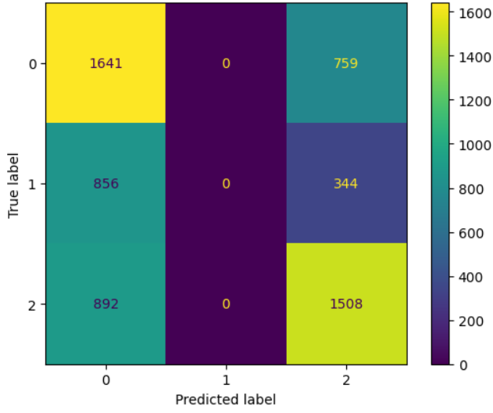
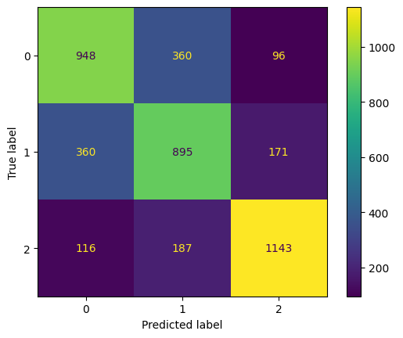
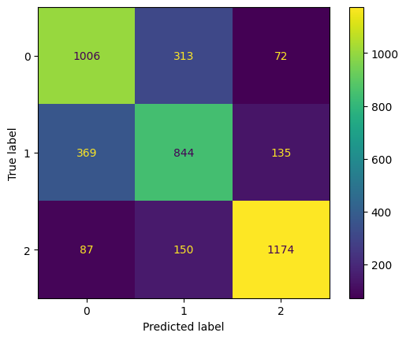
BEST MODEL SELECTION
ML Models Approaches Evaluation Scores
Confusion Matrix
Approach 1
Approach 2
Approach 3
Per Label Classification Report
Approach (SVC) | Label 0 |  |  | Label 1 |  |  | Label 2
 | Precision | Recall | F1 | Precision | Recall | F1 | Precision | Recall | F1
Approach 1 | 0.48 | 0.68 | 0.57 | 0.00 | 0.00 | 0.00 | 0.58 | 0.63 | 0.60
Approach 2 | 0.67 | 0.68 | 0.67 | 0.62 | 0.63 | 0.62 | 0.81 | 0.79 | 0.80
Approach 3 | 0.69 | 0.72 | 0.71 | 0.65 | 0.63 | 0.64 | 0.85 | 0.83 | 0.84

Slide 21
BEST MODEL SELECTION
DistilBERT Models Approaches
This section focusses on different approaches that were taken to evaluate BERT based distilBERT model performance based on different scores and metrics
Four different cross validations were performed which are categorised under four different approaches within this section
Note: The same pre-processed data is used as per ML best approach (3)
Key Definitions
Batch Size: The no. of samples of the dataset that model processes before updating it’s internal parameters
Random Seed: A no. used to initialise random no. generator to ensure the model results are reproducible
Learning Rate: A small no. that controls how much the model’s parameters are adjusted during training
Epoch: A complete loop or pass through the entire training dataset
Token Length: The no. of individual units (like words or sub-words) that make up a sequence in NLP tasks
Dropout Rate: The % of neurons randomly ignored during training to prevent model from over-fitting

Slide 22
BEST MODEL SELECTION
DistilBERT Models Approaches
Approach 1:
Cross Validation 1:
Split Ratio: 80 (Train) / 20 (Validate)
Random Seed: 42, 101, 789, 1001, 2023
Total Samples: 20,208 → Train: 16,166 | Val: 4042
Batch Size: 16
Learning Rate: 5e-5
Dropout Rate: 0.1
Token Length: 256
Epoch: 4

Slide 23
BEST MODEL SELECTION
DistilBERT Approaches Evaluation Scores
Approach 1:
Cross Validation 1:

Slide 24
BEST MODEL SELECTION
DistilBERT Approaches Evaluation Scores
Approach 1:
Cross Validation 1:
Train, Validation Mean Accuracy/Loss & Standard Deviation Across Different Seeds

Slide 25
BEST MODEL SELECTION
DistilBERT Models Approaches
Approach 2:
Cross Validation 2:
Split Ratio: 70 (Train) / 30 (Validate)
Random Seed: 42, 101, 789, 1001, 2023
Total Samples: 20,208 → Train: 14,145 | Val: 6063
Batch Size: 32
Learning Rate: 2e-5
Dropout Rate: 0.2
Token Length: 256
Epoch: 4

Slide 26
BEST MODEL SELECTION
DistilBERT Approaches Evaluation Scores
Approach 2:
Cross Validation 2:

Slide 27
BEST MODEL SELECTION
DistilBERT Approaches Evaluation Scores
Approach 2:
Cross Validation 2:
Train, Validation Mean Accuracy/Loss & Standard Deviation Across Different Seeds

Slide 28
BEST MODEL SELECTION
DistilBERT Models Approaches
Approach 3:
Cross Validation 3:
Split Ratio: 60 (Train) / 40 (Validate)
Random Seed: 42, 101, 789, 1001, 2023
Total Samples: 20,208 → Train: 12,124 | Val: 8084
Batch Size: 64
Learning Rate: 2e-5
Dropout Rate: 0.3
Token Length: 512
Epoch: 4

Slide 29
BEST MODEL SELECTION
DistilBERT Approaches Evaluation Scores
Approach 3:
Cross Validation 3:

Slide 30
BEST MODEL SELECTION
DistilBERT Approaches Evaluation Scores
Approach 3:
Cross Validation 3:
Train, Validation Mean Accuracy/Loss & Standard Deviation Across Different Seeds

Slide 31
BEST MODEL SELECTION
DistilBERT Models Approaches
Approach 4:
Cross Validation 4:
Split Ratio: 60 (Train) / 40 (Validate)
Random Seed: 42, 101, 789, 1001, 2023
Total Samples: 20,208 → Train: 12,124 | Val: 8084
Batch Size: 64
Learning Rate: 2e-5
Dropout Rate: 0.3
Token Length: 512
Epoch: 8

Slide 32
BEST MODEL SELECTION
DistilBERT Approaches Evaluation Scores
Approach 4:
Cross Validation 4:

Slide 33
BEST MODEL SELECTION
DistilBERT Approaches Evaluation Scores
Approach 4:
Cross Validation 4:
Train, Validation Mean Accuracy/Loss & Standard Deviation Across Different Seeds

Slide 34

BEST MODEL SELECTION
DistilBERT Approaches Evaluation Scores
Approach 1 vs Approach 2 vs Approach 3 vs Approach 4 (Validation Data)
Approach |  | distilBERT
 |  | Train Accuracy | Validation Accuracy | Training Loss | Validation Loss
Approach 1 |  | 83.25 | 73.16 | 0.0247 | 0.203
Approach 2 |  | 77.63 | 73.71 | 0.015 | 0.019
Approach 3 |  | 74.08 | 75.17 | 0.008 | 0.009
Approach 4 |  | 82.77 | 72.61 | 0.006 | 0.011

Slide 35
BEST MODEL SELECTION
DistilBERT Approaches Evaluation Scores
Approach 1 vs Approach 2 vs Approach 3 vs Approach 4 (Validation Data)
Approach | Label 0 |  |  | Label 1 |  |  | Label 2
 | Precision | Recall | F1 | Precision | Recall | F1 | Precision | Recall | F1
Approach 1 | 71 | 69 | 70 | 62 | 64 | 63 | 86 | 86 | 86
Approach 2 | 72 | 70 | 71 | 63 | 65 | 64 | 86 | 86 | 86
Approach 3 | 74 | 74 | 74 | 68 | 67 | 67.5 | 88 | 86 | 87
Approach 4 | 72 | 67 | 70 | 61 | 65 | 63 | 86 | 85 | 85

Slide 36
BEST MODEL SELECTION
Best Models Evaluation Comparison
ML vs DistilBERT
Model |  | Scores
 |  | Validation Accuracy
ML (SVM) (Approach 3) |  | 73.5
DistilBERT (Approach 3) |  | 75.17
Model | Label 0 |  |  | Label 1 |  |  | Label 2
 | Precision | Recall | F1 | Precision | Recall | F1 | Precision | Recall | F1
ML (SVM) | 0.69 | 0.72 | 0.71 | 0.65 | 0.63 | 0.64 | 0.85 | 0.83 | 0.84
DistilBERT | 74 | 74 | 74 | 68 | 67 | 67.5 | 88 | 86 | 87

Slide 37
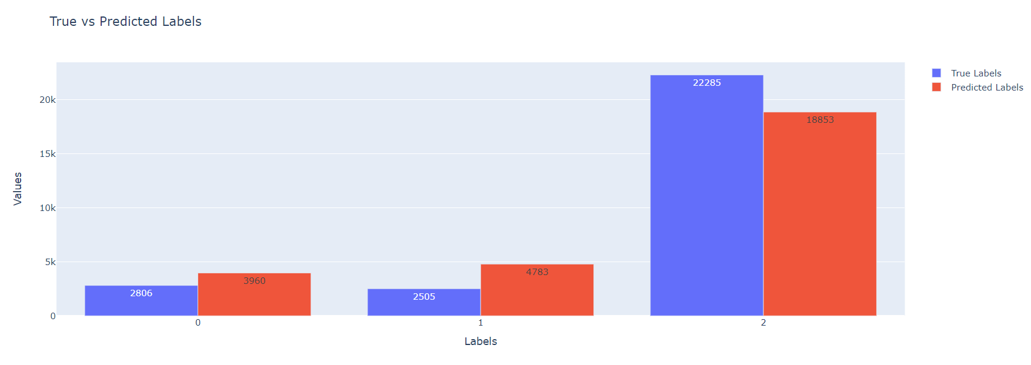
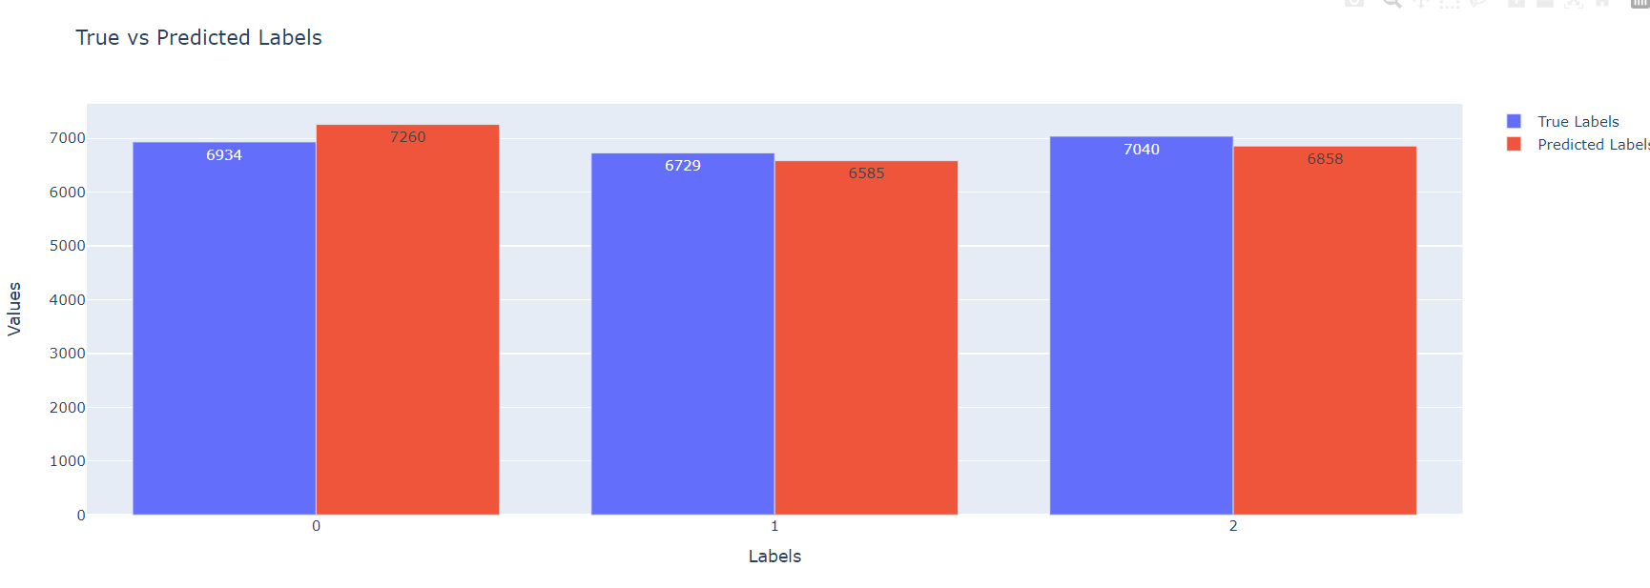
BEST MODEL SELECTION
Note
Label 0 = Rating 1 & 2
Label 1 = Rating 3
Label 2 = Rating 4 & 5
Best Models Evaluation Comparison
ML vs DistilBERT
Note: Tested on external dataset: 27,596 reviews and 27,703 (5 days additional data) for ML and DistilBERT respectively

Slide 38
ISSUE CLASSIFICATION
Objectives
Once sentiment is predicted by the model, then also to identify the possible issues especially behind the reviews which are predicted as label 0 or 1, meaning negative or neutral.
Not only for label 0 and 1 but even for identity issues in label 2 which are predicted as positive sentiments but Wex Photo Video encounters quite many reviews which are rated as 4 or 5 stars but still reflects customer dissatisfaction or complaints mentioned either related to the product or services of Wex.
These are the possible issues identified by going through the reviews on the review platforms :-
• Electronics Product
• Packaging Time
• Delivery Customer service
• General

Slide 39
ISSUE CLASSIFICATION(Cont.)
NLP (Natural Language Processing): spaCy → PhraseMatcher
issue_phrases = {
" Electronics ": [" laptop ", " camera ", " lens ", " mobile phone ", " smartphone ", " tripod ", " tablet ", " headphone ", " charger ", " battery "],
" Product ": [" product issue ", " defective product ", " faulty item ", " damaged ", " damage ", " torn ", " broken ", " break ", " gouged "],
" Packaging ": [" packaging ", " package ", " pack "],
" Time ": [" late ", " delayed ", " time issue ", "too long ", " long to arrive "],
" Delivery ": [" delivery issue ", " shipment problem ", " shipping issue ", " arrive ", " arrival ", " late delivery ", " delivery late ", " late ", " time ", " times "],
" Customer service ": [" customer service ", " support issue ", " service complaint ", " rude ", " aggressive ", " tone ", " behaviour ", " nonsense ", "not understand ", " staff ", " insult ", " salesperson "],
" Payment ": [" payment ", "pay", " money "],
" General ": [" issue ", " problem ", " complaint "]
}

Slide 40

ISSUE CLASSIFICATION(Cont.)
Source | Content | Issues
Trustpilot | love my new camera, got a nikon zf from here and the service in-store and online was really good. belfast branch let me see and use the display model they had, and answered all my questions in a helpful and friendly way, the also pointed out key features and things to consider plus alternatives if needed. | Electronics
Power Reviews | have just wasted 90 minutes driving to and from moor allerton as i needed a fast sony lens for a wedding tomorrow. There were two staff in the branch and one other customer when i went in. for some bizarre reason both staff members saw fit to ignore me and both dealt with the one customer. one said he would be with me in a minute and went out back to find something for the one customer they had, he was actually gone about 5 or 10 minutes, came back with something like a lens cap, then they both spent even more time with the same customer. the same staff member then walks past me again on his way to the store and says, i will be with you in a minute, you know, like he would said 10 minutes before. by the his point i would been stood by the counter for 15- 20 mins and i told him not to bother as I was leaving. so wex lost a decent sale and I will never shop there again. appalling and rude customer service! | Electronics, Customer Service, Delivery
Trustpilot | initial offer was fine but reduced by around 10% on a boxed lens in good condition. took quite a few days to make the offer after the lens was received. however the money owed was paid promptly. i do not plan to sell anything else through wex | Electronics Payment
Is this really
an issue !!??

Slide 41
ISSUE VALIDATION
Objectives
Since spaCy’s PhraseMatcher library depicts issues purely based on the text/phrase matching mechanism but there is no intelligence behind it, hence, an issue validator technique is implemented using the existing open-source pre-trained LLMs (Large Language Models).
Below are the tried and tested LLMs :-
LLM | Parameter | Prompt | Output | Avg Time Taken (s)
OpenAI 3.5 | 175B | do not have the item? | The review likely reflects frustration due to an item being out of stock or unavailable after purchase. | 0.8 s
Llama2 | 13B | do not have the item? | It's unclear and incomplete. A good review should provide specific feedback or experience with the product or service. | 69 s
Llama3 | 8B | do not have the item? | The reviewer may not have received the item or it may have been damaged during shipping. | 4.5 s

Slide 42
ISSUE VALIDATION
Source | Content | Issues | Reason (By Llama3)
Trustpilot | love my new camera, got a nikon zf from here and the service in-store and online was really good. belfast branch let me see and use the display model they had, and answered all my questions in a helpful and friendly way, the also pointed out key features and things to consider plus alternatives if needed. | Electronics | No issues found: Nikon camera, good service, helpful staff
Power Reviews | have just wasted 90 minutes driving to and from moor allerton as i needed a fast sony lens for a wedding tomorrow. There were two staff in the branch and one other customer when i went in. for some bizarre reason both staff members saw fit to ignore me and both dealt with the one customer. one said he would be with me in a minute and went out back to find something for the one customer they had, he was actually gone about 5 or 10 minutes, came back with something like a lens cap, then they both spent even more time with the same customer. the same staff member then walks past me again on his way to the store and says, i will be with you in a minute, you know, like he would said 10 minutes before. by the his point i would been stood by the counter for 15- 20 mins and i told him not to bother as I was leaving. so wex lost a decent sale and I will never shop there again. appalling and rude customer service! | Electronics, Customer Service, Delivery | Sony lens, poor service, wasted time, rude staff
Trustpilot | initial offer was fine but reduced by around 10% on a boxed lens in good condition. took quite a few days to make the offer after the lens was received. however the money owed was paid promptly. i do not plan to sell anything else through wex | Electronics, Payment | boxed lens, slow response time, no electronic products

Slide 43
CFA – WEB DEVELOPMENT
Customer Feedback Analysis via ML / BERT DL models are integrated into a python web framework which acts as an on-demand service to produce results whenever requested by the end-user.
The models with the best results are embedded in the web framework and used for prediction.
Using spaCy PhraseMatacher for Issue type prediction and Llama3 (8B) pre-trained model for reason behind issue feature implementation are also integrated within the web app.

Slide 44
CFA – WEB DEVELOPMENT
Use Case Diagram

Slide 45
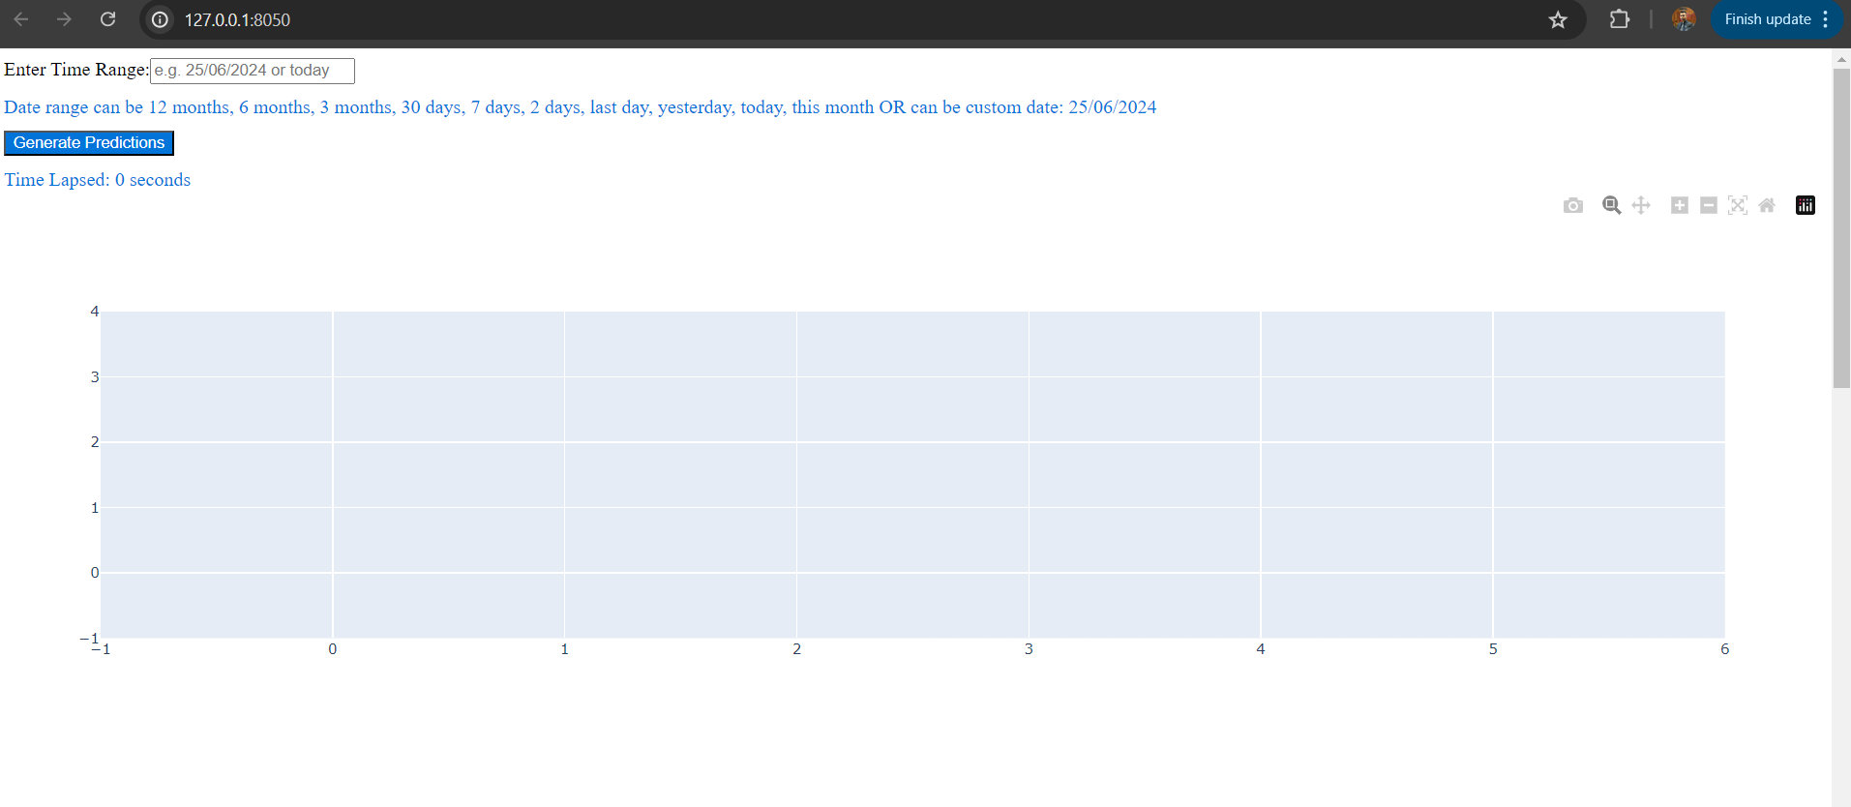
CFA – WEB DEVELOPMENT

Slide 46
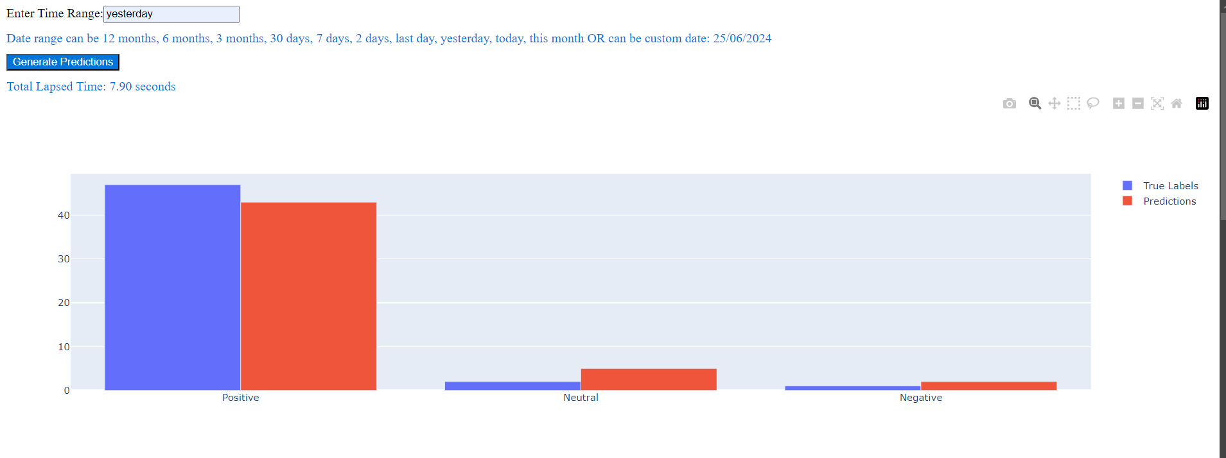
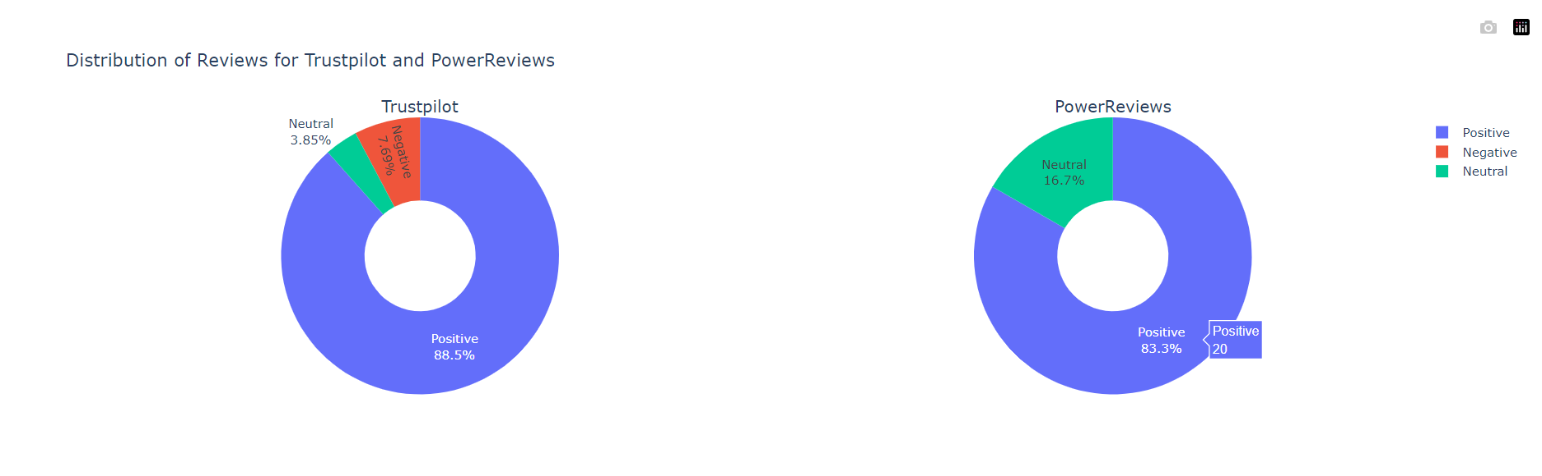
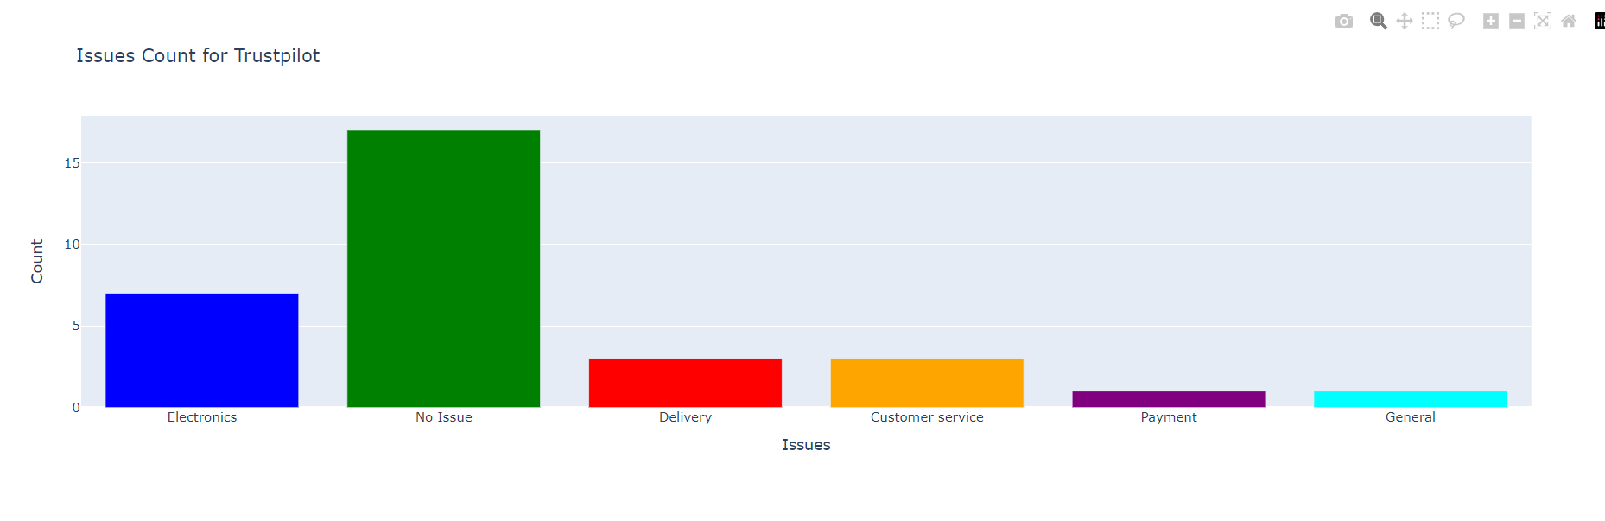
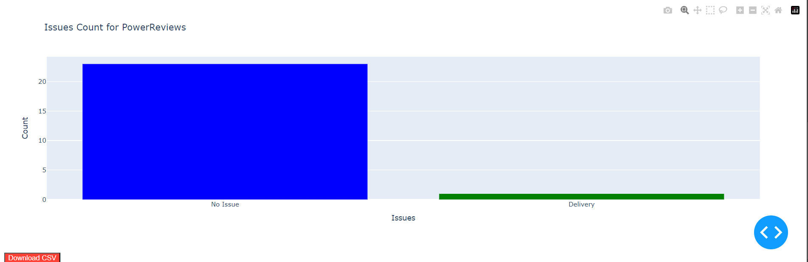
CFA – WEB DEVELOPMENT

Slide 47
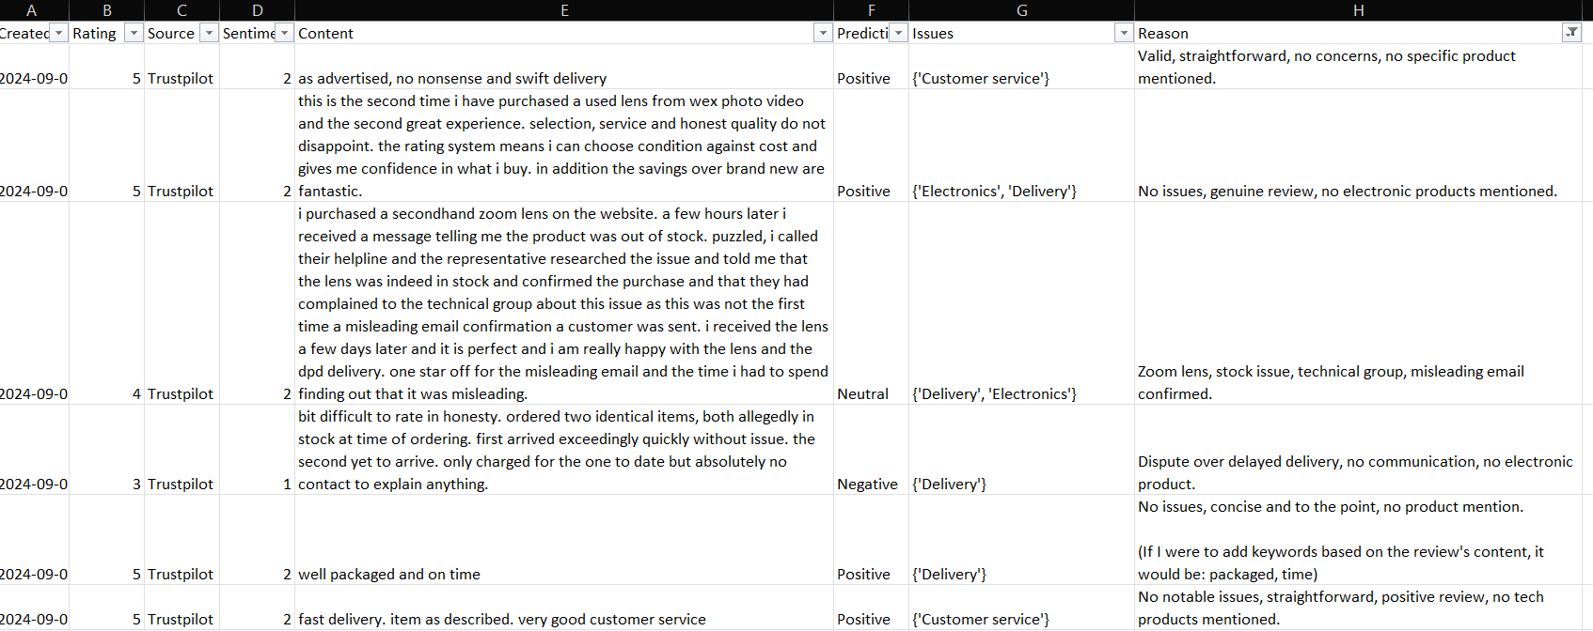
CFA – WEB DEVELOPMENT
Download-able CFA File

Slide 48
CONCLUSION
All 6 objectives are achieved including the last 2 which weren’t the part of initial set of objectives but were incorporated on special request from the Wex team.
Most of the challenges were resolved other than #3 mentioned in slide no. 9.
In terms of accuracies and predictions, DistilBERT models performed better than ML.
DistilBERT (66M) model turned out to be better suited for sentiment predictions.
spaCy phrase-matcher library matches the pre-defined phrases to extract possible issues but it isn’t a prediction model.
Llama3 pre-trained (8B) model mostly gives genuine and related reasons behind issues. However, if it is asked to be more specific, it can become extremely slow to process and generate output due to memory constraints.
On-demand web service has been implemented for end-user to monitor customer reviews at any time.

Slide 49
FUTURE WORK
Sentiment Prediction
Extensive hyper-parameter tuning – ML
Try and evaluate more BERT based models such as original BERT, roBERTa, BERTweet etc
Issues Classification
Automating issues classification using ML / DL models
Reason Behind Issues Generation
More computational resources might allow to use LLMs with more parameters
openAI GPT-4.0 or other equivalent paid APIs might give more precise output with lesser compute time

Slide 50
FUTURE WORK (WEX PHOTO VIDEO ONLY)
Customer Segmentation & Targeted Marketing || Customer Profiling & Predictive Analysis
Leveraging ML and DL techniques to create different customer profiles based on their historic data (customer details→ city/country, order items etc) and identifying purchase patterns
Classifying customers based on purchase patterns → Customer that buy a specific items more frequently / Most items sold during a particular season per location etc. and targeting specific customers by providing Personalised ads or maybe special offers to increase sales.
Customer Engagement & Problem Resolution
Similar to Customer Feedback Analysis up-to some extent but using
Identifying sentiments, issues and possible reasons behind issues → Actions / solutions can be identified by issues statistics (which type of issue occurs the most), what is the sentiment and reason behind those issues etc. and engaging with customers accordingly.

Slide 51
ACKNOWLEDGEMENT
I would like to thank my supervisor Dr. Wenjia Wang for his many suggestions and constant support during this research.
I am grateful to my fellow UEA colleagues / comrades / friends Ata Uzgoren & Joshua Newton for their valuable feedbacks and suggestions.
I would also like to thank entire Wex Team especially Ms. Illona Utting & Mr. Yoel Masih, for having me on-board & giving me the opportunity to be part of their AI journey.
THANK YOU
Aman Seth
100442755
a.seth@uea.ac.uk

