Slide 1


Develop an AI System for Automatically analysing Customer feedback
MSc Student: Aman Seth
Supervisors: Prof. Wenjia Wang(UEA)
Ms. Ilona Utting (Wex Photo Video)

Slide 2
Wex PHOTO VIDEO OBJECTIVES
Customer Profiling and Predictive Analysis
Personalised Advertising and Communication
Customer Feedback Analysis
Segmentation and Targeted Marketing
Customer Engagement and Problem Resolution

Slide 3
Content
Introduction
Problem Statement
Aim and Objectives
AI System Design Flowcharts
MODEL SCORES & Results
WEB APPLICATION – BEST MODELS DEPLOYMENT
Main Challenges
Conclusion and Future work

Slide 4
INTRODUCTION
Covers the design and approaches explored to perform Customer Feedback Analysis, dissecting the sentiments behind the customer reviews on platforms like Trustpilot and Power Reviews for Wex Photo Video.
Delves into the preprocessing steps and feature extraction techniques used to prepare the data for analysis.
Presents the results obtained from various supervised machine learning algorithms, including logistic regression, support vector machines etc. Furthermore, the presentation highlights the implementation and outcomes of the state-of-the-art BERT (distilBERT) transformer model.
A detailed comparison of the performance metrics of these models is provided to illustrate the effectiveness and accuracy of each approach in sentiment classification.

Slide 5
Problem statement
After analysing the current pain points for Call Centre Management team at Wex while performing CFA, below are a few problems identified:-
CCM team performs CFA manually for every single review platform which requires time and effort consumption.
Possible late response to a serious query / complaint by a customer.
Lack of automation.

Slide 6


Sample customer reviews
Trust pilot & Power Reviews

Slide 7
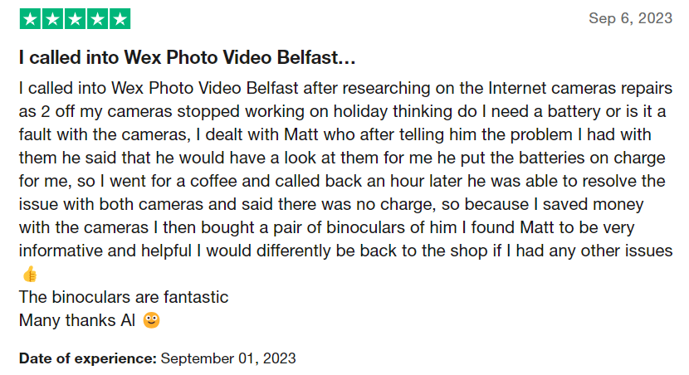
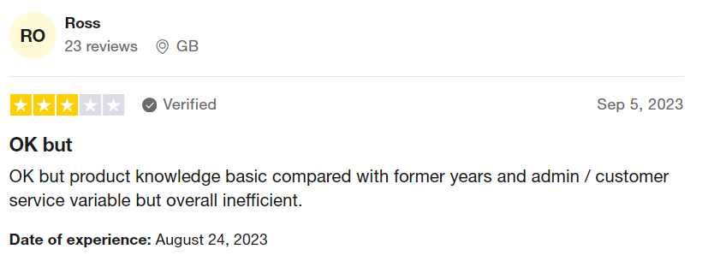
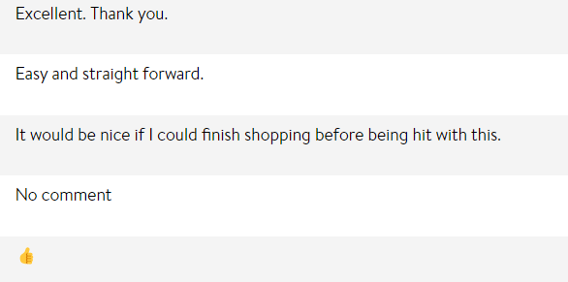
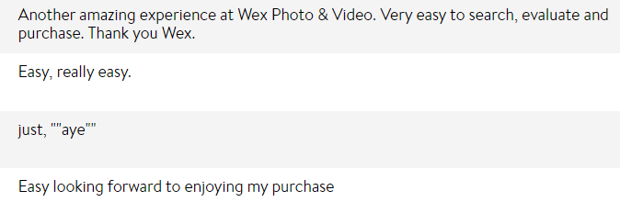

Slide 8
AIM and OBJECTIVES
Aim: To Develop an AI/ML System for Automatically Analysing Customer Feedback Analysis in Real Time
Objectives:-
Scrape review websites for customer comments
Deploy supervised learning ML models on extracted data to classify sentiments behind customer reviews (only Positive/Negative/Neutral)
Deploy BERT (Bidirectional Encoder Representations from Transformers) language DL model on extracted data
Classify possible issues behind customer sentiments using spaCy (NLP)
Issue validity via Llama3
Deploy best technique / approach on a web application

Slide 9
ML FLOWCHART

Slide 10
BERT FLOWCHART

Slide 11
SUPERVISED ML USE CASE DIAGRAM

Slide 12
SUPERVISED ML SEQUENCE DIAGRAM

Slide 13
SUPERVISED ML SEQUENCE DIAGRAM (CONT.)

Slide 14
DISTILBERT USE CASE DIAGRAM

Slide 15
DISTILBERT SEQUENCE DIAGRAM

Slide 16
DISTILBERT SEQUENCE DIAGRAM (CONT.)

Slide 17
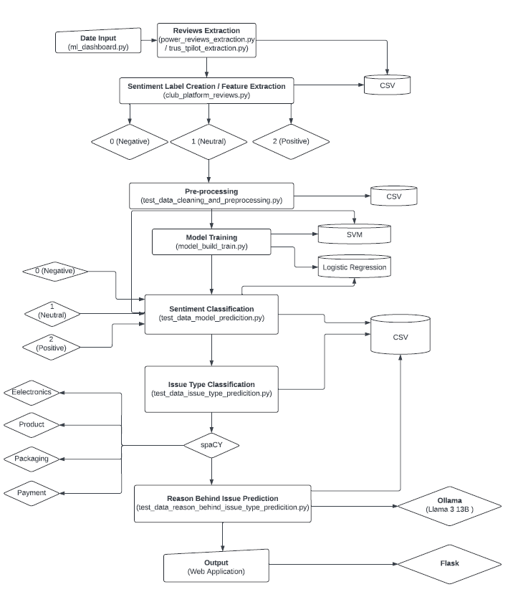
SUPERVISED ML LLD FLOWCHART

Slide 18
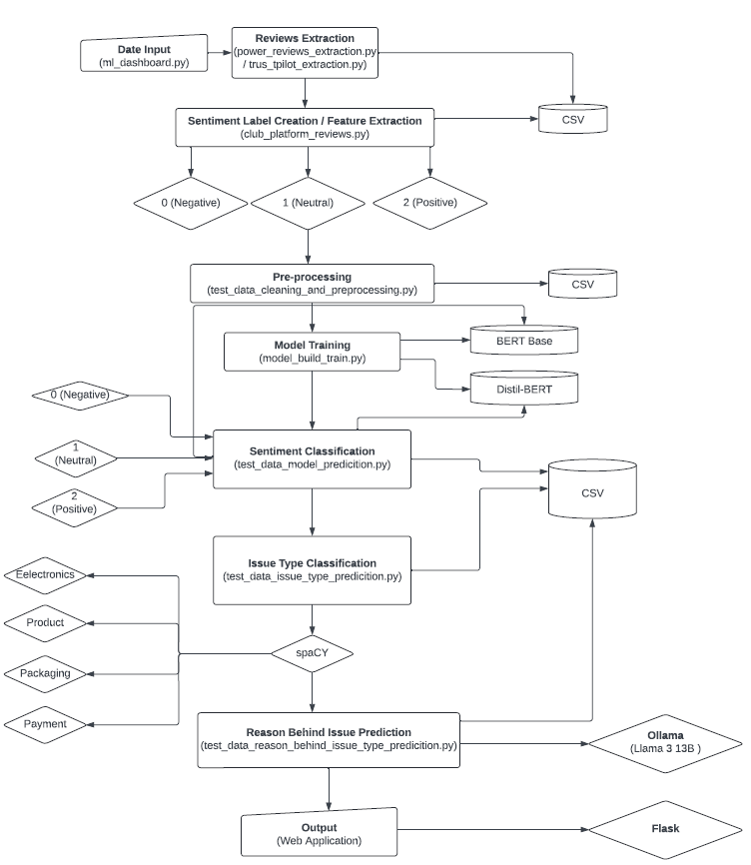
BERT LLD FLOWCHART

Slide 19
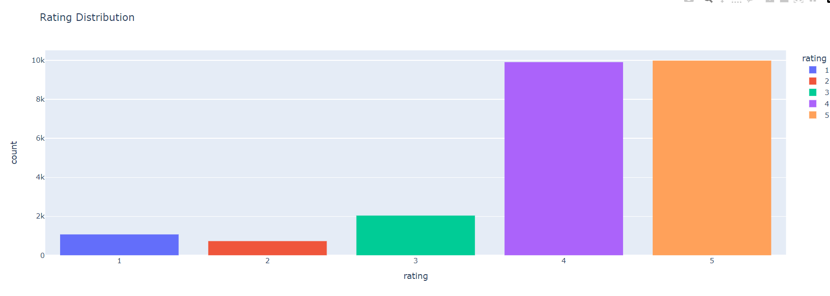
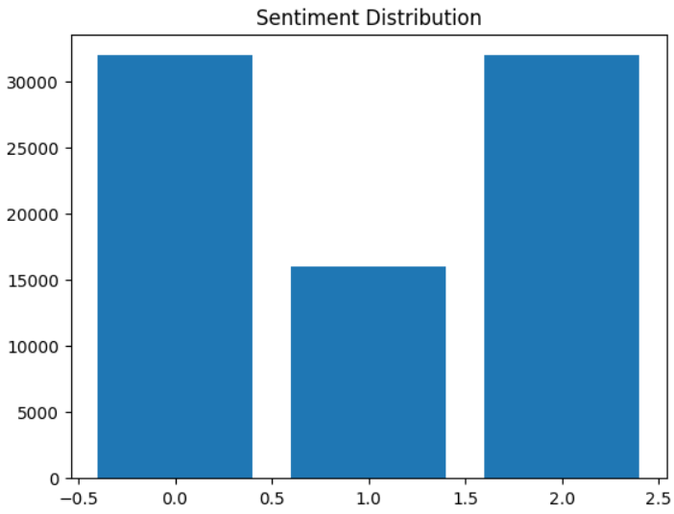
ML SCORES & EVALUATION METRICS
Approach 1:
Extract Trust pilot and Power reviews data – Since Jan 1 2015
Trust pilot – via API
Power Reviews – Manual since API returns incorrect results
Data observations
4 and 5 starts data overpowers rating 1 and 2 completely
TF-IDF + SMOTE Random Over sampling for data balancing
Randomly duplicated data of lower rating (Duplication of data)
Text Pre-processing
Lowercasing Contractions Removal Emoji Removal
Special characters removal Lemmatisation
Model Training and predictions
True vs Predicted sentiments

Slide 20
Approach 1 (Cont.):
Total Reviews: 30,000
Train/Validation Split: 80/20
Note
Label 0 = Rating 1 & 2
Label 1 = Rating 3
Label 2 = Rating 4 & 5
Train Data Distribution
Rating | No. of reviews
1 | 6000
2 | 6000
3 | 6000
4 | 6000
5 | 6000
Sentiment Label | No. of reviews
0 | 9600
1 | 4800
2 | 9600
Validation Data Distribution
Sentiment Label | No. of reviews
0 | 2400
1 | 1200
2 | 2400

Slide 21
Approach 1 (Cont.):
Scores
Best 2 models
Validation Data
Model | Accuracy | F1 Score
SVM | 0.491 | 0.38
Logistic Regression | 0.509 | 0.397
Random Forest | 0.44 | 0.366
KNN | 0.452 | 0.354
Naïve Bayes | 0.422 | 0.342

Slide 22
Approach 1 (Cont.):
Scores (Hyper-param tuned)
Validation Data
Model | Accuracy | F1 Score
SVM | 0.5248 | 0.3896
Logistic Regression | 0.5283 | 0.3922

Slide 23
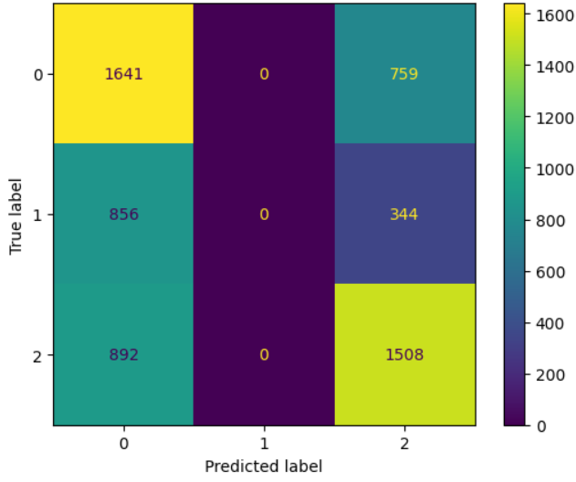
Approach 1 (Cont.):
Support Vector Machine
Note
Label 0 = Rating 1 & 2
Label 1 = Rating 3
Label 2 = Rating 4 & 5
Confusion Matrix (Validation Data)
Per label classification report
Label | Precision | Recall | F1
0 | 0.48 | 0.68 | 0.57
1 | 0.00 | 0.00 | 0.00
2 | 0.58 | 0.63 | 0.60

Slide 24

Approach 1 (Cont.):
Logistic Regression
Note
Label 0 = Rating 1 & 2
Label 1 = Rating 3
Label 2 = Rating 4 & 5
Confusion Matrix (Validation Data)
Per label classification report
Label | Precision | Recall | F1
0 | 0.49 | 0.68 | 0.57
1 | 0.00 | 0.00 | 0.00
2 | 0.58 | 0.64 | 0.61

Slide 25
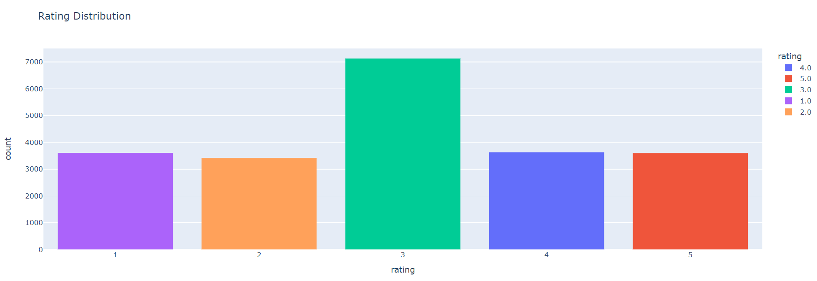
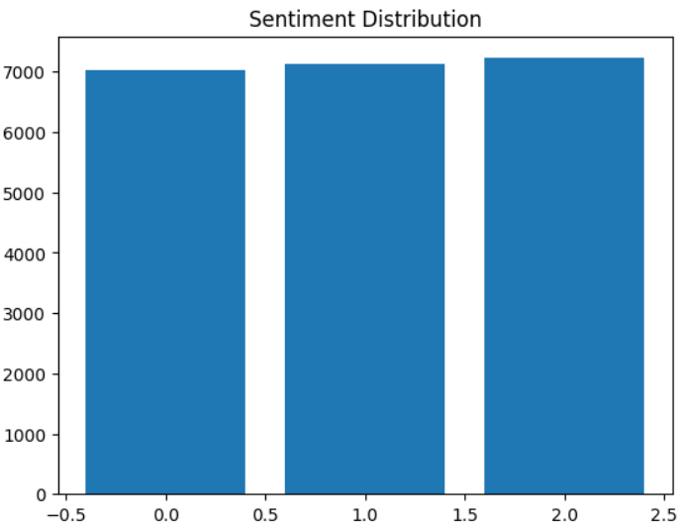
Approach 2:
Extract Trust pilot and Power reviews data – Since Jan 1 2015
Trust pilot – via API
Power Reviews – Manual since API returns incorrect results
Data observations
4 and 5 starts data overpowers rating 1 and 2 completely
Data Balancing performed using more unique neutral sentiments
Clubbed neutral (rating 3) sentiments with Trust pilot and Power reviews
Neutral sentiments data extracted from Kaggle (References in report)
Text Pre-processing
Lowercasing Contractions Removal Emoji Removal
Spl. Char Removal Lemmatisation
Model Training and predictions
True vs Predicted sentiments

Slide 26
Approach 2 (Cont.):
Total Reviews: 21,378
Train/Validation Split: 80/20
Note
Label 0 = Rating 1 & 2
Label 1 = Rating 3
Label 2 = Rating 4 & 5
Train Data Distribution
Rating | No. of reviews
1 | 3607
2 | 3413
3 | 7131
4 | 3628
5 | 3599
Sentiment Label | No. of reviews
0 | 5616
1 | 5705
2 | 5781
Validation Data Distribution
Sentiment Label | No. of reviews
0 | 1404
1 | 1426
2 | 1446

Slide 27
Approach 2 (Cont.):
Scores
Best 2 models
Validation Data
Model | Accuracy | F1 Score
SVM | 0.689 | 0.682
Logistic Regression | 0.697 | 0.696
Random Forest | 0.626 | 0.623
KNN | 0.473 | 0.43
Naïve Bayes | 0.639 | 0.643

Slide 28
Approach 2 (Cont.):
Scores (Hyper-param tuned)
Validation Data
Model | Accuracy | F1 Score
SVM | 0.698316 | 0.698329
Logistic Regression | 0.698784 | 0.696355
Note: Not much improvement observed post hyper-param tuning

Slide 29
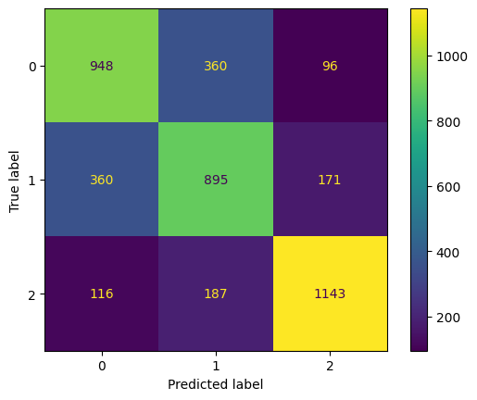
Approach 2 (Cont.):
Support Vector Machine
Note
Label 0 = Rating 1 & 2
Label 1 = Rating 3
Label 2 = Rating 4 & 5
Confusion Matrix
Per label classification report
Label | Precision | Recall | F1
0 | 0.67 | 0.68 | 0.67
1 | 0.62 | 0.63 | 0.62
2 | 0.81 | 0.79 | 0.80

Slide 30
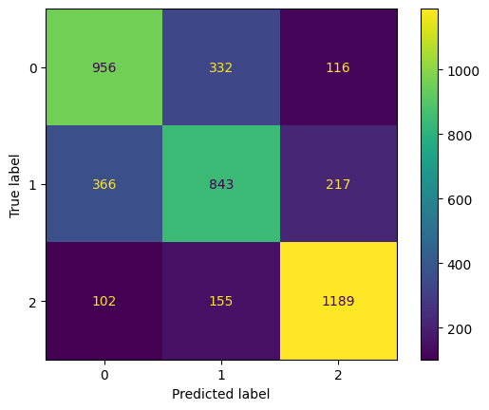
Approach 2 (Cont.):
Logistic Regression
Note
Label 0 = Rating 1 & 2
Label 1 = Rating 3
Label 2 = Rating 4 & 5
Confusion Matrix
Per label classification report
Label | Precision | Recall | F1
0 | 0.67 | 0.68 | 0.68
1 | 0.63 | 0.59 | 0.61
2 | 0.78 | 0.82 | 0.80

Slide 31
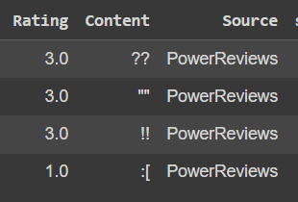
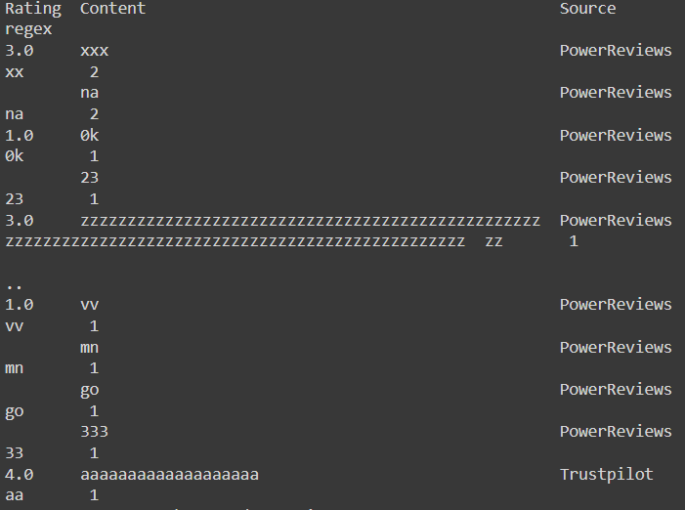
Approach 3 (Best Approach):
Extract Trust pilot and Power reviews data – Since Jan 1 2015
Trust pilot – via API
Power Reviews – Manual since API returns incorrect results
Data observations
4 and 5 starts data overpowers rating 1 and 2 completely
Data Balancing performed using more unique neutral sentiments
Clubbed neutral (rating 3) sentiments with Trust pilot and Power reviews
Neutral sentiments data extracted from Kaggle (References in notebook)
Micro Text Pre-processing → Exclusion of Lemmatisation / STOP words
Lowercasing Contractions Removal Emoji Replacement
Special characters removal Duplicates Removal
Model Training and predictions
True vs Predicted sentiments

Slide 32
Approach 3 (Cont.):
Total Reviews: 20,748
Train/Validation Split: 80/20
Note
Label 0 = Rating 1 & 2
Label 1 = Rating 3
Label 2 = Rating 4 & 5
Train Data Distribution
Rating | No. of reviews
1 | 3559
2 | 3395
3 | 6741
4 | 3586
5 | 3467
Sentiment Label | No. of reviews
0 | 5563
1 | 5392
2 | 5642
Validation Data Distribution
Sentiment Label | No. of reviews
0 | 1391
1 | 1349
2 | 1411

Slide 33
Approach 3 (Cont.):
Scores
Best 2 models
Validation Data
Model | Accuracy | F1 Score
SVM | 0.735 | 0.734
Logistic Regression | 0.731 | 0.729
Random Forest | 0.696 | 0.694
KNN | 0.446 | 0.355
Naïve Bayes | 0.699 | 0.693

Slide 34
Approach 3 (Cont.):
Scores (Hyper-param tuned)
Validation Data
Model | Accuracy | F1 Score
SVM | 0.728675 | 0.727326
Logistic Regression | 0.730120 | 0.726567
Note: Scores dropped down by ~0.5% post hyper-parameter tuning.

Slide 35
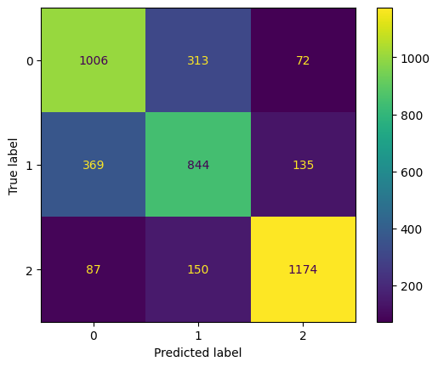
Approach 3 (Cont.):
Support Vector Machine
Note
Label 0 = Rating 1 & 2
Label 1 = Rating 3
Label 2 = Rating 4 & 5
Confusion Matrix
Per label classification report
Label | Precision | Recall | F1
0 | 0.69 | 0.72 | 0.71
1 | 0.65 | 0.63 | 0.64
2 | 0.85 | 0.83 | 0.84

Slide 36
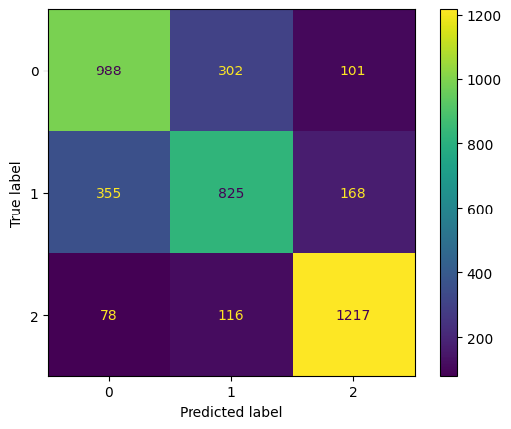
Approach 3 (Cont.):
Logistic Regression
Note
Label 0 = Rating 1 & 2
Label 1 = Rating 3
Label 2 = Rating 4 & 5
Confusion Matrix
Per label classification report
Label | Precision | Recall | F1
0 | 0.70 | 0.71 | 0.70
1 | 0.66 | 0.61 | 0.64
2 | 0.82 | 0.86 | 0.84

Slide 37

Approach 1 vs Approach 2 vs Approach 3 (Validation Data)
Approach |  | SVM |  | Logistic Regression
 |  | Validation Accuracy | F1 Score | Validation Accuracy | F1 Score
Approach 1 |  | 0.5248 | 0.3896 | 0.5283 | 0.3922
Approach 2 |  | 0.698316 | 0.698329 | 0.698784 | 0.696355
Approach 3 |  | 0.728675 | 0.727326 | 0.730120 | 0.726567
Approach | Label 0 |  |  | Label 1 |  |  | Label 2
 | Precision | Recall | F1 | Precision | Recall | F1 | Precision | Recall | F1
Approach 1 | 0.48 | 0.68 | 0.57 | 0.00 | 0.00 | 0.00 | 0.58 | 0.63 | 0.60
Approach 2 | 0.67 | 0.68 | 0.67 | 0.62 | 0.63 | 0.62 | 0.81 | 0.79 | 0.80
Approach 3 | 0.69 | 0.72 | 0.71 | 0.65 | 0.63 | 0.64 | 0.85 | 0.83 | 0.84

Slide 38
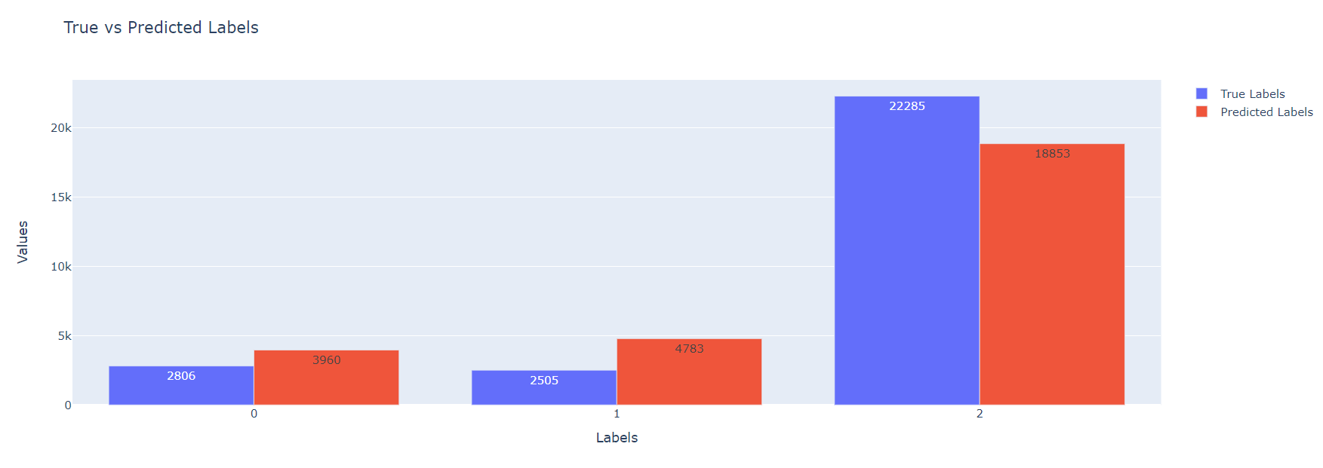
True vs Predicted Sentiments (Approach 3)
Note
Label 0 = Rating 1 & 2
Label 1 = Rating 3
Label 2 = Rating 4 & 5
Note: Tested on external dataset: 27,596 reviews

Slide 39
Summary – supervised ml
Accuracy and F1 scores increased by approximately ~20% from approach 1 to approach 2 on validation data.
Random oversampling created a lot of redundant synthetic data which lead to bias towards label 2.
Accuracy and scores increased by another ~4% after gibberish reviews removal and emoji replacement instead of removal.
Approach 3 (Best): Negative predictions more by ~18% than actual on external test data. Neutral predictions made but more by ~32% than actual. Positive sentiment predictions lesser by ~8% than actual.
ML sentiment prediction cycle was performed on 80/20 split with one random seed 42 only. Before proceeding any further with the cross validation using different random seeds and with different split sizes or using k-folds technique, BERT models training came into action. If BERT wouldn’t have given better results or similar results, then ML cross validations would have been performed. Let’s dive into BERT based models ..!!!

Slide 40
BERT SCORES & EVALUATION METRICS
Approach 1:
Dataset used: Same as used for ML
Text Pre-processing: Same as used in Best approach of ML
Cross Validation 1:
Split Ratio: 80 (Train) / 20 (Validate) Random Seed: 42, 101, 789, 1001, 2023
Batch Size: 16 Learning Rate: 5e-5
Dropout Rate: 0.1 Token Length: 256
Epoch: 4
Evaluate scores, metrics, mean accuracy / loss, standard deviations etc

Slide 41
Approach 1 (Cont.):
Total Reviews: 20,208
Train/Validate/Test Split: 80/20
Note
Label 0 = Rating 1 & 2
Label 1 = Rating 3
Label 2 = Rating 4 & 5
Train Data Distribution
Sentiment Label | No. of reviews
0 | 5389
1 | 5389
2 | 5388
Validation Data Distribution
Sentiment Label | No. of reviews
0 | 1347
1 | 1347
2 | 1348

Slide 42
Approach 1 (Cont.):

Slide 43
Approach 1 (Cont.):
Train, Validation Mean Accuracy/Loss & Standard Deviation Across Different Seeds

Slide 44
Approach 1 (Cont.):
Scores
Epoch | Batch Size | Learning Rate | Dropout rate | Train Accuracy | Validation Accuracy | Train Loss | Val Loss
4 | 16 | 5e-5 | 0.1 | 83.25% | 73.16% | ~0.0247 | ~0.203
x̄
x̄
x̄
x̄

Slide 45
Approach 2:
Dataset used: Same as used for ML
Text Pre-processing: Same as used in Best approach of ML
Cross Validation 1:
Split Ratio: 70 (Train) / 30 (Validate) Random Seed: 42, 101, 789, 1001, 2023
Batch Size: 32 Learning Rate: 2e-5
Dropout Rate: 0.2 Token Length: 256
Epoch: 4
Evaluate scores, metrics, mean accuracy / loss, standard deviations etc

Slide 46
Approach 2 (Cont.):
Total Reviews: 20,208
Train/Validate/Test Split: 70/30
Note
Label 0 = Rating 1 & 2
Label 1 = Rating 3
Label 2 = Rating 4 & 5
Train Data Distribution
Sentiment Label | No. of reviews
0 | 4715
1 | 4715
2 | 4715
Validation Data Distribution
Sentiment Label | No. of reviews
0 | 2021
1 | 2021
2 | 2021

Slide 47
Approach 2 (Cont.):

Slide 48
Approach 2 (Cont.):
Train, Validation Mean Accuracy/Loss & Standard Deviation Across Different Seeds

Slide 49
Approach 2 (Cont.):
Scores
Epoch | Batch Size | Learning Rate | Dropout rate | Train Accuracy | Validation Accuracy | Train Loss | Val Loss
4 | 32 | 2e-5 | 0.2 | 77.63% | 73.71% | ~0.015 | ~0.019
x̄
x̄
x̄
x̄

Slide 50
Approach 3:
Dataset used: Same as used for ML
Text Pre-processing: Same as used in Best approach of ML
Cross Validation 1:
Split Ratio: 60 (Train) / 40 (Validate) Random Seed: 42, 101, 789, 1001, 2023
Batch Size: 64 Learning Rate: 2e-5
Dropout Rate: 0.3 Token Length: 512
Epoch: 4
Evaluate scores, metrics, mean accuracy / loss, standard deviations etc

Slide 51
Approach 3 (Cont.):
Total Reviews: 20,208
Train/Validate/Test Split: 60/40
Note
Label 0 = Rating 1 & 2
Label 1 = Rating 3
Label 2 = Rating 4 & 5
Train Data Distribution
Sentiment Label | No. of reviews
0 | 4042
1 | 4041
2 | 4041
Validation Data Distribution
Sentiment Label | No. of reviews
0 | 2694
1 | 2695
2 | 2695

Slide 52
Approach 3 (Cont.):

Slide 53
Approach 3 (Cont.):
Train, Validation Mean Accuracy/Loss & Standard Deviation Across Different Seeds

Slide 54

Approach 3 (Cont.):
Scores
Epoch | Batch Size | Learning Rate | Dropout rate | Train Accuracy | Validation Accuracy | Train Loss | Val Loss
4 | 64 | 2e-5 | 0.3 | 74.08% | 75.17% | ~0.008 | ~0.009
x̄
x̄
x̄
x̄

Slide 55
Approach 4:
Dataset used: Same as used for ML
Text Pre-processing: Same as used in Best approach of ML
Cross Validation 1:
Split Ratio: 60 (Train) / 40 (Validate) Random Seed: 42, 101, 789, 1001, 2023
Batch Size: 64 Learning Rate: 2e-5
Dropout Rate: 0.3 Token Length: 512
Epoch: 8
Evaluate scores, metrics, mean accuracy / loss, standard deviations etc

Slide 56
Approach 4 (Cont.):
Total Reviews: 20,208
Train/Validate/Test Split: 70/30
Note
Label 0 = Rating 1 & 2
Label 1 = Rating 3
Label 2 = Rating 4 & 5
Train Data Distribution
Sentiment Label | No. of reviews
0 | 4042
1 | 4041
2 | 4041
Validation Data Distribution
Sentiment Label | No. of reviews
0 | 2694
1 | 2695
2 | 2695

Slide 57
Approach 4 (Cont.):

Slide 58
Approach 4 (Cont.):
Train, Validation Mean Accuracy/Loss & Standard Deviation Across Different Seeds

Slide 59


Approach 4 (Cont.):
Scores
Epoch | Batch Size | Learning Rate | Dropout rate | Train Accuracy | Validation Accuracy | Train Loss | Val Loss
8 | 64 | 2e-5 | 0.3 | 82.77% | 72.61% | ~0.006 | ~0.011
x̄
x̄
x̄
x̄

Slide 60
Approach 1 vs Approach 2 vs Approach 3 vs Approach 4 (Validation Data)
Approach |  | distilBERT
 |  | Train Accuracy | Validation Accuracy | Training Loss | Validation Loss
Approach 1 |  | 83.25 | 73.16 | 0.0247 | 0.203
Approach 2 |  | 77.63 | 73.71 | 0.015 | 0.019
Approach 3 |  | 74.08 | 75.17 | 0.008 | 0.009
Approach 4 |  | 82.77 | 72.61 | 0.006 | 0.011
Approach | Label 0 |  |  | Label 1 |  |  | Label 2
 | Precision | Recall | F1 | Precision | Recall | F1 | Precision | Recall | F1
Approach 1 | 71 | 69 | 70 | 62 | 64 | 63 | 86 | 86 | 86
Approach 2 | 72 | 70 | 71 | 63 | 65 | 64 | 86 | 86 | 86
Approach 3 | 74 | 74 | 74 | 68 | 67 | 67.5 | 88 | 86 | 87
Approach 4 | 72 | 67 | 70 | 61 | 65 | 63 | 86 | 85 | 85

Slide 61
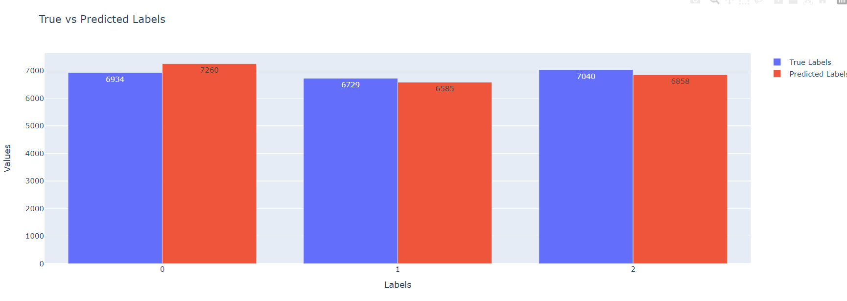
True vs Predicted Sentiments (Best Approach 3)
Note
Label 0 = Rating 1 & 2
Label 1 = Rating 3
Label 2 = Rating 4 & 5
Note: Tested on external dataset: 20,703 reviews

Slide 62
Summary – BERT
Approach 3 came out to be the best in terms of scores and metrics on validation data. However the margin of improvement between the approaches were not high marginal.
distilBERT best model (approach 3) performed really well on the external test dataset as well
There is hardly any improvement in accuracies and losses on increasing no. of epoch from 4 to 8 and leaving rest of the configurations exactly the same as approach 3.
Negative predictions made more by only approximately 2% than actual on the external dataset.
Neutral predictions made less by only about 1.5% than actual on the external dataset.
Positive predictions made less by only about 1.7% than actual on the external dataset.

Slide 63
ML vs berT
Model |  | Scores
 |  | Validation Accuracy
ML (SVM) |  | 72.86
DistilBERT |  | 75.17
Model | Label 0 |  |  | Label 1 |  |  | Label 2
 | Precision | Recall | F1 | Precision | Recall | F1 | Precision | Recall | F1
ML (SVM) | 0.69 | 0.72 | 0.71 | 0.65 | 0.63 | 0.64 | 0.85 | 0.83 | 0.84
DistilBERT | 74 | 74 | 74 | 68 | 67 | 67.5 | 88 | 86 | 87

Slide 64
ML vs bert (Cont.)
Note: Tested on external dataset: 27,596 reviews and 27,703 (5 days additional data) for ML and BERT respectively
ML (SVM) BERT (distilBERT)

Slide 65
ISSUE CLASSIFICATION
Objective: Once sentiment is predicted by the model, then also to identify the possible
issues especially behind the reviews which are predicted as label 0 or 1, meaning negative or neutral. Not
only for label 0 and 1 but even for label 2 which are predicted as positive sentiments but Wex Photo
Video encounters quite many reviews on daily basis which are rated as 4 or 5 stars but
still contains some issue or complaint mentioned either related to the product or services of Wex.
These are the possible issues identified by going through the reviews on the review platforms :-
• Electronics Product
• Packaging Time
• Delivery Customer service
• General

Slide 66
ISSUE CLASSIFICATION(Cont.)
NLP (Natural Language Processing): spaCy → PhraseMatcher
issue_phrases = {
" Electronics ": [" laptop ", " camera ", " lens ", " mobile phone ", " smartphone ", " tripod ", " tablet ", " headphone ", " charger ", " battery "],
" Product ": [" product issue ", " defective product ", " faulty item ", " damaged ", " damage ", " torn ", " broken ", " break ", " gouged "],
" Packaging ": [" packaging ", " package ", " pack "],
" Time ": [" late ", " delayed ", " time issue ", "too long ", " long to arrive "],
" Delivery ": [" delivery issue ", " shipment problem ", " shipping issue ", " arrive ", " arrival ", " late delivery ", " delivery late ", " late ", " time ", " times "],
" Customer service ": [" customer service ", " support issue ", " service complaint ", " rude ", " aggressive ", " tone ", " behaviour ", " nonsense ", "not understand ", " staff ", " insult ", " salesperson "],
" Payment ": [" payment ", "pay", " money "],
" General ": [" issue ", " problem ", " complaint "]
}

Slide 67

ISSUE CLASSIFICATION(Cont.)
Source | Content | Issues
Trustpilot | love my new camera, got a nikon zf from here and the service in-store and online was really good. belfast branch let me see and use the display model they had, and answered all my questions in a helpful and friendly way, the also pointed out key features and things to consider plus alternatives if needed. | Electronics
Power Reviews | have just wasted 90 minutes driving to and from moor allerton as i needed a fast sony lens for a wedding tomorrow. There were two staff in the branch and one other customer when i went in. for some bizarre reason both staff members saw fit to ignore me and both dealt with the one customer. one said he would be with me in a minute and went out back to find something for the one customer they had, he was actually gone about 5 or 10 minutes, came back with something like a lens cap, then they both spent even more time with the same customer. the same staff member then walks past me again on his way to the store and says, i will be with you in a minute, you know, like he would said 10 minutes before. by the his point i would been stood by the counter for 15- 20 mins and i told him not to bother as I was leaving. so wex lost a decent sale and I will never shop there again. appalling and rude customer service! | Electronics, Customer Service, Delivery
Trustpilot | initial offer was fine but reduced by around 10% on a boxed lens in good condition. took quite a few days to make the offer after the lens was received. however the money owed was paid promptly. i do not plan to sell anything else through wex | Electronics Payment
Is this really
an issue !!??

Slide 68
Issue validation
Objective: Since spaCy’s PhraseMatcher library depicts issues purely based on the text/phrase matching mechanism but there is no intelligence behind it, hence, an issue validator technique is implemented using the existing open-source pre-trained LLMs (Large Language Models).
Below are the tried and tested LLMs :-
LLM | Parameter | Prompt | Output | Avg Time Taken (s)
OpenAI 3.5 | 175B | do not have the item? | The review likely reflects frustration due to an item being out of stock or unavailable after purchase. | 0.8 s
Llama2 | 13B | do not have the item? | It's unclear and incomplete. A good review should provide specific feedback or experience with the product or service. | 69 s
Llama3 | 8B | do not have the item? | The reviewer may not have received the item or it may have been damaged during shipping. | 4.5 s

Slide 69
Issue validation (Cont.)
Source | Content | Issues | Reason (By Llama3)
Trustpilot | love my new camera, got a nikon zf from here and the service in-store and online was really good. belfast branch let me see and use the display model they had, and answered all my questions in a helpful and friendly way, the also pointed out key features and things to consider plus alternatives if needed. | Electronics | The review appears genuine, well-written, and provides specific details about the customer’s experience with the store and online service.
Power Reviews | have just wasted 90 minutes driving to and from moor allerton as i needed a fast sony lens for a wedding tomorrow. There were two staff in the branch and one other customer when i went in. for some bizarre reason both staff members saw fit to ignore me and both dealt with the one customer. one said he would be with me in a minute and went out back to find something for the one customer they had, he was actually gone about 5 or 10 minutes, came back with something like a lens cap, then they both spent even more time with the same customer. the same staff member then walks past me again on his way to the store and says, i will be with you in a minute, you know, like he would said 10 minutes before. by the his point i would been stood by the counter for 15- 20 mins and i told him not to bother as I was leaving. so wex lost a decent sale and I will never shop there again. appalling and rude customer service! | Electronics, Customer Service, Delivery | The review appears legitimate, detailing frustrating experiences with poor customer service and staff prioritizing another customer over the writer’s urgent request.
Trustpilot | initial offer was fine but reduced by around 10% on a boxed lens in good condition. took quite a few days to make the offer after the lens was received. however the money owed was paid promptly. i do not plan to sell anything else through wex | Electronics, Payment | The main issue seems to be the initial offer being reduced by 10%, which may impact trust and satisfaction with Wex’s service.

Slide 70
Cfa – weB DEVELOPMENT
Customer Feedback Analysis via ML / BERT DL models are integrated into a python web framework which acts as an on-demand service to produce results whenever requested by the end-user.
The models with the best results are embedded in the web framework and used for prediction.
Using spaCy PhraseMatacher for Issue type prediction and Llama3 (8B) pre-trained model for reason behind issue feature implementation are also integrated within the web app.

Slide 71
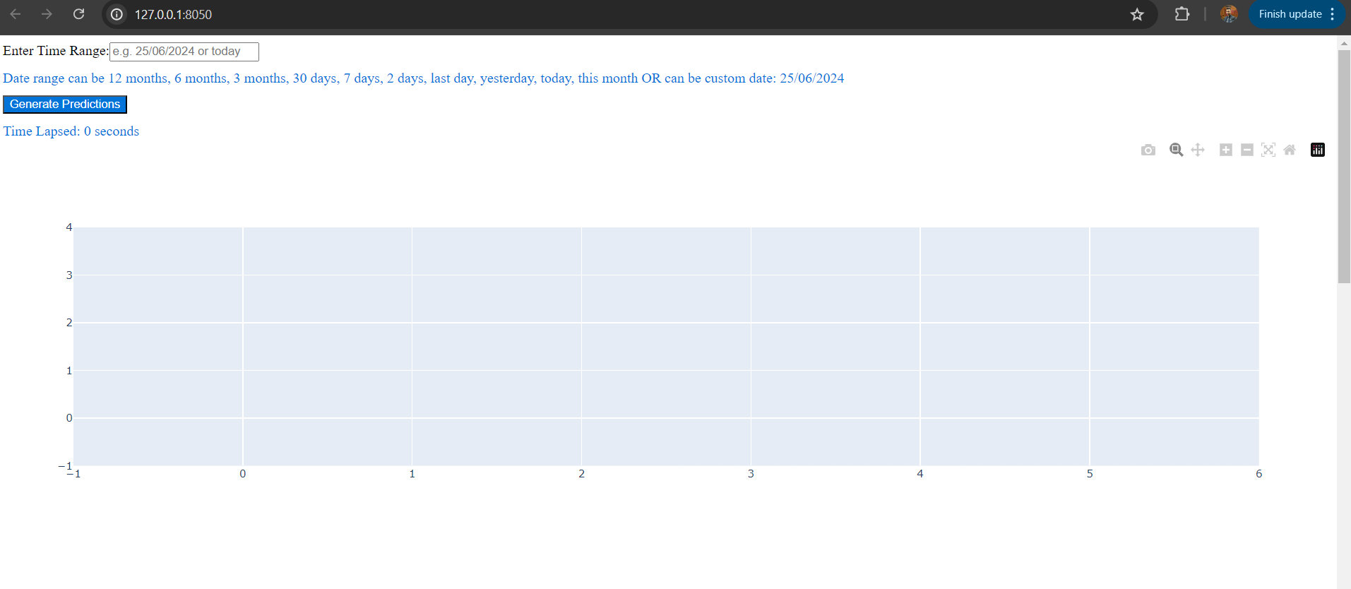
Cfa – weB DEVELOPMENT (Cont.)

Slide 72
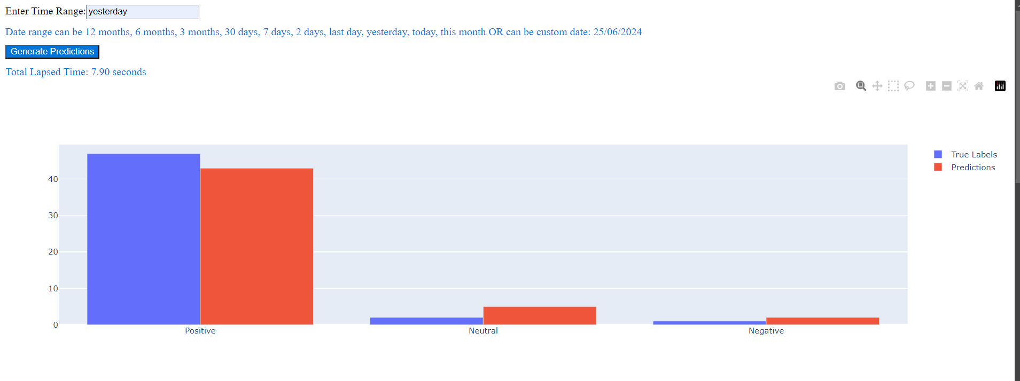
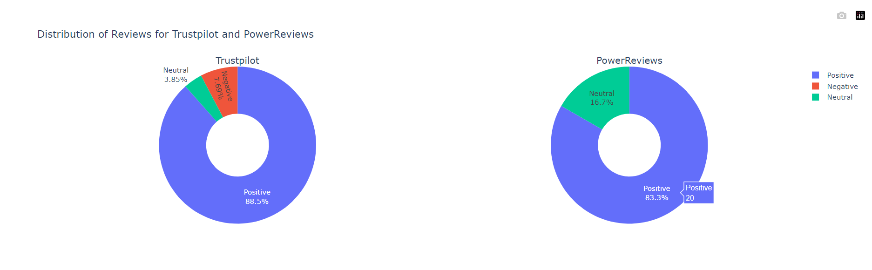
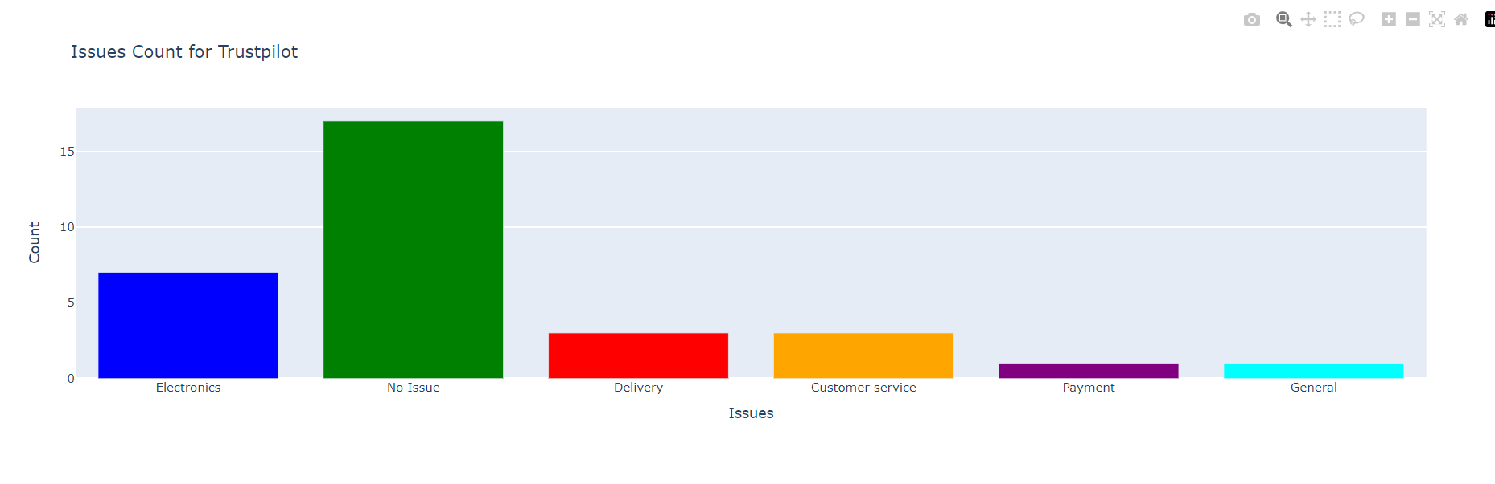
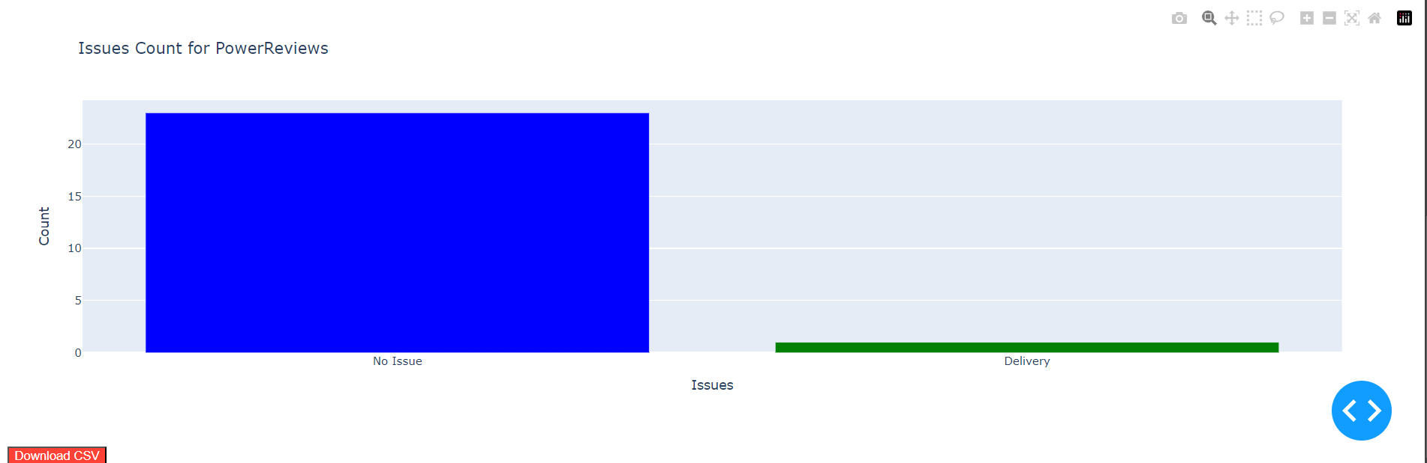
Cfa – weB DEVELOPMENT (Cont.)

Slide 73
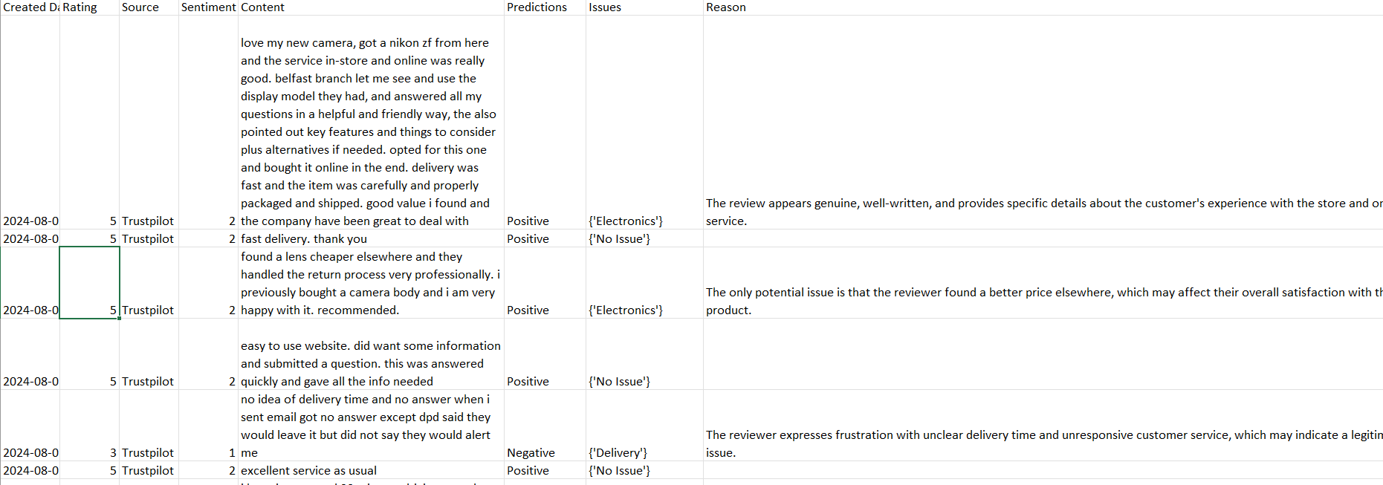
Cfa – weB DEVELOPMENT (Cont.)
Download-able CFA File

Slide 74
Main challenges
Virtual resource related challenges have been the biggest and major challenge during implementation of CFA project as a whole.
Extensive model training for cross validations was a big challenge as Google Colab doesn’t provide free GPU units and Kaggle provides 30 hours per week GPU usage which wasn’t enough at times.
Llama3 model by Ollama is used for generating possible reason behinds predicted issues and runs locally. Due to the resource constraints on the local machine, at times it runs extremely slow or not at all. The temporary solution is to restart local machine to free up RAM and cores or kill other processes manually.
Power Reviews reviews extraction API returns ~1-2 days old data from current data. This is already known to Wex Engineering team.

Slide 75
conclusion
Both chosen conventional ML and BERT DL models performed well in predicting sentiments behind Wex Photo Video’s customer reviews.
In terms of accuracies and predictions, DistilBERT models performed better than ML.
DistilBERT (66M) model turned out to be better suited for sentiment predictions.
spaCy phrase-matcher library matches the pre-defined phrases to extract possible issues but it isn’t a prediction model.
Llama3 pre-trained (8B) model mostly gives genuine and related reasons behind issues. However, if it is asked to be more specific, it can become extremely slow to process and generate output due to memory constraints.
On-demand web service has been implemented for end-user to monitor customer reviews at any time.

Slide 76
FUTURE WORK
Sentiment Prediction
Extensive hyper-parameter tuning – ML
Try and evaluate more BERT based models such as original BERT, roBERTa, BERTweet etc
Issues Classification
Automating issues classification using ML / DL models
Reason Behind Issues Generation
More computational resources might allow to use LLMs with more parameters
openAI GPT-4.0 or other equivalent paid APIs might give more precise output with lesser compute time

Slide 77
FUTURE WORK (WEX PHOTO VIDEO ONLY)
Customer Segmentation & Targeted Marketing || Customer Profiling & Predictive Analysis
Leveraging ML and DL techniques to create different customer profiles based on their historic data (customer details→ city/country, order items etc) and identifying purchase patterns
Classifying customers based on purchase patterns → Customer that buy a specific items more frequently / Most items sold during a particular season per location etc. and targeting specific customers by providing Personalised ads or maybe special offers to increase sales.
Customer Engagement & Problem Resolution
Similar to Customer Feedback Analysis up-to some extent but using
Identifying sentiments, issues and possible reasons behind issues → Actions / solutions can be identified by issues statistics (which type of issue occurs the most), what is the sentiment and reason behind those issues etc. and engaging with customers accordingly.

Slide 78
Acknowledgement
I would like to thank my supervisor Dr. Wenjia Wang for his many suggestions and constant support during this research.
I am grateful to my fellow UEA colleagues / comrades / friends Ata Uzgoren & Joshua Newton for their valuable feedbacks and suggestions
I would also like to thank entire Wex Team especially Ms. Illona Utting & Mr. Yoel Masih, for having me on-board & giving me the opportunity to be part of their AI journey.
THANK YOU
Aman Seth
100442755
a.seth@uea.ac.uk

