Slide 1
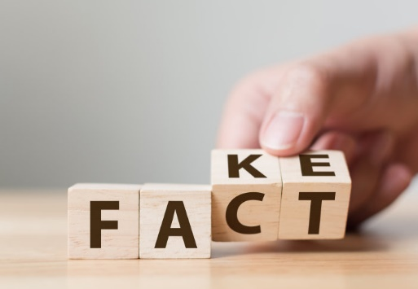

Project presentation: Fake news detection
Statistical Methods in AI (CSE 471)
Team Number 34

Slide 2
Contents
Introduction: What is Fake News?
About the Problem Statement
Motivation behind the task at hand
Model Structure and Hyperparameters
Observations
Result Analysis
Comparative Analysis
Challenges
Conclusion

Slide 3
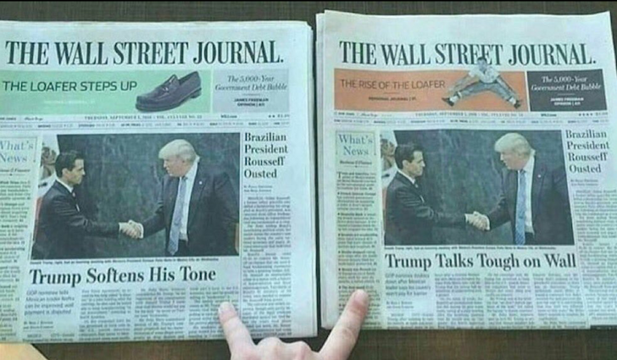
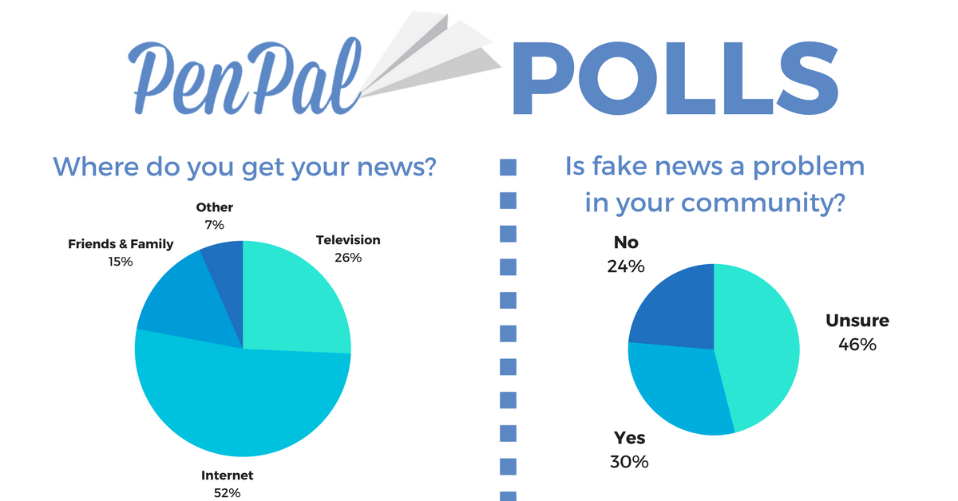
What is Fake News?
Fake news is news, stories or hoaxes created to deliberately misinform or deceive readers.
On social networks, the reach and effects of information spread occur at such a fast pace and so amplified that distorted, inaccurate or false information acquires a tremendous potential to cause real world impacts, within minutes, for millions of users.
Fake News, not a term many people used four years ago, thanks to Donald Trump, has been named the word of the year 2017.
People unaware of the consequences of fake news is another difficult problem to tackle.

Slide 4

Problem Statement
The goal of the Fake News Challenge is to explore how artificial intelligence technologies, particularly machine learning and natural language processing, might be leveraged to combat the fake news problem.
We believe that these AI technologies hold promise for significantly automating parts of the procedure human fact checkers use today to determine if a story is real or a hoax.
To put it in simple words, we need to automatize the task of establishing an authenticity between the news heading and news body as a measure to the relative similarity between them.
It is thus a classical Classification problem with it’s own set of classical challenges.

Slide 5
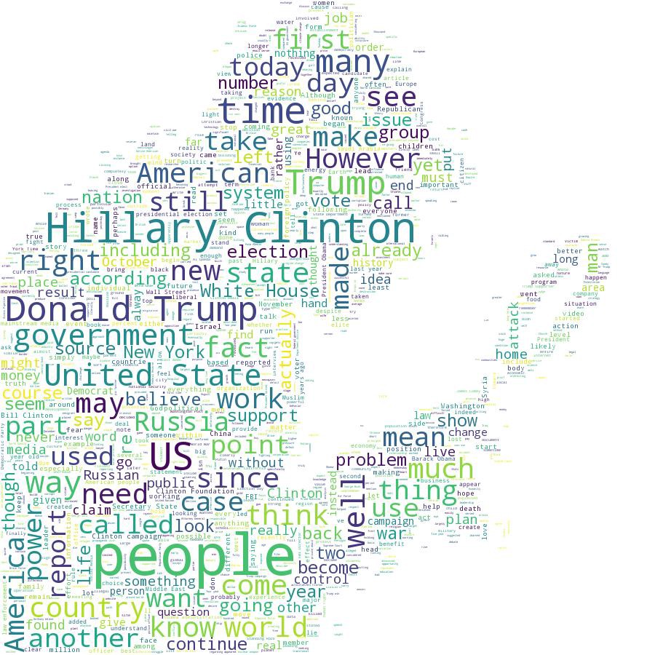
Motivation
Social media and the internet is suffering from fake accounts, fake posts, and fake news. The intention is often to mislead readers and/or manipulate them into purchasing or believing something that isn’t real.
The motivation behind this task is to allow people to take unbiased decisions based on the news they see by ensuring the relativity is pretty high.
The main motivation in a general sense would however be to make sure that devastating fake news is not propagated to ensure global well being.

Slide 6
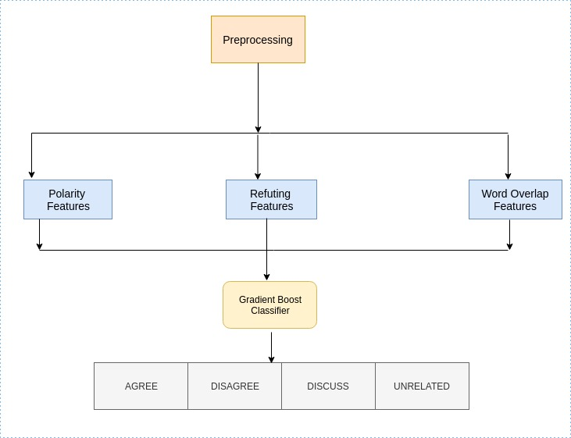
Model Architecture
(1) Baseline Architecture

Slide 7
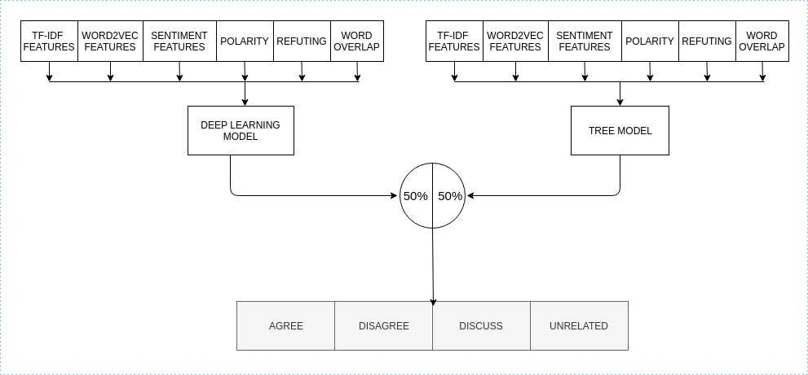
(2) Proposed Architecture : It is a combined model of tree-based model and deep learning model giving equal weightage to both.

Slide 8
Hyperparameters
Hyperparameters | TF-IDF vectors | Sentiment Features | Word2Vec Features | Baseline Features
MLP Layers | 6 | 2 | 5 | 2
MLP Neurons | [8000, 10000, 2000, 750, 100, 40] | [8, 40] | [600, 1000, 50, 100, 40] | [18, 40]
Dropout | [0.5, 0.5, 0.25, -, -, -] | [-,-] | [0.25, 0.125, 0.1, 0.1, -] | [-,-]
Activation | Re-Lu | Re-Lu | Re-Lu | Re-Lu
MLP Layers | 1
MLP Neurons | 4
Activation | Softmax
Optimizer | Adam
Learning Rate | 0.001
Batch Size | 32
Loss | Categorical Cross-Entropy

Slide 9
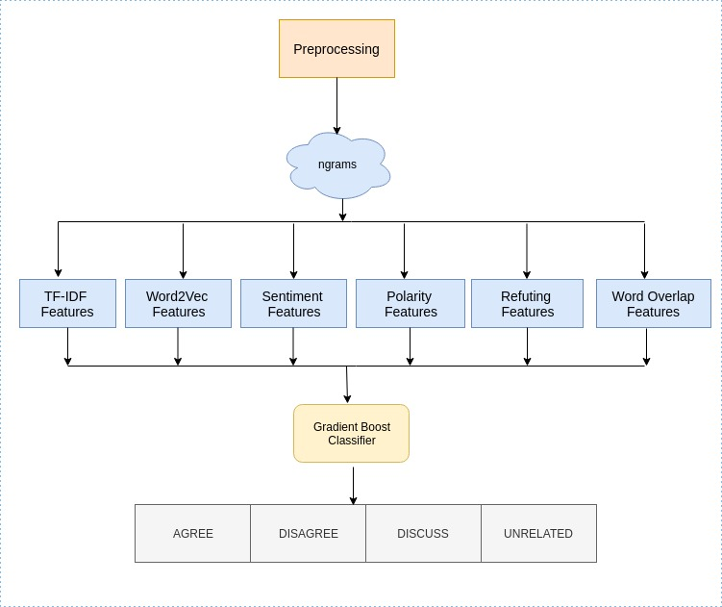
(2.a) Tree Based Model

Slide 10
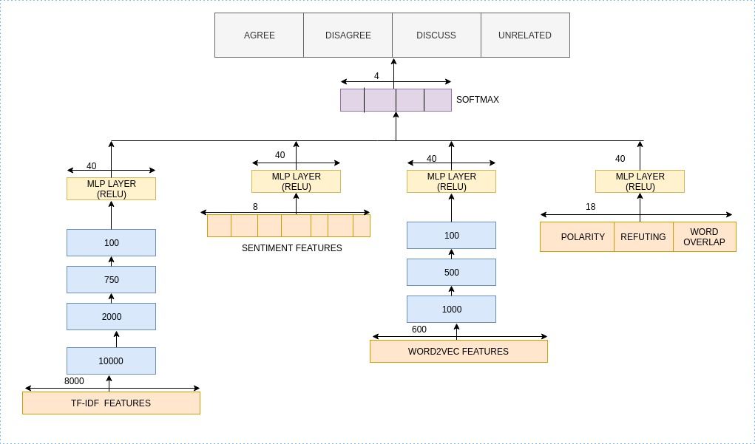
(2.b) Deep Learning Model

Slide 11
Observations
1. For Tree Based Model
 | Agree | Disagree | Discuss | Unrelated | Overall
Agree | 1057 | 11 | 639 | 196 | 1903
Disagree | 261 | 20 | 237 | 179 | 697
Discuss | 1019 | 15 | 2969 | 504 | 4464
Unrelated | 84 | 3 | 292 | 17979 | 18349
Overall | 2421 | 49 | 4094 | 18849 | 25413
Accuracy: 86.46% (Test), 93.99% (Validation)
FNC Score: 77.59 (Test), 90.28 (validation)

Slide 12
Observations(2)
2. For Baseline Model
 | Agree | Disagree | Discuss | Unrelated | Overall
Agree | 86 | 3 | 1535 | 279 | 1903
Disagree | 18 | 4 | 430 | 245 | 697
Discuss | 136 | 17 | 3708 | 603 | 4464
Unrelated | 9 | 1 | 567 | 17772 | 18349
Overall | 249 | 25 | 6240 | 18899 | 25413
Accuracy: 80.26% (Test), 83.19% (Validation)
FNC Score: 75.320 (Test), 78.799 (validation)

Slide 13
Observation(3)
(3) For Deep Learning Model
 | Agree | Disagree | Discuss | Unrelated | Overall
Agree | 799 | 6 | 816 | 282 | 1903
Disagree | 130 | 2 | 317 | 248 | 697
Discuss | 615 | 2 | 3241 | 606 | 4464
Unrelated | 60 | 0 | 328 | 17961 | 18349
Overall | 1604 | 10 | 4702 | 19097 | 25413
Accuracy: 86.58% (Test), 90.59% (Validation)
FNC Score: 77.277 (Test), 83.97 (validation)

Slide 14
Observation(4)
(4) For Proposed Model
 | Agree | Disagree | Discuss | Unrelated | Overall
Agree | 951 | 3 | 713 | 236 | 1903
Disagree | 190 | 9 | 276 | 222 | 697
Discuss | 731 | 4 | 3199 | 530 | 4464
Unrelated | 52 | 2 | 296 | 17999 | 18349
Overall | 1924 | 18 | 4484 | 18987 | 25413
Accuracy: 87.19% (test)
FNC Score: 78.42 (Test)
Precision: 0.86
Recall: 0.87
F1 Score: 0.85

Slide 15

Analysis of Results
Standalone Run of Tree Model and Deep Learning Model give us FNC score of 77.59 and 77.277. In contrast, when we use our proposed architecture, which is a combination of both these, we get an FNC score of 78.42. Better!
In contrast to the baseline model, the FNC score obtained is 75.320 and for our proposed model, the FNC score obtained is 78.42. Again, Better!

Slide 16
Performance of diﬀerent models on FNC-1 Test Dataset. The ﬁrst half of the table shows the baselines, followed by the top-4 submissions, and diﬀerent architectures used in our work. Column 2-5 shows the class-wise accuracy in % while the last column shows the overall accuracy
Comparative Analysis
Method | Score_{FNC} | Agree | Disagree | Discuss | Unrelated | Overall
FNC-1 Baseline | 75.20 | 9.09 | 1.00 | 79.65 | 97.97 | 85.44
WOrd2Vec | 75.78 | 50.70 | 9.61 | 53.38 | 96.05 | 82.79
TF-IDF Features | 81.72 | 44.04 | 6.60 | 81.38 | 97.90 | 88.46
SOLAT in SWEN | 82.05 | 58.50 | 1.86 | 76.18 | 98.70 | 89.08
Athene | 81.97 | 44.72 | 9.47 | 80.89 | 99.25 | 89.50
UCL M/C Reading | 81.72 | 44.04 | 6.60 | 81.38 | 97.90 | 88.46
Tree Model | 77.59 | 55.4 | 2.8 | 66.50 | 97.98 | 86.46
Deep Learning Model | 77.277 | 41.98 | 2.8 | 13.57 | 97.88 | 86.58
Proposed Model | 78.42 | 49.9 | 1.29 | 71.66 | 98.08 | 87.19

Slide 17
Results on Small Data Set
Predicted/True | Agree | Disagree | Discuss | Unrelated | Total
Agree | 645 | 8 | 371 | 879 | 1903
Disagree | 92 | 9 | 98 | 498 | 697
Discuss | 562 | 19 | 2014 | 1869 | 4464
Unrelated | 25 | 28 | 280 | 18016 | 18349
Total | 1324 | 64 | 2763 | 21262 | 25413
Accuracy: 81.39% (Test)
FNC Score: 64.02

Slide 18
Challenges
Implementation Challenges:
The major challenge faced while implementing our model was the computation lack-off due to which the process became tedious than normal
Other Challenges:
News characteristics such as timeliness and oddity indicate that the detection of fake news does not follow that of other fake information, e.g., fake statements and fake reviews, and thus brings about new challenges.
However the challenge much more bigger than fake news is civic reasoning in a social media environment which any AI algorithm can’t seem to monitor.

Slide 19
Conclusion and Future Scope
Since the challenge’s metric is highly affected by the imbalanced class distribution of the test data, the FNC score used for measuring performance can be considered as a weak metric. However, use of F1 score can provide a levelled evaluation.
More sophisticated machine learning techniques are needed, which have a deeper semantic understanding, and are able to determine the stance on the basis of propositional content instead of relying on lexical features.
We can incorporate more detailed datasets and also include news articles with images in them to expand the deliverables.

Slide 20
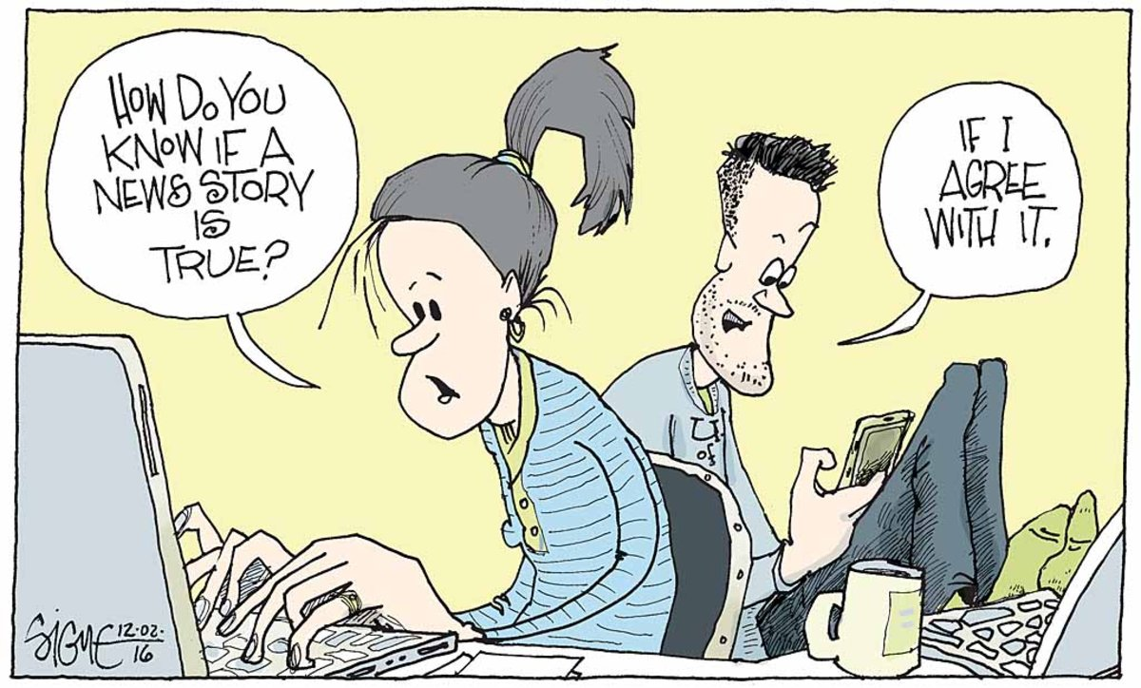

THANK YOU
(And Beware of Fake News!)

