Slide 1
Spinnaker Analytics Topic: Clustering Solar Energy Production Zones
Aman Shaikh
mar 2026

Slide 2
Agenda
Introduction
Project Objective
Overview of Dataset
Exploratory Data Analysis(EDA)
Data Preprocessing
Machine Learning Workflow
Algorithms Used
Model Comparison
Model Selection(Final)
Cluster Results
Conclusion

Slide 3
Introduction
Solar energy is a rapidly growing source of renewable energy worldwide.
Large datasets of solar projects contain valuable information about system size, energy production, and performance.
Analyzing this data can help identify patterns and improve decision-making.
Clustering techniques allow grouping of similar solar projects without prior labels.
This project applies machine learning to uncover meaningful segments in solar installations.

Slide 4
Project Objectives
To analyze solar project data and understand key patterns.
To apply clustering techniques to group similar solar installations.
To segment projects based on system size, energy production, and performance.
To evaluate clustering performance using appropriate metrics.
To generate meaningful insights for better decision-making.

Slide 5
Overview of Dataset
Data Source: Statewide Solar Projects
Key features:
Estimated PV System Size (kWdc, kWac)
Annual Energy Production (kWh)
Location details (City, Zip)
PV System Size (kWac)
Dataset Characteristics:
Contains a mix of small, medium, and large-scale solar projects.
Includes both residential and commercial/industrial installations
Provides quantitative data suitable for clustering and pattern analysis

Slide 6
Exploratory Data Analysis (EDA)
Purpose of EDA:
To understand the structure and distribution of the dataset.
To identify patterns, relationships, and potential issues such as outliers.
To gain insights that guide feature selection and modeling.
Insights Gained:
Most solar projects are small to medium-sized, with a few large-scale installations.
Strong correlation exists between system size and energy production.
Presence of outliers indicates large industrial projects.
Efficiency remains relatively consistent across different system sizes.

Slide 7
Data Preprocessing
Removed irrelevant columns to focus on important features.
Handled missing values to ensure data completeness.
Removed duplicate records to maintain data quality.
Applied feature engineering (Efficiency, AC/DC Ratio) to enhance insights.
Standardized features using scaling to ensure equal contribution.
Applied PCA to reduce dimensionality and improve computational efficiency.

Slide 8
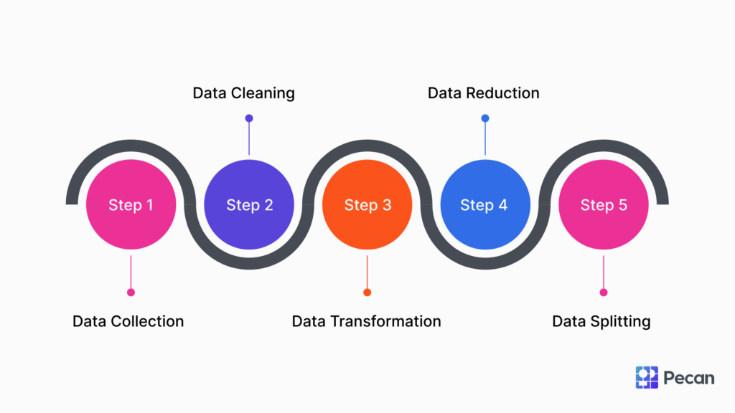
Machine Learning Workflow
Project Workflow

Slide 9
Algorithms Used
MiniBatchKMeans
Efficient and scalable clustering algorithm.
Suitable for large datasets.
Used as the primary model for clustering.
Hierarchical Clustering
Groups data based on hierarchical relationships.
Helps in understanding cluster structure.
Applied on sample data due to computational complexity.
Gaussian Mixture Model (GMM)
Probabilistic clustering approach.
Allows overlapping clusters.
Provides flexible cluster boundaries.

Slide 10
Model Comparison
Evaluation Metric
Silhouette Score used to measure cluster quality.
Higher score → Better cluster separation.
Model | Silhouette Score
MiniBatchKMeans | 0.463
Hierarchical (Sample) | 0.473
GMM | 0.305

Slide 11
Model Selection(final)
Selected Model: MiniBatchKMeans
Chosen due to its high efficiency and scalability for large datasets.
Achieved a strong silhouette score (~0.46) indicating good cluster separation.
Performs well on full dataset without computational issues.
Why Not Others?
Hierarchical Clustering: Higher score but limited to sample data due to high computational cost.
GMM: Lower silhouette score, indicating less distinct clusters.

Slide 12
Cluster Results
Identified Clusters
Cluster 0: Small-scale (Residential systems)
Cluster 1: Medium-scale (Commercial systems)
Cluster 2: Large-scale (Industrial systems)
Key Characteristics
System size and energy production increase across clusters.
Large-scale systems generate significantly higher energy output.
Clear separation between small and large installations.
Visualization
Clusters visualized using PCA (2D projection)
Distinct grouping observed in scatter plot

Slide 13
Conclusion
Successfully applied clustering techniques to segment solar projects.
Identified three distinct groups: residential, commercial, and industrial systems.
MiniBatchKMeans provided the best balance of performance and scalability.
Analysis revealed that system size strongly influences energy production, while efficiency remains consistent.
The project demonstrates how clustering can generate meaningful insights from real-world data.

Slide 14
Thank You!

