Slide 1
B.Tech Project
Submitted By :-
Aman Shreshtha (16095005)
Asif Hasan (160950)
Arpit Gupta (160950)
Deepak Maurya (16095009)
Supervised By :-
Dr. Kishor P. Sarawadekar

Slide 2
Implementing Image Processing techniques on Hardware Accelerators
Digital images and techniques used to process images.
Image processing
to improve images (enhancement, restoration)
to extract information (analysis, recognition, edge detection)
to change image structure (composition, image editing).

Slide 3
Why Go For Hardware ?
Real-time image processing
Parallelism :
spatial parallelism
temporal parallelism.
Hardware offers parallelism - significantly reducing the processing time.
Image processing requires processing large data - suitable for FPGA ( capable of parallel processing )
User can determine the hardware structure of FPGAs - program FPGA to process larger data with few clock cycle.

Slide 4
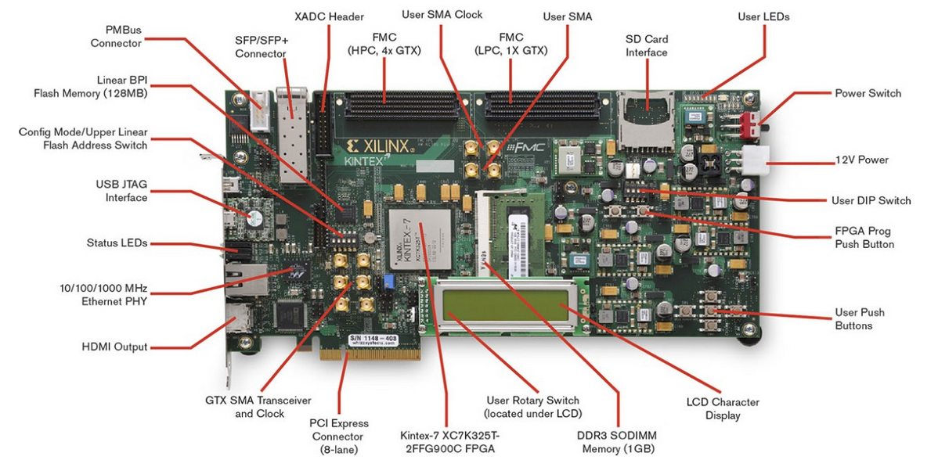
Image Processing on FPGA
We use the Kintex-7 FPGA KC705 Evaluation Kit to implement image processing algorithms in this project

Slide 5

Xilinx System Generator(XSG)
Xilinx system generator for hardware implementation
Xilinx Block set provides close integration with MATLAB Simulink
allows co-simulating the FPGA module with pixel vector provided by MATLAB Simulink Blocks.
Provides Xilinx DSP Block set such as adders, multipliers, registers, filters and memories for application specific design.
Downstream FPGA implementation steps including synthesis and place and route are automatically performed to generate an FPGA programming file.

Slide 6
Xilinx System Generator(XSG)
Co-simulating the FPGA module with pixel vector provided by MATLAB Simulink Blocks
Xilinx DSP Block set such as adders, multipliers, registers, filters and memories for application specific design
Downstream FPGA implementation steps including synthesis and place and route are automatically performed to generate an FPGA programming file.
Close Integration with MATLAB Simulink

Slide 7
The Road Ahead ….
Implementing Haze Removal Algorithm
Real Time Video Processing
Designing Custom DSP Filters

Slide 9
Steps Involved
Image pre-processing on MATLAB
Creating the design using Xilinx Blockset
Generating the hardware Co-Simulation block
Hardware Implementation on FPGA
Image post-processing on MATLAB

Slide 10
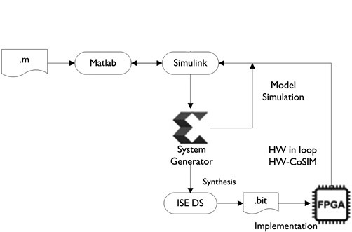
Block Diagram

Slide 11
Pre-processing on Matlab
Pre-processing of the image is done using MATLAB.
First an image is read into the workspace.
Then it is converted to gray scale using different methods depending on the format of image like jpg, bmp or png.
The image is two dimensional (2D) but to process the image using hardware, we convert it to a one dimentional (1D) array.

Slide 12
Xilinx Blockset
The Xilinx Blockset contains building blocks for constructing DSP and other digital systems in FPGAs using Simulink.
All Xilinx blocks should be connected between Gateway In and Gateway Out. Between the two Gateway blocks we add the blocks to design our algorithm.
All Xilinx blocks work on fixed point arithmetic but the real world signal (image, voice signal, etc.) are floating point so here the gateway in and gateway out blocks acts as translators for converting the real world signal into the desired form.

Slide 13
Hardware Co-Simulation

Slide 14
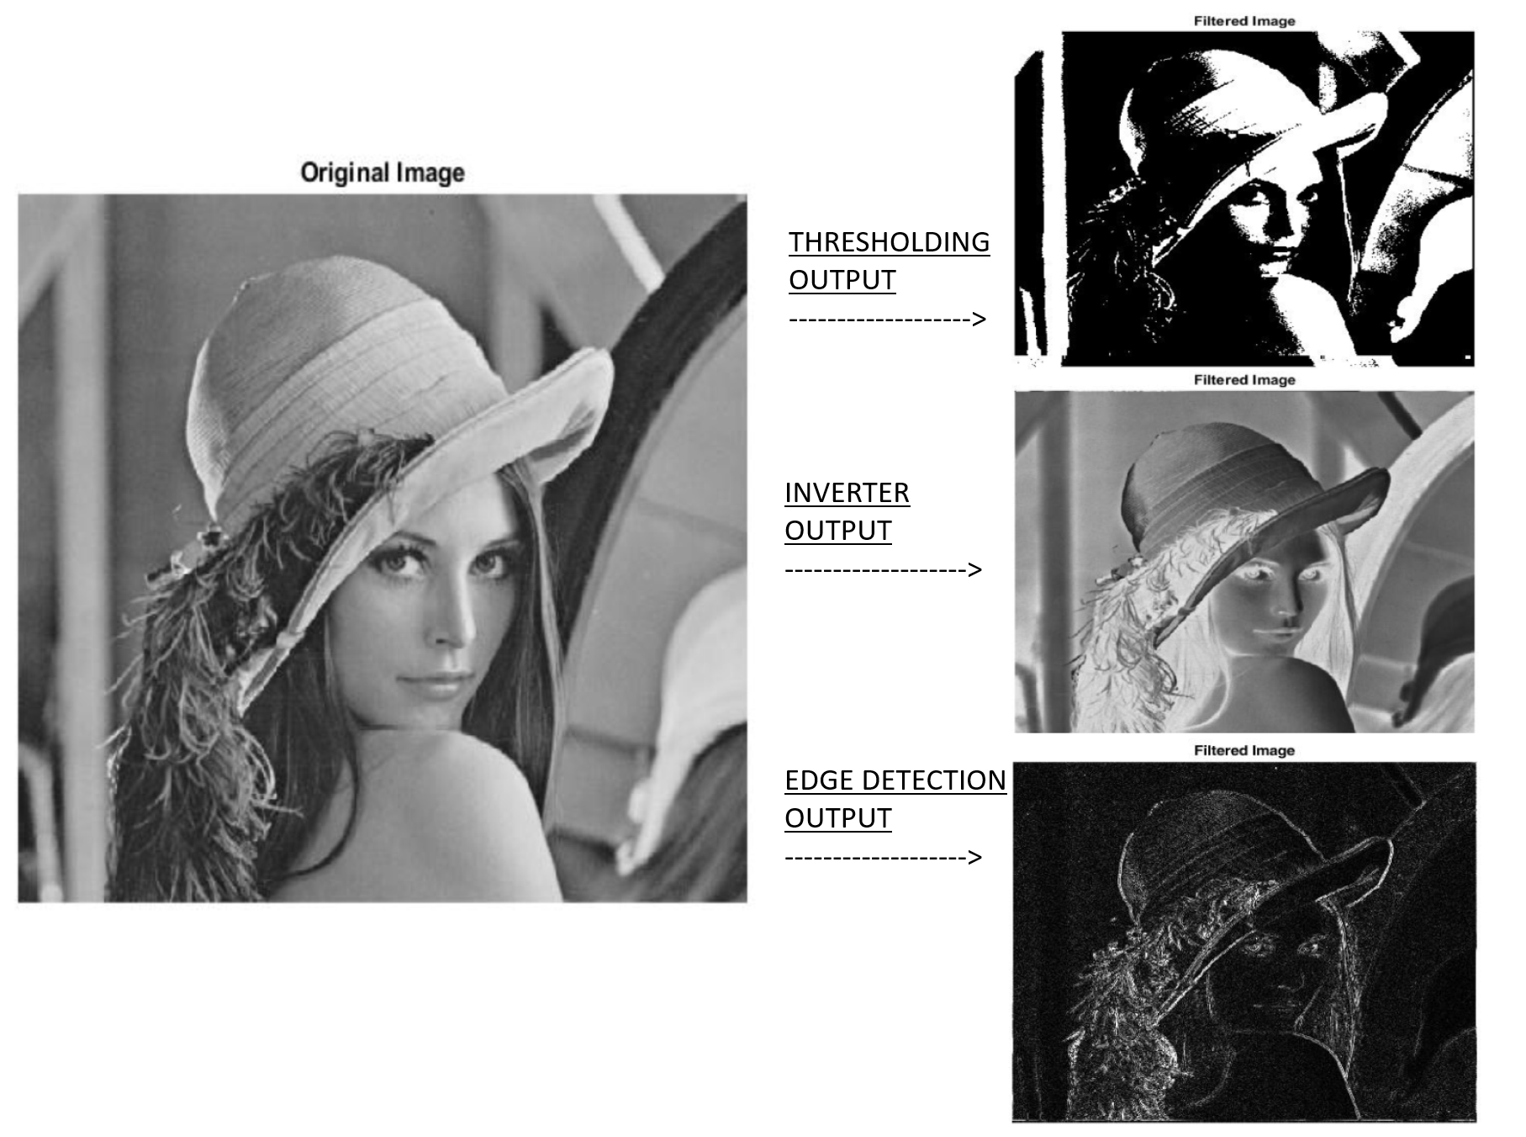
Algorithms Implemented

Slide 15
Image processing on hardware , fpga
Xilinx system gen – kyu use kar rahe
Pre processing - matlab
Post processing – matlab
Xilinx blockset
Co simulation step
Run on fpga
Block diagram of whole thing
Images
What is to be done next

Slide 16
Why Go For Hardware ?
Real-time image processing - difficult to achieve on a serial processor.
Parallelism in image processing algorithms exists in two major forms : spatial parallelism and temporal parallelism.
For real time processing, we implement the image processing techniques in hardware, which offers parallelism, significantly reducing the processing time.
Because image processing requires processing large data , it is very suitable for FPGA that is capable of parallel processing.
Since the user can determine the hardware structure of FPGAs, you can program FPGA to process larger data with few clock cycle.
Hardware implementation using FPGA offers much greater speed than a software implementation.

Slide 17
Xilinx System Generator(XSG)
Xilinx system generator for hardware implementation
Xilinx Block set provides close integration with MATLAB Simulink
allows co-simulating the FPGA module with pixel vector provided by MATLAB Simulink Blocks.
Provides Xilinx DSP Block set such as adders, multipliers, registers, filters and memories for application specific design.
Downstream FPGA implementation steps including synthesis and place and route are automatically performed to generate an FPGA programming file.

