Slide 1
B.Tech Project
Submitted By :-
Aman Shreshtha (16095005)
Asif Hasan (16095084)
Arpit Gupta (16095085)
Deepak Maurya (16095009)
Supervised By :-
Dr. Kishor P. Sarawadekar

Slide 2
Implementing Image Processing techniques on Hardware Accelerators
In this project, we implemented
various digital image-processing
algorithms on FPGA using
hardware-software co-simulation
technique.
IMAGE PROCESSING
Enhancement & restoration
Analysis, recognition, detection
Composition & editing

Slide 3
Why go for hardware implementation?
Parallelism (Spatial & Temporal)
Reduced processing time
Parallel processing of large image data
Real-time image processing

Slide 4
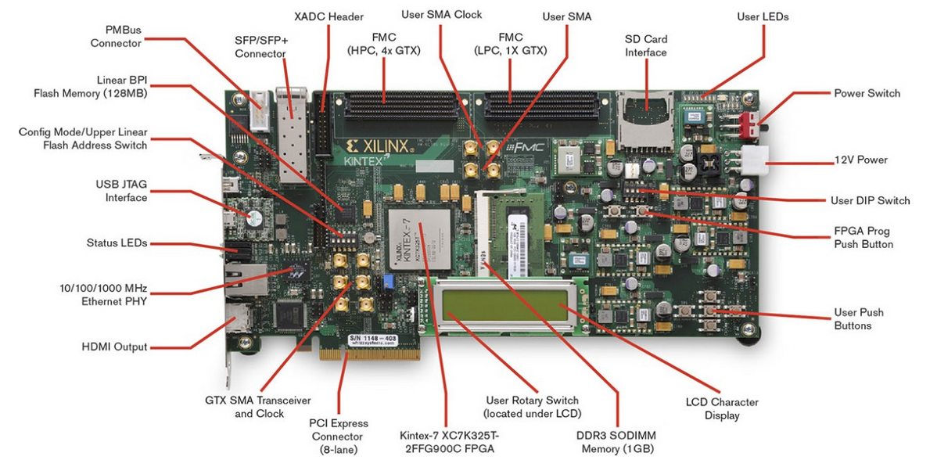
Image Processing on FPGA
We used Kintex-7 FPGA KC705 Evaluation Kit to implement image processing algorithms in this project

Slide 5

Xilinx System Generator(XSG)
Provides close integration with MATLAB Simulink thus helping in co-simulation of FPGA module with pixel vector provided by Simulink Blocks.
Part of Vivado Design Suite, thus providing Xilinx DSP block-set for application specific design.
All the downstream FPGA implementation steps including synthesis are automatically performed to generate an FPGA programming file.
Offers high level of compatibility with numerous boards and evaluation kits thus acting as a common integrated platform.

Slide 6
OUR Approach
Step-1
Image pre-processing on MATLAB
Step-2
Creating design using Xilinx Block-set in Simulink
Generating the hardware Co-simulation block
Step-3
Image post-processing on MATLAB
Programming the FPGA

Slide 7
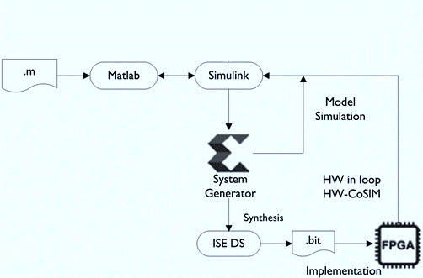
Block Diagram

Slide 8
ALGORITHMS IMPLEMENTED
Inverter
Image Thresholding
Sobel Edge Detection
Reversing the intensity levels of the image producing a photographic negative equivalent
Converting a grey-scale image into a binary image
Algorithm for enhancing and detecting edges

Slide 9
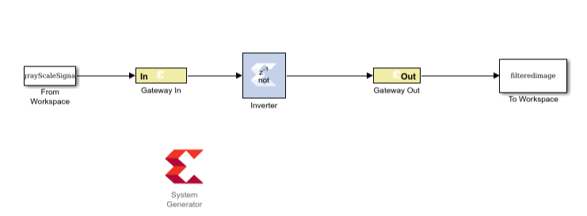
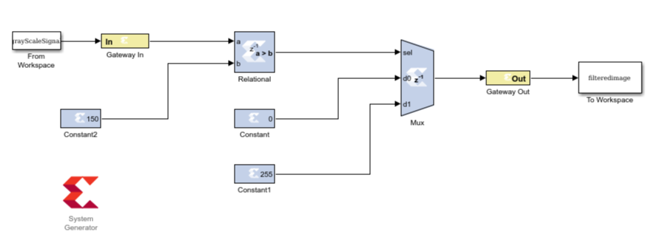
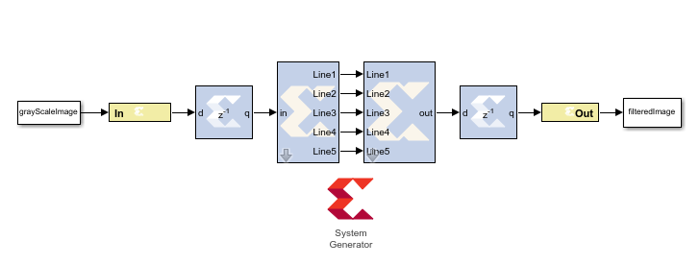
DESIGNED
BLOCKS
Image Inversion Block
Image Thresholding Block
Image Sobel edge-detection Block

Slide 10
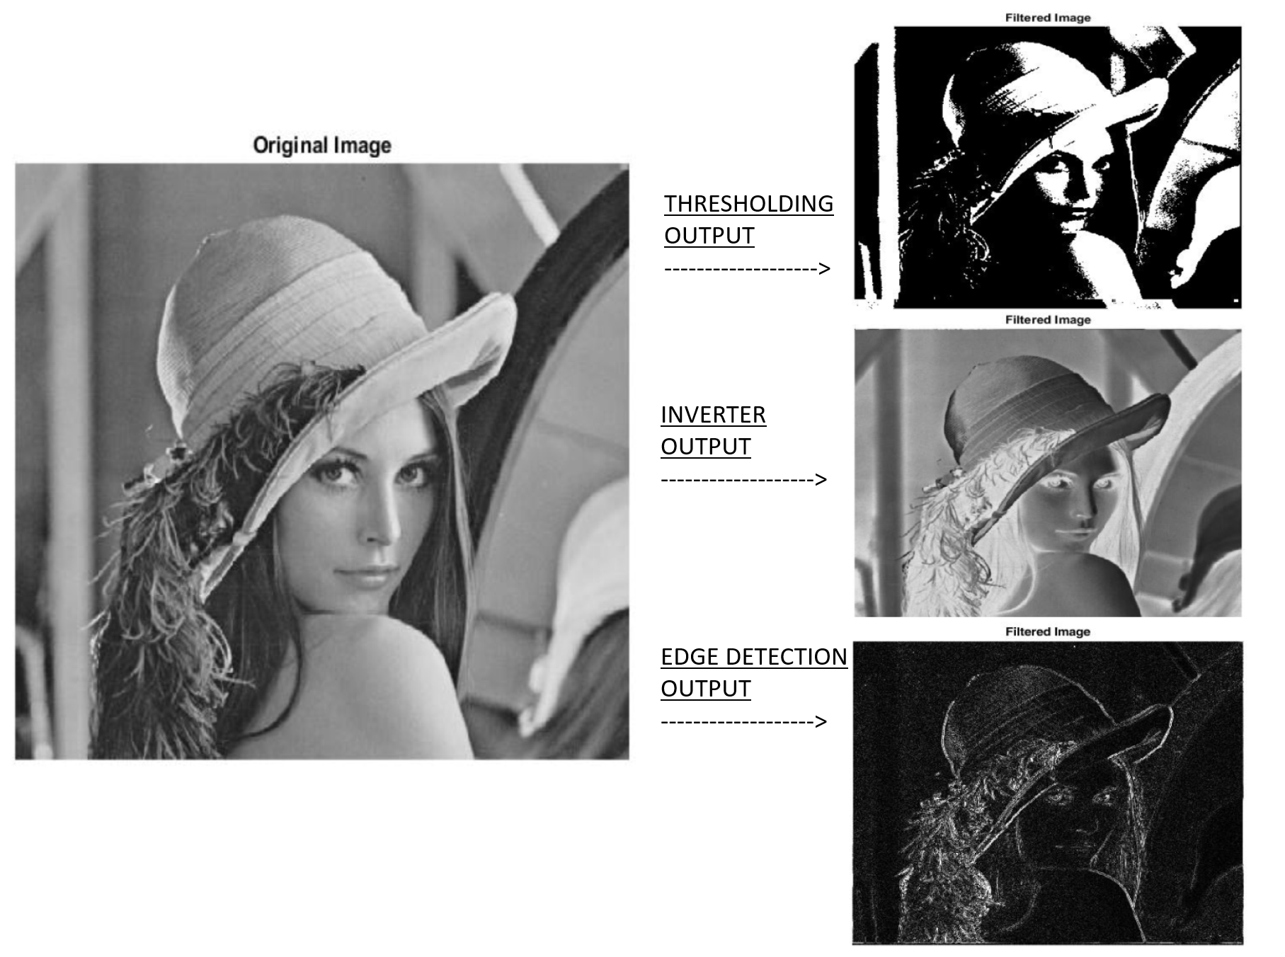
Outputs of various algorithms

Slide 11
The Road Ahead ….
Implementing Haze Removal Algorithm
Real Time Video Processing
Designing Custom DSP Filters

Slide 12
THANK YOU !

