Slide 1
H N G M N

Slide 2
Problem Statement-
Given the attached 50,000 words dictionary, write a program that can play hangman by choosing a letter based on the current state of the board. A board would initially have a series of blanks, each representing one letter in the word. As letters are guessed, all spaces in the word that match the letter should be replaced with that letter. Any letters that have no matches are put on a list of missed letters. Once the list of missed letters reaches 6, the game is lost. Write a C++ program that takes the word as a command-line argument and shows the board after each step as well as ultimate outcome. The guesses should come from the program, not from user input.
The code must pass all these constraints:
1.Number of words tested: 50,000
2.Number of words guessed correctly. Minimum 40,000
3. Correct Guesses (%): Minimum 80.0%
4.Time to run: less than 60 seconds

Slide 3
What is Hangman game?
In Hangman game computer chooses a random word and asks the user to guess the word suppose the word is HANGMAN then it will show dashes “_ _ _ _ _ _ _”.
Our aim is to guess that word. so, it will ask the user to enter a letter and if that letter is in the word the it will ask for another letter after writing the guessed letter in respective place. Suppose the guessed letter is “a” then it will show _ a _ _ _ a _.if the guessed word is not in the word it will deduct the life.
This process will go on until either lives becomes 0 or word is guessed.

Slide 4
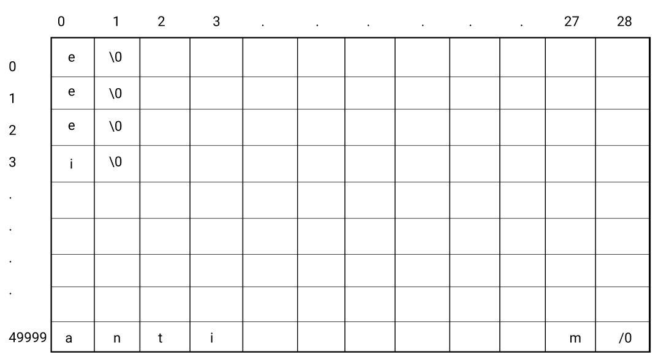
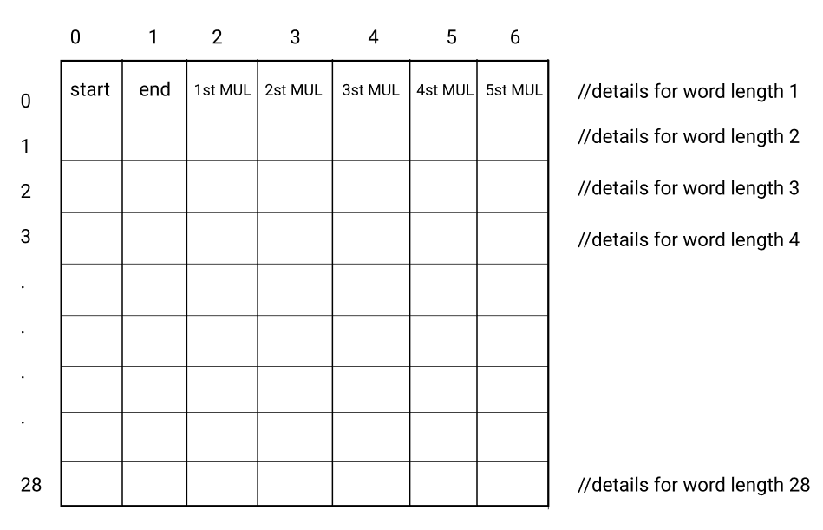
What we have to do?
We have to make a hangman game program as well as a program that guesses the word through some logic. The hangman program should take the whole 50,000 words file as a input and ask the another program for the letter for guessing
so for doing so we are creating two tables

Slide 5
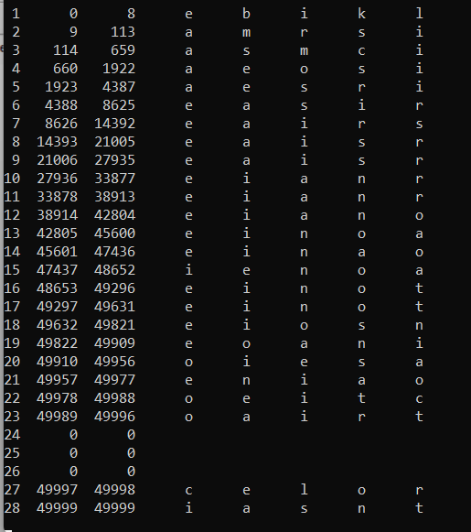
Table 2:

Slide 6
Suppose word is a b a t t i s e s
Word length:9
//row 21006
A:
B:
C:
D:
.
.
.
.
.
.
.
Z:
E:
A:
I:
S:
R:
.
.
.
.
.
.
.
Words having length 9
//row 27935
50,000 words table i.e table1
Guessed letter :e

Slide 7
_ _ _ _ _ _ _ e _
.
.
.
.
.
.
A:
B:
C:
D:
.
.
.
.
.
.
.
Z:
Through this alpha list the most used
series will be generated
i.e – first most used letter
second most used letter
third most used letter
fourth most used letter
fifth most used letter
_ _ _ _ _ _ _ e _
_ _ _ _ _ _ _ e _
_ _ _ _ _ _ _ e _
_ _ _ _ _ _ _ e _
A list of words containing
words with this pattern
Guessed word :the most used letter

Slide 8
If the most used letter is in the word there will be a new pattern created leading to creation of a new list of words and a corresponding alphalist so now the letter which will be given for guessing will be the MUL of the new alpha list.
If the MUL does not come in the word then a life will be deducted and a the next most used letter will be given for the guessing
This process will continue until the word is guessed or the lives = 0.

Slide 9


