Slide 1
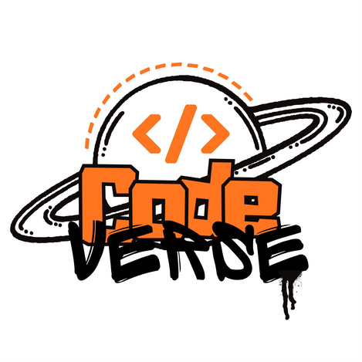


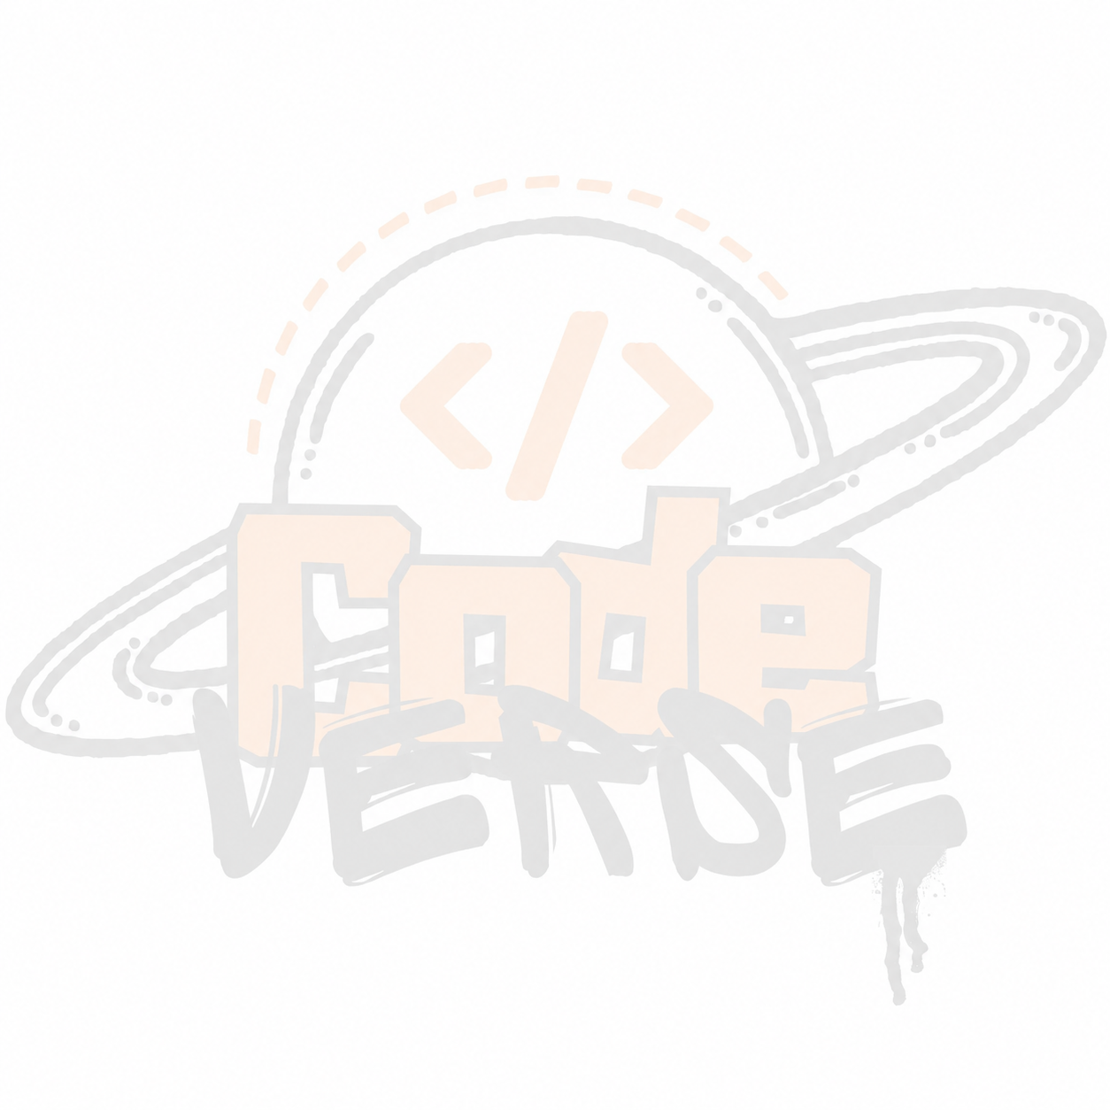
BUILD WITH
भारत 2.0
NATIONAL LEVEL HACKATHON
TEAM NAME: The Sovereign
PROBLEM STATEMENT: AI-Powered Hybrid Audio-Visual Guitar Learning Assistant
TEAM MEMBERS: Aman Singh, Anusha Singh, Abhay Rawat, Aaditya, Tejshwini Rathore
COLLEGE: Noida Institute of Engineering & Technology, Gr. Noida
BUILD WITH भारत 2.0

Slide 2
PROBLEM STATEMENT
Project: StrumSense — Tagline: An AI-Powered Hybrid Audio-Visual Guitar Assistant for All Skill Levels
Self-taught guitarists face a major hurdle: no real-time, accurate feedback while practicing alone.
Beginners struggle to know if they're playing the right chords or following the correct strumming pattern (e.g., Down-Down-Up-Up-Down-Up).
Existing apps like Yousician rely only on audio — they detect chords but cannot see whether the strumming hand is moving in the correct rhythm.
Without a human tutor, learners develop bad timing habits, and even advanced players lack tools to analyze micro-timing or auto-generate chord sheets from jam sessions.
BUILD WITH भारत 2.0

Slide 3
SOLUTION
A Hybrid AI Approach — Dual-Engine Detection
Camera-only tracking fails because fingers hide each other behind the fretboard — so StrumSense listens AND watches.
Audio Engine — The Ear
Vision Engine — The Eye
Listens via the microphone and identifies the chord being played using chroma-based audio analysis.
Uses the camera to track the strumming hand's wrist motion, identifying Upstrokes vs Downstrokes in real time.
Core Features
Real-time tracking: live camera feed with motion-tracking dots + chord/strum-direction text overlay.
Session recording & smart analytics: timeline report of every chord and strum pattern played.
Progress dashboard: stores past sessions so users can track timing and accuracy over weeks or months.
BUILD WITH भारत 2.0

Slide 4
FLOW OF SOLUTION
Mic Input
Chroma Feature
Extraction (librosa)
Chord Template
Matching → Chord ID
Camera Input
MediaPipe Pose
(Wrist Tracking)
Motion Direction →
Strum Up / Down
Timestamp Sync / Fusion Engine
Real-Time Output: Chord + Strum Direction
Session Recorder
Analytics Dashboard +
Auto Chord-Sheet PDF
Engineering risk: camera frames and audio buffers run on different latencies — StrumSense uses timestamp-based fusion to keep chord detection and strumming feedback synchronized, preventing visible drift.
BUILD WITH भारत 2.0

Slide 5
TECH STACK
Frontend (UI & Camera)
Streamlit (Python) or WebRTC — chosen for rapid hackathon deployment of a live camera + audio UI.
Vision Backend (Strumming)
Google MediaPipe Pose module — tracks wrist Y-axis velocity for robust Up/Down detection (more reliable at speed than full hand/finger landmarks, which blur during fast strumming).
Audio Backend (Chord Detection)
Python librosa — chroma_cqt chromagram + template matching against known chord shapes (C, G, D, Em, etc.), which handles overlapping string harmonics far better than raw FFT peak-picking.
Sync Layer
Timestamp-based fusion of the audio buffer and video frame streams, so the chord and strum-direction output stay aligned in real time.
BUILD WITH भारत 2.0

Slide 6
UNIQUE SELLING PROPOSITION (USP)
Hybrid Audio + Vision Detection
Newbie Mode
Most competitors (Yousician, Chordify) are audio-only and cannot see whether the strumming hand is moving in the correct rhythm.
Ghost-chord diagrams, metronome sync-up, and a slow-mo "Patience Mode" that waits for the correct sound before advancing.
Pro Mode
Progress Dashboard
Auto-generated, downloadable chord-sheet PDF from a jam session, plus micro-timing analysis (rushing/dragging vs. the beat).
Stores past sessions so users can visually track timing and accuracy improvements over weeks or months.
BUILD WITH भारत 2.0

Slide 7
FEASIBILITY & COMPETITORS
Feature | Yousician | Chordify | StrumSense
Chord Detection | Yes | Yes | Yes
Strum Direction Detection | No | No | Yes
Auto Chord-Sheet Generation | No | Partial | Yes
Micro-Timing Analysis | No | No | Yes
Hackathon MVP Scope
Live demo: Streamlit app with live camera feed — MediaPipe prints UP/DOWN while the mic detects 3–4 pre-programmed open chords.
Stretch features (Newbie/Pro modes, timeline analytics, auto-PDF) shown as high-quality Figma mockups in the pitch deck.
Key Challenges & Mitigation
Audio-video sync drift → timestamp-fuse both streams at the fusion layer.
Live mic/camera demo risk on stage → always keep a pre-recorded backup demo video ready.
BUILD WITH भारत 2.0

Slide 8

RESEARCH & REFERENCE
References
Google MediaPipe — Pose landmark detection documentation.
librosa — chroma_cqt / chord-recognition reference implementations.
Yousician & Chordify — reviewed as closest competitor apps for feasibility benchmarking.
GitHub Repository: github.com/amansinghrajput-asr/StrumSense
Demo Video Link: https://youtu.be/Up5L2xeT9Qs?si=ljazp9moHquukmZA
Thank You!
Explore the Repo
BUILD WITH भारत 2.0

