Slide 1
Final Project Part-II:
Optimization of Longest Customized Overlap Substring operation
NCTU IEE 2019 Spring Computer Organization
TA: Aman Sinha
Email: amansinha.sw@gmail.com

Slide 2
In this project you will learning...
Basic Knowledge
C/C++ Programming
Basic Linux Usage
Algorithm Design and Code Optimization
Data Structures and Algorithm
Longest Customized Overlap Substring

Slide 3
Schedule
06/08: Part-II announced
07/03: Part-II due day

Slide 4
Outline
Introduction to Longest Customized Overlap Substring operation
Introduction to C/C++ Code optimization
Profiling using Valgrind
Base Program
Grading Policy
Useful Reference

Slide 5
Longest Customized Overlap Substring
Allow some part of the overlap to be unmatched
Add extra variables to Final Project Part-I:
max_custom_overlap : Maximum overlap length, with unmatching part in it
min_custom_overlap: Minimum overlap length, with unmatching part in it
min_overlap_fraction: Minimum acceptable value of match_count / total_custom_overlap_length
Check if all conditions satisfied for particular index using all other indices, find index with maximum overlap_fraction and store it in OutputA

Slide 6
Longest Customized Overlap Substring Illustration
min_custom_overlap = 8 max_custom_overlap = 16 min_overlap_fraction = 0.75
Index String OutputA
0 ATGTCTTATGGACACTT 2
1 AGATCTACTATTTTAAGCCTTGA -1
2 TTTGGACACTGAGGCAGCGCTGGCT -1
3 CTGTTGAAGAAATACTCTTT 1
4 TATATAATATCCAGGCGCTCT -1
For index 0, match with index 2:
ATGTCTTATGGACACTT
TTTGGACACTGAGGCAGCGCTGGCT
Similarly, for index=3 and other indices.
Match_count = 9
Total_custom_overlap_length = 11 < max_custom_overlap
Overlap_fraction = Match_count / Overlap count
= 9 / 11 = 0.8181 > min_overlap_fraction

Slide 7
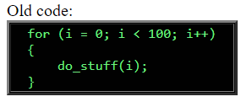
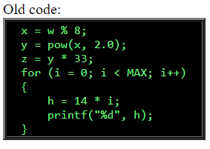
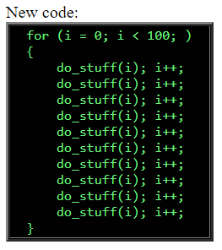
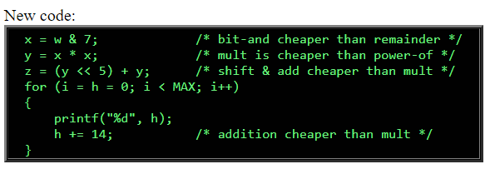
C/C++ Code optimization Techniques
Loop Unrolling
Strength Reduction

Slide 8
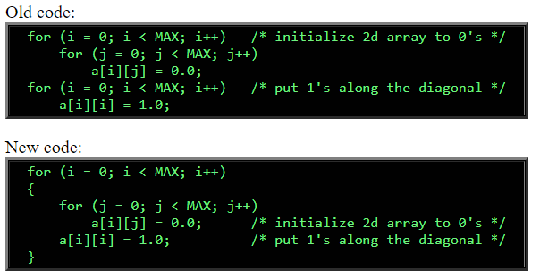
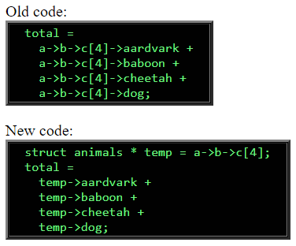
Contd.
Loop Jamming Loop Invariant Computation

Slide 9
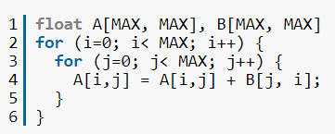
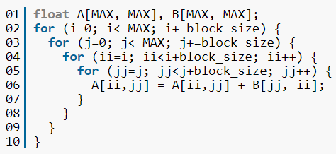
Contd.
Loop blocking
Use pointers, instead of copying large arrays
Minimize Code size
Avoid using standard libraries

Slide 10
Goal:
Optimize Customized Longest Overlap Substring operation

Slide 11
Functions
init() - Initialize the data by reading from file
defaultCompute() – Baseline function to compute all the results
distinctStringSequential() – Find distinct strings sequentially
custom_LOS_Sequential() – Find Longest Customized overlap Sequences sequentially
checker() - Check the result is correct

Slide 12
Profiling using Valgrind
Memcheck : Memory usage and error check
Addrcheck : Memory leaks and bad addresses check
--db-attach : Attach debugger
Callgrind : function call-graph
Details reference: https://www.slideshare.net/aidanshribman/valgrind-29203055

Slide 13
Environment
Get base program source code with below command
git clone https://github.com/amansinha-sw/CO2019S-FP2
Compile code using make
Run code using make run

Slide 14
Task and Evaluation
Task: Implement distinctStringSequential() and custom_LOS_Sequential(), store your result in the OutputA and use Valgrind to analyze your code
checker() will check correctness of the results by comparing with results from defaultCompute()
clock_gettime() is used to measure your preformance
Call your functions within two clock_gettime() functions
You must pass the checking to ensure your result is correct!
We will compare the execution time to rank the solutions of all the students

Slide 15
Grading Policy
FP1 (8%) and FP2 (12%)
FP2:
Completeness (40%)
All results must be correct (Pass the check) (25%)
You get speedup compared to defaultCompute() (15%)
Report (40%)
Describe your implementation algorithm and explain your results (20%)
Show how you use Valgrind profiler to help you find and solve perf. issues (5%)
Discussions on the optimizations you do (10%)
Feedback of this project (5%)
Performance Rank (20%)
We will rank your functions’ performance based on speedup
The fastest one will get 20% and the last one will get 1%
DELAY IS NOT ACCEPTABLE

Slide 16
Other Rules
Compress your code and report into one zip file and upload to E3
Name your package as: StudentID_FP2.zip
Please name your report as: StudentID_Report_FP2.pdf
Make sure TA can compile and run your code with “make” and “make run” on the provided server
Strict plagiarism check will be done to ensure integrity

Slide 17
Questions?

