Slide 1




SCHOOL OF BUSINESS
INDIAN INSTITUTE OF TECHNOLOGY
GUWAHATI
Reimagining the Non-Communicable Disease (NCD)
Crisis in India: A Tech-Driven Approach
Case Conqueror
Abhirup Saha
Aman Kumar Sinha
Divyansh Kumar
Harsh Verma

Slide 2
Non-Communicable Disease: Noncommunicable diseases (NCDs), also known as chronic diseases, tend to be of long duration and are the result of a combination of genetic, physiological, environmental and behavioral and Lifestyle factors.
The main types of NCD are cardiovascular diseases (such as heart attacks and stroke), cancers, chronic respiratory diseases (such as chronic obstructive pulmonary disease and asthma) and diabetes.
NCDs disproportionately affect people in low- and middle-income countries, where more than three quarters of global NCD deaths (31.4 million) occur.
Key facts from WHO:
Noncommunicable diseases (NCDs) kill 41 million people each year, equivalent to 74% of all deaths globally.
Each year, 17 million people die from a NCD before age 70; 86% of these premature deaths occur in low- and middle-income countries.
Of all NCD deaths, 77% are in low- and middle-income countries.
Cardiovascular diseases account for most NCD deaths, or 17.9 million people annually, followed by cancers (9.3 million), chronic respiratory diseases (4.1 million), and diabetes (2.0 million including kidney disease deaths caused by diabetes).
These four groups of diseases account for over 80% of all premature NCD deaths.
Tobacco use, physical inactivity, the harmful use of alcohol, unhealthy diets and air pollution all increase the risk of dying from an NCD.
Detection, screening and treatment of NCDs, as well as palliative care, are key components of the response to NCDs

Slide 3
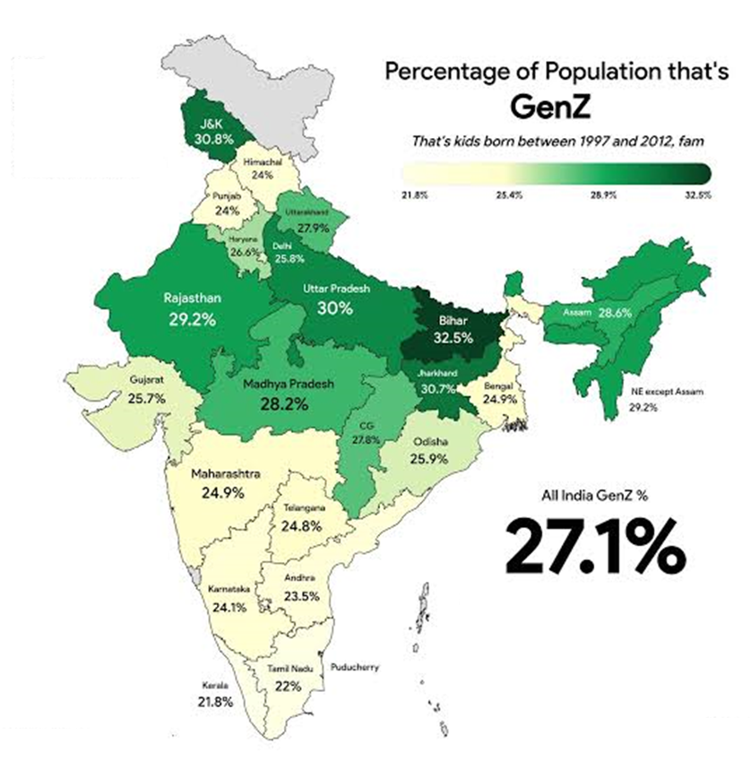
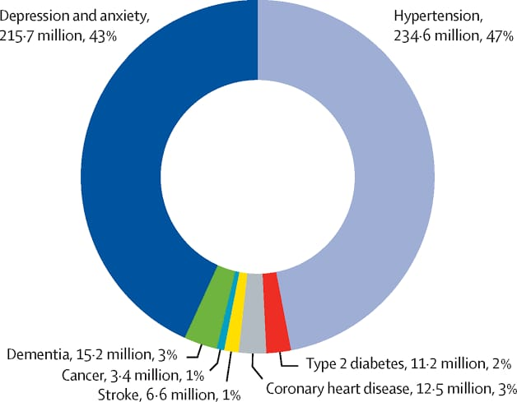
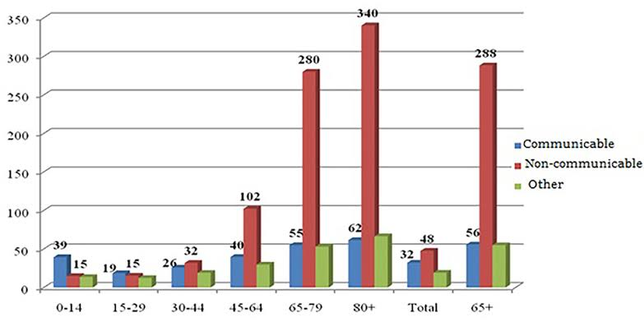
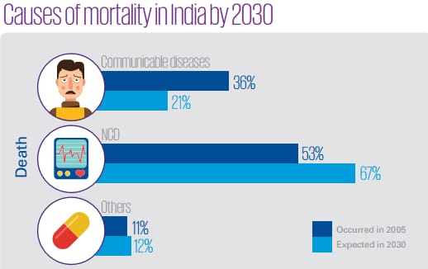
Various Slides representing GenZ population in India, Number of deaths caused by NCD and its bifurcation.
Future Mortality Rate Predictions Due to NCDs
Rising Global Burden
Significant Increase in Low- and Middle-Income Countries
Impact of Aging Population
Lifestyle Factors Driving Mortality
Projected Death Toll by 2030

Slide 4
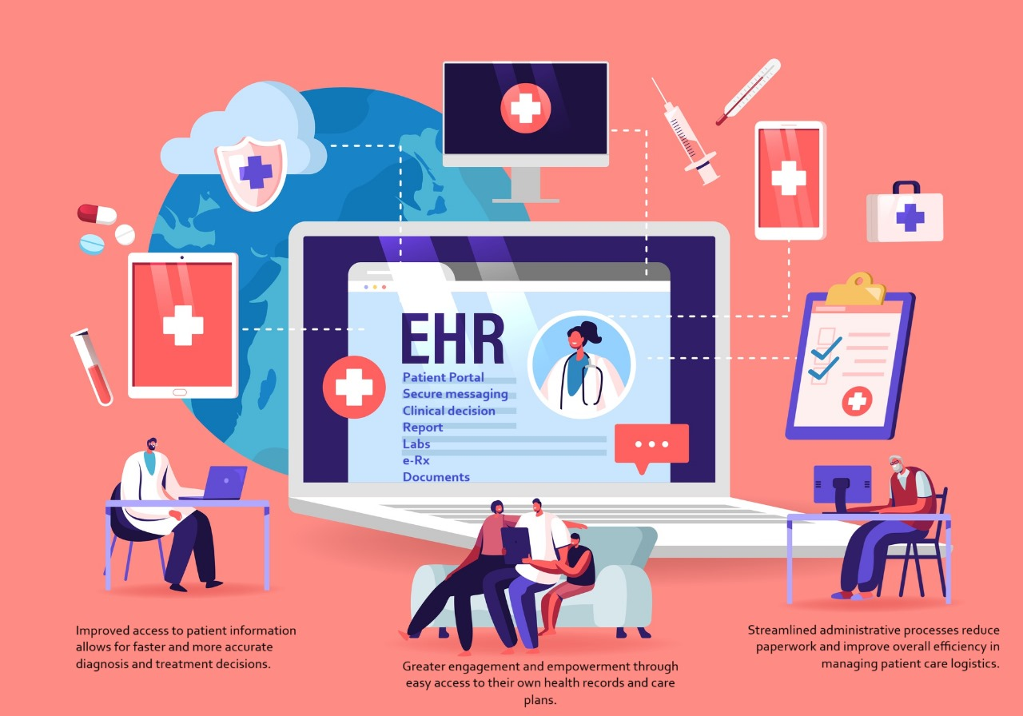
"The fight against non-communicable diseases is not just about curing the ill; it's about creating environments where health is the default, prevention is the priority, and every life is valued."
Solution:
We will engage NCD patients and Gen Z through a comprehensive app and software platform, driven by integrated and personalized EHR (Electronic Health Record) technology and a health and AI based Lifestyle tracker.
Explanation:
We will create a software platform that connects doctors, hospitals, and patients by maintaining up-to-date Electronic Health Records (EHR) for all patients. This will enable smooth communication and data sharing, improving healthcare delivery.
Key features include:
EHR Management: Secure storage and regular updates of patient medical data, including history, prescriptions, and reports.
Accessibility: Available to both public and private hospitals, doctors, and patients for easy access and sharing of medical records.
Security: Robust security to protect patient privacy, allowing access only to authorized users.
Communication: Direct communication between doctors and patients for appointments, report sharing, and treatment discussions.
Integration: Compatibility with other healthcare systems and devices for streamlined data collection and analysis.

Slide 5
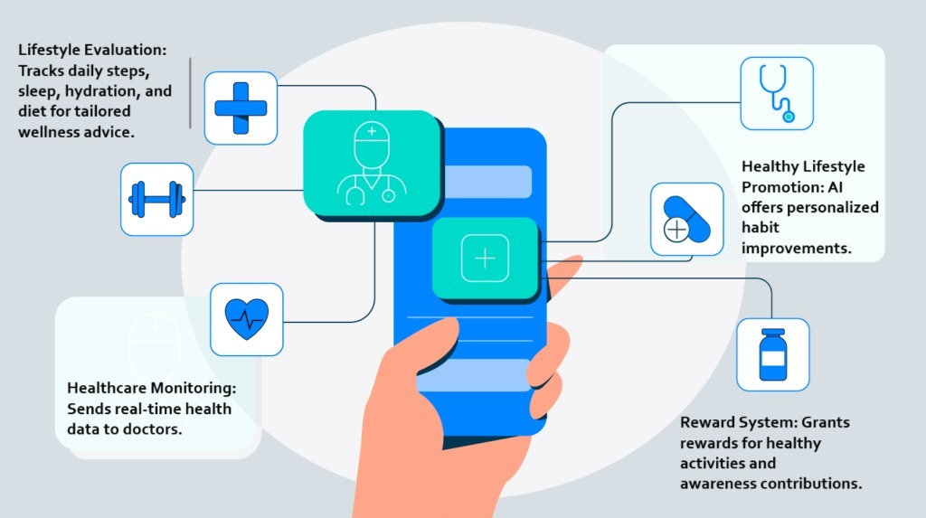
Along with the software, we will also develop an app that will integrate AI and a Health Tracker. This Health Tracker app will record day-to-day lifestyle data, such as how many kilometers were walked, the number of footsteps, physical data, sleep cycles, and other health tracker data. All this data will be securely stored in the app and made available to doctors from time to time, allowing them to monitor the patient's health condition and provide appropriate medical advice.
To engage GenZ and create awareness we will develop a reward-based system. The system will work as follows: Users earn personalized rewards like Movie tickets, Food Coupons, Netflix subscriptions etc. for achieving health goals set on the Health Tracker app. Rewards will only be given for engaging in awareness activities and sharing contents on social media apps and then updating the details on app. This system promotes healthy habits and active app use.
For NCD patients improving their lifestyle or those in advanced stages, we will provide personalized rewards based on their progress. This will boost their morale and confidence. These personalized experiences will reflect our social responsibility and marketing philosophy.
Our revenue model is subscription-based, generating income from both patients and hospitals.
Patients: They will subscribe to the platform to access the benefits of the software, such as maintaining and sharing their EHRs, direct communication with doctors, appointment scheduling, and accessing their medical history and reports.
Hospitals: Hospitals will subscribe to access our technology and the patient data we provide. This allows them to seamlessly integrate with the platform, ensuring efficient healthcare delivery, streamlined patient management, and access to comprehensive patient records.
This dual subscription model ensures a steady revenue stream while providing value to both patients and healthcare providers.

Slide 6
Future benefits of implementing our solution:
Health Empowerment: Gen Z values personalized experiences and self-management. By tracking their lifestyle data and providing AI-driven health insights, they can actively manage their health and make informed decisions, aligning with their preference for personalized and tech-driven solutions.
Engagement through Rewards: Gen Z is motivated by digital rewards and experiences. Personalized incentives like movie tickets, Netflix subscriptions, and gaming access cater to their interests and encourage ongoing engagement and making them to create awareness with health goals and app usage.
Social Awareness: This generation is highly socially conscious. Offering charitable experiences for those showing significant health improvements resonates with their values, as it reflects a commitment to social responsibility and community support.
Interactive Experience: Gen Z thrives on interactive experiences.
Seamless Integration: Gen Z expects seamless, technology-driven solutions. The app’s integration of lifestyle tracking, AI advice, and real-time data sharing with doctors meets their as well as NCD Patients demand for cohesive experiences.
Positive Brand Perception: By addressing health needs and offering personalized rewards and charitable experiences, the platform enhances its appeal to Gen Z and NCD Patients that offer value and social impact.
Lifestyle Changes to Decrease NCDs: The app promotes healthy habits such as regular exercise, balanced nutrition, and adequate sleep, which are crucial in preventing and managing non-communicable diseases (NCDs) like diabetes, cardiovascular conditions, and obesity.
Precautions Against NCDs: The app includes features to raise awareness about risk factors, provide preventive tips, and encourage regular health check-ups, helping users take proactive steps to avoid or manage NCDs.
Future Vision:
We will incorporate Genome Sequence in our app and software which will help in predicting future abnormalities and diseases.
We will develop a microchip for advanced and enhanced tracking of the patients.

Slide 7
THANK YOU

