Slide 1



SMART INDIA HACKATHON 2025
HackOps
  Problem Statement ID: SIH25029
  Problem Statement Title: Authenticity Validator for Academia
  Theme: Smart Education
  PS Category: Software
  Team ID:14
  Team Name: HackOps

Slide 2

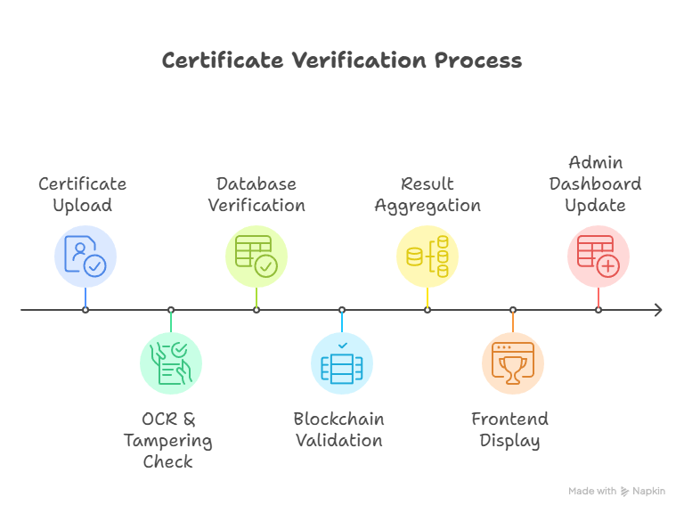
CERTIFYGUARD
HackOps
Academic Authenticity Validation Platform
(Secure • Trusted • Tamper-Proof)
Proposed Solution
Role-Based Access Platform – Unified portal for students, employers, universities, and admins with secure authentication and authorization.
AI-Powered Verification Engine – OCR, anomaly detection, and image forensics to identify forged seals, tampered grades, and duplicate certificates.
Blockchain-Backed Validation – Immutable cryptographic hashes and QR code watermarks for future-proof digital certificate authentication.
Admin Intelligence Dashboard – Real-time fraud analytics, blacklisting system, ERP/database integration, and automated alerts for forged entries.
Uniqueness & Innovation
Dual Certificate Compatibility – Handles both legacy physical certificates via OCR and modern ERP-generated digital certificates via blockchain/QR.
Advanced Fraud Detection – AI-powered anomaly checks for tampered grades, image manipulation, forged seals, and duplicate records.
Seamless ERP/Database Integration – Supports both bulk uploads and real-time certificate validation at scale.
How CertifyGuard Solves the Problem?
Eliminates manual verification delays by providing a digital, automated certificate validation system.
Detects forged, tampered, or duplicate certificates using AI, OCR, and image forensics.
Ensures tamper-proof authenticity with blockchain-backed digital hashes and QR code watermarks.
Builds trust and transparency for employers, institutions, and government bodies through real-time verification and fraud monitoring.
Certificate Upload Process

Slide 3
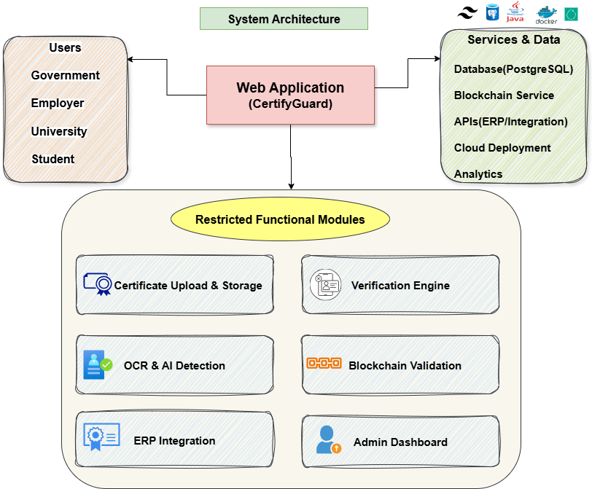






TECHNICAL APPROACH
HackOps
Technical Stack
Frontend
React.js - Dynamic UI.
TailwindCSS – Responsive design and styling.
Backend
Flask (Python) - AI/ML pipeline integration.
Go (Gin Framework) - REST APIs & business logic.
Database
PostgreSQL - Secure certificate storage.
AI / ML Pipeline
EasyOCR & Tesseract - OCR text extraction.
TF-IDF + Logistic Regression - Text anomaly detection.
ResNet18 CNN - Image forgery detection.
Fusion Layer - Verdict: Valid/Fake.
Blockchain Validation
Web3.py + Cryptography - Immutable hash storage.
Deployment
Docker - Containerized deployment.
gunicorn - FlaskAPI serve.

Slide 4



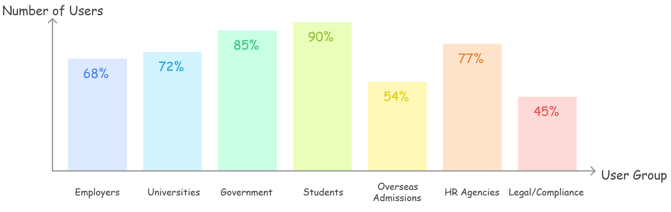



FEASIBILITY AND VIABILITY
HackOps
Feasibility
Built on a secure, scalable tech stack with ERP integration and role-based access for easy adoption.
Reduces verification costs by up to 60% while ensuring compliance with IT Act & GDPR.
Viability
Strong market demand as 30–40% of employers face certificate fraud; ready for large- scale use.
High ROI through fraud prevention, HR savings, and long-term adoption via blockchain validation.
Business Potential
EdTech & Universities - Seamless integration with ERP systems for issuing and verifying digital certificates.
Corporate & HR Tech - Recruitment platforms and enterprises needing large-scale credential verification.
Government & Public Sector - Unified verification system for education, licensing, and employment records.
Global Market Expansion - Cross-border verification for international education and workforce mobility.
Revenue Model - Subscription-based plans for institutions and enterprises ensuring recurring revenue.
Challenges
Data Privacy & Security
Scalability & Accuracy
Adoption Resistance
Fraud Attempts
Mitigation
Encryption + Blockchain + Role-based access.
Optimized backend + AI model updates.
ERP Integration + User Training for smooth onboarding.
Blockchain + Anomaly Detection + Security Testing.
Estimated Use Cases Of CertifyGuard

Slide 5
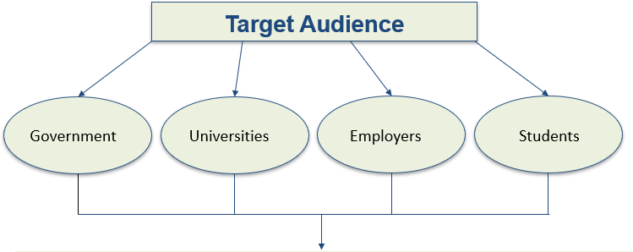




IMPACT AND BENEFITS
HackOps
Benefits
Social Benefits
Builds trust in academic credentials, reducing fraud and fake degree cases.
Enhances transparency between students, employers, and institutions.
Strengthens society’s confidence in the education system.
Economic Benefits
Saves time and cost of manual verification for universities, companies, and students.
Prevents economic losses due to fraudulent hiring.
Encourages a secure digital economy through blockchain-backed verification.
Educational Benefits
Ensures authentic recognition of student achievements.
Protects institutions’ reputation by reducing misuse of their name through fake certificates.
Facilitates global acceptance of Indian degrees through verified, tamper-proof records.
Potential Impact On Target Audience
Government – Reduce 70–80% fraud, save admin costs, boost Digital India.
Universities – 75% less misuse, 65% workload reduction, stronger reputation.
Employers – Up to 90% reduction in false hires, 50–60% reduction in HR verification costs, enabling trusted hiring.
Students – 100% authenticity, 60% faster verification, global acceptance.

Slide 6
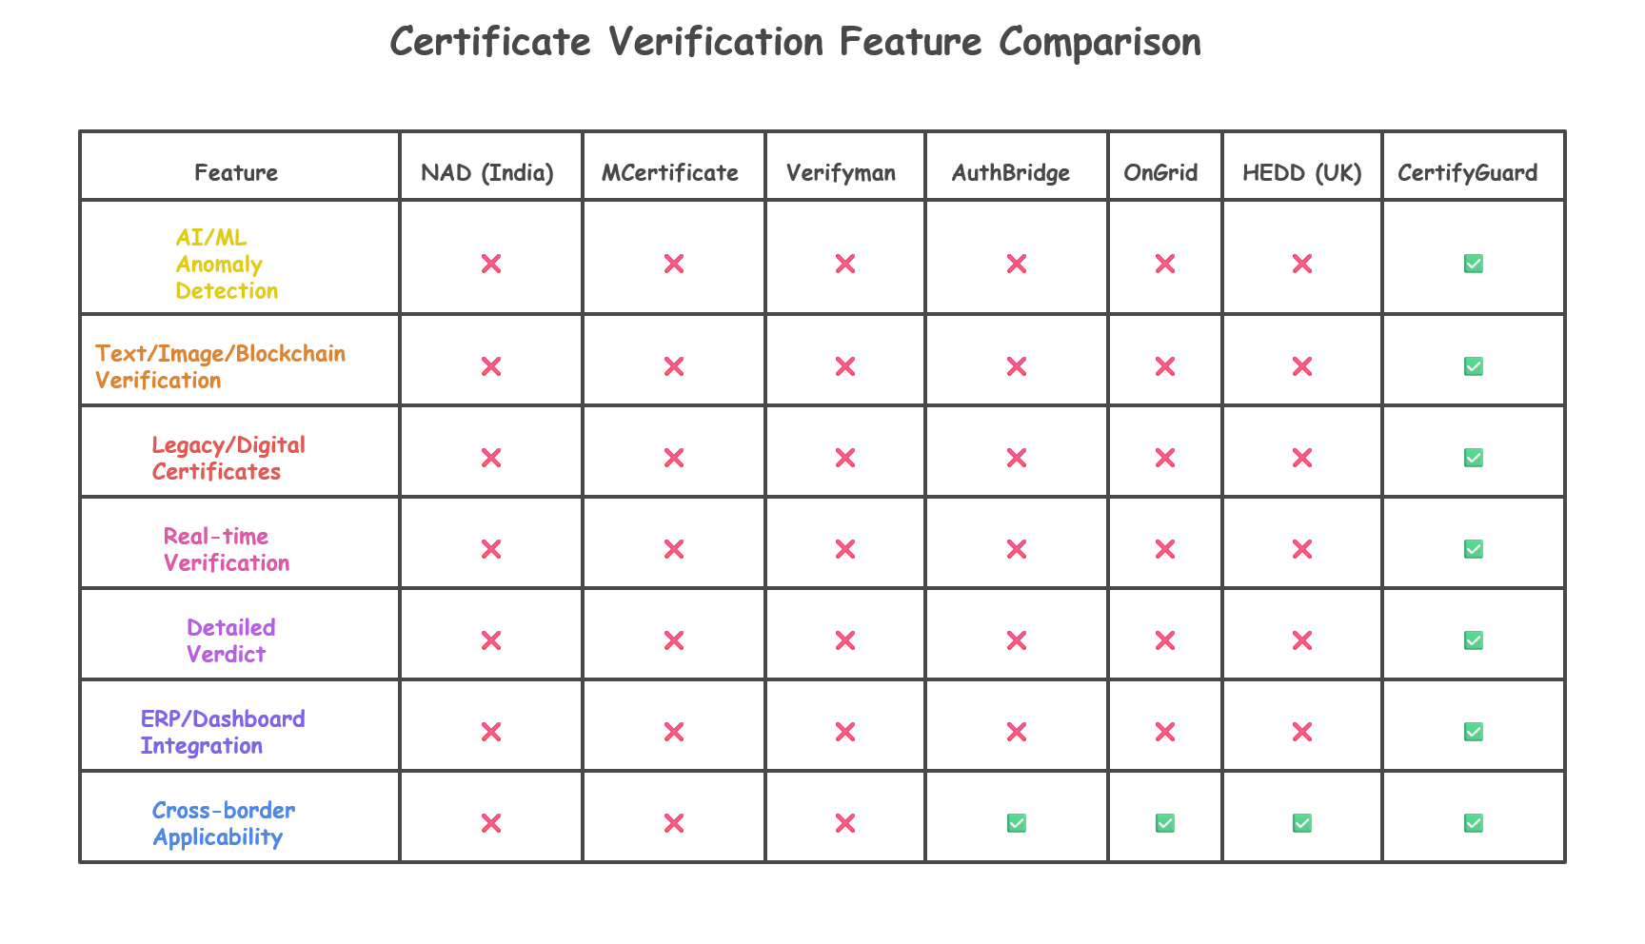
RESEARCH AND REFERENCES
HackOps
Research & References
https://roboflow.com/
https://github.com/golang/go
https://cloud.google.com/use-cases/ocr
https://tailwindcss.com/docs
https://www.postgresql.org/docs/
https://nad.gov.in/
https://www.digilocker.gov.in
https://www.workpro.com.au
https://www.microsoft.com/en-us/learning/certification-verification.aspx
Comparison With Existing Systems
Demo Video Link: https://bit.ly/HackOps_Prototype

