Slide 1
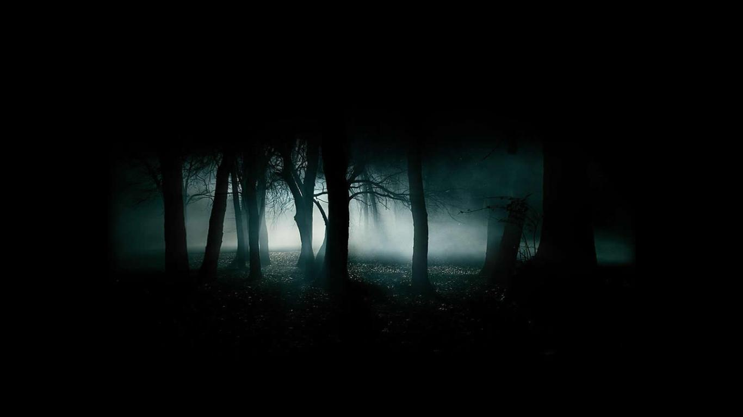
THE ART OF WRITING SCARY JAVASCRIPT

Slide 2
Hi, I’m Aman http://anixir.com

Slide 3
Why Write Scary JS?
Fun
Job Security
Makes you feel smarter
Peace of Mind

Slide 4
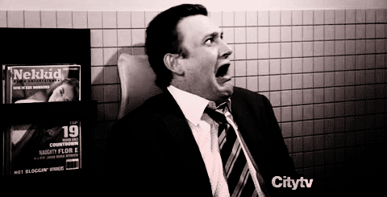
Is Your JS Scary?

Slide 5
Scary JS
JS Anti-Patterns
No Code Smiles

Slide 6
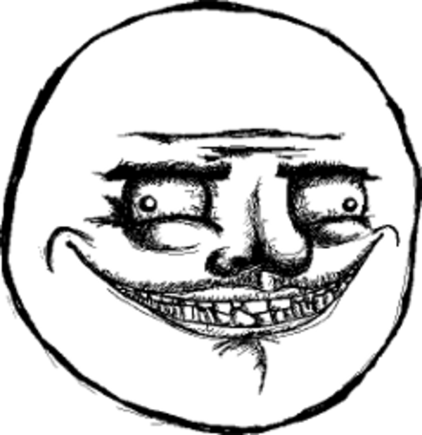
JS Anti-Patterns

Slide 7
Procedural JS
Spaghetti Code
$paghetti with Jquery
0 Abstractions and Large Routines
Modern GOTO or Callback Hell
Good for a Page, Not for an App

Slide 8
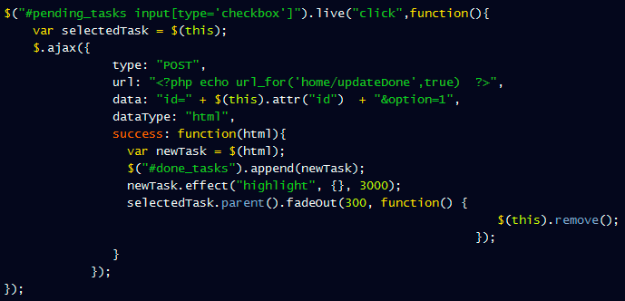
$paghetti

Slide 9
Procedural JS: Write Assembly
Write Assembly and Interpret with JS
Use Require.JS to Include the Assembly Files
Lie about performance
http://e4004.szyc.org/asm.html

Slide 10
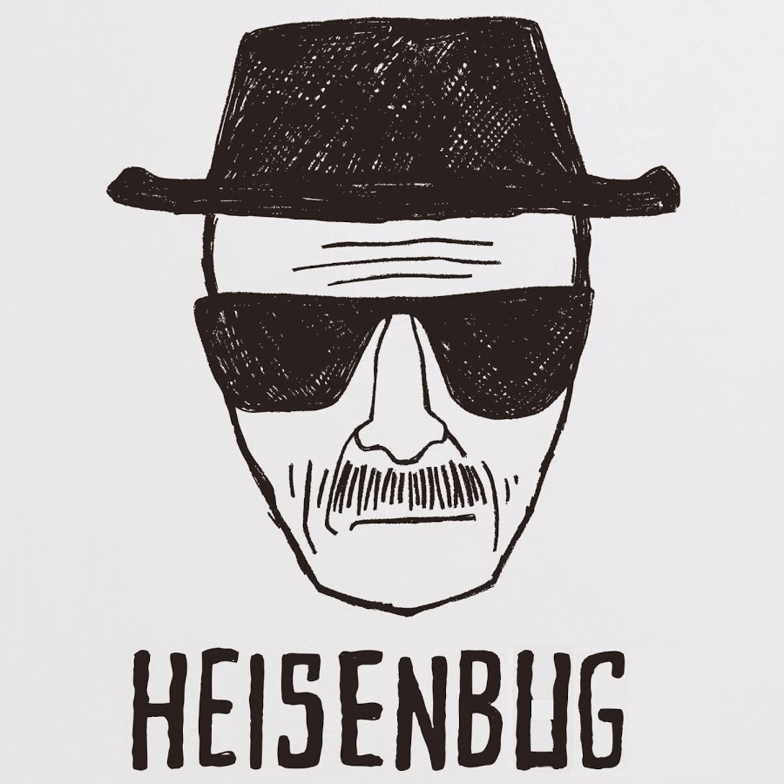
Heisenbug

Slide 11
Heisenbug
A Computer Bug that disappears or alters its characteristics when an attempt is made to study it.
Using console.log in IE
State-Modifying Debug statements
Re-Initializing Globals
Modifying Original Objects from references

Slide 12
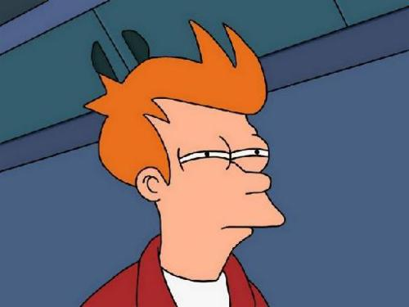
Obfuscation

Slide 13
Abuse Type Casting
1: +!+[]
0: +[]
10: [+!+[]]+[+[]]
true: !![]
Eval: []["filter"]["constructor"]( CODE )()

Slide 14
Abuse Type Casting
_f="filter", _c="constructor",__="toString",
o=+!+[],oo=(!+[]+!+[]), _o=o+oo, _oo=_o+o,
___=+([+!+[]]+[+[]]),_=(___*_o)+_o, ____=(___+(_oo+_o))[__](_)+
(___+_oo)[__](_)+(___*oo+o)[__](_)+(___*oo+o)[__](_)+(___*oo+_oo)[__](_)+
', '+(_-o)[__](_)+(___*oo+_oo)[__](_)+(___*oo+(_oo+_o))[__](_)+
(___*oo+o)[__](_)+(___+_o)[__](_),[][_f][_c](
(___)[__](_)+(___*oo+o)[__](_)+(___+_oo)[__](_)+
(___*oo+(_oo+_o))[__](_)+(___*oo+((_oo*oo)+o))[__](_)+
'("'+____+'")')()

Slide 15
Exploit Oddities
// Nan === Nan is false
If( parseInt( NonNumericString ) === NaN ){
// This never executes
….
}
// Floating point arithmetic
Var a = 0.1, b = 0.2;
If( (a + b) === 0.3 ){
// This never executes
…
}

Slide 16
More Anti-Patterns
Treasure Hunt
Kill Yoda
Numbers Everywhere
Wet Coding
Markup Littering

Slide 17

Scary JS
JS Anti-Patterns
No Code Smiles

Slide 18
Code “Smiles”

Slide 19
Code “Smiles”
Common Sense Naming Conventions
Descriptive Comments
Cohesive And Loosely Coupled Modules
Elegant Abstractions
Lack of Duplication

Slide 20
Refuctoring the Code Smiles
Take a well-designed piece of code,
With a series of small, reversible changes,
Render it completely Unmaintainable
By anybody except Yourself
-- Jason Gorman

Slide 21
Common Sense Naming Conventions
// Instantiating Shadow HTML
var shadowDOM = new HTML ()
// Instantiating a Teen Policy
var teenPolicy = new NewTeenDriversPolicy();
// Invoke on state
if( STATES_RI ){ calculatePremimumForRI (); }

Slide 22
Common Sense Naming Conventions Creative Naming Conventions
// Instantiating Shadow HTML
var shadowDOM = new HTML ()
var freddieDaParser = new HeatherTinaMarieLawson()
// Instantiating a Teen Policy
var teenPolicy = new NewTeenDriversPolicy();
var loDHom = new vav();
// Invoke on state
if( STATES_RI ){ calculatePremimumForRI (); }
if( thorin ){ gotoLonelyMountain(); }

Slide 23
Code Comments State “How”, Not “Why”
Avoid Gotchas
If you can't say anything nice, don't say anything at all
State the Bleeding Obvious
/* Add 1 to j, and let the Operating System Advance the Program Counter */
Insult people in comments
/* Optimized Search with Rabin-Karp
This stuff is too clever for the dullards at XYZ Inc.
who would rather do this in log(n+n^2) */

Slide 24
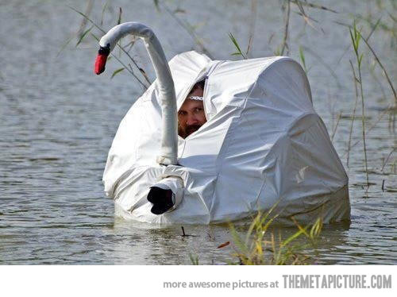
Camouflage

Slide 25
Trick Syntax Highlighting
<!– This Code Never Gets Executed--><!--<?php
<script>
var x = "This";
</script>
< !-- End Camouflaged code--> ?>-->

Slide 26
More Refuctoring
Donkey Case or Random CapITalizAtion
Recycle Variables
Masquerade as keywords
Misuse Semicolons

Slide 27
Scary JS
JS Anti-Patterns
No Code Smiles

Slide 28
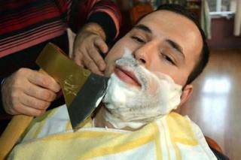
Tools to Avoid

Slide 29
Tools to Avoid
Linting Tools
JSLint, JSHint..
CI Tools
Bamboo, Jenkins..
Functional Programming Libraries
Underscore, Lo-Dash..

Slide 30
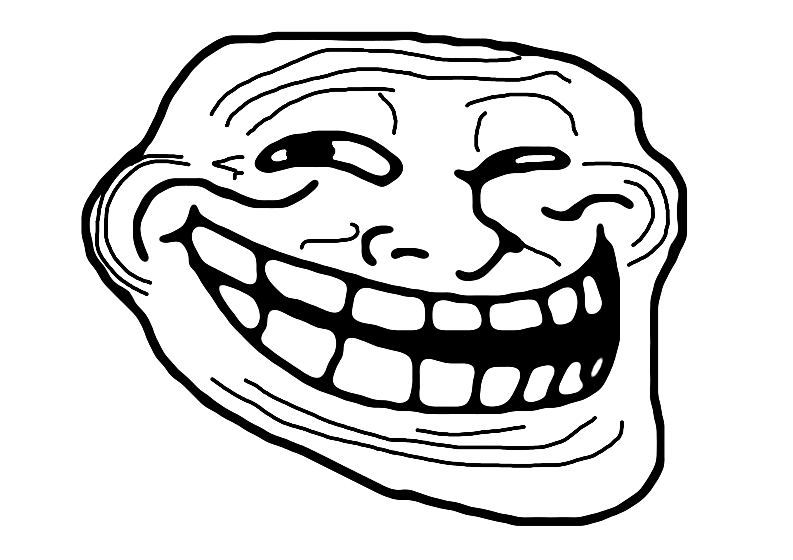
Questions?

