Slide 1
Comparative Study of Temporal Segmentation Methods for Radar-Based Kick Gesture Recognition
Aman Syed | OTH Regensburg | Supervisor: Prof. Dr. Matthias Ehrnsperger | 18th Dec 2025

Slide 2
Motivation & Why Radar
Motivation
Modern vehicles use hands-free “kick-to-open” systems for comfort and convenience.
This is especially useful when the driver’s hands are occupied with bags or luggage.
The system must correctly detect a real kick and ignore random leg or body movements.
Why Radar Sensing
Camera-based systems face privacy issues and do not work well in poor lighting.
Infrared and ultrasonic sensors are sensitive to weather and surface conditions.
FMCW radar works reliably in all lighting conditions and preserves user privacy.
Key Challenge
A kick gesture happens only for a short duration inside a long radar signal.
Therefore, accurate temporal segmentation is required before gesture classification.

Slide 3
Problem Statement & Project Objectives
Problem Statement
Radar signals are long in duration, but the kick gesture occurs only briefly.
Different people perform kicks in different ways, causing high variability.
Normal movements near the vehicle can produce false activations.
Without proper segmentation, the classifier may learn irrelevant signal parts.
Project Objectives
Accurately locate the kick gesture region in long radar recordings.
Study and compare different temporal segmentation techniques.
Train a deep learning model for robust kick gesture recognition.
Ensure person-independent performance using unseen users.

Slide 4

Radar Data & Signal Representation
Radar Data Description
The system uses an FMCW radar sensor to capture motion information.
The radar outputs complex baseband signals representing reflected waves from moving objects.
Each recording contains information from four signal channels.
Signal Representation
I and Q components represent the in-phase and quadrature parts of the signal.
Lower and upper channels capture reflections from different antenna paths.
Sampling frequency: 4000 Hz
Each recording length: ~12000 samples
Labels
Valid Kick → intentional kick gesture
Invalid Motion → non-kick or background movement

Slide 5


Signal Preprocessing
Why Preprocessing Is Needed
Raw radar signals contain noise, static reflections, and unwanted background components.
Different users produce signals with different amplitudes.
Preprocessing ensures the data is clean and consistent before segmentation and classification.
Bandpass Filtering
A bandpass filter is applied to keep only motion-related frequencies.
Low-frequency clutter (ground, vehicle body) is removed.
High-frequency noise is suppressed.
Amplitude Normalization
Scales all signals to a common range [−1, 1].
Reduces variation caused by different kicking strengths.
Helps the deep learning model learn general patterns.

Slide 6
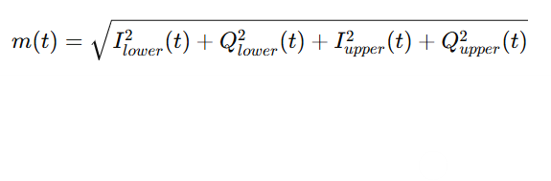

.
Method 1 – Energy-Based Segmentation
Basic Idea
A kick involves strong and fast leg movement.
This movement produces a high-energy response in the radar signal.
The goal is to find the time where the signal energy is maximum.
Magnitude Computation
Combines all four radar channels into a single motion signal.
Removes phase information and keeps overall motion strength
Short-Time Energy
Energy is computed over a short sliding window.
Smooths noise and highlights dominant motion regions.

Slide 7

Segmentation Point
The fixed-length window is extracted around t*.

Slide 8
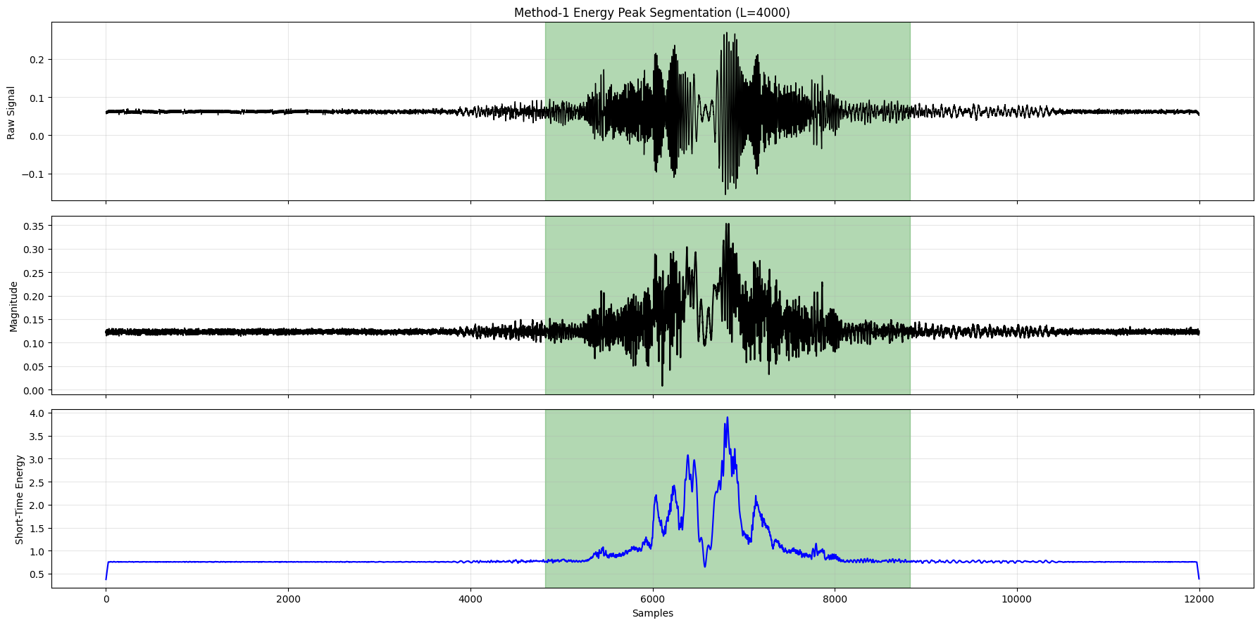

Slide 9
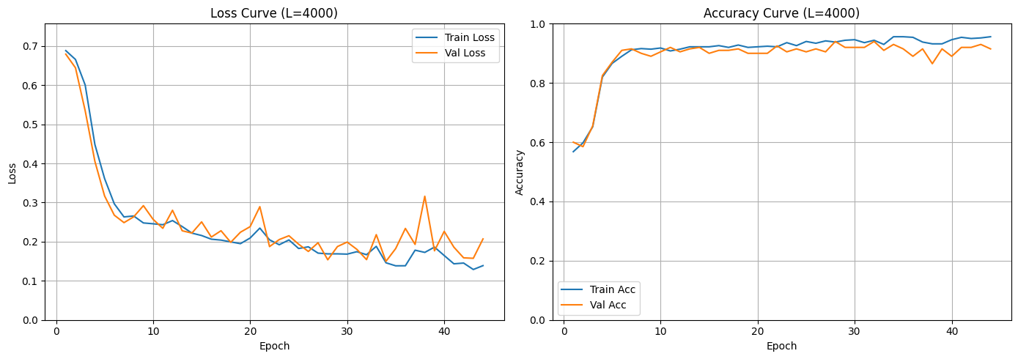

Slide 10
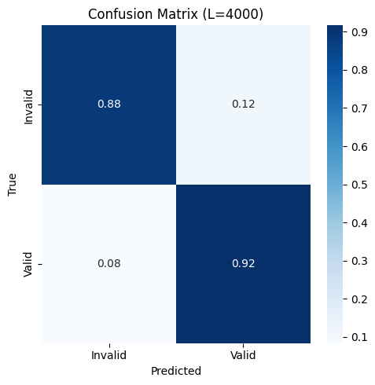
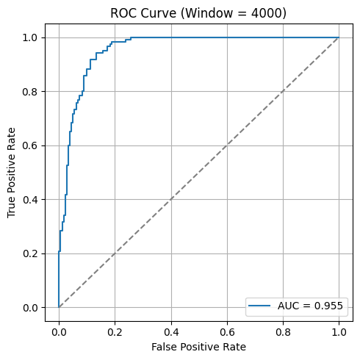

Slide 11
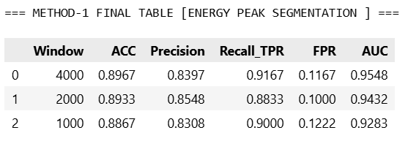

Slide 12

Method 2 – Gradient-Based Segmentation
Basic Idea
A kick does not only have high energy, it also starts suddenly.
This sudden start creates a sharp change in the radar signal.
Gradient-based segmentation focuses on motion onset rather than motion strength.
Temporal Gradient
Measures how fast the signal magnitude changes over time.
Large gradient values indicate sudden movement.

Slide 13


Gradient Smoothing
A moving average is applied to reduce noise.
Ensures stable and reliable peak detection.
Segmentation Point
The fixed window is extracted around this point.

Slide 14
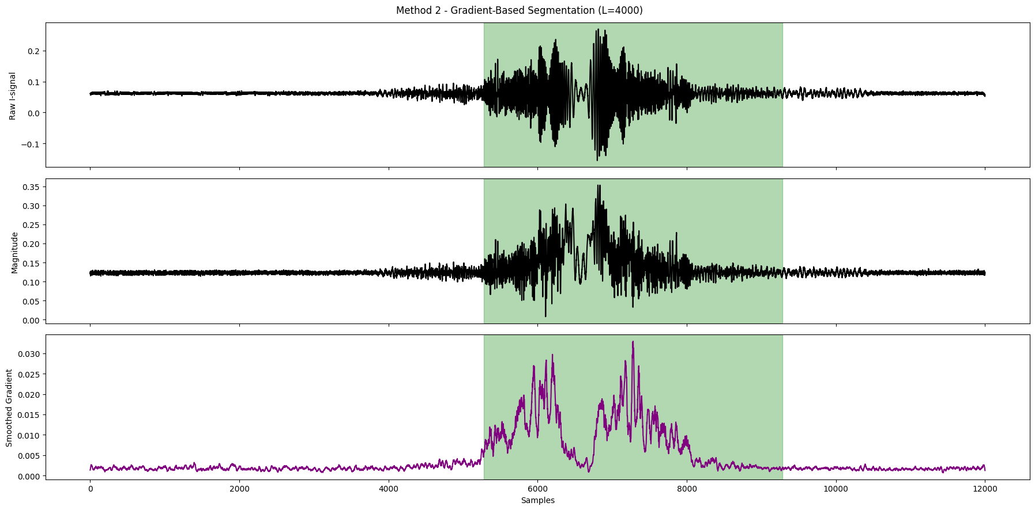

Slide 15
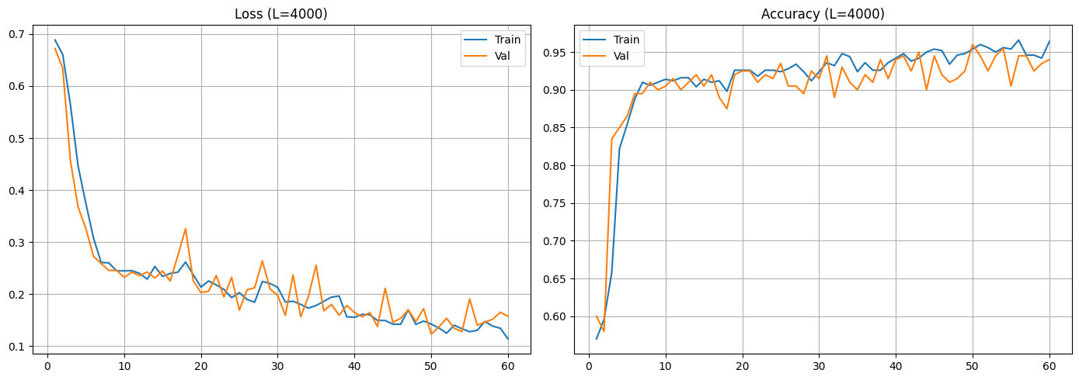

Slide 16
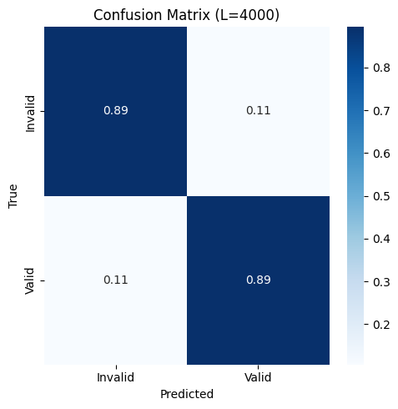


Slide 17
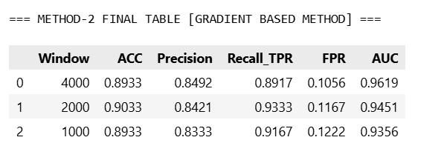

Slide 18

Method 3 – Doppler (STFT)-Based Segmentation
Converts the signal from time domain to time–frequency domain.
Shows how frequency (velocity) changes over time.
Basic Idea
Radar measures velocity through the Doppler effect.
A kick produces a distinct velocity pattern compared to normal movements.
Doppler-based segmentation uses this physical motion information.
Short-Time Fourier Transform (STFT)
Converts the signal from time domain to time–frequency domain.
Shows how frequency (velocity) changes over time

Slide 19


Doppler Energy
Measures motion energy in the Doppler domain.
High Doppler energy indicates strong foot movement.
Segmentation Point
The corresponding time location is used to extract the fixed window.

Slide 20
Windowing Strategy & Evaluation Approach
Fixed-Length Windowing
After segmentation, a fixed-length window is extracted around the detected kick point.
This window contains the most informative part of the kick gesture.
Fixed-size input is required for training the deep learning model.
Window Lengths Tested
Different window sizes capture different levels of motion context.
Window Length | Approx. Duration
4000 samples | ~1.0 s
2000 samples | ~0.5 s
1000 samples | ~0.25 s

Slide 21
Training Strategy
One segmented window is used per recording for training.
Ensures clean and consistent learning.
Testing Strategy (Sliding Window)
During testing, a sliding window is applied over the full signal.
Predictions from multiple windows are aggregated for final decision.
This follows the real-world deployment scenario.

Slide 22
CNN-Based Classification Model
Why Deep Learning
Radar signals are high-dimensional time-series data.
Handcrafted features may miss important motion patterns.
A CNN can automatically learn discriminative features from raw signals.
CNN Architecture (Overview)
1D Convolutional layers extract temporal motion patterns.
Pooling layers reduce noise and dimensionality.
Global Average Pooling summarizes learned features.
Fully connected layer outputs the final prediction.

Slide 23

Model Output
Binary classification:
  1 → Valid Kick
  0 → Invalid Motion
Loss Function
Binary cross-entropy loss penalizes incorrect predictions.
Encourages confident and correct classification

Slide 24
Results & Outputs
Performance Evaluation
The performance of the system depends strongly on the segmentation method and window length.
All models were evaluated using a person-wise 80/20 split with unseen subjects.
Key Outputs Generated
Segmented radar signals for all three methods
CNN training and validation curves
ROC curves and confusion matrices
Quantitative performance comparison tables

Slide 25
Key Observations
Energy-based segmentation
  Simple and fast
  More false detections in background motion
Gradient-based segmentation
  Better temporal localization
  More stable than energy-based method
Doppler-based segmentation
  Most robust and consistent
  Best generalization across unseen users
Best Configuration
Best segmentation method: Doppler-based (STFT)
Best window length: 4000 samples

Slide 26
Conclusion & Future Work
Conclusion
This project presented a radar-based approach for kick gesture recognition.
Accurate temporal segmentation was shown to be critical for reliable performance.
Among all methods, Doppler-based segmentation achieved the most robust results.
The proposed system generalizes well to unseen users, validating real-world applicability.
Key Contributions
Comparative analysis of three temporal segmentation techniques.
Implementation of a person-independent evaluation strategy.
Integration of segmentation with CNN-based classification.

Slide 27
Future Work
Extend the system to multi-class gesture recognition.
Collect data from more users and environments.
Explore advanced deep learning models and sensor fusion techniques.
Thank You…

