Slide 1

Seasonal Agriculture Performance Analysis
Mohammed Sulaiman Adnan
AICTE STU ID : STU6a6cb9f16ef7e1785510385

Slide 2

PROBLEM STATEMENT
Agricultural activities are affected by seasonal changes in environmental conditions, farming practices, availability of resources, and market conditions. Because of these changes, agricultural performance can vary from one season to another. However, raw agricultural data alone does not clearly show how performance changes between seasons or what patterns exist under different seasonal conditions. The problem is to analyze the given agricultural dataset and study the differences in agricultural performance across seasons by identifying meaningful patterns, trends, relationships, and variations present in the available data.

Slide 3
Project Description
This project analyzes 3,880 farm records from 8 Indian states, covering 8 major crops and 3 growing seasons (Kharif, Rabi, and Zaid). The study examines how profitability, yield, water usage, input consumption, and pest or disease risk change across different seasons. Using Python with Pandas, Matplotlib, and Seaborn, the analysis focuses on seasonal profitability, resource usage, crop-wise performance, environmental risk relationships, input-use patterns, water efficiency, feature correlations, state-wise comparisons, and yield-gap analysis. The project provides data-driven insights that can be useful for farmers, agribusinesses, and policymakers.

Slide 4

WHO ARE THE END USERS?
Farmers & Agronomists – select suitable crops and seasons to achieve better yield and profitability
Agricultural Policymakers & Government Bodies – support planning for irrigation, subsidies, and efficient resource allocation
Agribusinesses & Agri-fintech Companies – evaluate crop and seasonal risks for insurance and lending decisions
Researchers & Agri-Tech Students – use the analysis as a reference for future data-driven agricultural studies

Slide 5
Technology Used
Python 3
Pandas & NumPy – used for data cleaning and data aggregation
Matplotlib & Seaborn – used for creating data visualizations
Jupyter Notebook / Google Colab – used as the development environment
Structured CSV Dataset – contains 3,880 records with 28 features

Slide 6
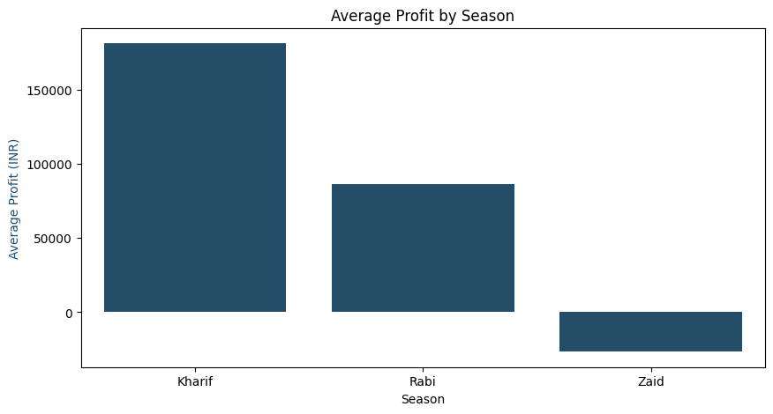
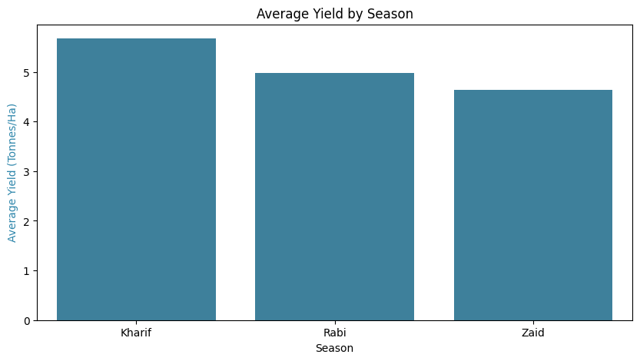
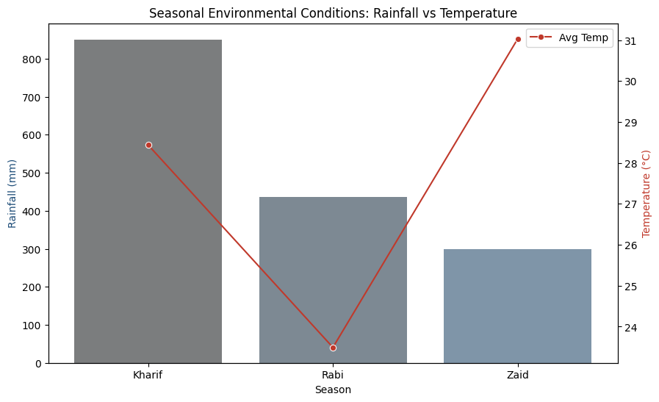
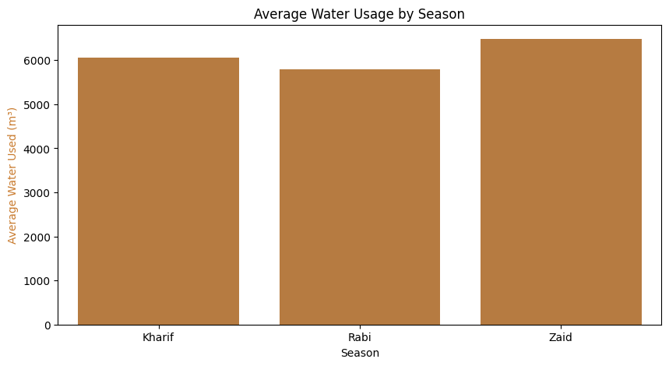
RESULTS

Slide 7
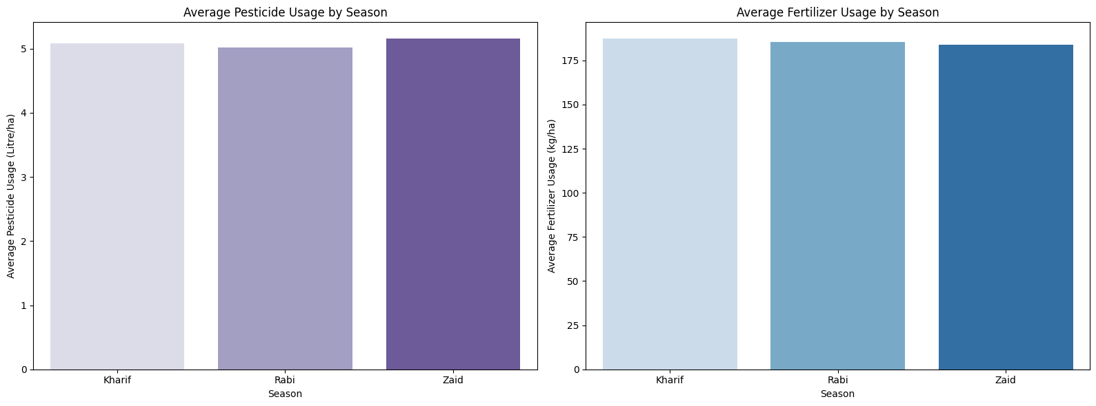
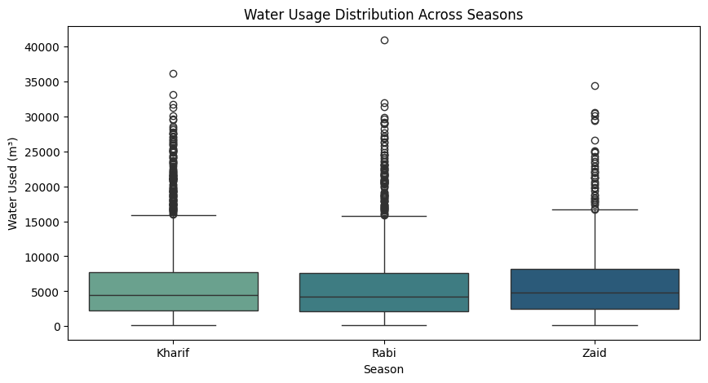
RESULTS
Resource & Input Usage

Slide 8
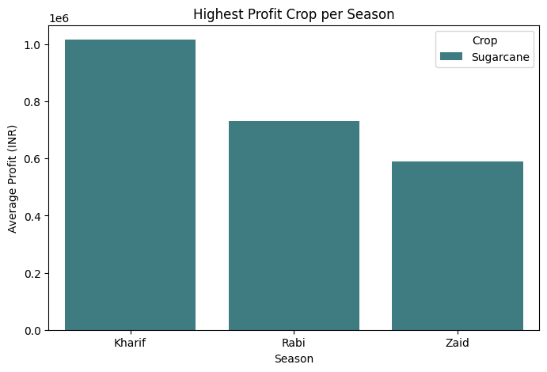
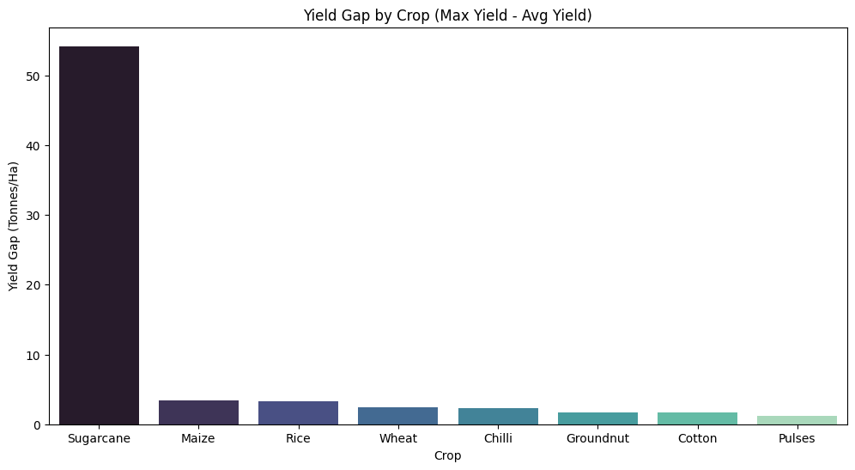
RESULTS
Crop-Specific Performance

Slide 9
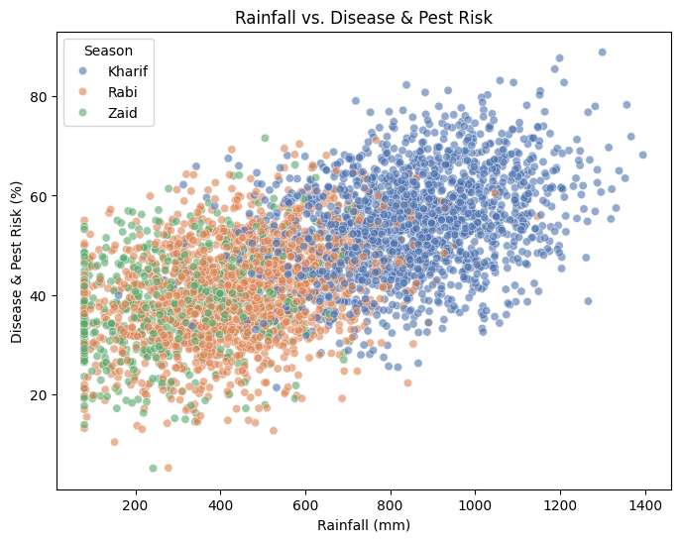
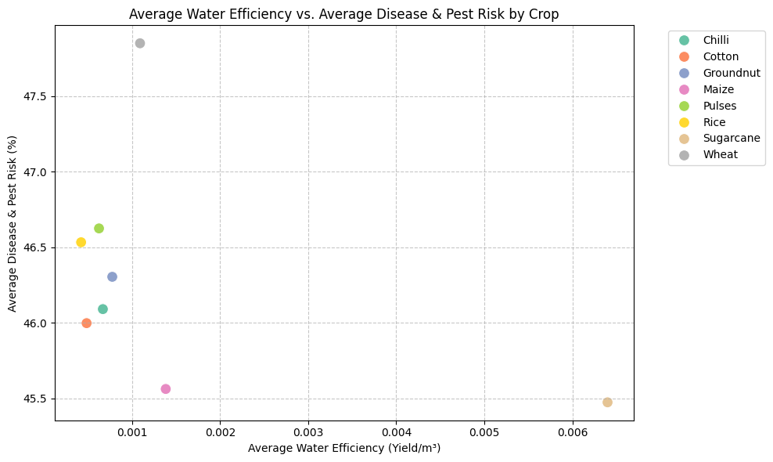
RESULTS
Environmental & Disease Risk

Slide 10
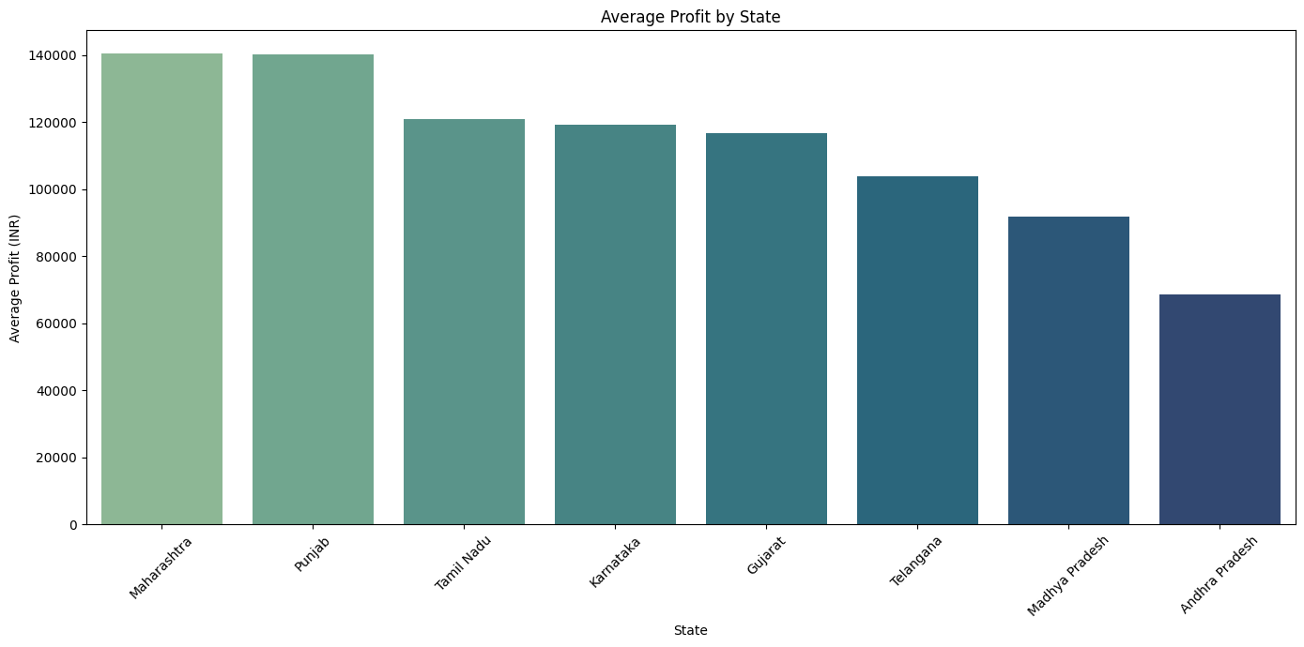
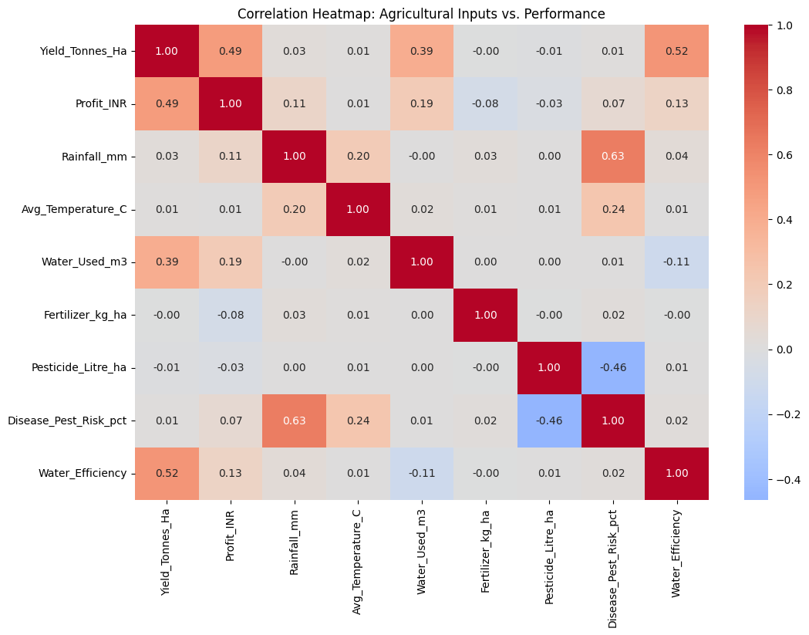
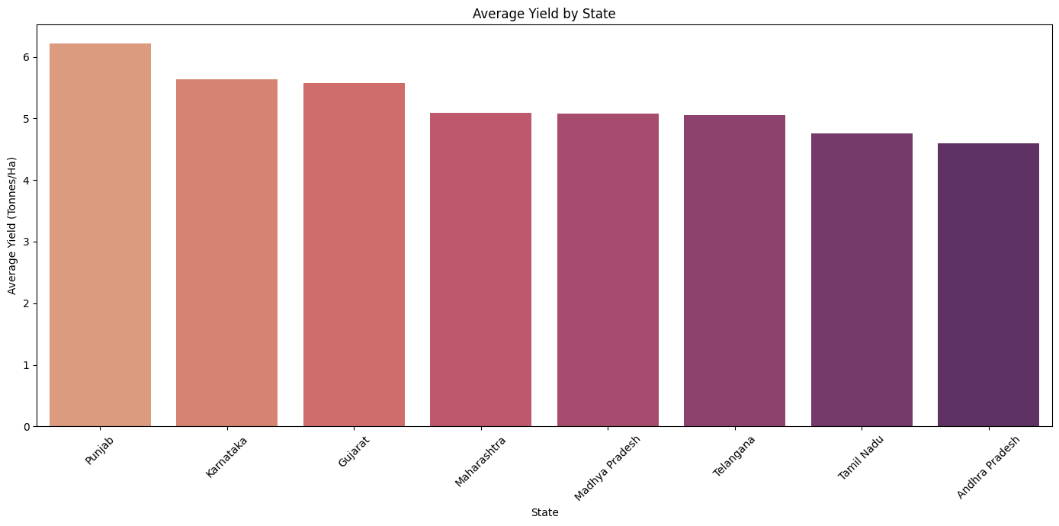
RESULTS
Correlation & State Analysis

Slide 11
Future scope
• Integrate real-time weather and market-price APIs to support live seasonal forecasting
• Develop a machine-learning model that can recommend the most suitable crop and season for a specific farm
• Expand the analysis to cover more states and multi-year data for long-term trend prediction
• Create an interactive dashboard using Power BI or Streamlit for farmers and policymakers
• Add soil-health and satellite-imagery data to gain deeper insights into environmental conditions

Slide 12
GitHub Link
https://github.com/amantabb79015-sketch/-data-analytics

Slide 13

VOIS Course completion certificate -
Course name- Data Visualization

Slide 14
Thank you
Thank you. I'm happy to answer any questions about the project.
.
.

