Slide 1
FAKE REVIEW DETECTION SYSTEM:
Background –
In the online ecosystem with minimal personal interaction, reviews enable the customer to take an informed decision and learn from others experiences. As every thing has its pros and cons, these days’ competitors have misused the review system to create fake reviews and drive customers in misinformed decisions.
It usually happens when there is cut throat completion for a single product like AUTO Insurance. There are
approx. 2K AUTO insurance companies providing almost similar features to the customers with similar rates.
Target Domain –
Insurance Industry

Slide 2
FAKE REVIEW DETECTION SYSTEM:
Need –
There is not yet a detection system for insurance industry today. We come from an insurance background and according to a survey 80% people trust online reviews blindly.
Objective –
To classify and rank the reviews based on their authenticity using natural language processing .
Target Audience –
This tool can be help alert the online shopping savvies to rely only on genuine reviews by giving the probability of a review being fake
Language Used –
Python 3
Platform Used –
Jupyter Notebook

Slide 3
Tools and Libraries:
Libraries –
Pandas lib: This has been used for Data preparation and formatting.
Nltk lib: Natural language took kit for NLP
Sklearn library: Python machine learning library
Functions –
nltk.corpus import stopwords: For removing stop word from the reviews.
from nltk.tokenize import word_tokenize: To divide strings into list of substring
from nltk import pos_tag: It tags the words as nouns and verbs in the sentences.
from nltk.stem.wordnet import WordNetLemmatizer: Stemming and relating similar words to its root word.
Implementing bag of words: Is is used for calculating the (frequency of) occurrence of each word which are used as a feature for training a classifier.
sklearn import cross_validation: For cross validation model evaluation of random forest model.
sklearn.ensemble import RandomForestClassifier: Random forest classifier (more details in further slides)
from sklearn.grid_search import GridSearchCV: For random selection of variables for the estimator

Slide 4
Tools and Libraries:
corpara.Dictonary:
To convert data into normalize and vectorized form using corpara.Dictonary
a) filter_extremes (no_below=5, no_above=0.5)
Filter out tokens that appear in:
1. Less than ”no_below” documents (absolute number) or
2. More than ”no_above” documents
b) doc2bow – It converts the data into bag of words representation
c) matutils.corpus2csc -Convert a streamed corpus into a sparse matrix
d) corpus.transpose-Transposes the matrix

Slide 5
Implementation:
Step 1 – Dataset Preparation
Step 2 – Model Preparation
Step 3 – Model Evaluation

Slide 6
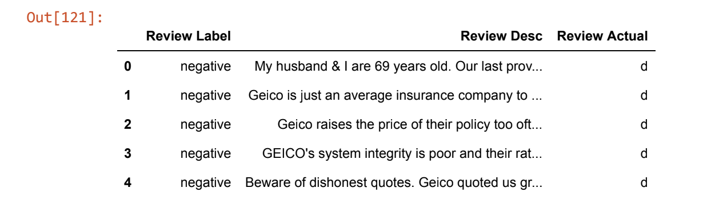
Step 1:
The training data set was prepared by :
1) Categorizing the positive reviews in a positive folder and negative reviews in a negative folder.
2) Loading these reviews into positive and negative data frames respectively.
3) The negative and positive data was then segregated into deceptive positive and deceptive negative, true positive and true negative respectively, resulting in the following 4 categories –
Deceptive positive
True positive
Deceptive negative
True negative

Slide 7
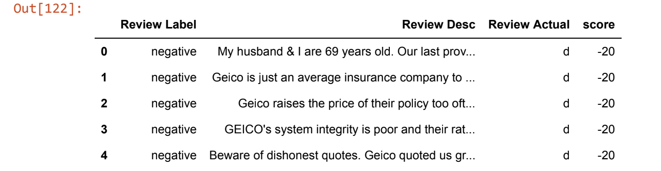
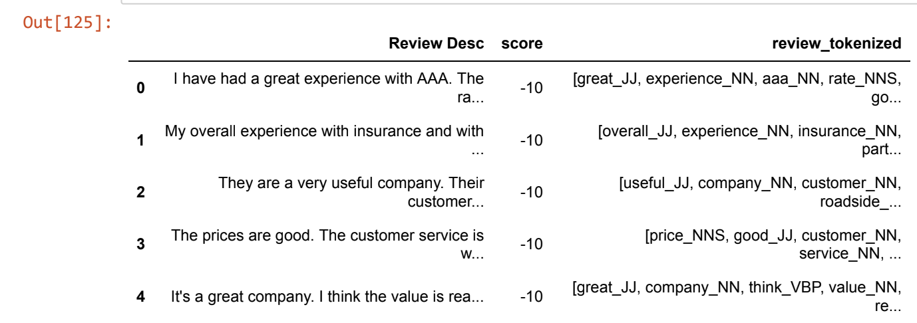
4) These 4 categories were then given respective weights as follows :
Deceptive positive : -10
True positive : 10
Deceptive negative : -20
True negative : 20
5) The reviews were then lemmatized and tokenized and stop words were removed to create corpus.

Slide 8
Categorization source data:
Example -
True Review –
“I bought ALLSTATE Auto insurance and really appreciate the claims procedure, It is easy, with less paper work and quick turn around time”
Deceptive review –
“I bought ALLSTATE insurance and it is very good. ALLSTATE insurance has made my life tension free. With ALLSTATE insurance I am not much worried NY parking my Car in the crowded New York streets. ALLSTATE you Rock”
It is clearly visible in the first case that the review is to the point with the intention of telling the true experience. We can observe the subject ALLSTATE occurring only once with no unrelated lengthy information or usage of good, excellent and other such adjectives.
However, the second review is a little suspicious, we see subject repeated multiple times, this is usually done to draw more attention towards the product. Also, observe the unnecessary information and usage positive adjectives.

Slide 9
Challenges in data preparation:
Challenge – Our major challenge was to find such a training dataset, which is already categorized into these 4 categories. We did not find any such dataset on the web ☹
Solution – As we know there can’t be a better judge than humans. We unloaded the dataset from different insurance marketplace and requested 5 of our friends to categorize the reviews into the four categories. Note that none of our friends had Insurance background and this helped us to get a fair decision without being biased due to insurance background

Slide 10
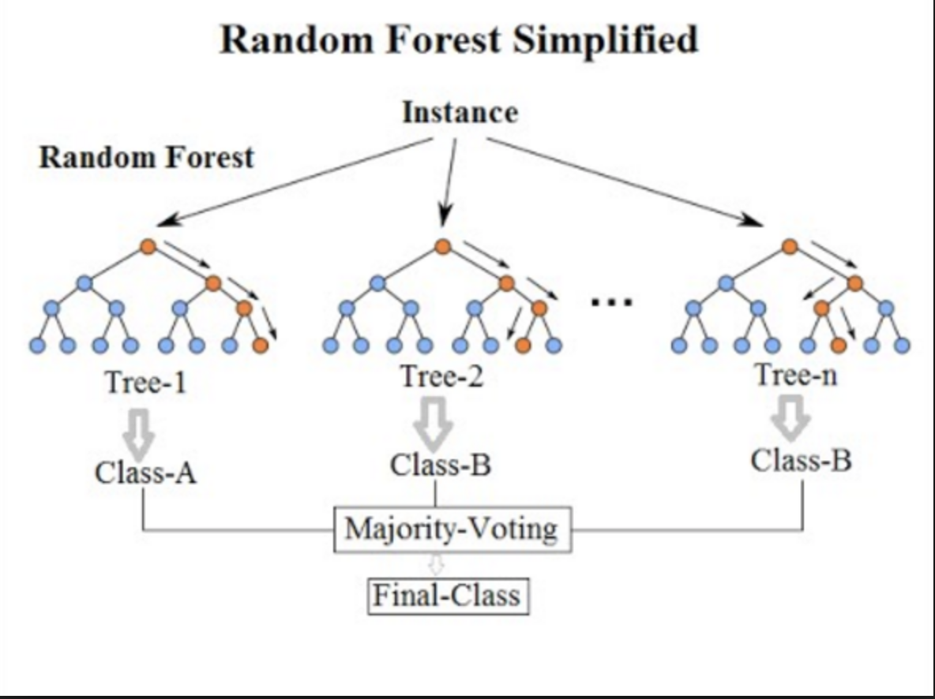
Step 2:
Build the classifier using Random Forest model:
Random Forest –
Random forest is a supervised learning algorithm. It can be used for both classification and regression. A forest is comprised of trees. It is said that the more trees it has, the more robust a forest is. Similarly the Random forest algorithm decision trees are created using the sample data and by means of voting the decision are made.
In our case, each review is categorized into fake or true by human beings based on various factors. This process is similar to a decision tree. Now these decisions tree outputs are collected and the final categorization is done based on voting process. This process is basically based on divide and conquers where each decision tree is made on randomly split dataset.
It generates the decision trees on already categorized data, which is termed as random forest, more the sample data or denser the forest is, more the probability of getting the accurate results. Each tree depends upon its own selection criteria of variables and final voting decides the winner. In case of regression, average of all the voting is considered as the final result.

Slide 11
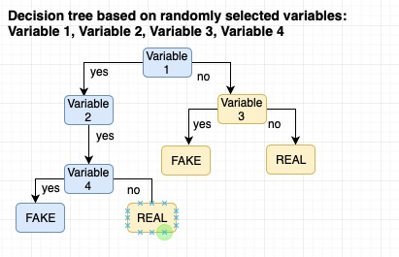
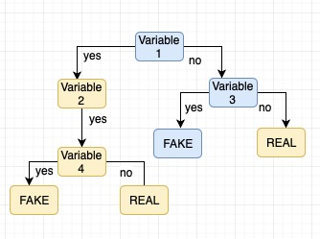
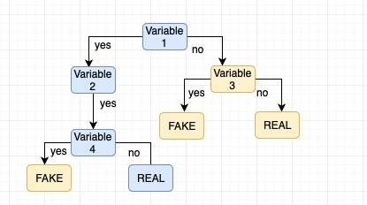
Random forest:
Decision trees based on randomly selected variables:
The blue leg participates in decision making based on the features.
Similarly, for the next decision tree, a different set of variables are selected and this
process goes on until n times. (Below is the depiction of 3 such decision trees)

Slide 12
Step 3:
Model evaluation:
On evaluating the Random Forest model using the predict function, we could achieve the accuracy of 46%. Since we created the source data manually with the help of our friends, we could only manage creating 70 data entries. We are confident that the accuracy would increase as we get more data entries.
References –
https://scikit-learn.org/stable/
https://stackoverflow.com
https://radimrehurek.com/gensim/models/ldamodel.html

Slide 13
Running the code:
Make sure you have python version 3 or higher
Download the training dataset and place it in two separate directories in root folder as - train_negative and train_positive
Import all the Python libraries.
Download the NTK lookups - WordNetLemmatizer
Run the attached train_reviews_version11.py file.
Reviews can be modified under the train_positive and train_negative directories .Please make sure to follow the naming conventions.

Slide 14
Thanks!!

