Slide 1



Assignment 5
By Aman Tewary &Nikhil Kamath
View in Power BI
Last data refresh:
7/17/2018 3:24:29 PM Atlantic Standard Time
Downloaded at:
7/17/2018 4:38:32 PM Atlantic Standard Time

Slide 2
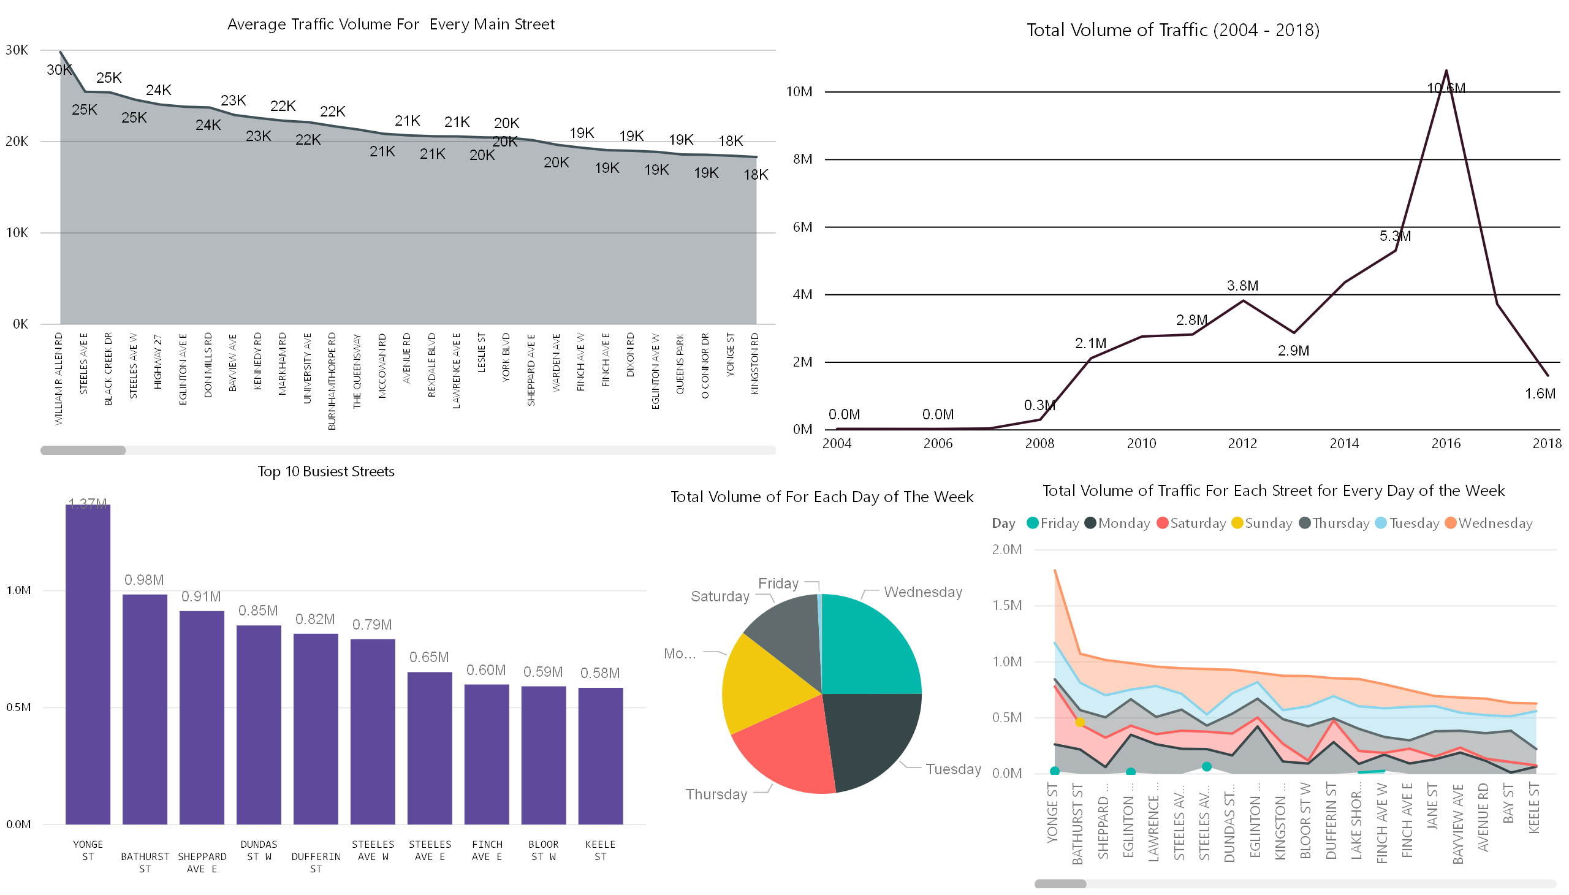

Slide 3
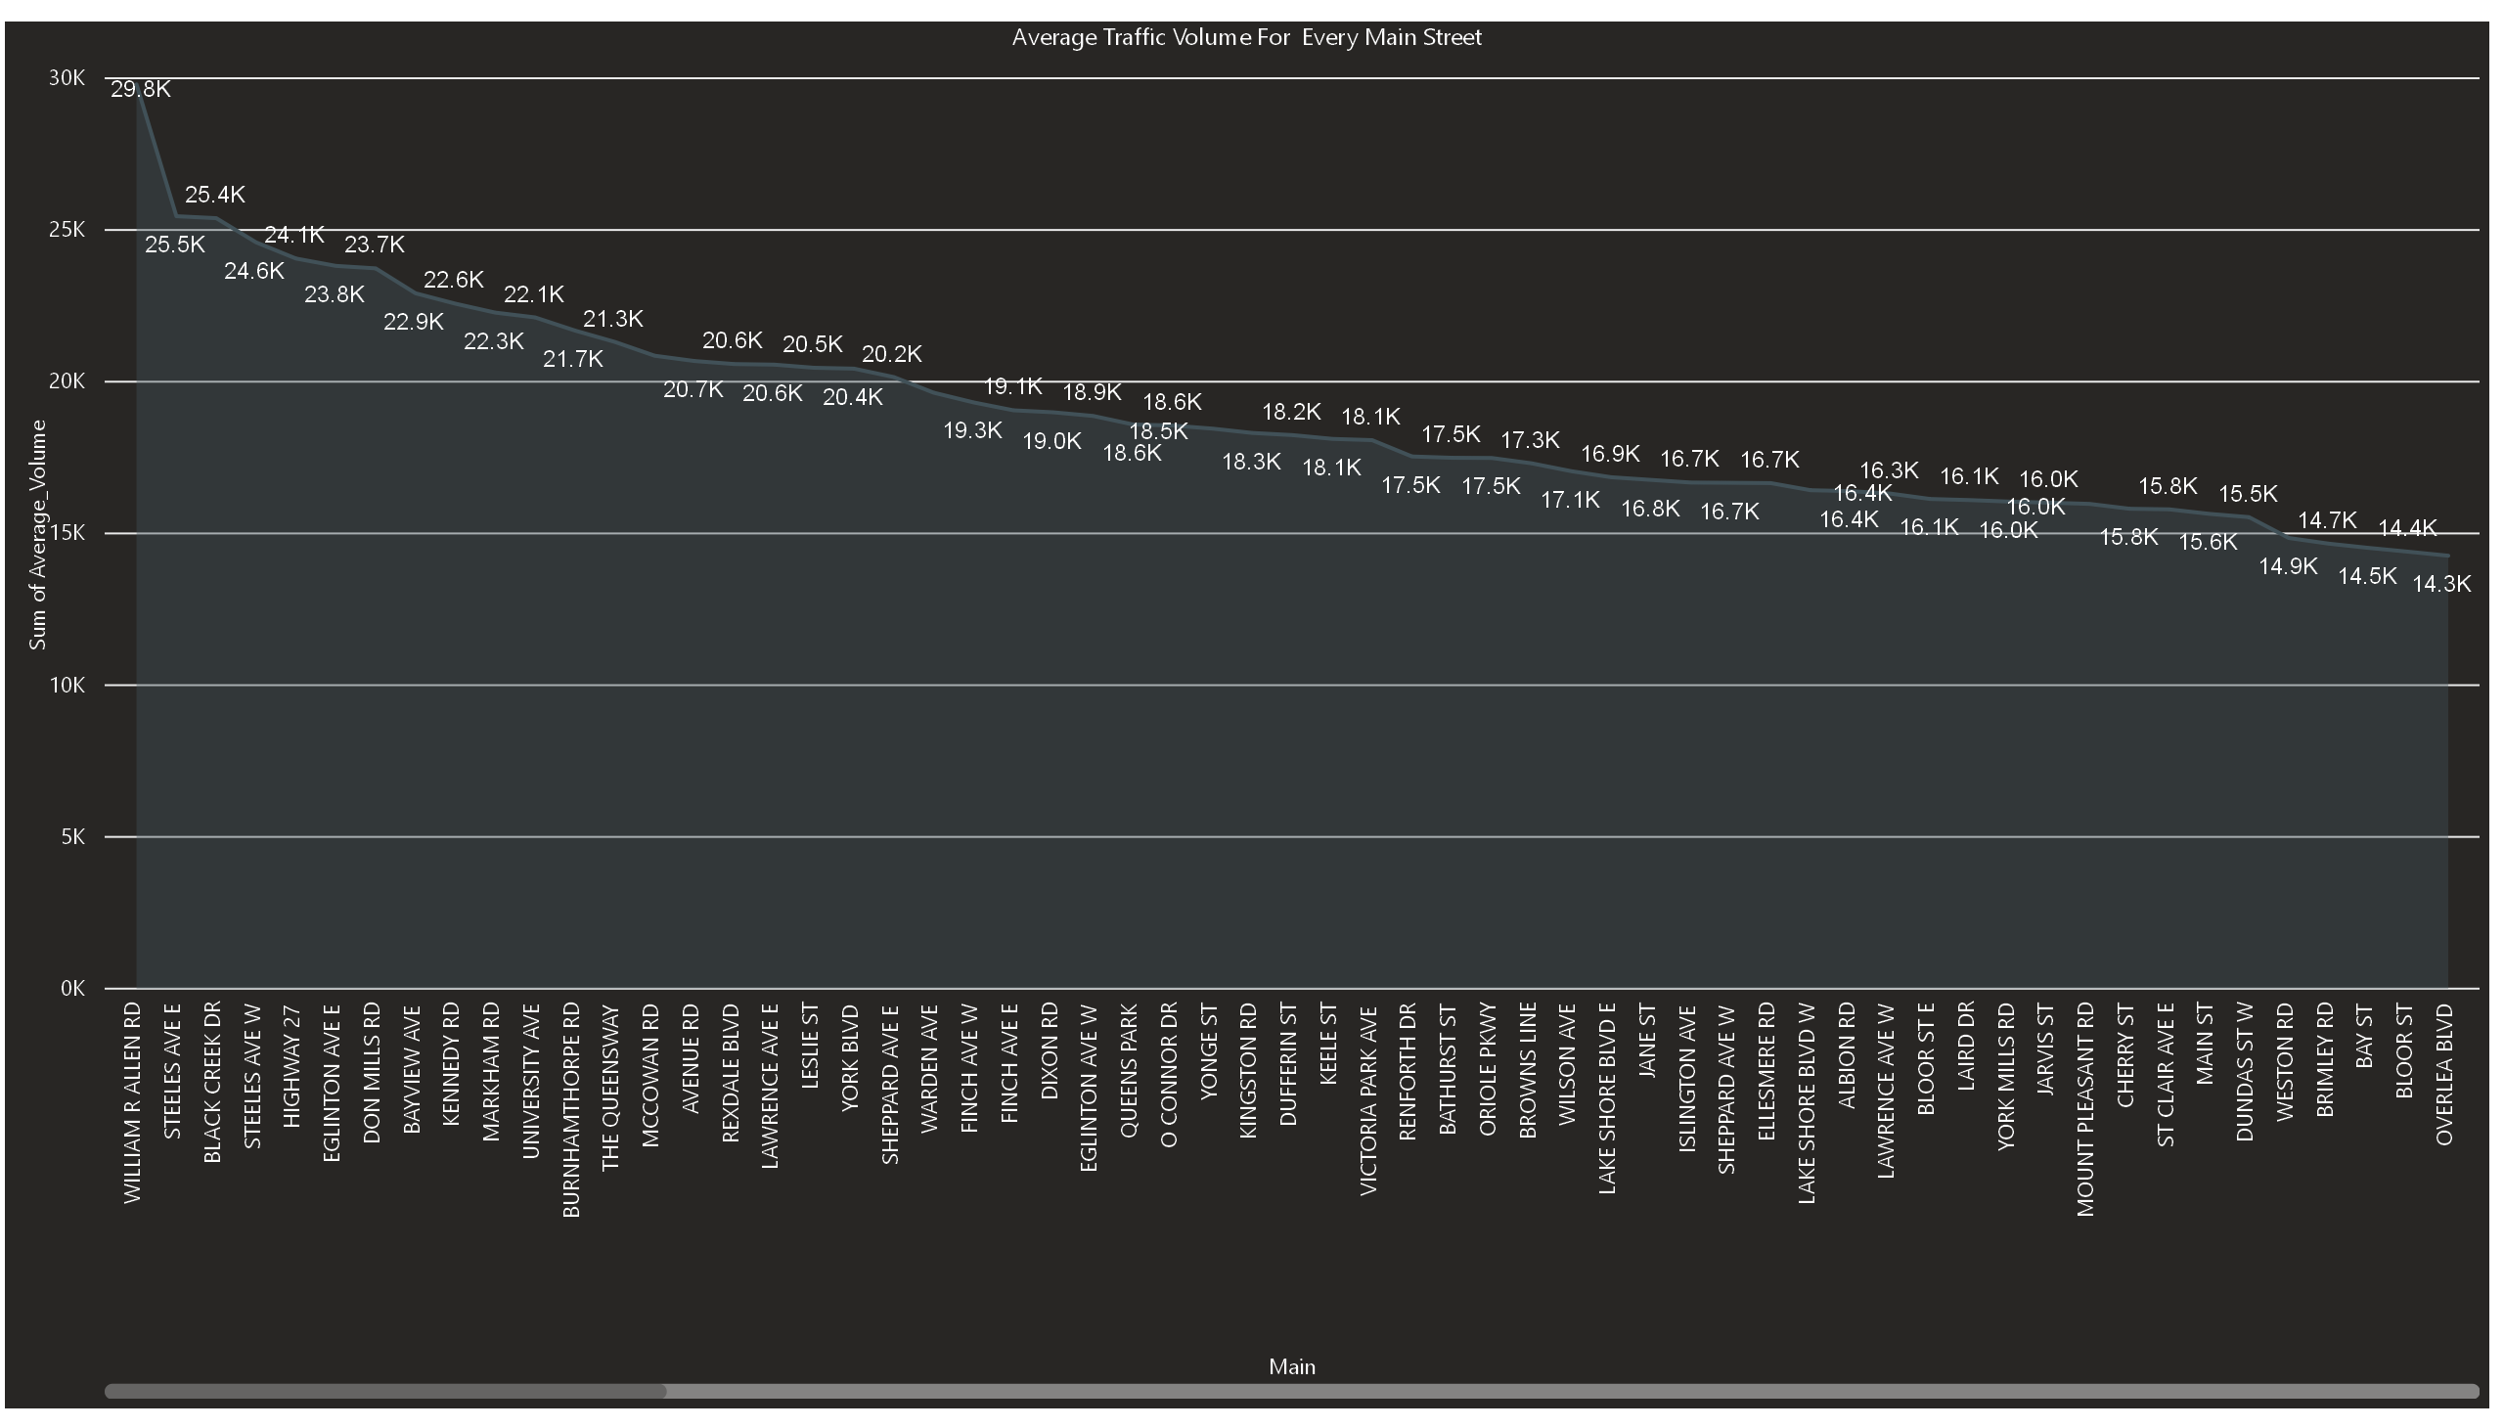

Slide 4
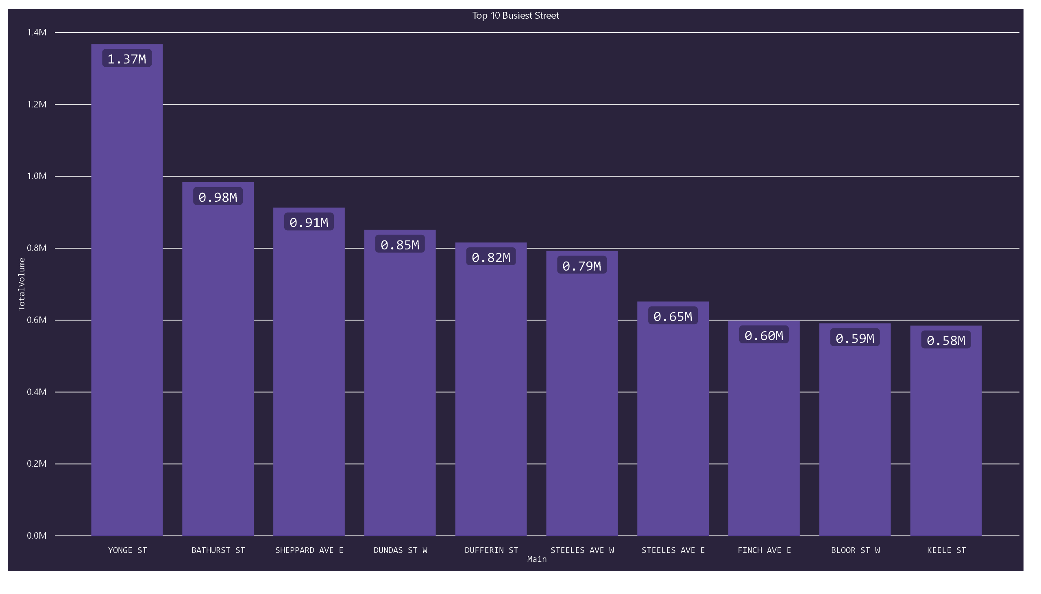

Slide 5
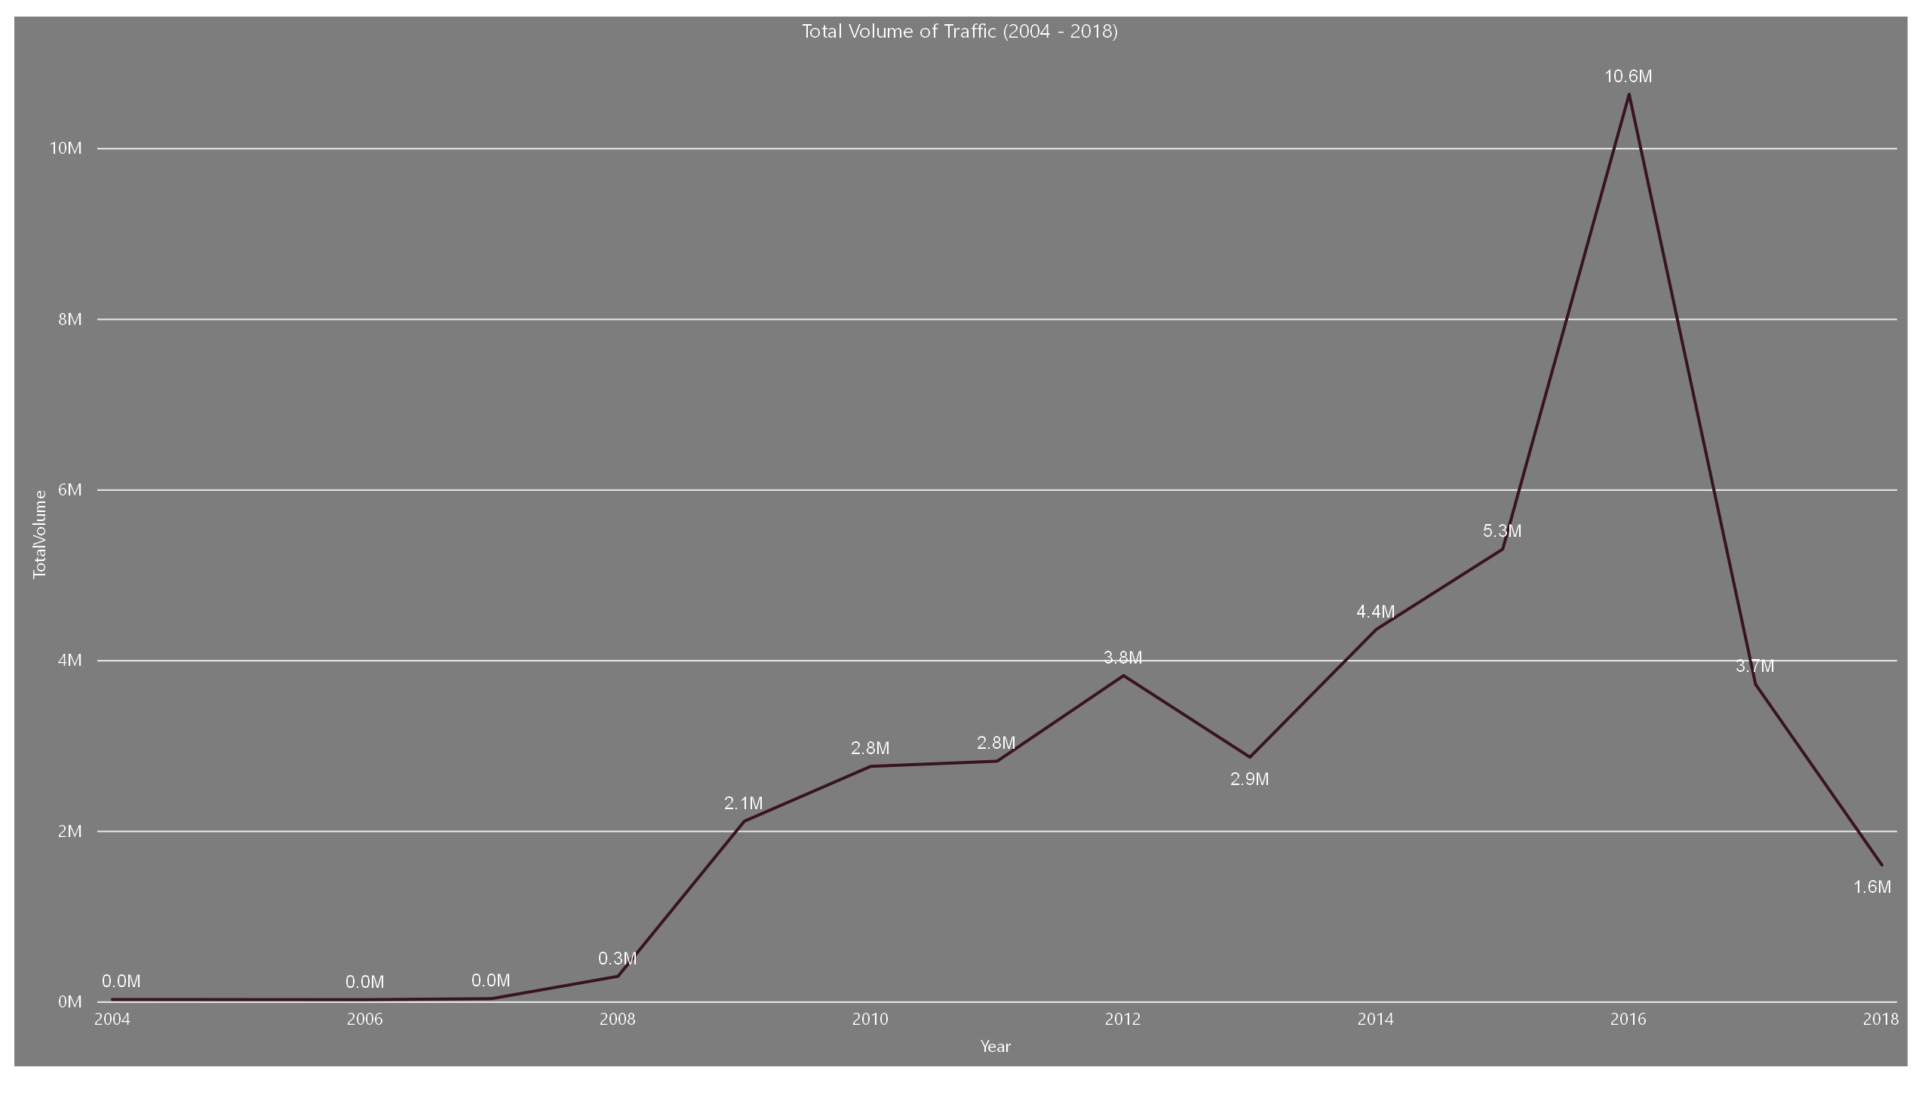

Slide 6
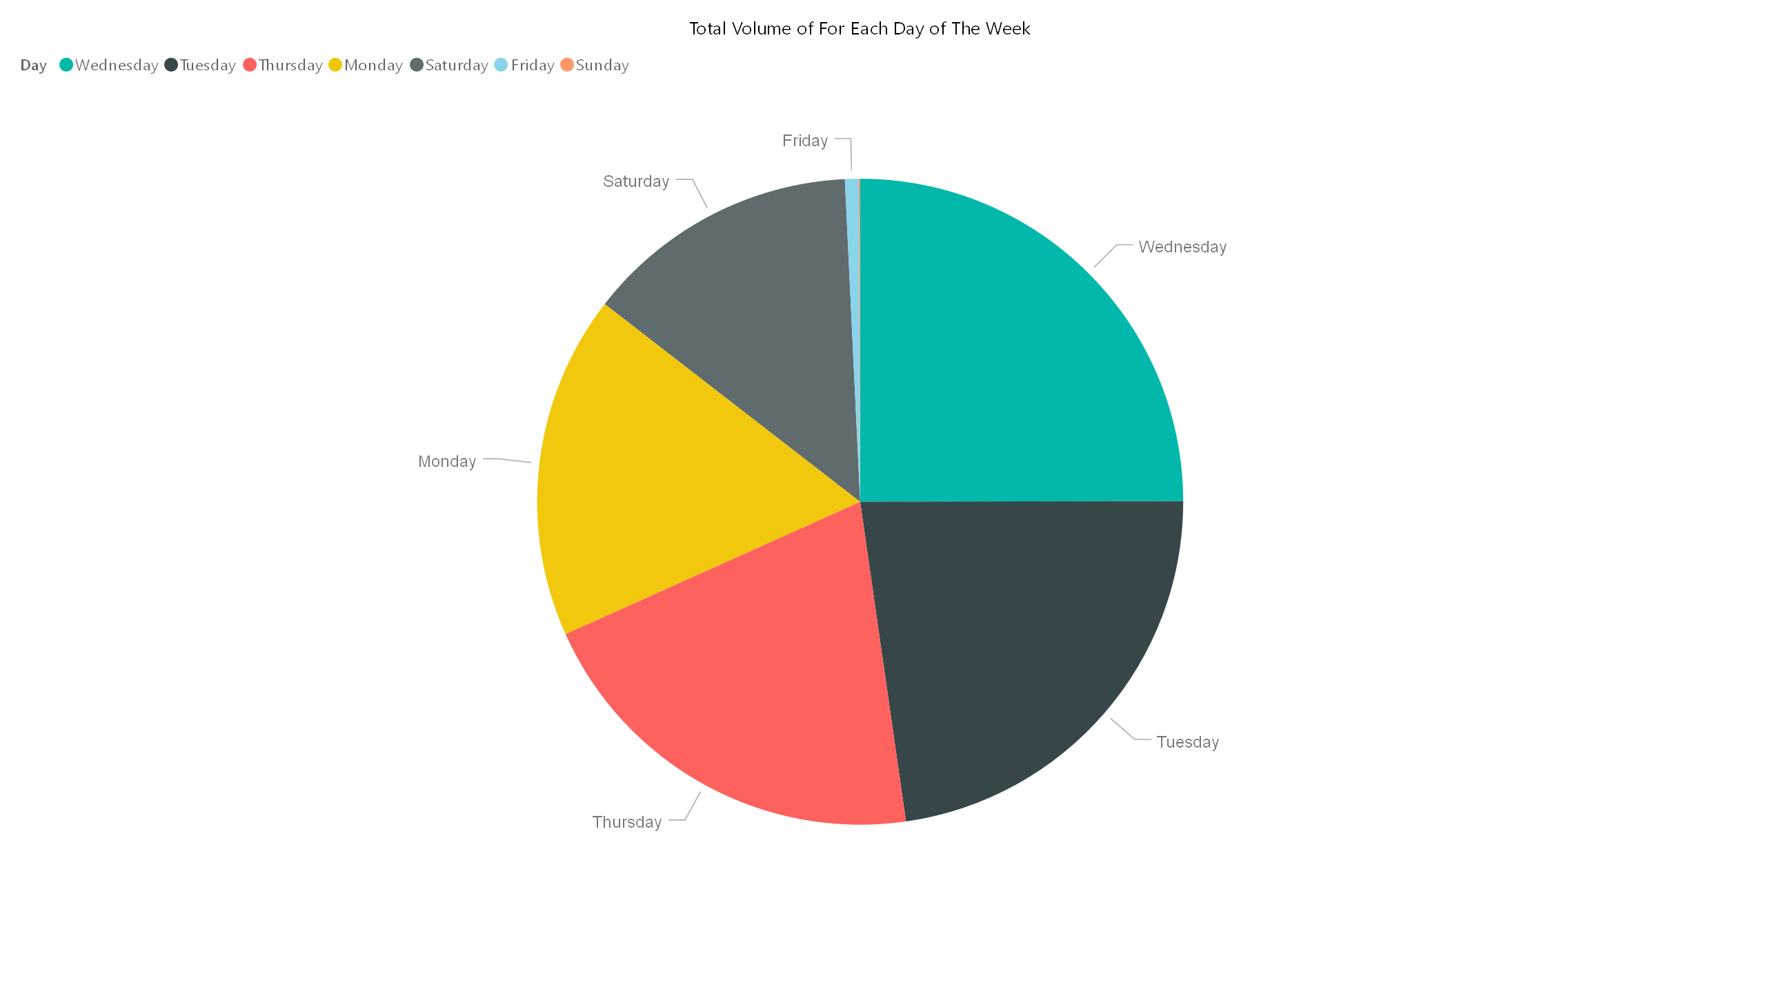

Slide 7
